Slide 1


Department of Information Technology V R Siddhartha Engineering College
A Cohort-Aware Ensemble Reinforcement Learning Framework for Personalized Glycemic Control
Health Care
B.Tech in Information Technology
Major Project Review Presentation
Presented by
P.Hruthik krishna(228W1A12B4)
M.Sudhamsh(228W1A12A5)
Under the guidance of
Dr. G. Kalyani, Associate Professor

Slide 2
Agenda
Introduction and Problem Statement
Objective and Outcomes of the Project
Literature Summary
Datasets and Requirements
Methodology and Algorithms Involved
Architecture
Compete Results Obtained
Results Analysis & Future work
References

Slide 3
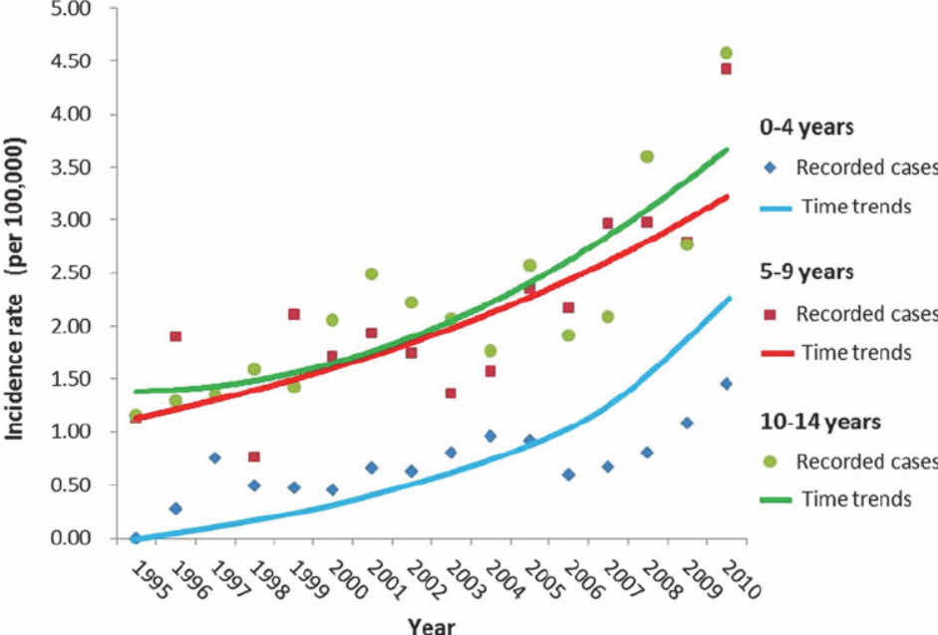
Introduction
Diabetes is a global health crisis, affecting millions, facing challenges in managing blood glucose levels effectively and consistently.
Manual interventions often lead to delays and errors, increasing the risk of hypo- and hyperglycemia.
RL offers a dynamic solution, training an autonomous agent to learn an adaptive insulin delivery policy through simulated interaction, to actively reduce human error.

Slide 4
Problem statement
Traditional diabetes management requires precise carbohydrate counting and timely insulin administration.
Simple miscalculations in this process often lead to unsafe blood sugar levels like hypo- and hyperglycemia.
A generalized RL framework that learns optimal insulin delivery policies at the cohort level (children, adolescents, and adults), ensuring precise glucose control without needing manual carbohydrate inputs.

Slide 5
Objectives
Establish a Simglucose environment for reinforcement learning agent training.
Develop an autonomous agent that learns an optimal insulin dosing policy through simulation.
Validate the learned control policies across diverse simulated patient scenarios within each cohort.
Outcomes
A generalized RL agent that learns cohort-level glucose–insulin dynamics and delivers adaptive insulin dosing.
Improved patient outcomes by reduced occurrences of hypo- and hyperglycemia .

Slide 6
Summary of Literature review
Paper Title | Simulator/ Dataset | Algorithms Used | conclusion | limitations
Fully-Automated Patient-Agnostic Diabetes Management with Deep Reinforcement Learning (2024) | Simglucose | Deep Reinforcement Learning (Soft Actor-Critic) | Achieved 80.3% (TIR), outperforming standard PID baselines (77.3%). | lacks temporal memory (e.g., LSTM) to track delayed insulin action.
Toward a Fully Automated Artificial Pancreas System Using a Bioinspired RL (2024) | Simglucose | Proximal Policy Optimization (PPO) | TIR 92.8% (adults), 86.9% adolescents in single-meal, bio-inspired reward function pancreatic β-cells | Training focused on single-meal/day scenarios

Slide 7
Summary of Literature review
Paper Title | Datasets Used | Algorithms Used | conclusion | limitations
A distributional RL model for optimal glucose control after cardiac surgery (2025) | MIMIC-IV, eICU-CRD | Actor–Critic | Achieved higher returns (0.00 vs –1.29 internal; –0.63 vs –1.02 external) and lower MAE (1.90 vs 2.24) | Restricted for 24h post–cardiac surgery not generalizable to longer time. Not fully automatic designed for clinician use only
Using Reinforcement Learning to Simplify Mealtime Insulin Dosing for People with Type 1 Diabetes: In-Silico Experiments (El Fathi & Breton, 2023) | UVA/Padova Type 1 | Q-Learning based RL for meal bolus optimization | Achieving an average TIR of 73.1 ± 11.6 % in adults | Optimized for mealtime insulin only, without addressing basal insulin.

Slide 8



Datasets and requirements
Simulation Environment – SimGlucose [1]
Is a Type1 diabetes simulator , which is open source version of FDA approved UVa/ Padova simulator. Simulator includes Virtual patients : child 5 – 11 years, adults 19 - 77 years , adolscents 12 – 18 years)
Software Requirements-
Python 3.9
Deep Learning Frameworks: PyTorch, TensorFlow (for NN building)
StableBaselines3 (Train RL agent)
Gym, Gymnasium
Simulation Environment (SimGlucose)
Matplotlib, Seaborn (for visualization)

Slide 9
Methodology
Environment & State Design
Simulator: SimGlucose (T1D) wrapped in Gymnasium API.
State Space: Agent's state as [BG, △BG, IOB, BW]
Agent Architecture : Dynamic Hybrid Ensemble
SAC-Baseline: Stochastic policy for entropy-based exploration and glucose variability.
TD3-Baseline: Deterministic twin-critic architecture for precise, high-dose delivery.
Meta-Controller: Trainable gating network – dynamically weights agent outputs in real-time.
Training Protocol
Cohort Learning: The agent dynamically samples from a training patients (e.g., adult#001 to adult#10)
Meta-Optimization: Trainable gating network – dynamically weights agent outputs via backpropagation
Safety Layer: Hard-limit constraint to prevent insulin stacking and enforce safe dosage boundaries.
Evaluation Protocol
Evaluating the generalized agent on unseen test patients.
Metrics: Time in Range (TIR), Hypo %, Hyper %

Slide 10
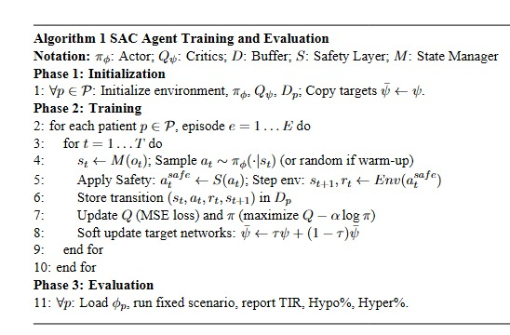
Algorithm
1. SAC - Baseline Agent

Slide 11
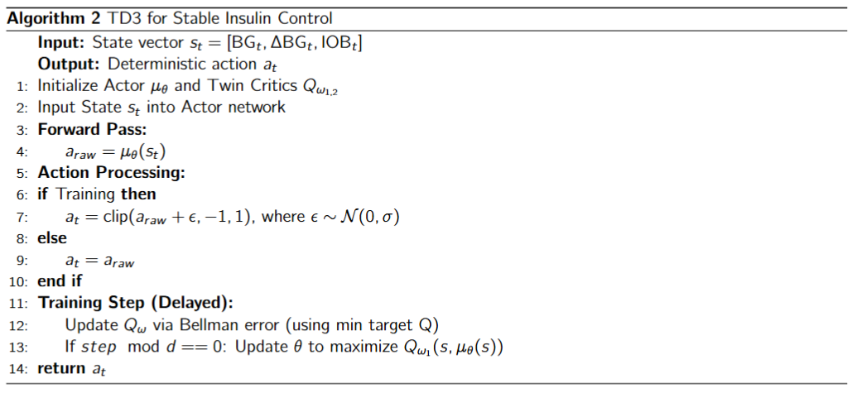
Algorithm
2. TD3 - Baseline Agent

Slide 12
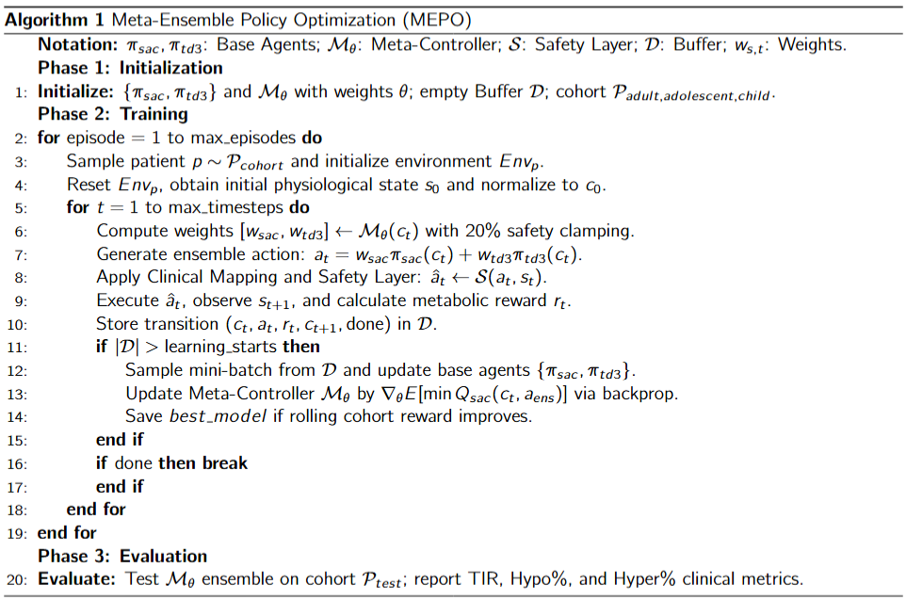
Algorithm
3. Meta Ensemble Agent (Proposed):

Slide 13
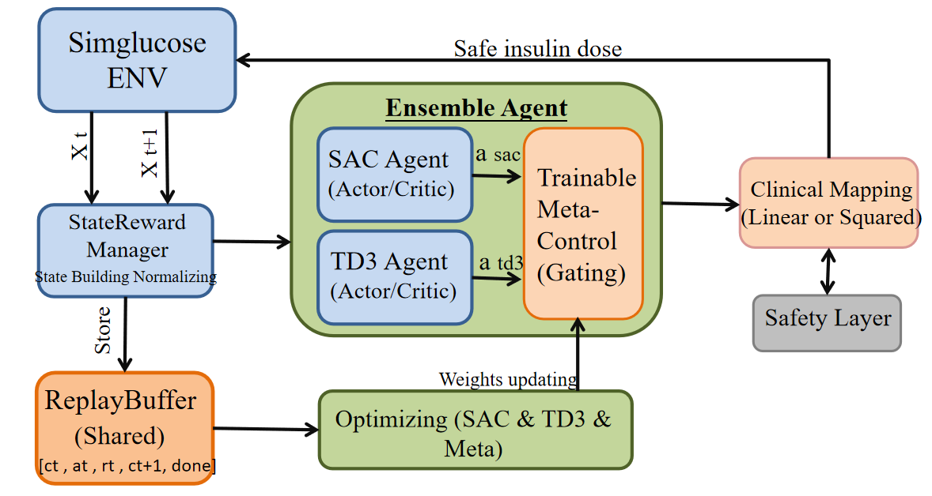
Architecture
Fig: 1 System Architecture

Slide 14
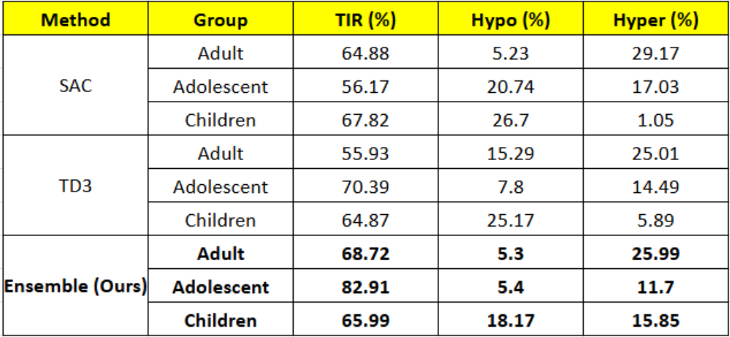
Results Obtained:
1. Short-Term Performance:
Table 1: Short-Term Evaluation (1-Day Simulation)
Ensemble achieves the highest Time-in-Range in Adolescents, reaching 82.91%, compared to 56.17% for SAC and 70.39% for TD3
In Adults, Ensemble improves Time-in-Range to 68.72%, compared to 64.88% for SAC and 55.93% for TD3
In Children, Ensemble achieves a Time-in-Range of 65.99%, which is close to 67.82% for SAC and slightly higher than 64.87% for TD3

Slide 15
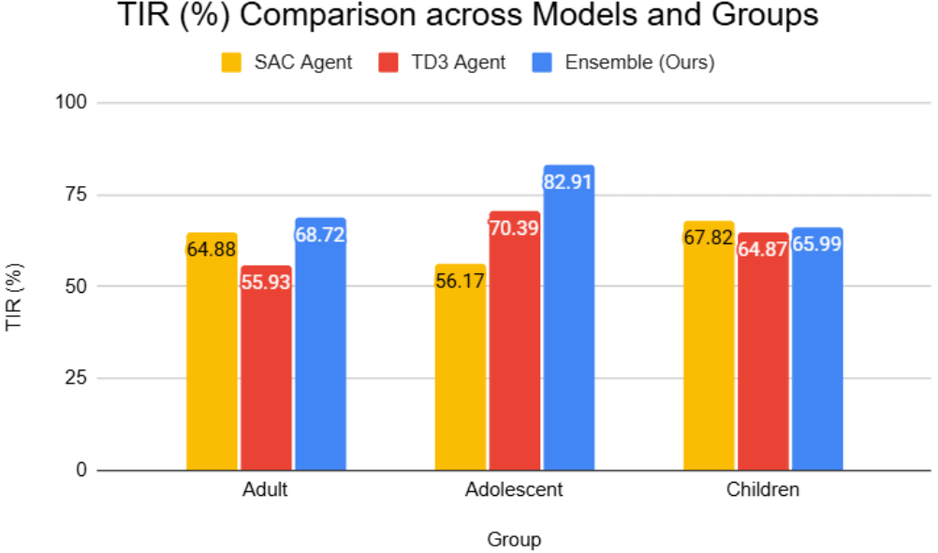
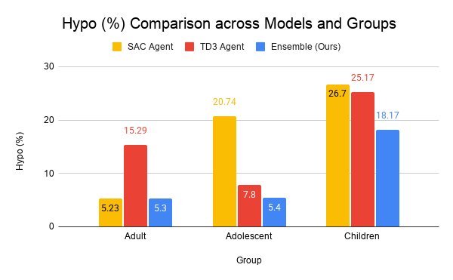
Figure 4.1. Comparison of Time in Range (TIR) Across Methods and Cohorts
Figure4.8.Comparison of Hypoglycemia Percentage Across Methods and Cohorts
In Adolescents, Ensemble reduces Hypoglycemia to 5.4%, compared to 20.74% for SAC and 7.8% for TD3
In Adults, Ensemble maintains low Hypoglycemia at 5.3%, comparable to 5.23% for SAC and significantly lower than 15.29% for TD3
In Children, Ensemble reduces Hypoglycemia to 18.17%, compared to 26.7% for SAC and 25.17% for TD3

Slide 16
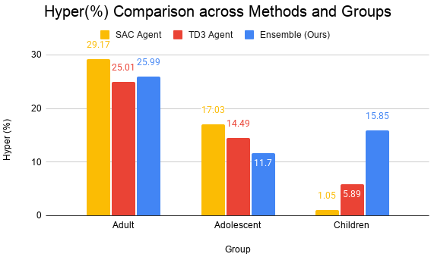
Figure 4.9 Comparison of Hyperglycemia Percentage Across Methods and Cohorts
In Adolescents, Ensemble achieves the lowest Hyperglycemia at 11.7%, compared to 17.03% for SAC and 14.49% for TD3
In Adults, Ensemble reduces Hyperglycemia to 25.99%, compared to 29.17% for SAC and 25.01% for TD3, showing improved glucose regulation
In Children, Hyperglycemia for Ensemble is 15.85%, compared to 1.05% for SAC and 5.89% for TD3, represents a controlled trade-off , resulting in more balanced and safer glucose control overall.

Slide 17
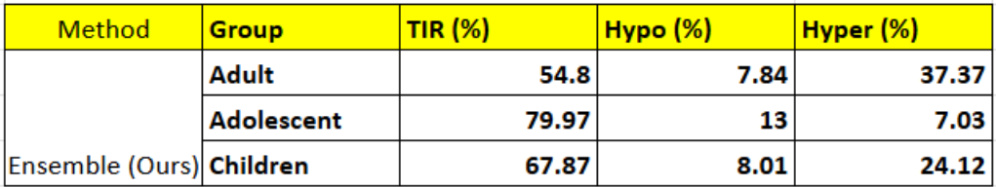
2. Long-Term Evaluation:
Table 2: Long-Term Evaluation (10-Day Simulation)
To evaluate long-term performance, the Meta-Ensemble agent tested over a 10-day simulation across all cohorts
The adolescent cohort maintains strong performance with a TIR of 79.97%.
The child cohort achieves a TIR of 67.87%, showing stable but variable behavior.
The adult cohort records a TIR of 54.8%, indicating challenges in long-term regulation.
Unlike baseline models, the ensemble framework remains stable throughout the simulation.

Slide 18
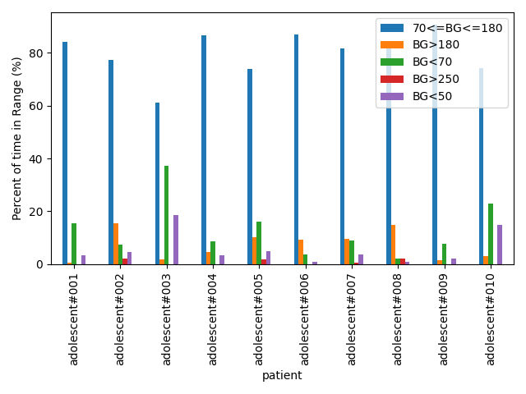
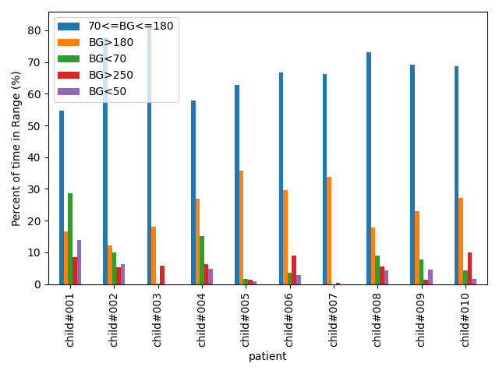
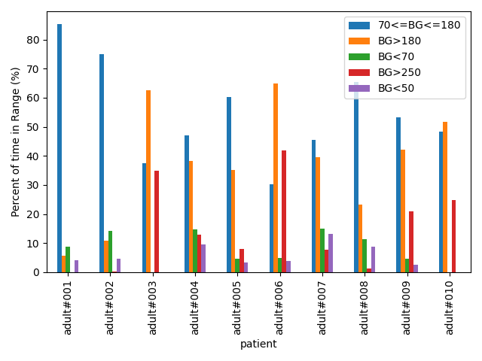
Result Analysis:
Figure 4.11. Patient-wise Glucose Zone Distribution for Adult Cohort
Figure 4.12. Patient-wise Glucose Zone Distribution for Child Cohort
Figure 4.10. Patient-wise Glucose Zone Distribution for Adolescent Cohort
In the adolescent cohort, around 8–9 patients remain mostly within the healthy glucose range (70–180 mg/dL), indicating stable and effective control.
In the adult cohort, only about 4–5 patients consistently stay in the target range, with several patients showing higher hyperglycemic exposure.
In the child cohort, around 6–7 patients achieve good control, but some experience increased hypoglycemia due to higher insulin sensitivity.

Slide 19
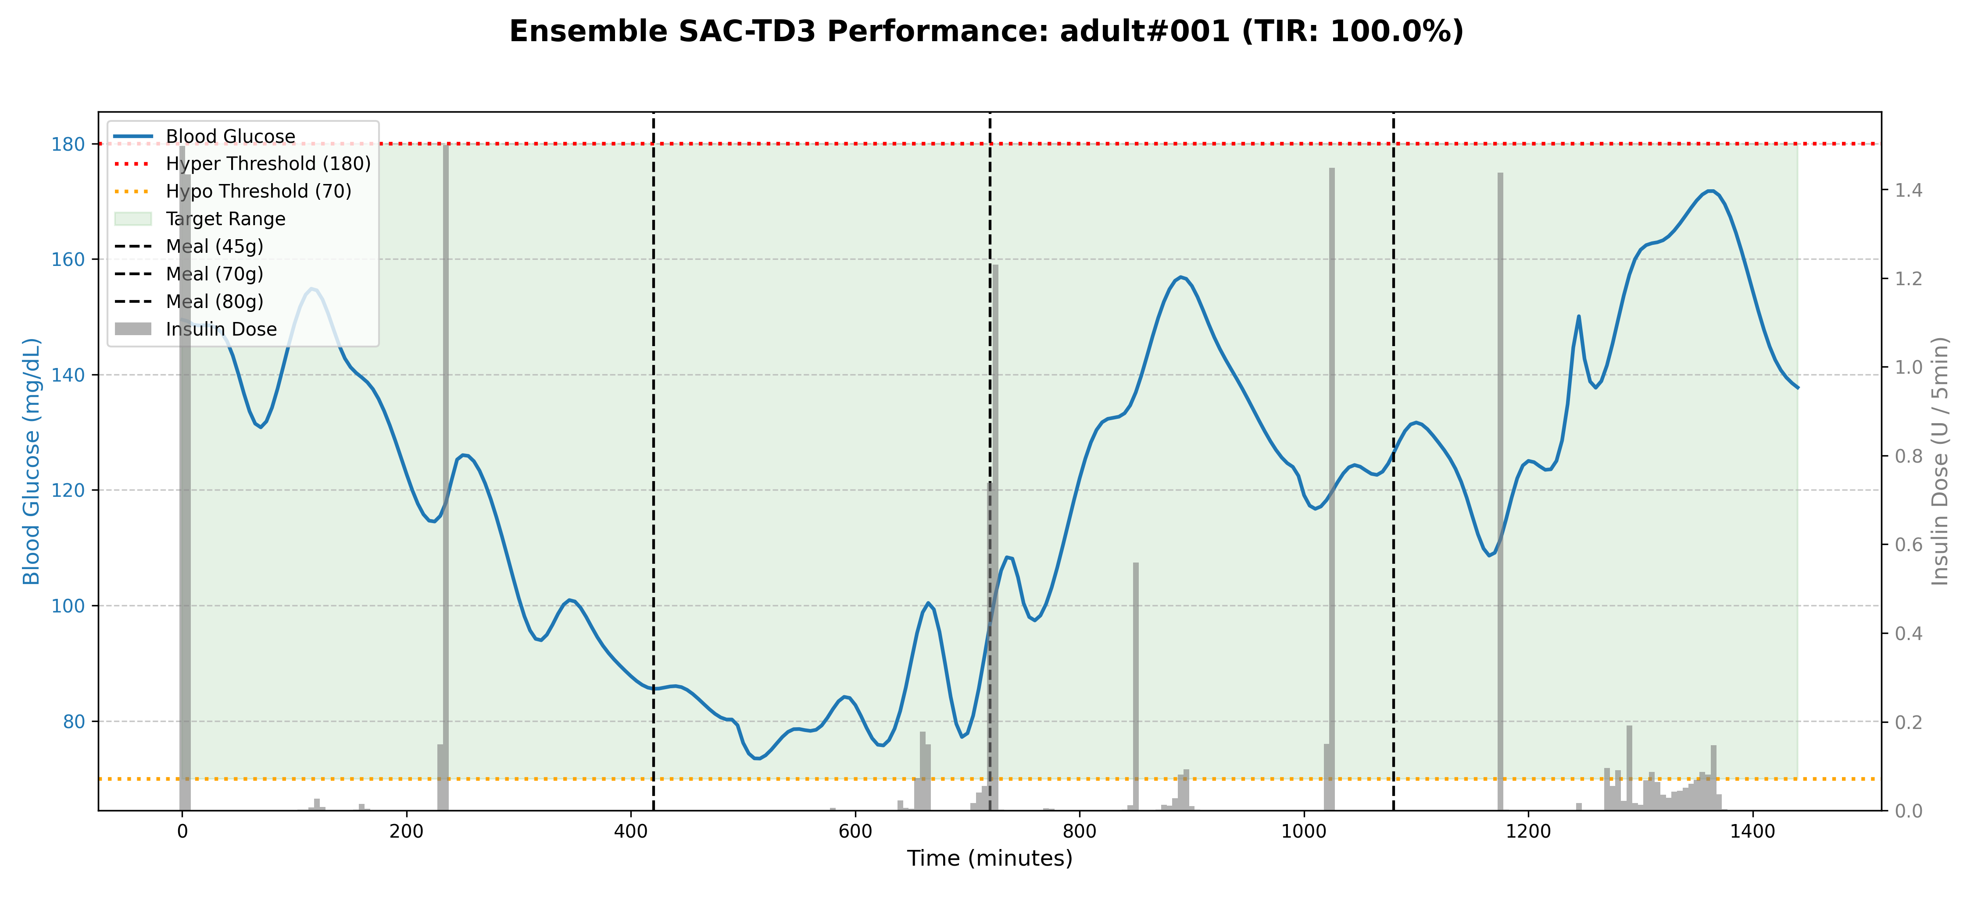
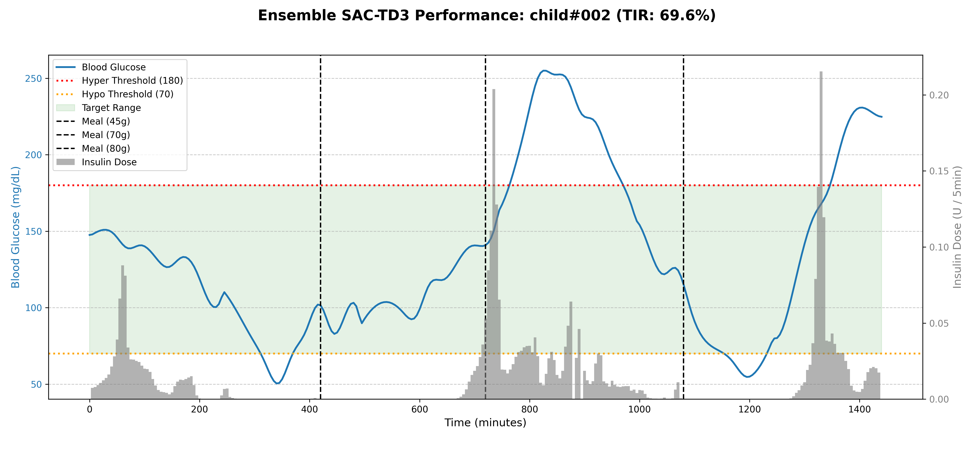
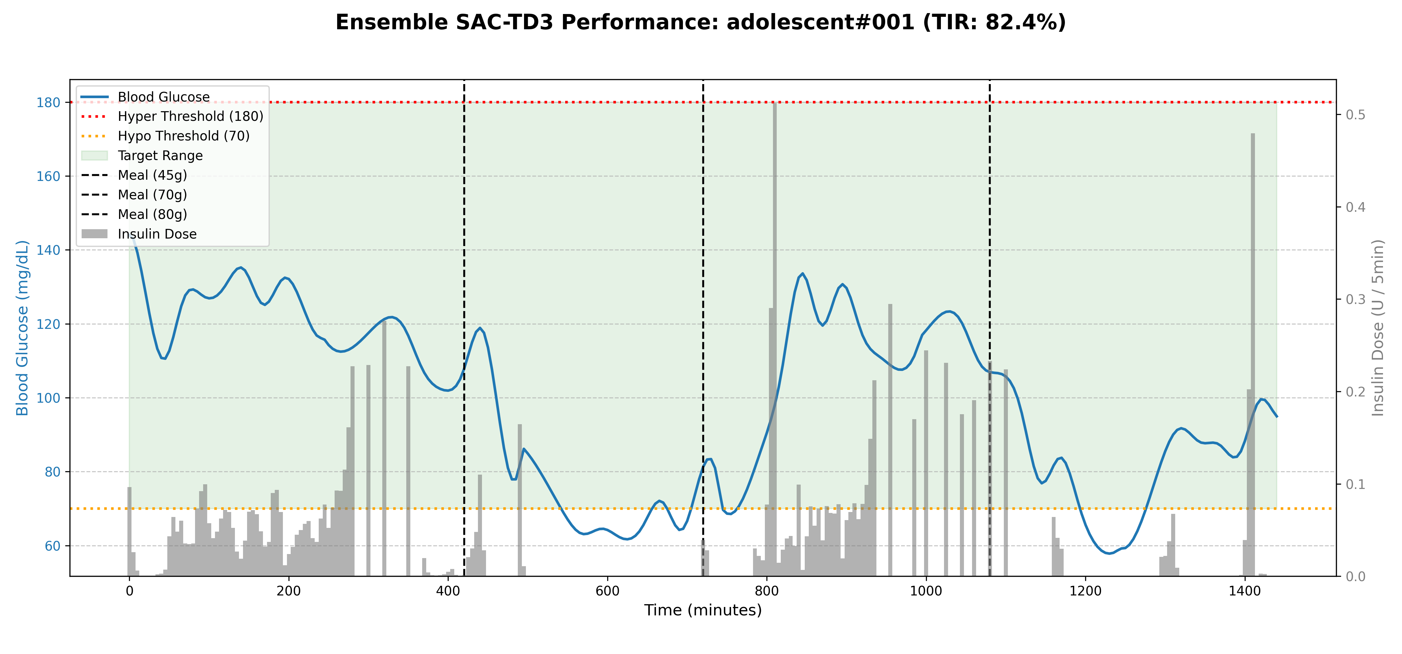
Figure 4.5 Glucose and insulin response of the Meta-Ensemble Agent for Adult
Figure 4.6 Glucose and insulin response of the Meta-Ensemble Agent for Child
Figure 4.4 Glucose and insulin response of the Meta-Ensemble Agent for Adolescent

Slide 20
Conclusion
Proposed cohort-aware ensemble RL framework improves glycemic control across diverse patient groups
Generalized model demonstrates adaptability, indicating potential for real-world deployment
Achieves higher TIR and significantly reduces hypoglycemia compared to SAC and TD3
Future Work
Integrate physiological signals (exercise, stress) to improve personalization
Move towards real-time deployment in closed-loop artificial pancreas systems
Evaluate on real-world datasets for clinical reliability and scalability

Slide 21
References
Jinyu Xie. Simglucose v0.2 (2018) [Online], available: https://github.com/jxx123/simglucose.
S. Lee, J. Kim, S. W. Park, S. -M. Jin and S. -M. Park, "Toward a Fully Automated Artificial Pancreas System Using a Bioinspired Reinforcement Learning Design: In Silico Validation," in IEEE Journal of Biomedical and Health Informatics, vol. 25, no. 2, pp. 536-546, Feb. 2024, doi: 10.1109/JBHI.2020.3002022
Desman, J.M., Hong, ZW., Sabounchi, M. et al. A distributional reinforcement learning model for optimal glucose control after cardiac surgery. npj Digit. Med. 8, 313 (2025).
V. K. R. R. Satuluri and V. Ponnusamy, "Precision insulin delivery: Predictive modelling for bolus insulin injection in real-time," Int. J. Adv. Comput. Sci. Appl., vol. 15, no. 2, pp. 291-300, 2024.

Slide 22
S. M. Ganie, P. K. D. Pramanik, M. B. Malik, S. Malik, and H. Qin, "An ensemble learning approach for diabetes prediction using boosting techniques," Front. Genet., vol. 14, 2023, Art. no. 1252159, doi: 10.3389/fgene.2023.1252159.

