Slide 1

9th International Conference on Micro-Electronics, Electromagnetics and Telecommunications(ICMEET - 2024)
PNEUMONIA DETECTION IN CHEST X-RAYS USING FEATURE-LEVEL ENSEMBLE LEARNING
Paper ID= 203
Date :20/12/2024
*P.Hruthik krishna 1 , K.Pranathi 2 ,K.Ganesh3 , K.Surya4

Slide 2
Contents
Abstract
Problem Statement
Objectives and Outcomes of the Project
Literature Survey
Methodology and Algorithms involved
Architecture diagram
Complete Results obtained
Result Analysis
Societal impact of the project and Field word
References

Slide 3
Abstract
Pneumonia is a major global health issue, and timely diagnosis is essential. Chest X-rays (CXRs) are widely used for diagnosis, but manual interpretation can be error-prone. This work proposes an ensemble learning model combining VGG19, EfficientNetB0, and DenseNet121 to improve diagnostic accuracy. By dynamically prioritizing the most relevant features with trainable weights, the model enhances detection capabilities.
To improve interpretability, Grad-CAM is employed to generate heatmaps highlighting important regions in CXRs. The model achieves a classification accuracy of 93.11%, demonstrating its potential to assist healthcare professionals.

Slide 4
Problem Statement
Diagnosing pneumonia from chest X-ray images is challenging for doctors due to the complexity and variability of the visual features, making it prone to human error.
This project aims to develop an accurate and interpretable machine learning solution using an ensemble of Convolutional Neural Networks (CNNs) to improve pneumonia detection, enhancing diagnostic precision and transparency.

Slide 5
OBJECTIVES
Develop an ensemble model combining features from multiple pre-trained models(VGG19, EfficientNetB0, DenseNet121).
Enhance the model's performance by leveraging the strengths of diverse model architectures.
Generate interpretable heatmaps using Grad-CAM to highlight key areas in chest X-rays.
OUTCOMES
An effective ensemble model that accurately detects pneumonia from chest X-rays.
Heatmaps highlighting the areas that contribute to the model's prediction, providing valuable insights into the detection process.

Slide 6
Why Ensemble Learning
Each model’s unique architecture extracts different representations of the data.
Combining these features captures a wide range of details—which is especially valuable in analyzing medical images.
Model | Advantages | Disadvantages
VGG19 | -Simple and Deep Architecture -Good at capturing detailed spatial hierarchies | High number of parameters; slower to train
EfficientnetB0 | -Smaller & Lightweight -Compound Scaling (scaling depth, width, and resolution simultaneously.) -High Accuracy with Fewer Parameters: | -Harder to tune for specific tasks - May not perform well with very fine details
DenseNet121 | -Dense connectivity Architecture -Strong features reuse capable -Better information flow through the network | -Slower training due to dense connection -May not perform well with very large patterns

Slide 7
Summary of Literature review
Author | year | Algorithms Used | Work done | Datasets Used | Study area | conclusion | limitations
Mudasir Ali, Mobeen Shahroz, Urooj Akram, et al. | 2024 | CNN, InceptionResNetV2,Xception, VGG16, ResNet50, EfficientNetV2L | Compared six models for pneumonia detection using chest X-rays | Chest X-ray dataset (pneumonia/normal-Kaggle) | Pneumonia detection using chest X-ray images | EfficientnetV2L outperformed all models, showing its robustness and potential. | More preprocessing techniques are needed for further improvement
M.S. Al Reshan, K.S.Gill, V. Anand | 2023 | MobileNet, ResNet50, ResNet152V2, DenseNet201, DenseNet121 | The study compared multiple models, finding MobileNet the most effective | ChestX-ray14 dataset, chest X-ray Dataset | Deep learning-based pneumonia detection | MobileNet was identified as reliable for pneumonia detection across datasets. | Focused only on accuracy and performance,lack of Model Interpretability

Slide 8
Author | year | Algorithms Used | Work done | Datasets Used | Study area | conclusion | limitations
Mabrouk, A., Díaz Redondo, R.P., et al | 2022 | Ensemble of MobileNetV2, DenseNet169, Vision Transformer (Boosting) | Developed an ensemble of CNN models for pneumonia detection using chest X-ray images | Chest X-ray dataset (Kaggle) | Pneumonia detection via deep learning | Achieved 93.91% accuracy, outperforming individual CNN models | Time consuming hyperparameter tuning; requires large dataset for better generalization

Slide 9
Methodology
Data Collection
Pre-processing
Dataset Splitting
Test
Train
Validation
Grad-CAM
Visualization
Performance Evaluation
Model Training
Fine Tune the model

Slide 10
Algorithms involved
Convolutional Neural Networks (CNNs)
VGG19: Simple , straight forward architecture – extract detailed features
EffcientNetB0: Smallest and light weight model – Compound Scaling method
DenseNet121: Dense connectivity architecture – Features reuse
Ensemble Learning Techniques:
Feature-Level Ensemble: Concatenate features extracted by different models (e.g., VGG19, EfficientNetB0, DenseNet121) and add trainable weights to these features.
This approach enables the model to learn the optimal combination of features from each individual model for more accurate predictions.

Slide 11
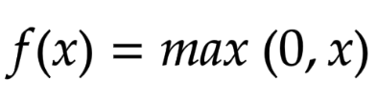
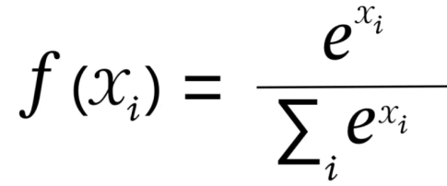
Activation functions:
ReLU (Rectified Linear Unit): Used in hidden layers to introduce non-linearity and improve model performance.
ReLU Function:
Softmax: Used in the output layer for multi-class classification, providing probabilities for each class.
Softmax function:
Visualization Algorithms:
Grad-CAM (Gradient-weighted Class Activation Mapping): generating heatmaps that visualize the regions of the input image were important for the model’s predictions

Slide 12
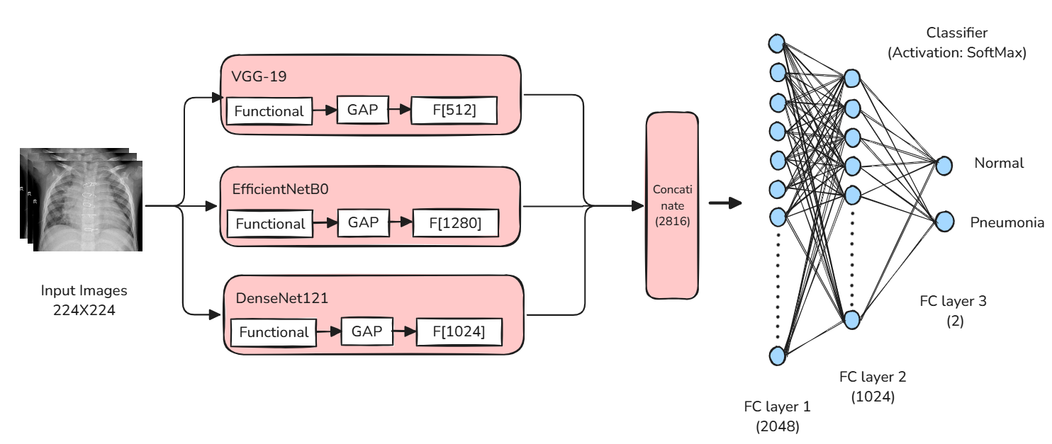
Ensemble Model Architecture diagram

Slide 13
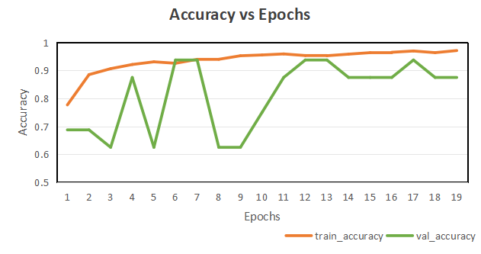
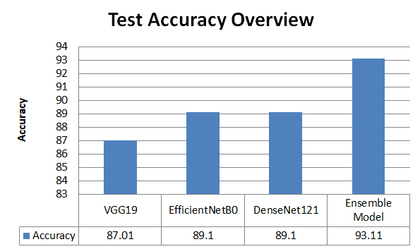
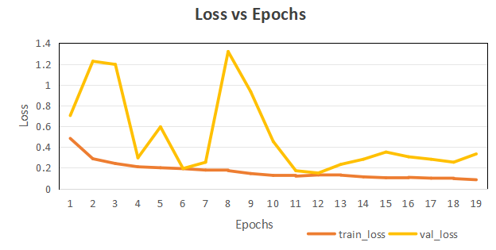
Result Analysis
Ensemble Model:
Models

Slide 14
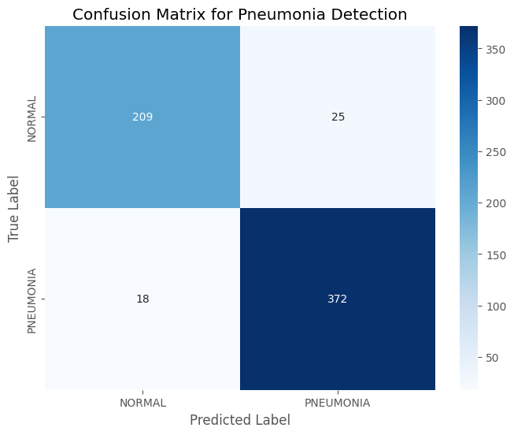
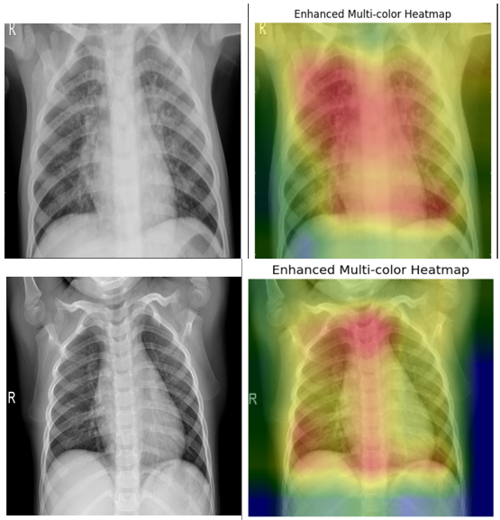
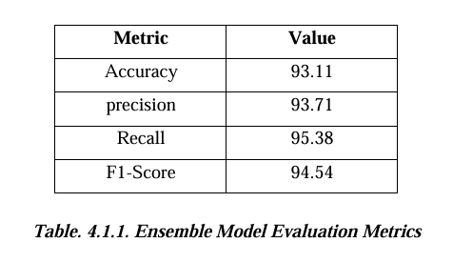
Confusion Matrix:
The heatmap images highlight important areas in the lungs that influence the model's predictions, promoting interpretability of the model's decision-making process.

Slide 15
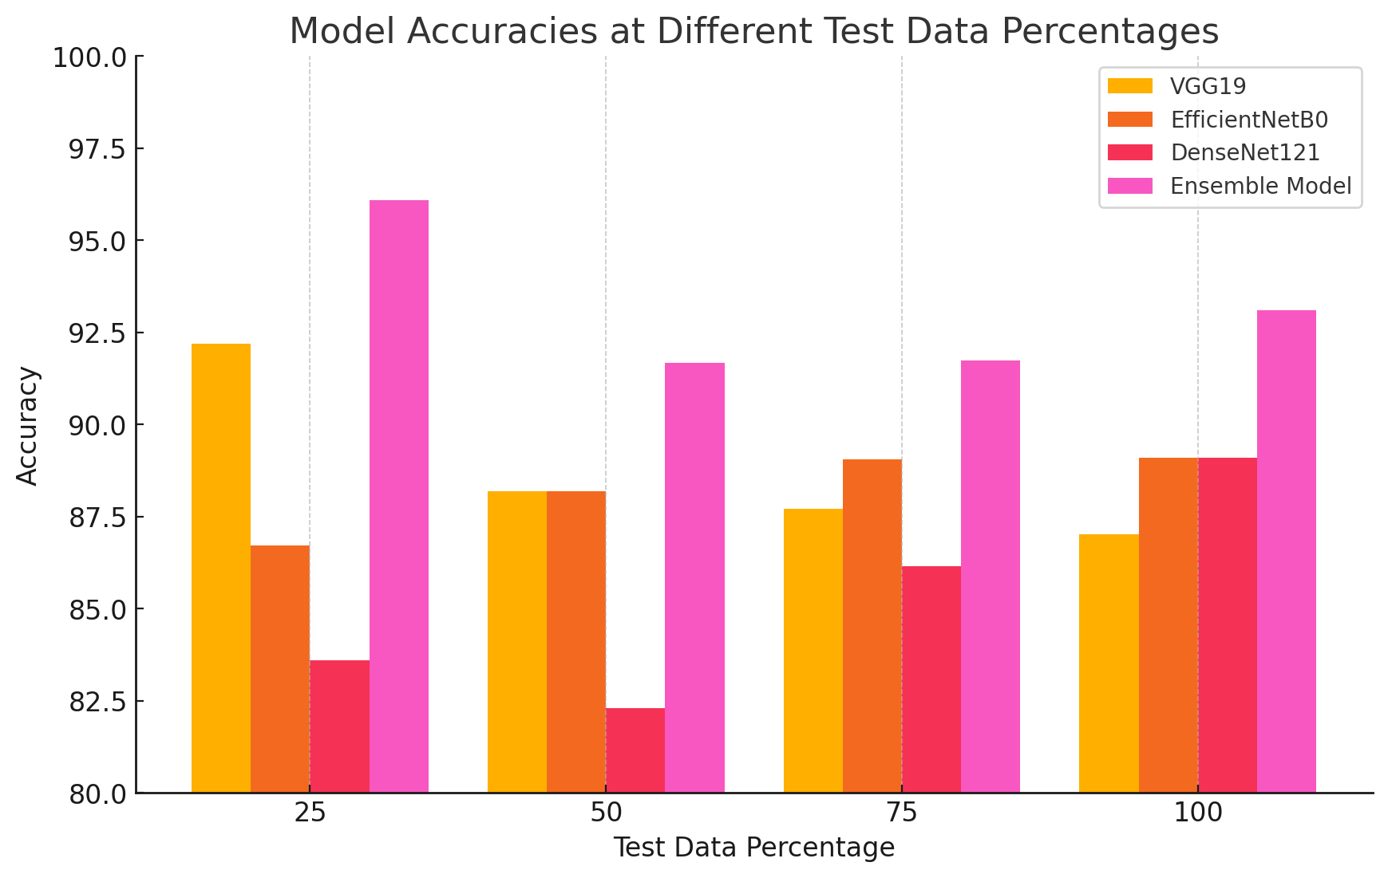
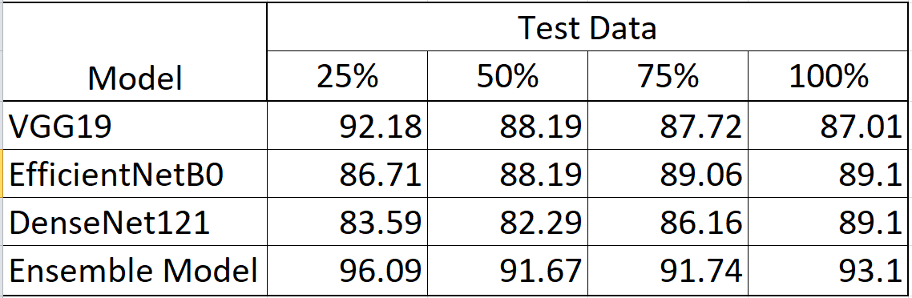
Comparative Accuracy of Models Across Test Data

Slide 16
Society Impact of the Project
Enhanced Diagnostic Accuracy: Reduces diagnostic errors and improves patient outcomes.
Reduced Workload: Automates the diagnostic process, easing the burden on healthcare professionals.
Timely Intervention: Faster detection leads to quicker treatment, potentially saving lives.
Increased Interpretability with Heatmap Images: Heatmaps highlight key areas influencing model predictions, enhancing transparency and helping healthcare professionals validate diagnostic results.

Slide 17
References
I. Ashraf ,M. F. Mushtaq(2024)Pneumonia Detection Using Chest Radiographs With Novel EfficientNetV2L Model.IEEE Access.
Sukhendra Singh, Manoj Kumar, Abhay Kumar, Birendra Kumar Verma, Kumar Abhishek & Shitharth Selvarajan(2024). [1] Efficient pneumonia detection using Vision Transformers on chest X‑rays.
M. S. Al Reshan, K. S. Gill, H. Alshahrani, A. Sulaiman, V. Anand, S. Gupta, A. Shaikh(2023).[2] Detection of Pneumonia from Chest X-ray Images Utilizing MobileNet Model.
Kanakaprabha. S, D. Radha (2021) Analysis of COVID-19 and Pneumonia Detection in Chest X-Ray Images using Deep Learning.

Slide 18
Thank you

