Slide 1
DAA Macro Project
DESIGN AND ANALYSIS OF ALGORITHMS
Merge Sort · Optimal Merge Pattern · Travelling Salesperson · Sum of Subsets · 0/1 Knapsack
· Group 05 (G5) ·

Slide 2
Learning Objectives of the Project
UNIT I
UNIT II
UNIT IV
UNIT V
UNIT III
Merge Sort
Optimal Merge
Sum of Subsets
0/1 Knapsack
TSP
● Dynamic Programming
● Divide and Conquer
● Greedy
● Backtracking
● Branch and Bound
● Merge tree
● Bitmask states
● State-space tree
● Recursion tree
● Upper bounds
● Least total cost
● O(n² · 2ⁿ)
● Prune branches
● O(n log n)
● Prune by bound

Slide 3
Divide and Conquer, Greedy
UNIT I
UNIT II
Merge Sort Recursion Tree
Optimal Merge Pattern Tree
● Splits the array into halves recursively
● Merges many sorted files at least cost
● Merges sorted halves back together
● Always merges the two smallest first
● Recursion tree is about log n levels deep
● Merge tree shows the order and step costs
● Time O(n log n), space O(n)
● Time O(n log n) with a min-heap
O(n log n)
Smallest two first

Slide 4
Dynamic Programming, Backtracking
UNIT III
UNIT IV
Travelling Salesperson Problem
Sum of Subsets Tree
● Finds subsets that add up to a target
● Cheapest tour through every city once
● Includes or excludes each element in turn
● Bitmask marks the visited cities
● Prunes branches that cannot reach the target
● dp[mask][last] reuses subproblem costs
● Worst case 2ⁿ nodes, far fewer in practice
● Time O(n² · 2ⁿ), space O(n · 2ⁿ)
Include or exclude
O(n² · 2ⁿ)

Slide 5
Branch and Bound, and Technologies
UNIT V
TOOLS
0/1 Knapsack
Technologies
● Maximise profit within the weight capacity
● Java for the algorithm implementations
● Items are taken whole or not at all
● Git and GitHub for version control
● Upper bounds estimate each branch
● Markdown READMEs for documentation
● Prunes branches that cannot beat the best
● One folder per unit with code and notes
Bound and prune
Java · Git · Markdown

Slide 6
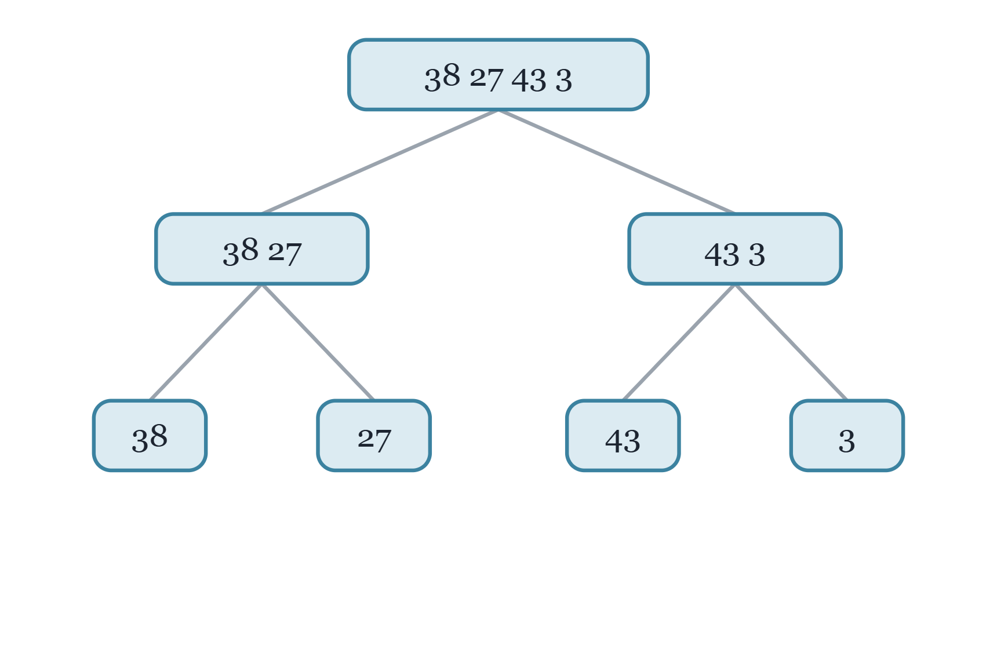
Merge Sort: Divide
UNIT I
● Merge Sort is a divide-and-conquer algorithm.
● Divide: split the array into two halves.
● Conquer: sort each half recursively.
● Base case: one element is already sorted.
● The recursion tree has one node per call, about log n levels deep.
Notes:
Illustrative array.

Slide 7
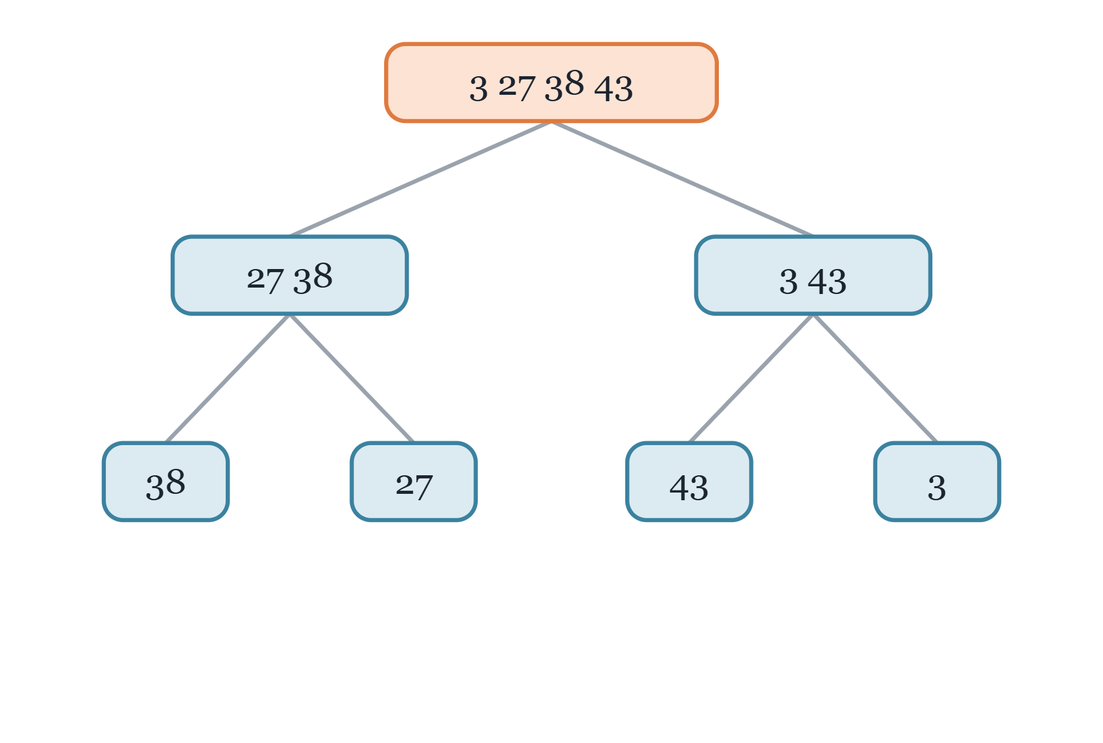
Merge Sort: Merge and Cost
UNIT I
● Combine: merge two sorted halves into one.
● Merging n elements takes O(n) work.
● Every level of the tree does n work in total.
● About log n levels give time O(n log n).
● Extra space is O(n); the sort is stable.
Notes:
Merge step on the same illustrative array.

Slide 8
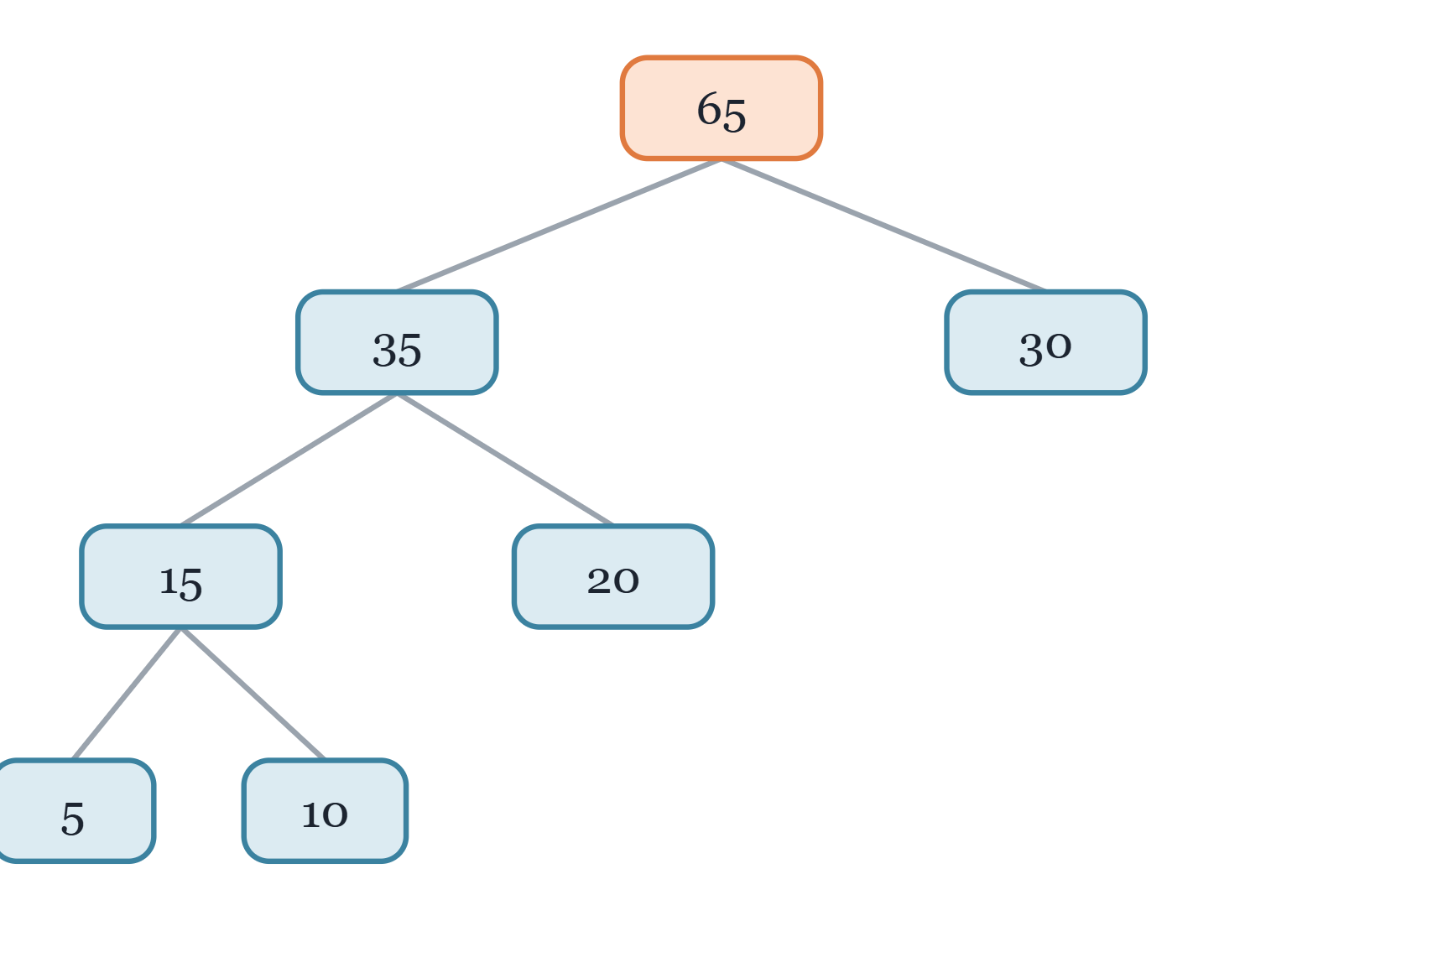
Optimal Merge Pattern: Greedy Choice
UNIT II
● Problem: merge n sorted files into one file.
● Merging files of size a and b costs a + b.
● The merge order changes the total cost.
● Greedy rule: always merge the two smallest files.
● The merge tree shows the order and cost of each step.
Notes:
Files of size 5, 10, 20, 30.

Slide 9
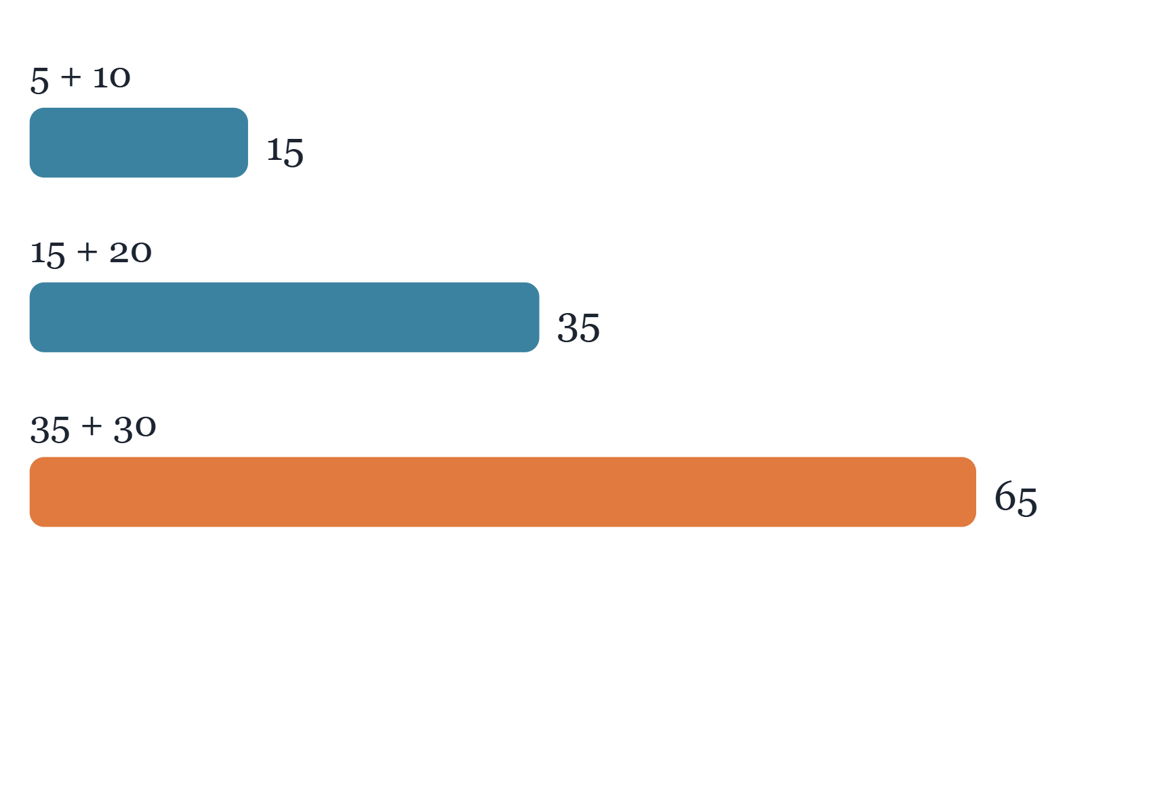
Optimal Merge Pattern: Total Cost
UNIT II
● Example file sizes: 5, 10, 20 and 30.
● Merge 5 + 10 = 15, then 15 + 20 = 35, then 35 + 30 = 65.
● Total cost = 15 + 35 + 65 = 115.
● A min-heap picks the two smallest files each time.
● Time O(n log n), the same idea as Huffman coding.
Notes:
Illustrative example.

Slide 10
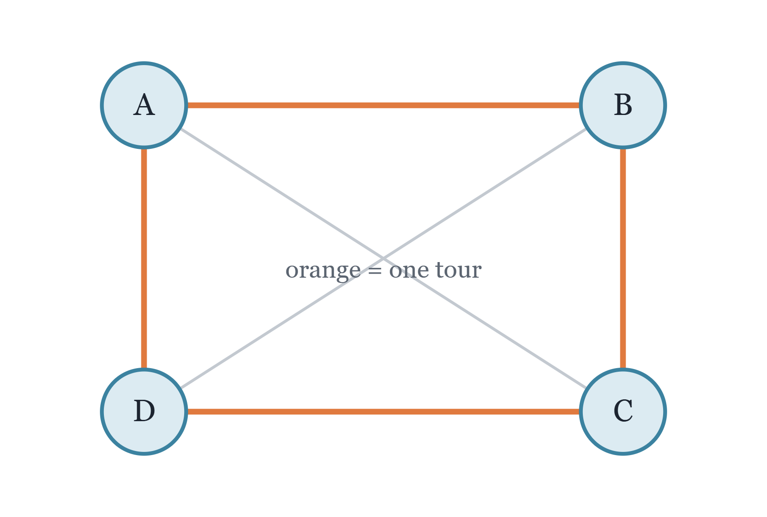
Travelling Salesperson: The Problem
UNIT III
● Given cities and the cost between every pair.
● Find the cheapest tour that visits each city once.
● The tour must return to the starting city.
● Brute force checks (n − 1)! possible routes.
● Subproblems overlap, so dynamic programming applies.

Slide 11
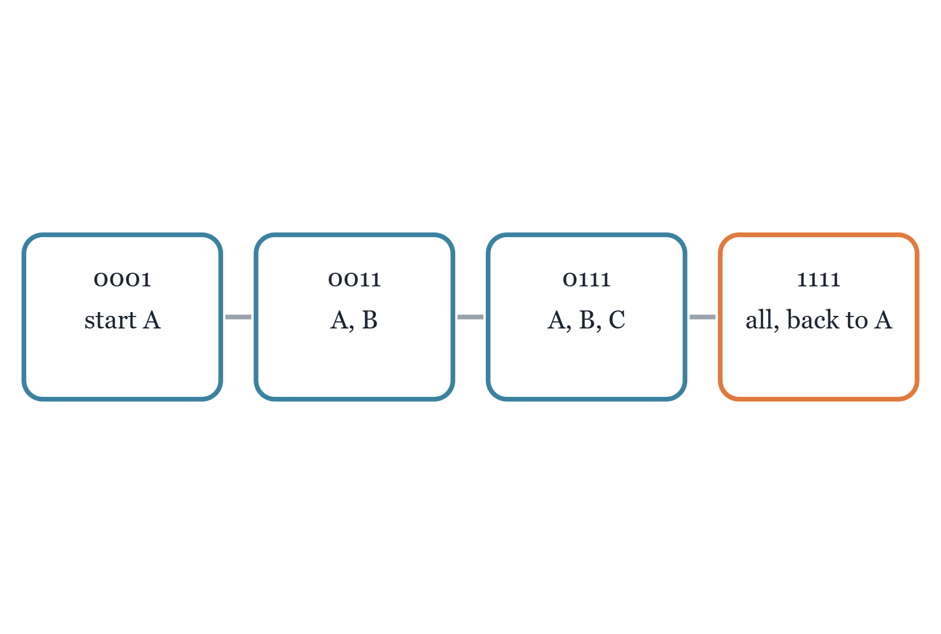
Travelling Salesperson: Bitmask DP
UNIT III
● Bitmask: bit i is 1 when city i is visited.
● State dp[mask][last] is the cheapest cost to reach last.
● Transition: add one unvisited city to the mask.
● Answer: best full tour plus the cost back to the start.
● Time O(n² · 2ⁿ), space O(n · 2ⁿ).
Notes:
Mask example for four cities.

Slide 12
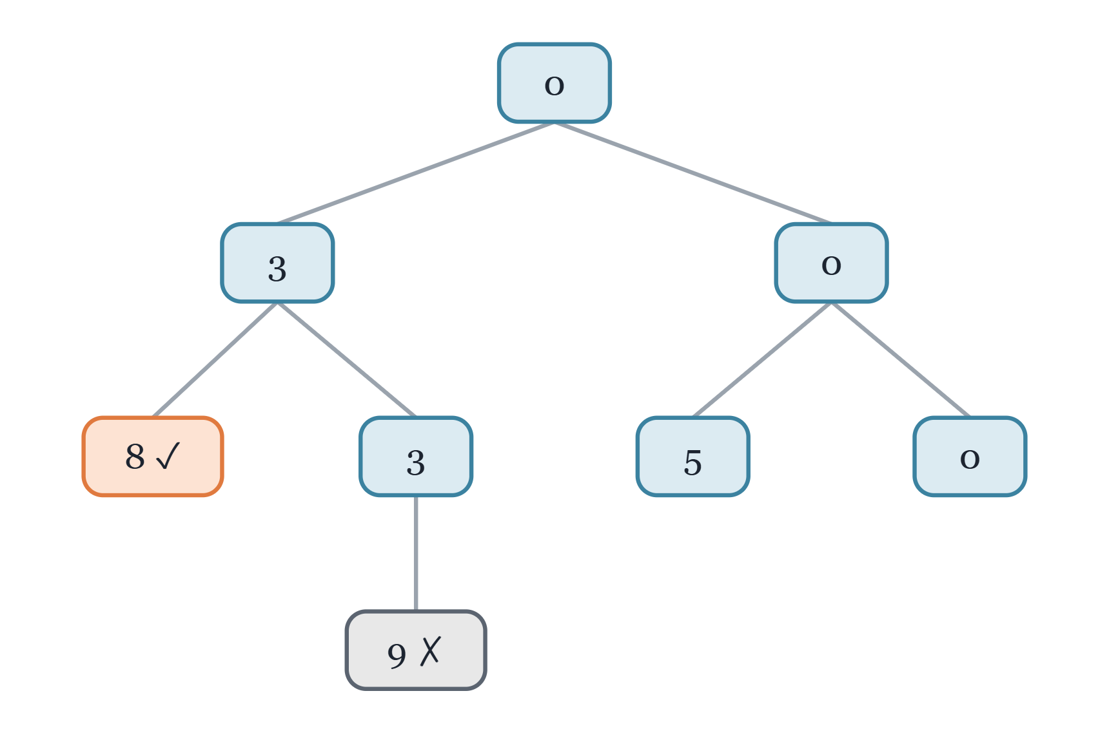
Sum of Subsets: State-Space Tree
UNIT IV
● Find subsets whose elements add up to a target.
● Each level of the tree decides one element.
● Left branch includes it, right branch excludes it.
● Example: set {3, 5, 6} with target 8.
● Subset {3, 5} reaches the target; the path to 9 is cut.
Notes:
Illustrative example.

Slide 13
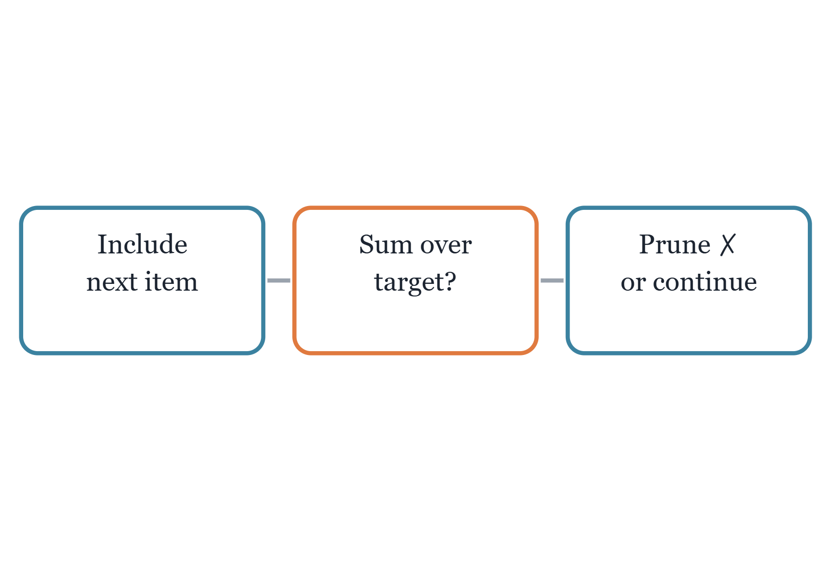
Sum of Subsets: Pruning
UNIT IV
● Backtracking abandons a branch that cannot succeed.
● Prune when the running sum exceeds the target.
● Prune when the remaining items cannot reach it.
● Then backtrack and try the other choice.
● Worst case 2ⁿ nodes, far fewer in practice.

Slide 14
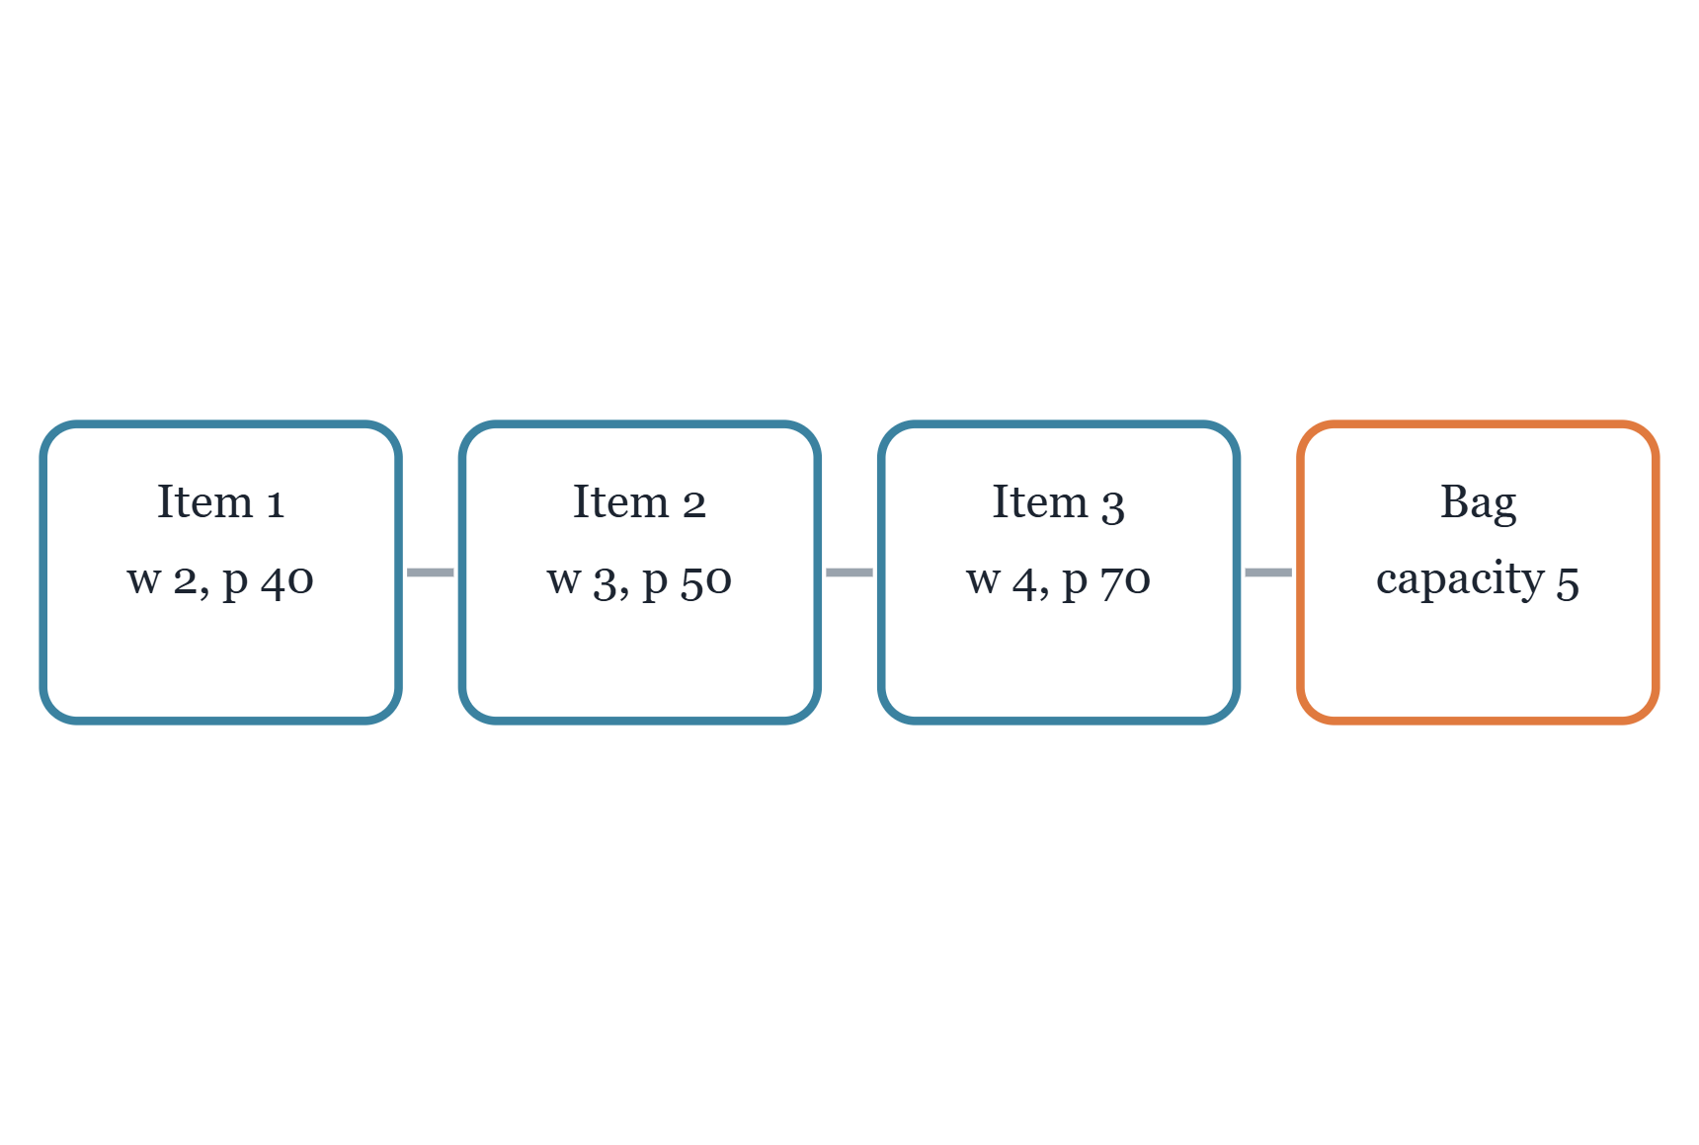
0/1 Knapsack: The Problem
UNIT V
● Each item has a weight and a profit.
● The bag has a fixed capacity.
● Goal: maximise total profit within the capacity.
● Each item is taken whole or left out.
● Example, capacity 5: items 1 and 2 give profit 90.
Notes:
Illustrative example: best choice is items 1 and 2, profit 90.

Slide 15
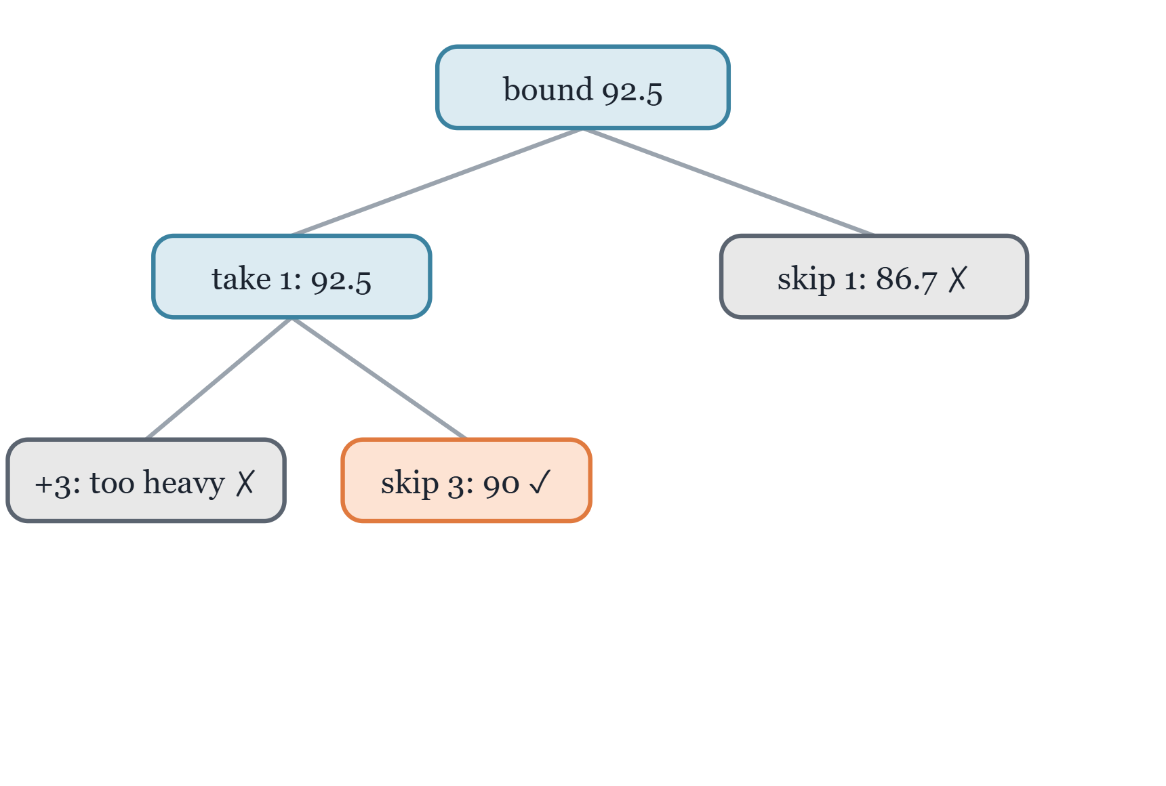
Knapsack: Branch and Bound
UNIT V
● Sort items by profit-to-weight ratio.
● Each node gets an upper bound from a fractional fill.
● Prune a node that is too heavy.
● Prune a node whose bound cannot beat the best profit.
● Worst case 2ⁿ, usually far fewer nodes.
Notes:
Same illustrative items; best found is 90, so the 86.7 branch is pruned.

Slide 16
THANK YOU !
For your valuable time.

