Slide 1
CERTIFICATE VALIDATION USING BLOCKCHAIN ETHVALIDIFY
PIP104 University Project-II
Review-2
Batch Number: CSE-G133
Under the Supervision of,
Ms . Naiwrita Borah
Assisstent Professor
School of Computer Science & Engineering
Presidency University
Roll Number | Student Name
20201CSE0697 | Nandeesh Gowda C
20201CSE0682 | Hruthik S
20201CSE0683 | Sudarsh V

Slide 2
Introduction
Advances in information technology, the wide availability of the Internet, and common usage of mobile devices have changed the lifestyle of human beings.
Virtual currency, digital coins originally designed for use online, has begun to be extensively adopted in real life. Because of the convenience of the Internet, various virtual currencies are thriving, including the most popular— Bitcoin, Ether, and Ripple ,the value of which has surged recently. Blockchain features a decentralized and incorruptible database that has high potential for a diverse range of uses.

Slide 3
Objective
In this study, we developed a decentralized application and designed a certificate system based on Ethereum blockchain. This technology was selected because it is incorruptible, encrypted, and trackable and permits data synchronization.
By integrating the features of blockchain, the system improves the efficiency operations at each stage.
The system saves on paper, cuts management costs, prevents document forgery, and provides accurate and reliable information on digital certificates.

Slide 4
Proposed Methodology:
The system proposed a new dynamic certificate generation approach using ethereum blockchain.
There will be mainly 3 actors in these projects:
Central authority-
-has the ability to add institutes
Institutes-
-registered institutes can add/revoke the certificates
Potential employers-
-are the one who verifies the certificate
So the issued certificate will be stored in the ethereum blockchain by consuming some quantity of eth.

Slide 5
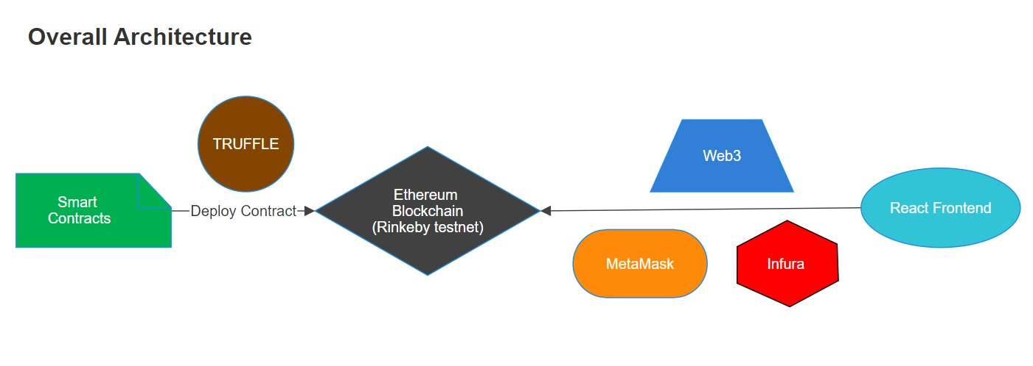
Architecture:

Slide 6
System Design and Implementation:
1. Set up a decentralized blockchain network to ensure a secure and transparent environment for the validation of certificates.
2. Develop and implement smart contracts that outline the criteria for issuing and validating certificates.
3. Design user-friendly interfaces for stakeholders involved in the certification process and ensure seamless interoperability.

Slide 7
Pseudo code: index.html
<!DOCTYPE html>
<html lang="en">
<head>
<meta charset="utf-8">
<meta name="viewport" content="width=device-width, initial-scale=1, shrink-to-fit=no">
<title>Ethvalidify</title>
</head>
<body>
<div id="root"></div>
</body>
</html>

Slide 8
Pseudo code: index.js
import React from "react";
import ReactDOM from "react-dom";
import "./index.css";
import App from "./App";
import { BrowserRouter } from "react-router-dom";
import { MuiThemeProvider, createTheme } from "@material-ui/core/styles";
const theme = createTheme({
palette: {
primary: { main: "#363b98" },
secondary: { main: "#b09ce8" },
},
typography: {
fontFamily: `"Open Sans", sans-serif, "Roboto", "Helvetica", "Arial"`,
useNextVariants: true,
},
});

Slide 9
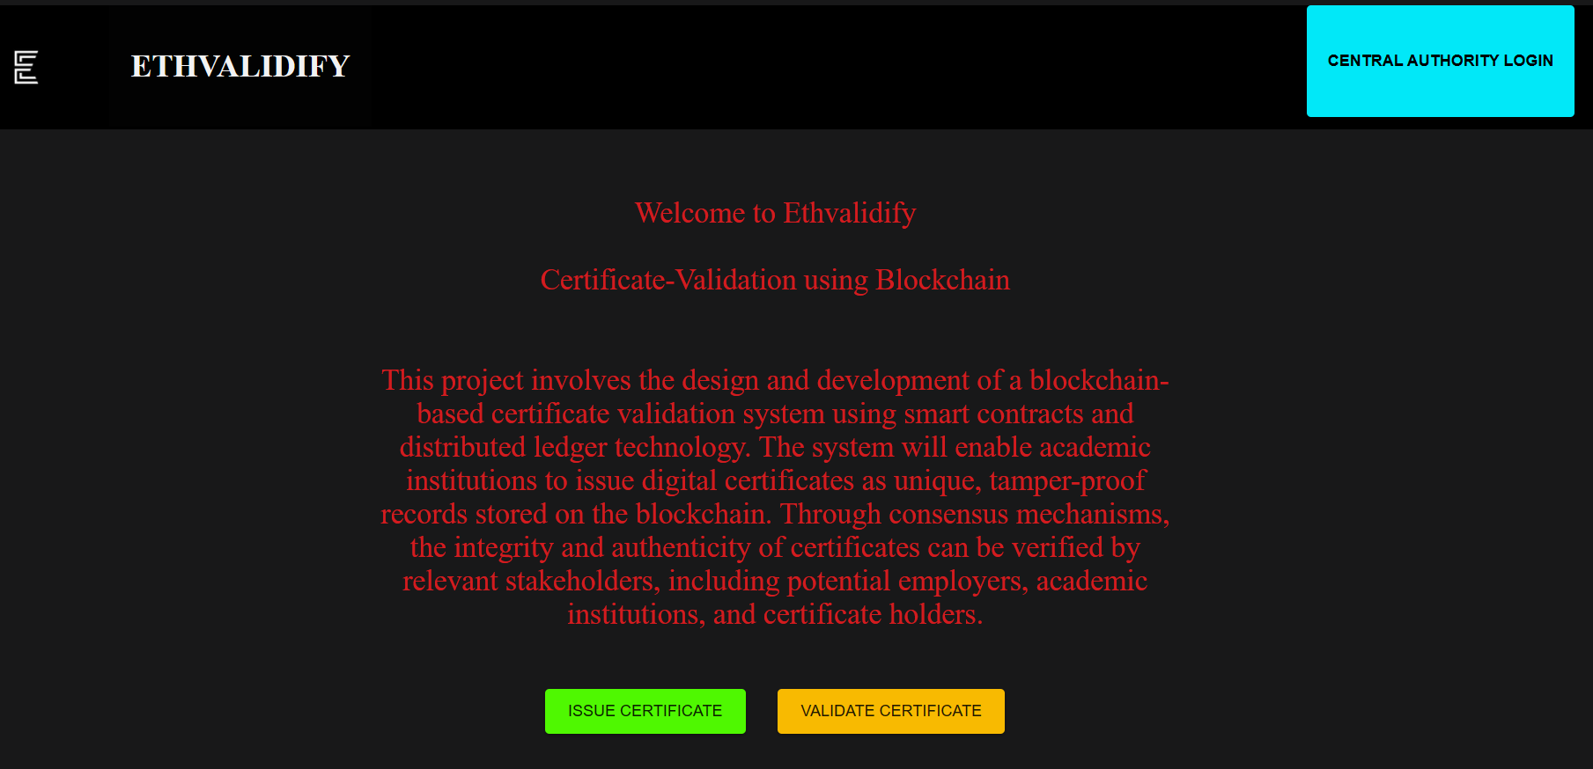
Output/Screenshot : home page

Slide 10
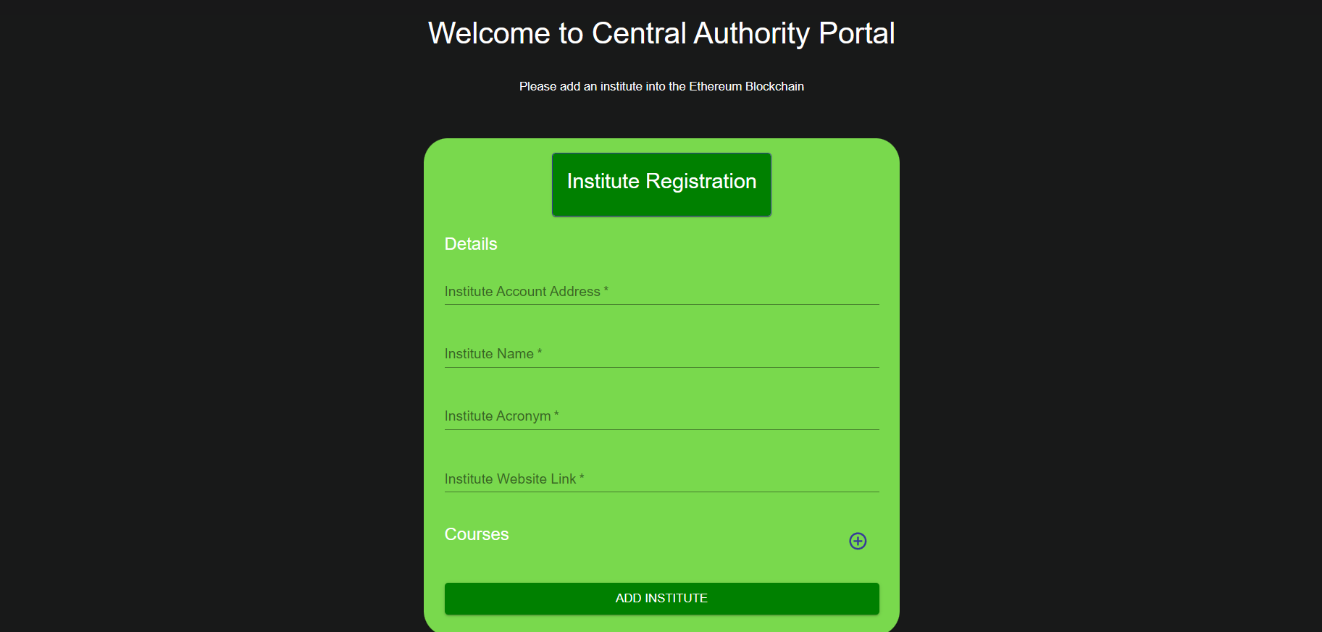
Output/Screenshot : Central Authority Portal

Slide 11
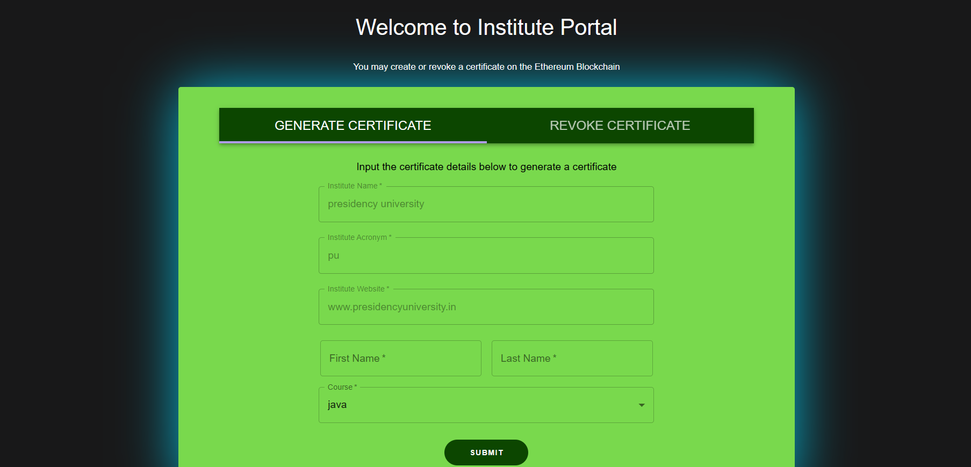
Output/Screenshot : Institute Portal

Slide 12
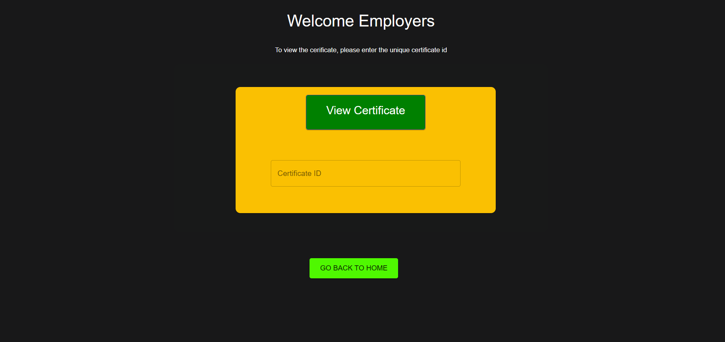
Output/Screenshot : Employer Portal

Slide 13
Conclusion
Data security is one of the major features of blockchain technology. Blockchain is a large and open-access online ledger in which each node saves and verifies the same data.
Using the proposed blockchain-based system reduces the likelihood of certificate forgery.
The process of certificate application and automated certificate granting are open and transparent in the system. Companies or organizations can thus inquire for information on any certificate from the system.
In conclusion, the system assures information accuracy and security.

Slide 14
Thank You
Github link:https://github.com/hruthiks6/ethvalidify

