Slide 1
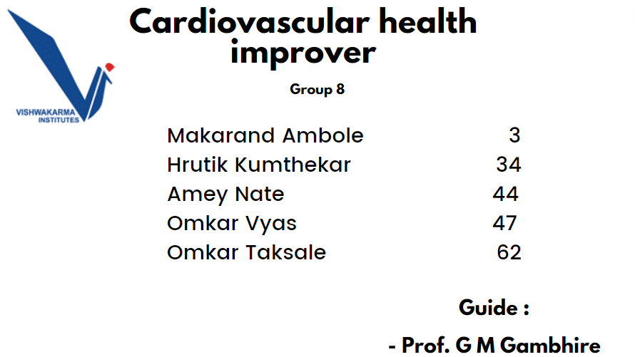

Slide 2
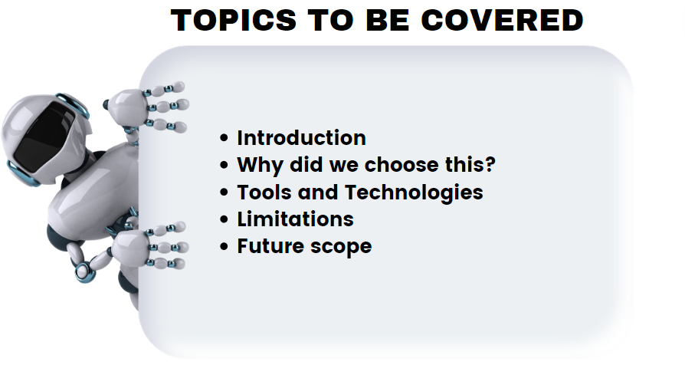

Slide 3
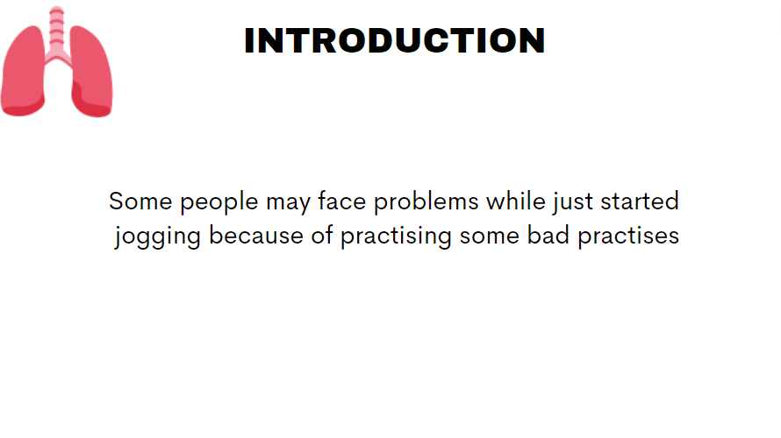

Slide 4
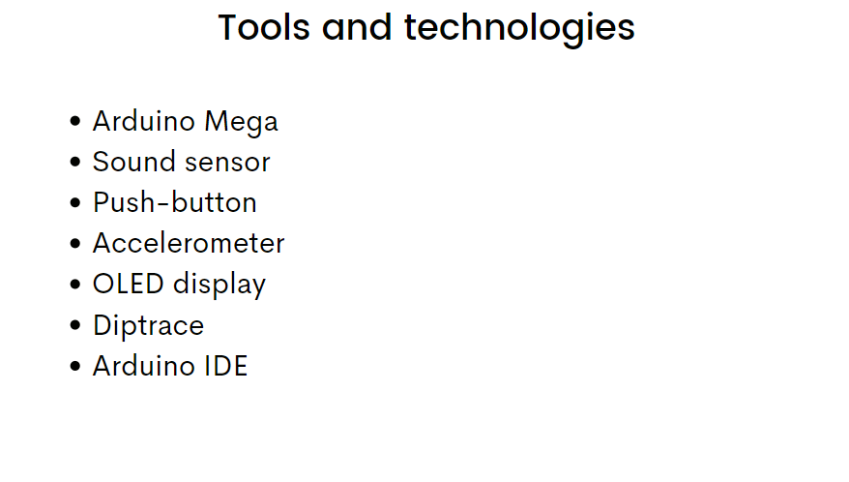
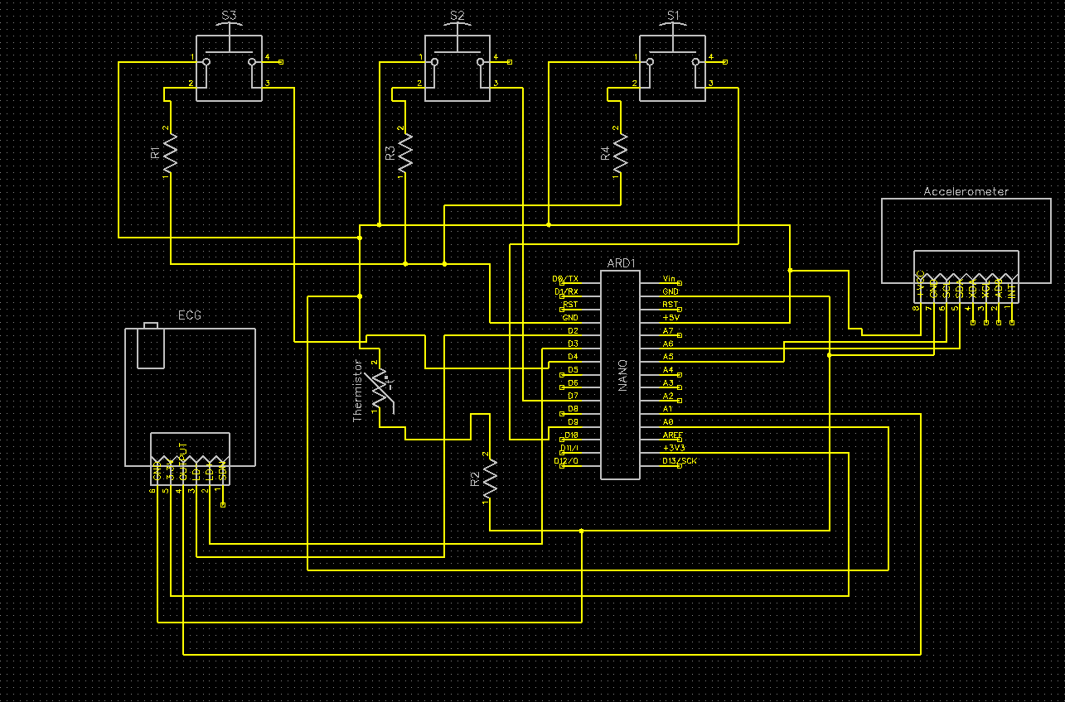

Slide 5
Costing
Component | Price
Ardunio Mega | 1900
Sound sensor | 54
Accelerometer | 123
OLED display | 188
Bread board + jumper wire e.t.c | 482

Slide 6
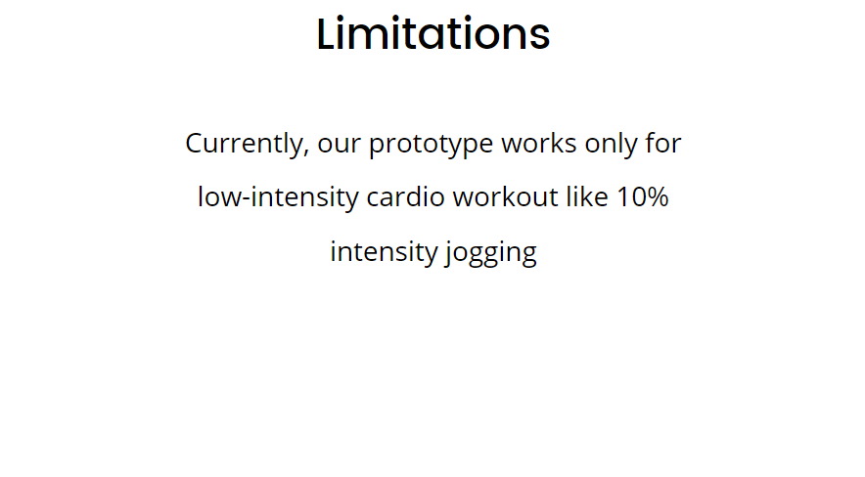

Slide 7
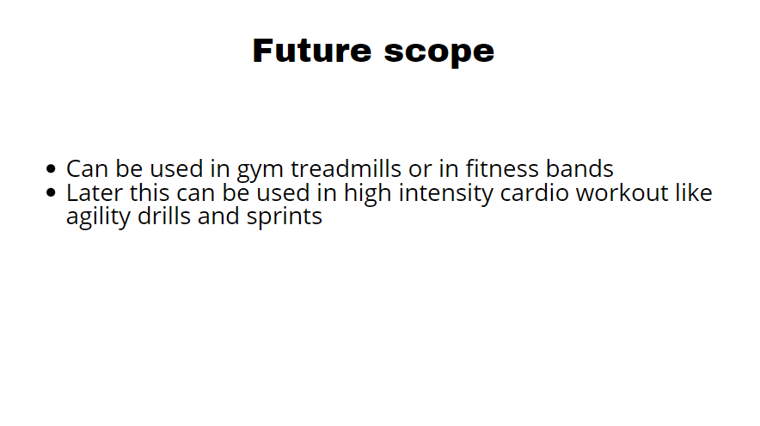

Slide 8
Thank you

