Slide 1
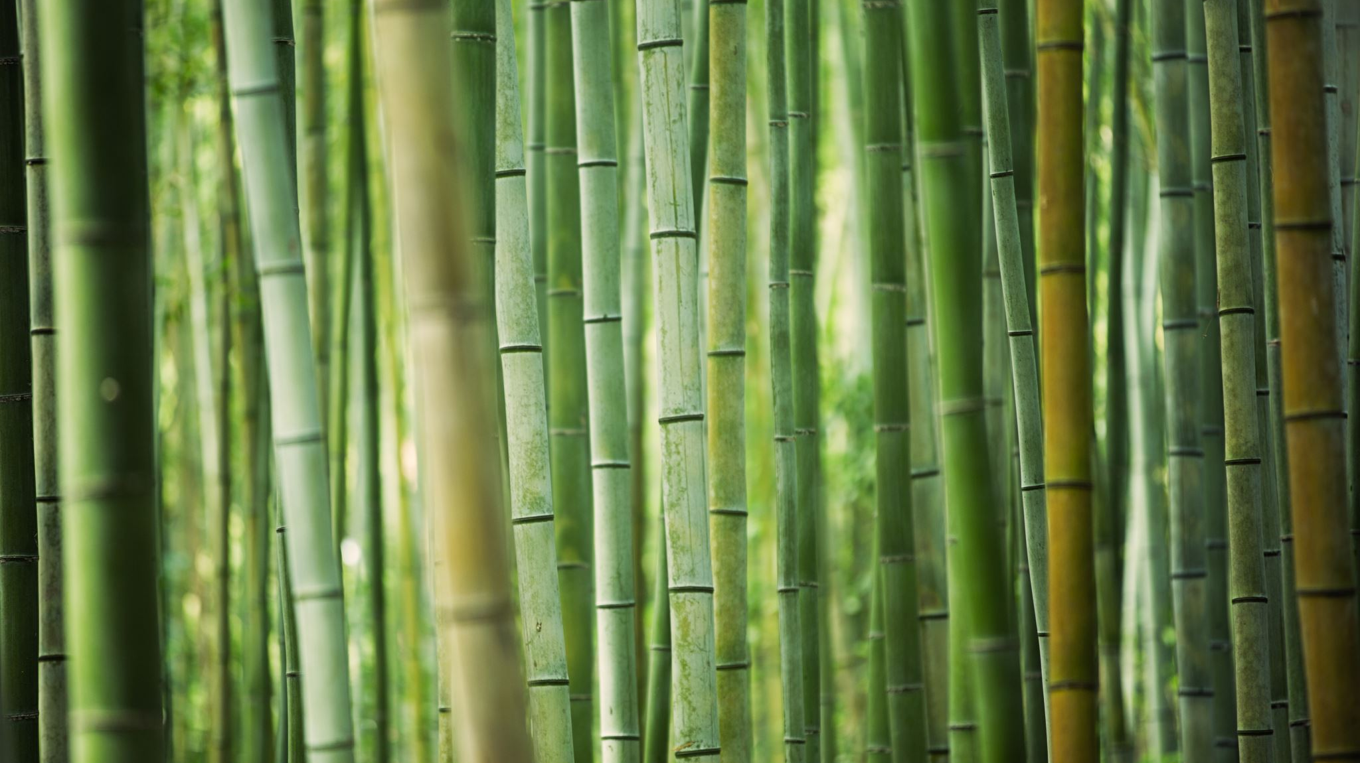
Bambus filteri
Jelena Glasovac, Hrvoje Radoš
Mentor: dr. sc. Mirjana Domazet-Lošo

Slide 2
AMQ strukture podataka
(eng. approximate membership query)
Bloom filter
Cuckoo filter
Bamboo filter

Slide 3
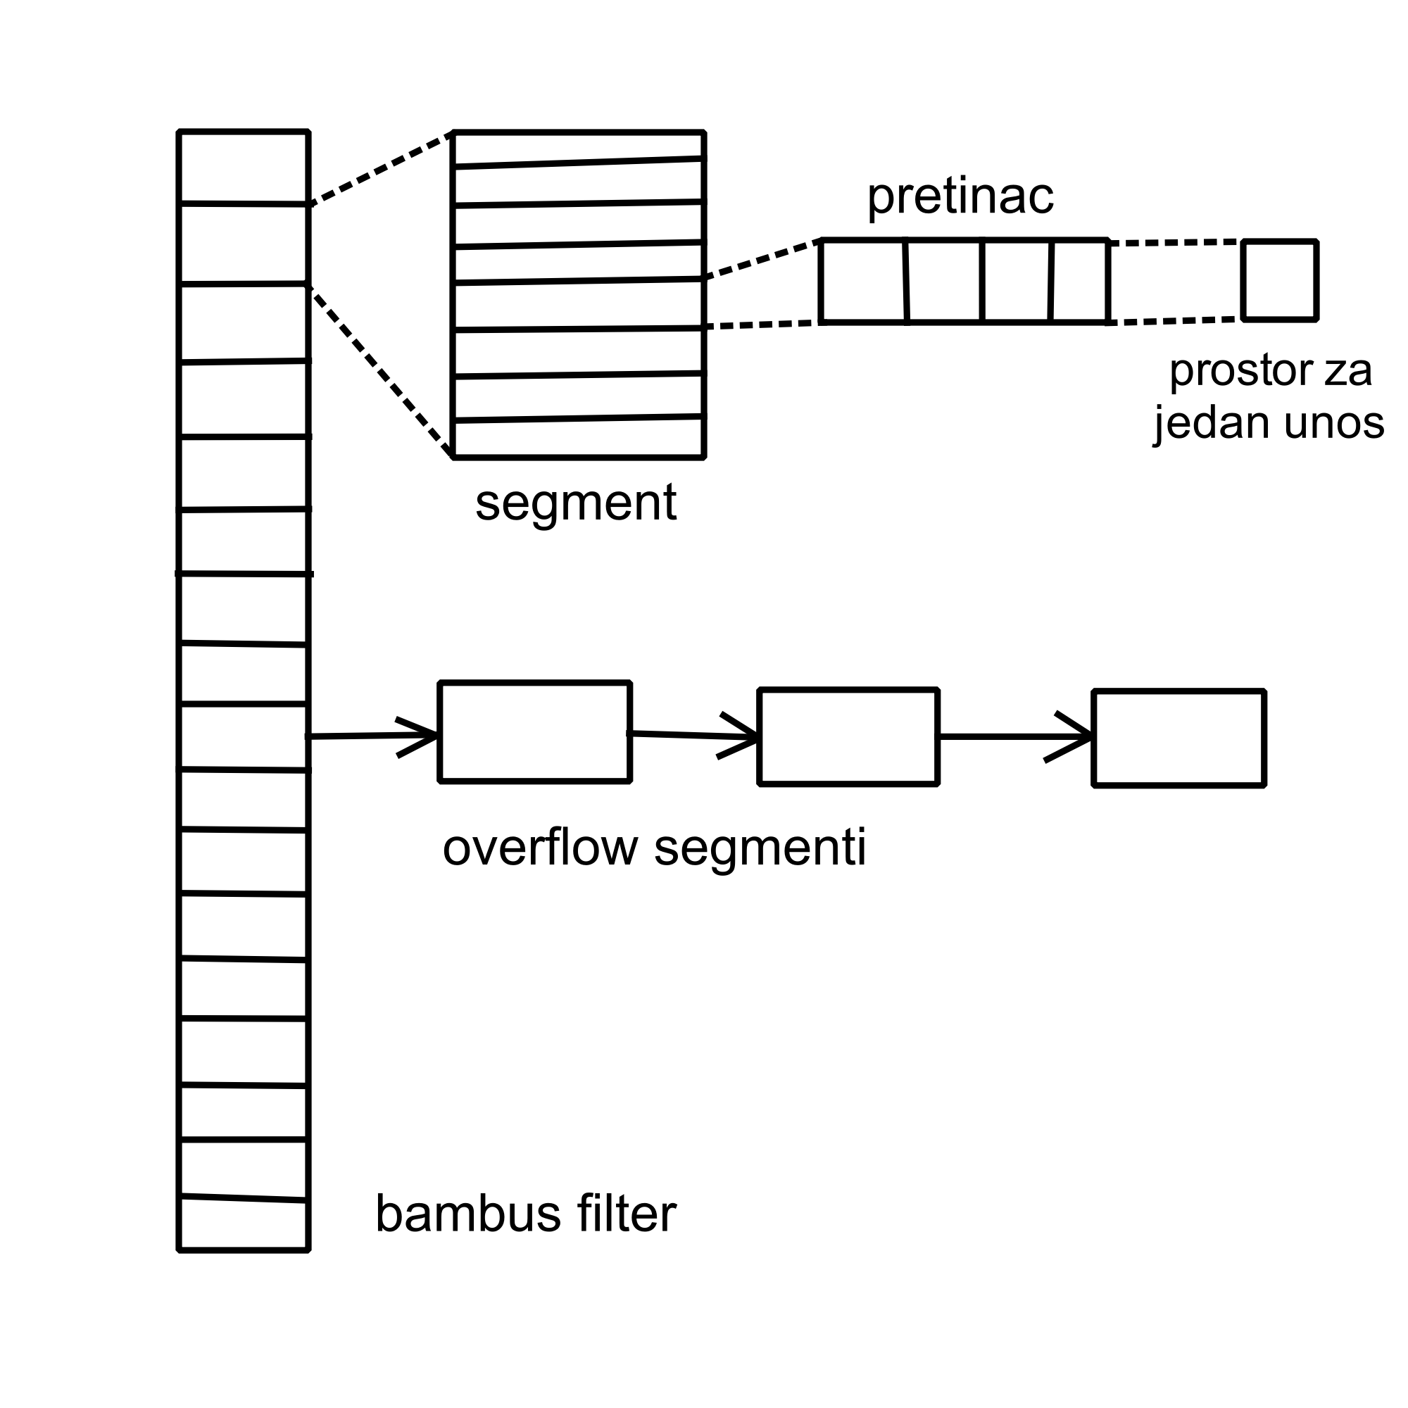
Bambus filter
Funkcionalnosti:
umetanje
čitanje
brisanje
proširivanje
komprimiranje

Slide 4
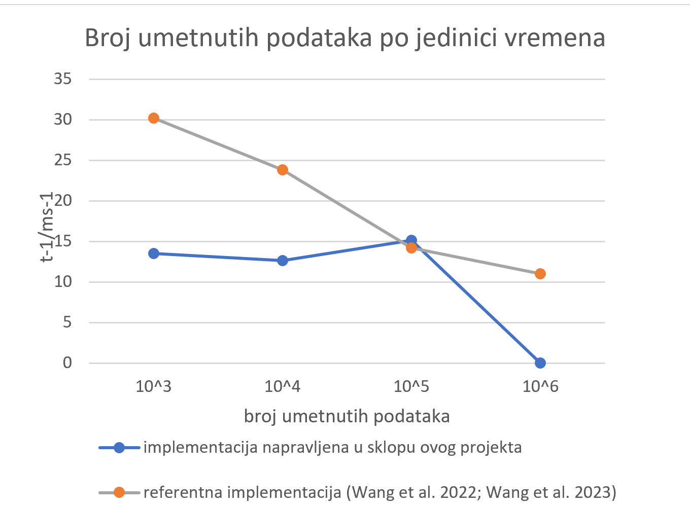
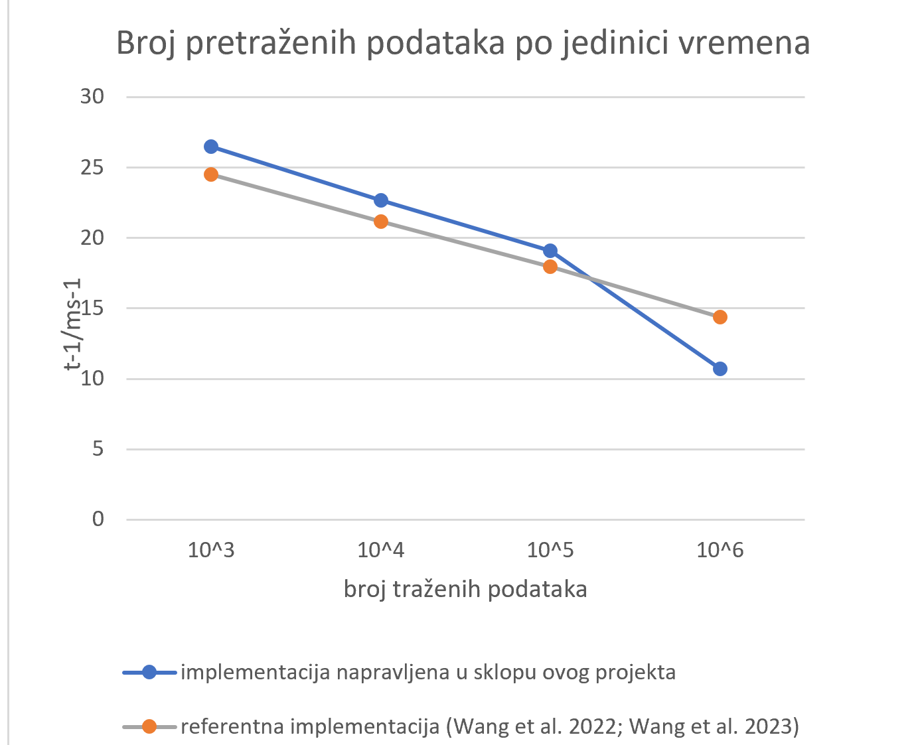
Rezultati

Slide 5
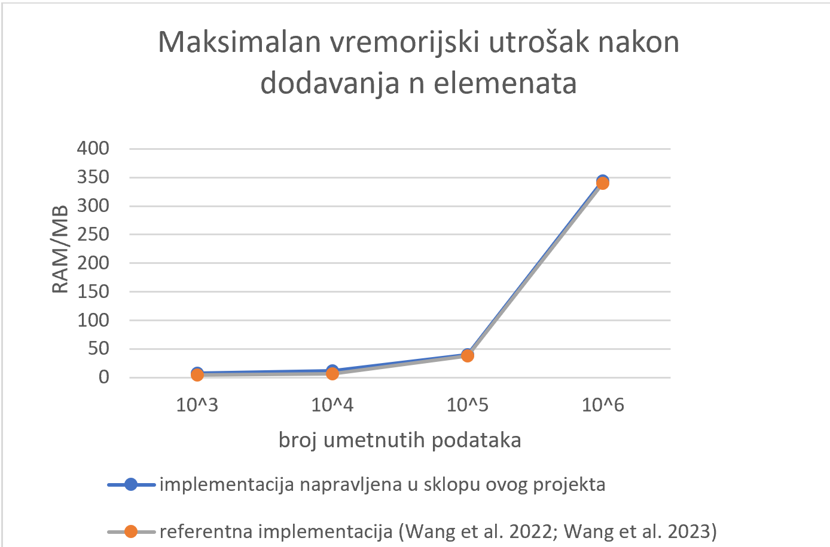
Rezultati

Slide 6
Literatura
Wang et al. Bamboo Filters: Make Resizing Smooth doi: 10.1109/ICDE53745.2022.00078
Wang et al. Bamboo Filters: Make Resizing Smooth and Adaptive 10.1109/TNET.2024.3403997
Fan et al. 2013. Cuckoo Filter: Better Than Bloom; https://www.cs.cmu.edu/~binfan/papers/login_cuckoofilter.pdf • Fan et al. 2014.
Cuckoo Filter: Practically Better Than Bloom; http://www.cs.cmu.edu/%7Ebinfan/papers/conext14_cuckoofilter.pdf

Slide 7
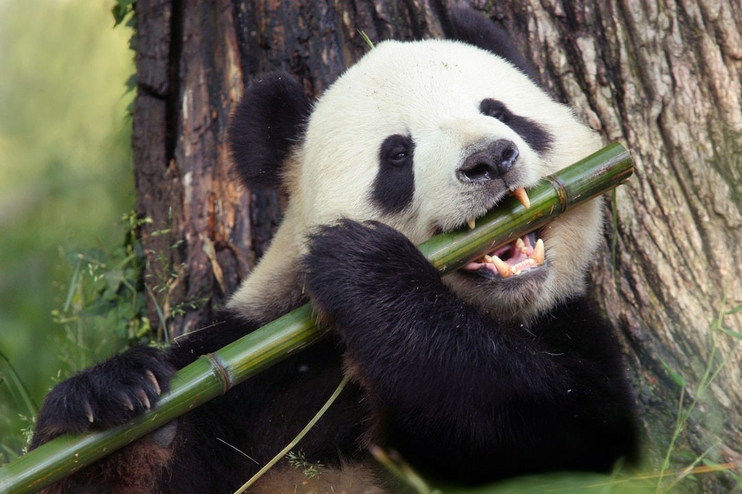
Hvala na pozornosti
Slika preuzeta s poveznice: https://kids.nationalgeographic.com/animals/mammals/facts/giant-panda

