Slide 1
Recipe Generator

Slide 2
Contents
Introduction
Aims
Initial Plans and Design
Database Design
Code & Functionality (Tools used)
Tests
Application Demo
Conclusion
Further Questions

Slide 3
Introduction

Slide 4
Aims
To Produce:
An cooking application to produce a list of ingredients and a method of cooking to the end-user
Service orientated application
1 – Frontend
2 – Ingredients Generator
3 – Method Generator
4 – Final Recipe Calculator

Slide 5
User Stories

Slide 6
Ingredient Generator

Slide 7
Method Generator

Slide 8
Final Recipe Calculator

Slide 9
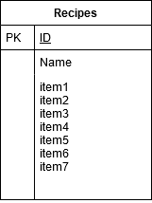
Database Design
Original Design featured 3 tables, Recipes, Methods, Ingredients

Slide 10
Risk Assessment
Risk | Impact | Likelihood | Mitigation
External database access | High | Low | Environmental Variables, Passwords
GCP account security | High | Low | Passwords/ Google also has above average security
Deleting Code | Medium | Medium | Git Repo/ Rewriting code
Deleting user files | Medium | Medium | Users can’t delete recipes on app. Database access locked behind passwords
Losing Scope | High | High | Trello board planning / experience with programming

Slide 11
Technologies Used

Slide 12
Project Obstacles
- Writing tests for cross service interactions
- Making requests across services with lists
Json does not suppose lists
Using Eval (which isn’t good practice)
Notes:
Night before it was due Jenkins crashed unexpectedly. Solved by freeing up memory so that it could run. In future set up a docker prune clause to remove un-used images

Slide 13
Tests

Slide 14
Live Demo: http://35.246.44.85/home

Slide 15
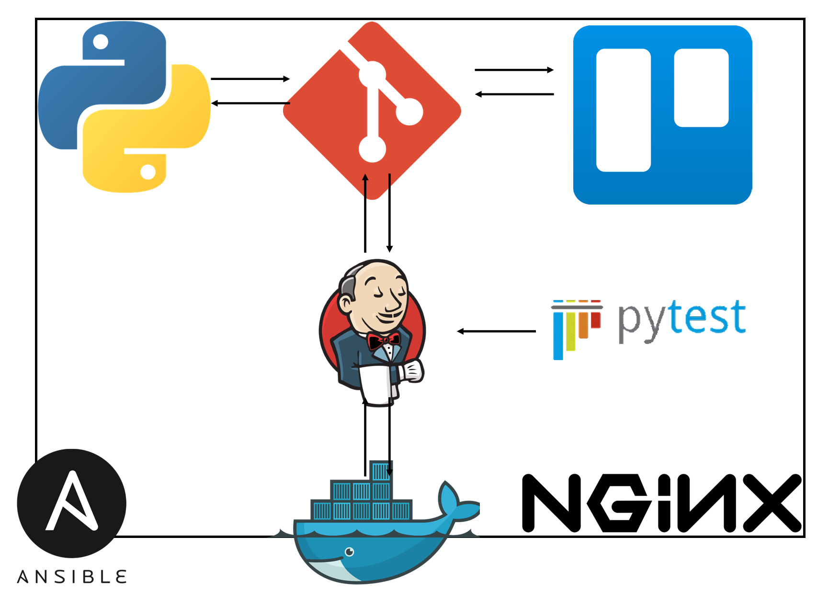

Slide 16
Tech Used

Slide 17
Conclusion

Slide 18
Further Questions

