Slide 1
Q-FORCE / HACKATHON RESEARCH
QUANTUM
RAILWAYS
Optimizing the Tracks of Tomorrow
Catalin · Artiom · Zus · Sabina · Livia
5 route decisions / 32 plans
Notes:
Open with the research question: can a quantum optimizer sample useful railway investment plans under a budget? The routes, costs and rewards in the current application are fictional. This presentation reports reproducible local experiments and a verified IBM status check.
Sources and provenance: repository branch zus, commit 728ce483; presentation/EXPERIMENT_EVIDENCE.md

Slide 2
01 / CHALLENGE
Which connections should we build?
A fictional Romanian route network, five binary investment choices, one budget.
0
Iași–Brașov
cost 2 / score 4
xᵢ = 1
1
Iași–Cluj-Napoca
cost 3 / score 6
choose route i
2
Cluj-Napoca–Brașov
cost 2 / score 5
3
Brașov–București
cost 4 / score 9
Σ costᵢ xᵢ ≤ 7
4
București–Constanța
cost 4 / score 7
maximize Σ scoreᵢ xᵢ
Route costs and scores: railway_data.py; scenario route IDs 0, 1, 2, 6, 8.
Q-FORCE / QUANTUM RAILWAYS
02
Notes:
Each binary variable represents purchasing one route. The five selected routes span five distinct cities. Objective is additive score under a construction-budget cap. The app does not optimize passenger connectivity; routes are fictional and are drawn between real city positions.
Sources and provenance: railway_data.py; classical_optimizer.py; presentation/experiments/penalty_0_7_seed_2026.json

Slide 3
02 / CLASSICAL REFERENCE
32 plans. 16 valid. Two best.
Exhaustive enumeration is the ground truth for this five-route instance.
2⁵ = 32
16
15 / 7
binary plans
budget-feasible
best score / cost
TIED OPTIMA
01010
00111
routes 1 + 6
routes 0 + 1 + 2
Exact enumeration on route IDs 0,1,2,6,8 · B=7 · score ties included.
Q-FORCE / QUANTUM RAILWAYS
03
Notes:
Enumerate all 2^5 combinations and filter cost ≤7. Sixteen plans are feasible. Two distinct plans tie at value 15 and cost 7. This deterministic reference lets us distinguish “best observed feasible QAOA sample” from a guarantee. Displayed bitstrings follow the application decision order.
Sources and provenance: presentation/experiments/penalty_0_7_seed_2026.json; classical_optimizer.py

Slide 4
03 / MODEL
A low-energy answer can break the budget
The squared penalty is centered on spending exactly B, while the rule allows spending less.
E(x) = −V(x) + λ [C(x) − B]²
λ = 0.7
EXACT FEASIBLE OPTIMUM
EXACT QUBO MINIMUM
score 15 · cost 7
score 18 · cost 8
Budget respected
−17.3 energy · 1 over budget
Direct cost model, QUBO and Ising energies agree for all 32 states (max difference <1.1×10⁻¹⁴).
Q-FORCE / QUANTUM RAILWAYS
04
Notes:
This is the central mathematical failure. The QUBO conversion is internally consistent, but a weak squared equality penalty rewards an invalid, over-budget plan in this scenario. At λ=4 the exact model minimum becomes feasible, but squared penalties do not universally encode an inequality. Do not compare absolute energies across different λ because the objective changes.
Sources and provenance: quantum_optimizer.py; presentation/source_data/experiments_summary.json

Slide 5
04 / QUANTUM METHOD
QAOA turns plan quality into interference
Five route decisions become five qubits; one layer has two trainable angles.
H
COST
MIXER
MEASURE
→
→
→
32-plan
superposition
RZ / RZZ
phase γ
RX rotations
angle β
finite shots
bitstrings
COBYLA adjusts γ and β to lower expected model energy; we then sample the trained circuit.
p=1 local training: ideal statevector expectation; ideal Aer and synthetic-noise Aer sampling.
Q-FORCE / QUANTUM RAILWAYS
05
Notes:
Explain QAOA physically: Hadamard gates create a superposition; the cost unitary applies objective-dependent phase; the mixer allows amplitudes to interfere; a classical optimizer picks angles. In this implementation, COBYLA trains on an ideal statevector expectation, then finite-shot measurement estimates output probabilities. Samples are decoded and feasible ones ranked by true score.
Sources and provenance: quantum_optimizer.py:105-113,179-220,268-321,357-440

Slide 6
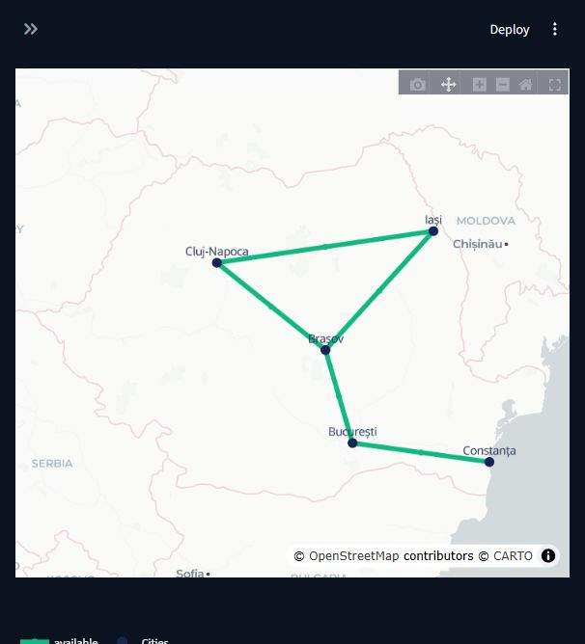
05 / IMPLEMENTATION
An end-to-end planning laboratory
The app ties scenario design, exact reference, QAOA, maps and reproducible reports.
01
Select routes & budget
02
Build QUBO + exact reference
03
Train and sample QAOA
04
Compare maps, statistics, reports
Screenshot: running local Streamlit app, captured 8 Nov 2026; fictional schematic edges.
Q-FORCE / QUANTUM RAILWAYS
06
Notes:
This is an actual screenshot of the locally running Streamlit app. The UI supports route selection, incident toggles, simulation controls, results, history and PDF export. An HTML report exists through backend API. The map uses real city positions but fictional direct route edges. The screenshot was captured from the five-route, budget-seven scenario.
Sources and provenance: app.py; experiment.py; presentation/screenshots/app_map.png

Slide 7
06 / EXPERIMENT DESIGN
Change one axis; keep the comparison honest
Run-level JSON preserves configurations, seeds, counts, resources and optimizer status.
PRIMARY
Penalty λ
0.7 vs 4.0
3 paired seeds
PRECISION
Shots
256–4096
fixed trained circuit
SCALE
Route decisions
5 → 7 → 8
2⁵ → 2⁸ states
PLANNING
Budget
5 → 7 → 9
retrain per budget
EXECUTION
Backend
ideal vs local noise
same bound angles
Local replay: p=1, COBYLA, 30 evaluation limit, 2048 shots unless shot study; 8-route compare limit.
Q-FORCE / QUANTUM RAILWAYS
07
Notes:
The penalty study is the only three-seed matched comparison in the main deck. Its route set, true scoring, budget, depth, evaluation limit and shots are fixed. Shot sensitivity samples one fixed trained circuit without retraining. Budget and network-size studies retrain because the optimization problem changes. Ideal and synthetic-noise samples use the same trained angles within each run. All six penalty optimizers exhausted their evaluation budget.
Sources and provenance: presentation/run_experiments.py; presentation/source_data/experiments_summary.json

Slide 8
07 / PRIMARY FINDING
A stronger penalty fixes the model, not sampling
Exact validity flips at λ=4; measured feasible rates move both ways across seeds.
2026
λ = 0.7
52.5%
EXACT MODEL MINIMUM
λ = 4.0
51.1%
λ .7 → invalid
2027
λ = 0.7
62%
λ = 4.0
λ 4 → valid
45.5%
2028
λ = 0.7
All six optimizers hit the evaluation limit.
47.4%
λ = 4.0
65.4%
Five routes, five cities, B=7, p=1, 2048 ideal shots, 30 evaluations, matched seeds.
Q-FORCE / QUANTUM RAILWAYS
08
Notes:
Read paired rates by seed: λ=.7 gives 52.54%, 62.01%, 47.41%; λ=4 gives 51.07%, 45.46%, 65.43%. Changes are mixed, not a monotonic improvement. Probability of either tied true optimum likewise varies. Exact model minimum is over budget at .7 and feasible at 4. All six optimizers reported evaluation-limit exhaustion, so this is preliminary evidence, not a convergence claim. Cross-penalty absolute model energies are not comparable.
Sources and provenance: presentation/experiments/penalty_*.json; presentation/EXPERIMENT_EVIDENCE.md

Slide 9
08 / PRECISION
More shots narrow uncertainty
We remeasured the same trained circuit; its underlying state did not change.
256
1024
2048
4096
shots
shots
shots
shots
~±6.1%
~±3.1%
~±2.2%
~±1.5%
95% sampling band
95% sampling band
95% sampling band
95% sampling band
Three seeds per shot count • fixed γ, β and scenario • finite-shot P(feasible) estimates
Wilson intervals from presentation/source_data/shot_sensitivity.json; band shown near p≈0.5.
Q-FORCE / QUANTUM RAILWAYS
09
Notes:
This is a fixed-state shot-count study, not four newly optimized circuits. Exact statevector P(feasible) is unchanged. Across three measurement seeds, observed estimates fluctuate. The displayed ~± values are approximate Wilson 95% half-widths for p near 0.5; exact run-specific intervals are preserved in source JSON. Shots, optimizer evaluations, and independent seeds are distinct resources.
Sources and provenance: presentation/source_data/shot_sensitivity.json

Slide 10
09 / SCALING
Routes set qubits; cities do not
A route decision is one binary variable, so the state space grows as 2ⁿ routes.
5 routes
7 routes
8 routes
5 cities
7 cities
7 cities
32 states
128 states
256 states
baseline
local compare
current compare limit
Budget 5 → 7 → 9
Exact best score 11 → 15 → 20
Size and budget replays: seed 2026, p=1, 2048 shots; each changed problem retrained.
Q-FORCE / QUANTUM RAILWAYS
10
Notes:
Decision-space size depends on number of route variables. The seven- and eight-route scenarios both cover seven distinct cities, but require seven and eight qubits respectively. Their exact state counts are 128 and 256. The current ideal-plus-local-noise app comparison caps at eight active routes. Budget experiments hold the five-route set fixed but change B and retrain. Higher raw optimum under larger B reflects a different planning problem, not improved quantum performance.
Sources and provenance: presentation/experiments/size_*.json; presentation/experiments/budget_*.json

Slide 11
10 / LOCAL NOISE
The same angles, two simulators
One baseline run shows similar finite-shot feasibility; no noise benefit follows.
52.5%
53.0%
15
ideal feasible
synthetic noisy feasible
exact best feasible
2048 shots
2048 shots
true score
Trained once → bound γ, β → sampled with Aer statevector and a local synthetic noise backend
Five routes, B=7, λ=.7, p=1, seed 2026; local GenericBackendV2 + Aer density matrix.
Q-FORCE / QUANTUM RAILWAYS
11
Notes:
Within this run the ideal and synthetic-noisy measurements use the same trained QAOA angles. Ideal feasibility was 1076/2048, noisy 1086/2048. Difference is small and finite-shot uncertain. Best feasible true score was 15 for both. This noise model is local and synthetic; it is not an IBM QPU run. Noise does not improve the quantum algorithm based on one sample.
Sources and provenance: presentation/experiments/penalty_0_7_seed_2026.json

Slide 12
11 / HARDWARE PATH
From trained angles to physical measurements
Hardware changes mapping, depth and error profile; decoding must follow the final layout.
Train
Bind
Transpile
IBM QPU
Decode
→
→
→
→
ideal expectation
γ / β
device layout
physical gates
feasible plans
Compare identical scenario, parameters, shots and decoded bit order wherever records permit.
Hardware workflow implemented separately in IBM runner; no verified counts available for this deck.
Q-FORCE / QUANTUM RAILWAYS
12
Notes:
The hardware comparison requires the submitted circuit, parameter values, transpiled layout, backend, shot count and counts. Logical-to-physical mapping and bit order must be preserved when decoding. Classical enumeration is deterministic; ideal/noisy/QPU output distributions are measured. The team has a recorded hardware job identifier, but no verified completed counts.
Sources and provenance: ibm_notebook_runner.py; presentation/IBM_QPU_STATUS.md

Slide 13
12 / IBM STATUS
IBM QPU measurements remain unverified
The recorded job ID was not found in the configured IBM account at final check.
NO VERIFIED COUNTS
dbnpc00ou4as73b4u830
Recorded backend: ibm_marrakesh • 4096 requested shots • p = 1
Status query: RuntimeJobNotFound for the locally configured account
Recorded submission metadata only. No QPU success rate, score or distribution is claimed.
Q-FORCE / QUANTUM RAILWAYS
13
Notes:
The archived ibm_job.json records a job ID, backend ibm_marrakesh, p=1 and 4096 shots. There is no counts file in that run folder. A read-only IBM Runtime query on 8 November 2026 returned RuntimeJobNotFound for the configured account. That may reflect account mismatch, access, or record status; it does not establish job failure or completion. No additional QPU job was submitted. The refresh command checks again without submitting a new job.
Sources and provenance: output/script_20261107_231254_822277/ibm_job.json; presentation/IBM_QPU_STATUS.md

Slide 14
13 / FUTURE RESEARCH
From a hackathon game to real Romania
A staged, source-grounded subnetwork study is the responsible next experiment.
01
02
03
04
05
CFR + ERA data
→
Real network graph
→
Public investment case
→
Classical benchmark
→
Quantum comparison
validate stations, tracks
connectivity & constraints
reported costs, transparent benefit
small regional subproblem
resources, validity, limits
CFR reports 10,615 km of lines and 896 operating points (2026 network statement annex).
CFR Network Statement 2026, Annex 5; ERA RINF Romania dataset. Real project costs not inferred from distance.
Q-FORCE / QUANTUM RAILWAYS
14
Notes:
This is future work, not a claim that the current app has real railway costs or network constraints. CFR Network Statement Annex 5 reports 10,615 km of lines and 896 operating points; confirm source definitions and period before analytic use. ERA RINF provides official infrastructure records but topology and licensing must be validated. Choose a manageable region, define a public-interest objective, use reported project costs, solve classically, then formulate a small quantum counterpart. Do not attempt naive nationwide QAOA.
Sources and provenance: https://cfr.ro/download-drr-2026-network-statement/ ; https://cfr.ro/files/ddr/EN%202026/Annex%205%20.pdf ; https://rinf.data.era.europa.eu/dataset-explorer ; presentation/REAL_ROMANIA_FEASIBILITY.md

Slide 15
14 / CONCLUSION
Meaningful solutions need more than low energy
Three lessons from one controlled railway optimization study.
01
Exact classical reference
reveals what is truly optimal
02
Budget encoding
can reward an invalid model minimum
03
Training + sampling
shape the plans we actually see
“Quantum optimization is about finding meaningful solutions.”
Q-FORCE / QUANTUM RAILWAYS
15
Notes:
Close on honest scientific value: exact enumeration exposes the weak-penalty failure; stronger penalty corrects the exact five-route model minimum but does not consistently improve QAOA feasibility at three seeds; increasing shots improves estimate precision, while scale and physical noise add constraints. No quantum advantage or verified hardware result is claimed. Team Q-Force: Catalin, Artiom, Zus, Sabina, Livia.
Sources and provenance: presentation/EXPERIMENT_EVIDENCE.md; presentation/IBM_QPU_STATUS.md

Slide 16
APPENDIX A / EQUATIONS
The implemented energy path
All 32 direct, QUBO and Ising energies matched numerically.
E(x)=−Σ vᵢxᵢ + λ(Σ cᵢxᵢ−B)²
aᵢ=−vᵢ + λ(cᵢ²−2Bcᵢ) bᵢⱼ=2λcᵢcⱼ
xᵢ=(1−Zᵢ)/2 → H = const + Σ hᵢZᵢ + Σ JᵢⱼZᵢZⱼ
Direct/QUBO max |ΔE|=1.07×10⁻¹⁴; QUBO/Ising max |ΔE|=7.11×10⁻¹⁵.
Q-FORCE / QUANTUM RAILWAYS
16
Notes:
These coefficients follow the implemented squared penalty. The direct and converted energies were checked over every five-bit state. Correct conversion does not prove the encoded minimum satisfies the original inequality.
Sources and provenance: quantum_optimizer.py; presentation/source_data/experiments_summary.json

Slide 17
APPENDIX B / RESOURCES
Training stopped at its evaluation limit
A single archived 19-route depth test is illustrative, not a general depth result.
46
43
171 → 342
p = 1 observed best
p = 2 observed best
two-qubit gates
19 routes, B=20
same archived seed
p=1 → p=2
One archived seed (2026) • 30 evaluations each • neither optimizer converged
Tracked archive: validation/p_comparison_seed2026/comparison.json; configuration differs from five-route runs.
Q-FORCE / QUANTUM RAILWAYS
17
Notes:
Do not merge this result with the five-route penalty study. It has nineteen route variables, budget 20, λ=.7, 4096 shots, and seed 2026. It is archived rather than newly rerun for this presentation. p=1 observed feasible score 46; p=2 observed 43. Compiled two-qubit gates increased from 171 to 342. Both optimizer runs exhausted their budget, so this does not show that shallower circuits generally outperform deeper circuits.
Sources and provenance: validation/p_comparison_seed2026/comparison.json

Slide 18
APPENDIX C / PROVENANCE
Every number has a source
Rebuild from frozen run JSON; refresh hardware only after verified measurements.
LOCAL REPLAY
10 full run JSON files
presentation/experiments/
SHOT STUDY
12 fixed-state samplings
presentation/source_data/shot_sensitivity.json
IBM RECORD
job metadata, no counts
output/script_20261107_231254_822277/
REAL NETWORK
CFR + ERA sources
presentation/REAL_ROMANIA_FEASIBILITY.md
Rebuild: presentation/rebuild.ps1 · IBM read-only refresh: presentation/refresh_qpu_results.py --rebuild
Q-FORCE / QUANTUM RAILWAYS
18
Notes:
Explain provenance categories clearly: executed local runs, archived tracked result, read-only IBM job record, and official external data source. The source files and rebuild scripts ship with this deck. No hardware measurement is represented by a simulated number.
Sources and provenance: presentation/README.md; presentation/EXPERIMENT_EVIDENCE.md

Slide 19
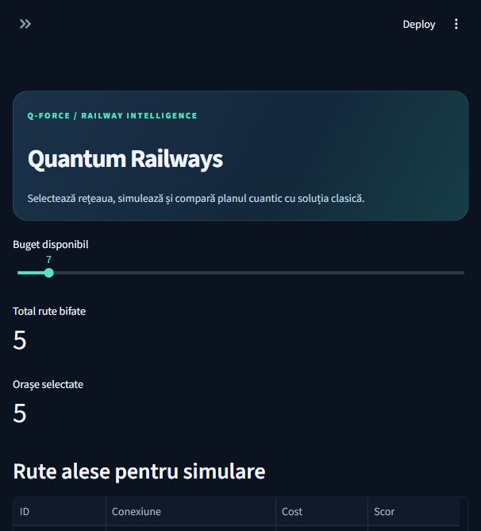
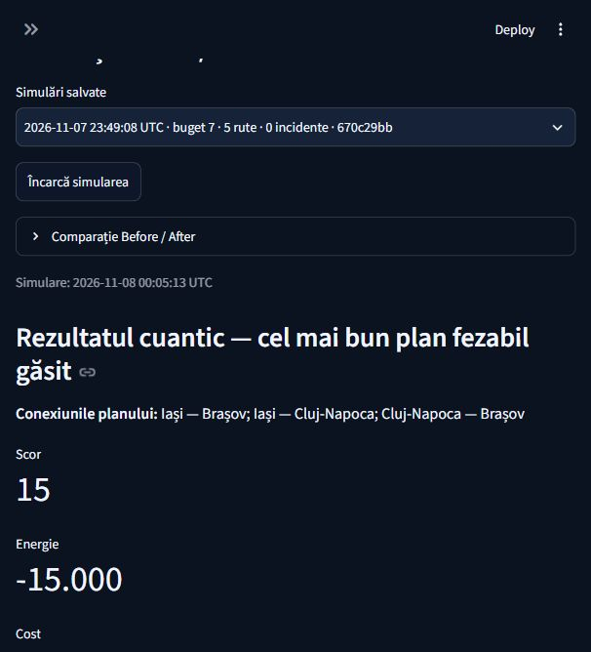
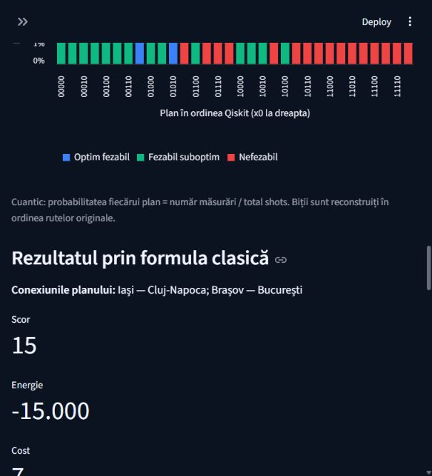
APPENDIX D / LIVE APPLICATION
The app presents both quantum and exact plans
Genuine local Streamlit captures from a five-route, budget-seven run.
Main interface
Best feasible sampled
Exact classical
Captured from the locally running app 8 Nov 2026. UI run is separate from frozen experimental JSON.
Q-FORCE / QUANTUM RAILWAYS
19
Notes:
These are genuine Streamlit UI screenshots captured during a live local run at five selected routes and budget seven. The sampled result panel reports the best feasible observed quantum plan, not the most frequent bitstring or an exact quantum guarantee. The classical panel is the exact enumeration reference. These UI captures are not used as the numerical source for the controlled penalty chart.
Sources and provenance: presentation/screenshots/app_overview.png; presentation/screenshots/app_results.png; presentation/screenshots/app_classical.png

