Slide 1




Are Time Series Foundation Models Ready to Revolutionize Predictive Building Analytics?
Ozan Baris Mulayim, Pengrui Quan, Liying Han, Xiaomin Ouyang, Dezhi Hong*, Mario Bergés*, and Mani Srivastava*.
*Associated with Amazon, but work unrelated to Amazon

Slide 2

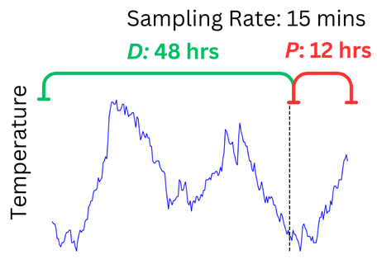



Introduction What would you do in this situation?
Icons: flaticon.com
Introduction
Motivation
Methodology
Results
Future
Review

Slide 3


Motivation Foundation Models' success inspires time series advancements.
Icons: flaticon.com
Foundation Models rose in popularity due to their success with Large Language Models.
These models excelled in generalization, achieving zero-shot or few-shot performance without domain-specific training.
Researchers have attempted to replicate this success with Time Series Foundation Models (TSFMs).
TSFMs
Assessing TSFMs' readiness for building analytics.
Introduction
Motivation
Methodology
Results
Future
Review

Slide 4
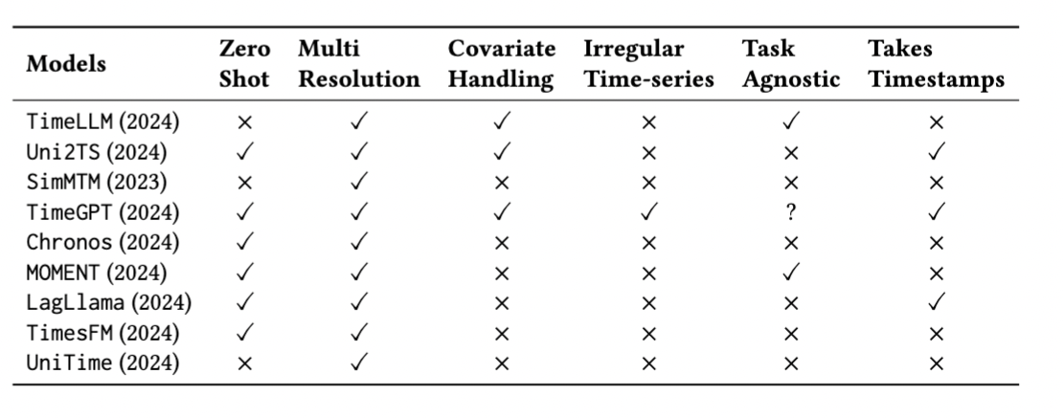
Review of TSFMs Few have the necessary features
Icons: flaticon.com
Today’s TSFMs are
Not Time Series: don’t take timestamps
Not Foundation Models: not task-agnostic
Focus on univariate zero-shot forecasting due to limited number of models with covariate handling.
Introduction
Motivation
Methodology
Results
Future
Review

Slide 5






Methodology-I
Icons: flaticon.com
Dataset-level Familiarity
Modality-level Familiarity
Generalizability
ecobee DYD Dataset: 1,000 homes (California, Texas, Illinois, New York), 5-minute intervals, 32 homes for detailed analysis.
UCI Electricity Dataset: 370 clients (Portugal, 2011-2014), 15-minute intervals, 30 homes across seasons.
Smart* Dataset: 114 apartments (Amherst, Massachusetts, 2014-2016), 15-minute intervals, 30 homes across seasons.
Introduction
Motivation
Methodology
Results
Future
Review

Slide 6
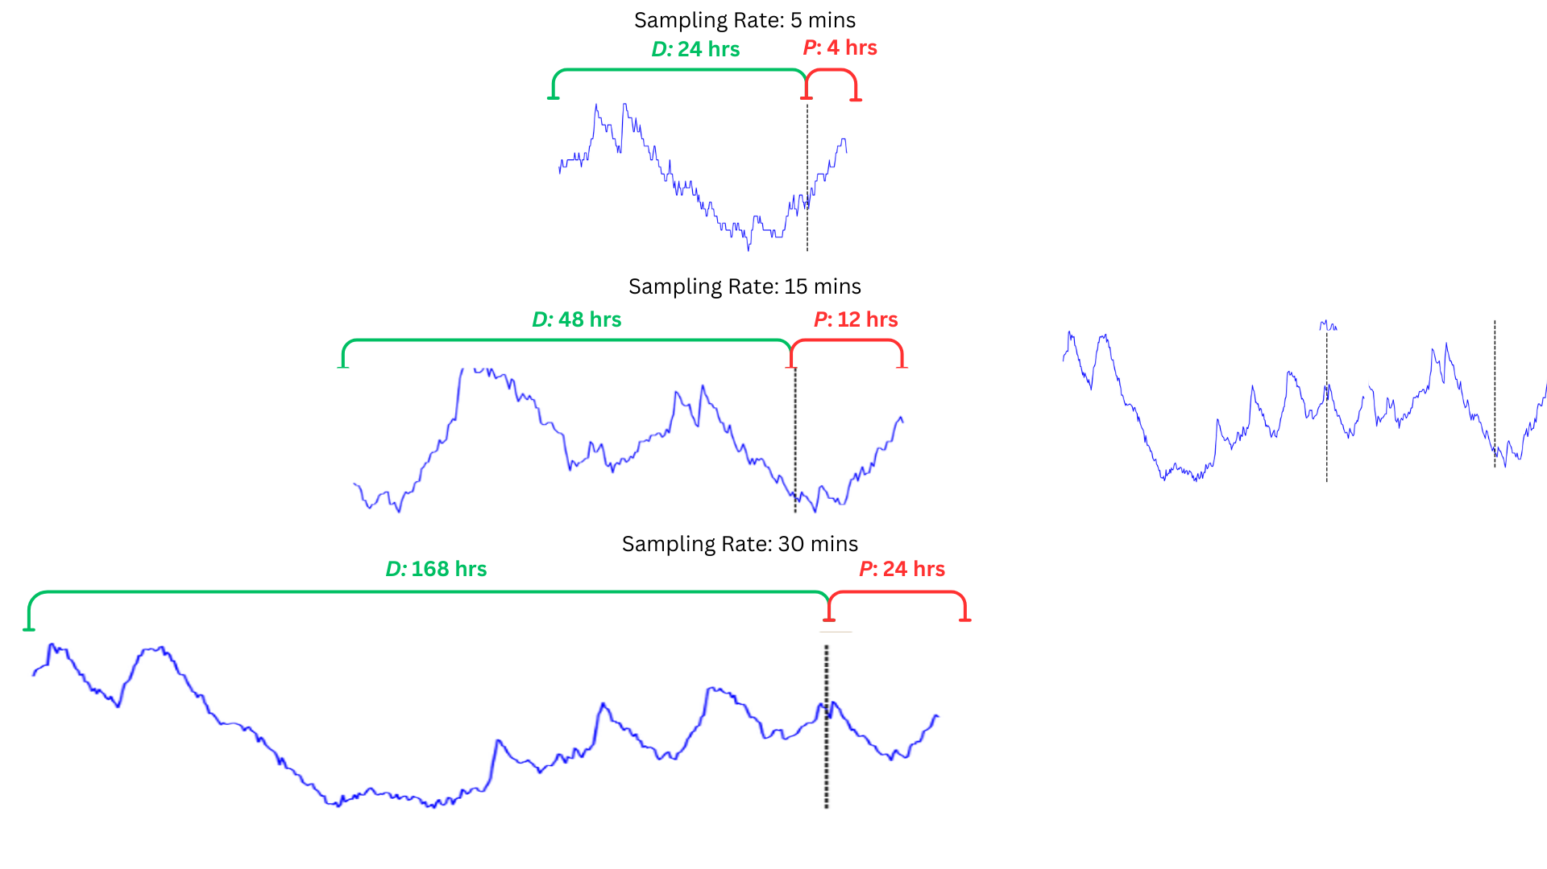

Methodology-II
Icons: flaticon.com
Experimental Design details:
Context (D)
Horizon (P)
Sampling Rate (f_{s})
Statistical Models were trained from scratch before each prediction using only the specific context window.
AutoARIMA
Best Fit Curve
Seasonal ARIMA
Introduction
Motivation
Methodology
Results
Future
Review

Slide 7
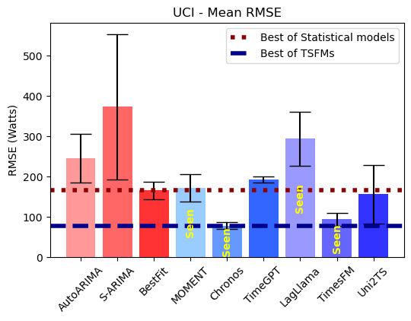
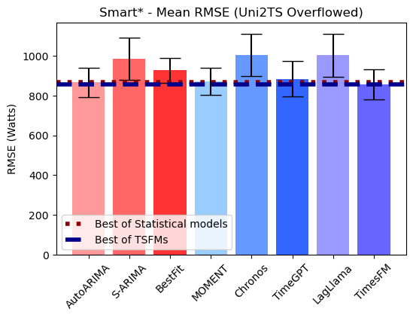
Results-I TSFMs are marginally better than statistical models trained with very little data
Icons: flaticon.com
Seen dataset
Unseen dataset
Introduction
Motivation
Methodology
Results
Future
Review

Slide 8
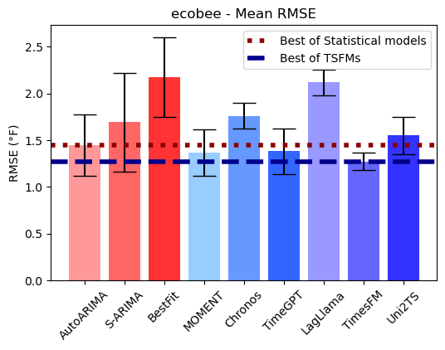
Results-II TSFMs fail to generalize to an unseen modality (i.e., indoor temp)
Icons: flaticon.com
On unseen datasets and modalities, the performance gap between statistical models and TSFMs is marginal.
Unseen modality
Introduction
Motivation
Methodology
Results
Future
Review

Slide 9



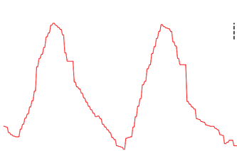


Future Community effort to develop TSFMs with key features
Icons: flaticon.com
This is indoor air temperature
data collected from a house
in Pittsburgh …
Context
Detect anomalies in this given time series data ..
Task agnostic
Indoor temp, outdoor temp, solar gain, …
New attributes
Introduction
Motivation
Methodology
Results
Future
Review

Slide 10


Future Community effort to develop TSFMs with key features
Icons: flaticon.com
Data Curation and Sharing
Architectural Innovation
Evaluation and Benchmarking
Resource Sharing & Training Techniques
Github Page: https://github.com/nesl/TSFM_Building
Introduction
Motivation
Methodology
Results
Future
Review

