Slide 1
Listen to the Long Now
Chinese Chart – Listener Behaviour Across Years
Seven years of chart metadata · audio embeddings of 374 charted songs
Presented by Jiang Chuyang (3036589703) · Liu Yibo (3036589636)
HKU COMP2501 · Section 1SH · October 2026

Slide 2
OVERVIEW
Agenda
01
Project Background The story, the questions, why it matters, prior work
02
Method and Pipeline From chart scrapes to CLAP audio vectors
03
Data Analysis Changepoints, genre drift, cross-region — and the taste map
04
Insights & Limitations What we learned — and what we cannot claim
05
Conclusion Answers, future works, references
2

Slide 3
Part1
Project Background
What is it? Why is it important?

Slide 4
PROJECT BACKGROUND
The story: 2018–2024
Between 2018 and 2024, did Chinese mainstream-music chart-listener behaviour drift in measurable ways?
2019
2020
2022
Douyin takeover
COVID-19 stay-at-home
Ecosystem split
Short-video feeds become a hit-making machine; QQ launches the Douyin Hit chart (topId 60) as Douyin reaches ~400M DAU.
Nationwide lockdown (Jan–Apr); TikTok passes 2B downloads. Chart activity contracts, then surges after the lockdown.
QQ launches the Guofeng Hot Songs chart (topId 65); post-COVID, platform and genre structures reorganise.
Two lenses, one question. Chart metadata — rotation speed, weekly unique songs, cross-chart correlation. Audio embeddings — what the picked songs actually sound like. Can we find statistically significant changepoints, and do they line up with these three events?
4

Slide 5
PROJECT BACKGROUND
Data science questions
Q1
Regime shifts in QQ chart behaviour
Across 2018–2024, do QQ Music's seven public weekly toplists (~137,000 song-week rows) show statistically significant regime shifts — rotation speed, weekly unique-song count, cross-chart correlation — and which years mark them?
Q2
Platform-conditional or market-wide?
On the same day, do catalogue-freshness and star-concentration profiles of QQ, NetEase, Apple Music CN and Apple Music US diverge in a way that separates platform-conditional from market-wide behaviour?
Q3
Does the audio drift too? (our extension)
Do CLAP embeddings of the charted songs themselves drift across years — and do the two Chinese platforms pick songs that sound different, or just different songs?
Q1–Q2 are answered from chart metadata; Q3 is the audio-embedding lens — listed as future work in the first draft, delivered here.
5

Slide 6
PROJECT BACKGROUND
Why important
01
The world's largest music market
Chinese streaming is the world's largest recorded-music market, yet year-over-year listener-behaviour drift is rarely measured at chart-history level. Seven years of weekly toplists make it measurable.
02
Three events should leave fingerprints
2019: Douyin reaches ~400M DAU. 2020: COVID-19 nationwide stay-at-home. 2022: post-COVID platform / genre ecosystem split. If behaviour really shifted, the charts should show it.
03
From ranks to sound
Ranks say what was picked; embeddings say what it sounds like. Adding the audio lens is the step beyond metadata-only chart studies.
If listener behaviour really changed, we should see it twice — in what gets charted, and in how it sounds.
6

Slide 7
PROJECT BACKGROUND
Existing works & our position
01
Western chart evolution
Serrà et al. 2012 (Scientific Reports) and Mauch et al. 2015 (Royal Society Open Science) traced Western popular music through audio features — pitch, timbre, loudness.
02
Chinese music studies
Focus on metadata, lyrics and recommendation systems; quantitative chart-history work on Chinese platforms is scarce — no drift studies at this scale.
03
Our position
Bring the Western chart-evolution lens to Chinese charts: 7-year QQ chart metadata + CLAP audio embeddings of 374 charted songs — one pipeline, both lenses.
The audio-embedding extension was explicitly listed as future work in the first draft of this project — this presentation delivers it.
7

Slide 8
Part2
Method and Pipeline
From chart scrapes to CLAP audio vectors

Slide 9
METHOD AND PIPELINE
Data Resources
1
QQ Music — 7 weekly toplists
2018W30–2024W52, ~137,000 song-week rows. Public endpoint u.y.qq.com (same as the web client), no login; JSON cache + long-format CSV.
2
NetEase Cloud Music — current snapshot
Annual Tops and Top-200 from music.163.com (public). No historical weekly endpoint exists.
3
Apple Music CN + US — current snapshots
Top-50 each, official RSS (rss.applemarketingtools.com) — same-day cross-platform comparison.
4
Local audio — manually downloaded & post-processed
Charted songs collected as MP3s manually, then post-processed (decrypted / converted to standard MP3) and matched by normalized title: QQ 429 entries / 319 songs (58.8%), NetEase 60 / 55 (95.2%).
5
Derived data
CLAP 512-d embeddings (374 songs), yearly / monthly centroids, R analysis database (22 CSVs) — every figure reproducible end-to-end.
9

Slide 10
METHOD AND PIPELINE
Pipeline, toolchain & reproducibility
01
02
03
04
Fetch — Python
POST u.y.qq.com musicu.fcg for 7 topIds × ~340 weekly issues → JSON cache + long CSV. Snapshot collectors: NetEase top-200, Apple CN/US top-50.
Clean & aggregate — R
01_clean.R builds the song-year table: 137K song-week rows → 22,000+ (song, year) rows, version-normalised, genre-tagged.
Analyse — R
Changepoint (BIC + permutation), yearly offset, cross-chart correlation, genre drift, cross-region, LOF outliers, COVID features (scripts 02–17).
Audio branch — Python + R
CLAP vectorization on GPU — 374 songs in 4.7 min, 0 failures → export_for_r.py → r_project/: 9 R scripts regenerate every taste-map figure.
TOOLCHAIN & REPRODUCIBILITY
Python 3.13.7 (fetch, CLAP, GPU) · R 4.2.3 + renv (69 packages locked) · pandoc 3.1.13 · CLAP laion/clap-htsat-unfused
renv::restore() → run the scripts in order → every figure and number regenerates. Chart endpoints are public; audio stays local.
10

Slide 11
METHOD AND PIPELINE
Difficulties — and how we handled them
01
QQ's public API clamps the window
Periods outside 2018W30–2024W52 are rejected → we work within the window and document the gap.
02
Play-counts require login
Per-song play counts return code 500003 without login → analysis uses chart-rank metadata only.
03
No public weekly history elsewhere
NetEase, Spotify Charts, Apple Music, Kugou, Douyin, Bilibili, Last.fm all lack historical endpoints → current-snapshot structural metrics only.
04
Audio coverage is partial
No legal bulk-audio API → MP3s manually downloaded and post-processed: QQ 58.8% coverage, NetEase annual only, QQ 2024 H2 missing → reported as boundary, not interpreted.
11

Slide 12
METHOD AND PIPELINE
What data we used, and how it became vectors
01
Two charts
QQ Music monthly Top10, 730 entries (2018-2022) + NetEase Cloud Music annual song chart, 63 entries (2018-2024)
02
Matched to local audio — manually collected
Normalized-title matching against local MP3s, manually downloaded and post-processed (decrypted / converted to standard MP3): QQ 429 entries / 319 songs (58.8%), NetEase 60 / 55 (95.2%)
03
Each song → a 512-dim vector
CLAP (laion/clap-htsat-unfused): 48 kHz mono → 10 s windows, 10 s hop → log-Mel spectrogram → HTS-AT encoder → window average → L2
04
374 unique songs, one shared space
Every vector lives in the same 512-dim space, so platforms and years are directly comparable. GPU vectorization: 4.7 min, 0 failures.
12

Slide 13
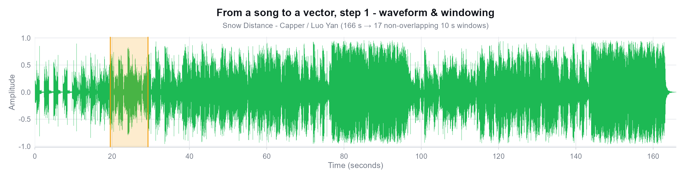
METHOD AND PIPELINE
How a song becomes a vector · ① waveform & windowing
Sample song: Snow Distance - Capper / Luo Yan (NetEase annual chart #1, 2023)
Why cut 10-second windows?
CLAP's audio encoder only accepts fixed-length input (~10 s). A 166 s song is cut into 17 non-overlapping windows; each window is encoded separately and averaged - so every section of the song is seen, not just the chorus.
13

Slide 14
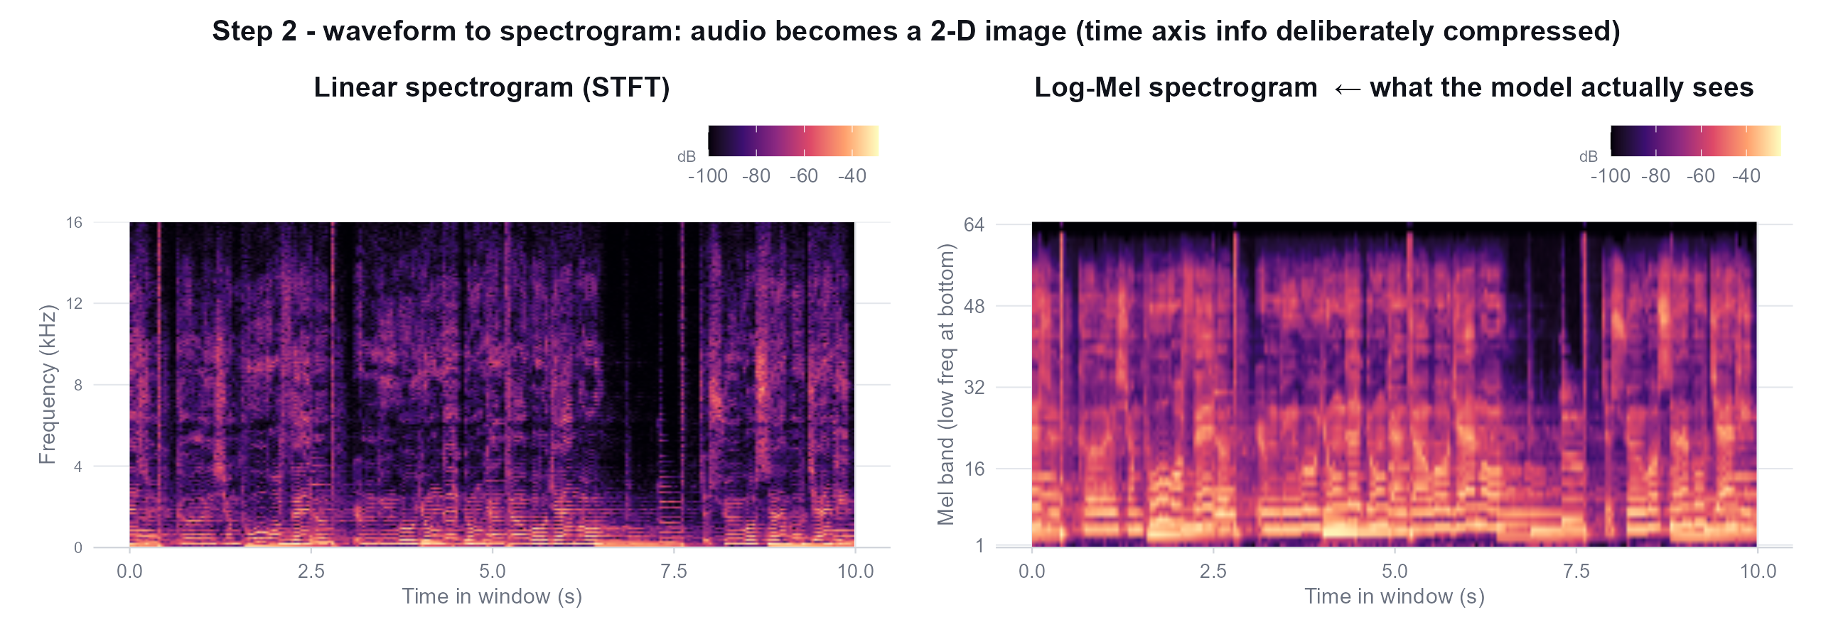
METHOD AND PIPELINE
How a song becomes a vector · ② waveform to spectrogram
The log-Mel spectrogram is the model's real input.
It warps linear frequency onto a scale that mimics the human ear (low-freq dense, high-freq sparse) and takes the log of magnitudes - that is how ears hear. From here on the model never sees the waveform again.
14

Slide 15
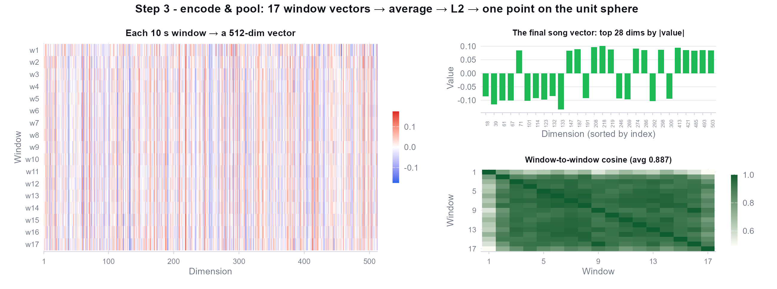
METHOD AND PIPELINE
How a song becomes a vector · ③ encode & pool
17 window vectors → average → L2 normalize → one song = one point in 512-dim space.
Window-to-window cosine averages 0.887 - sections of the same song are genuinely similar, so averaging is safe.
15

Slide 16
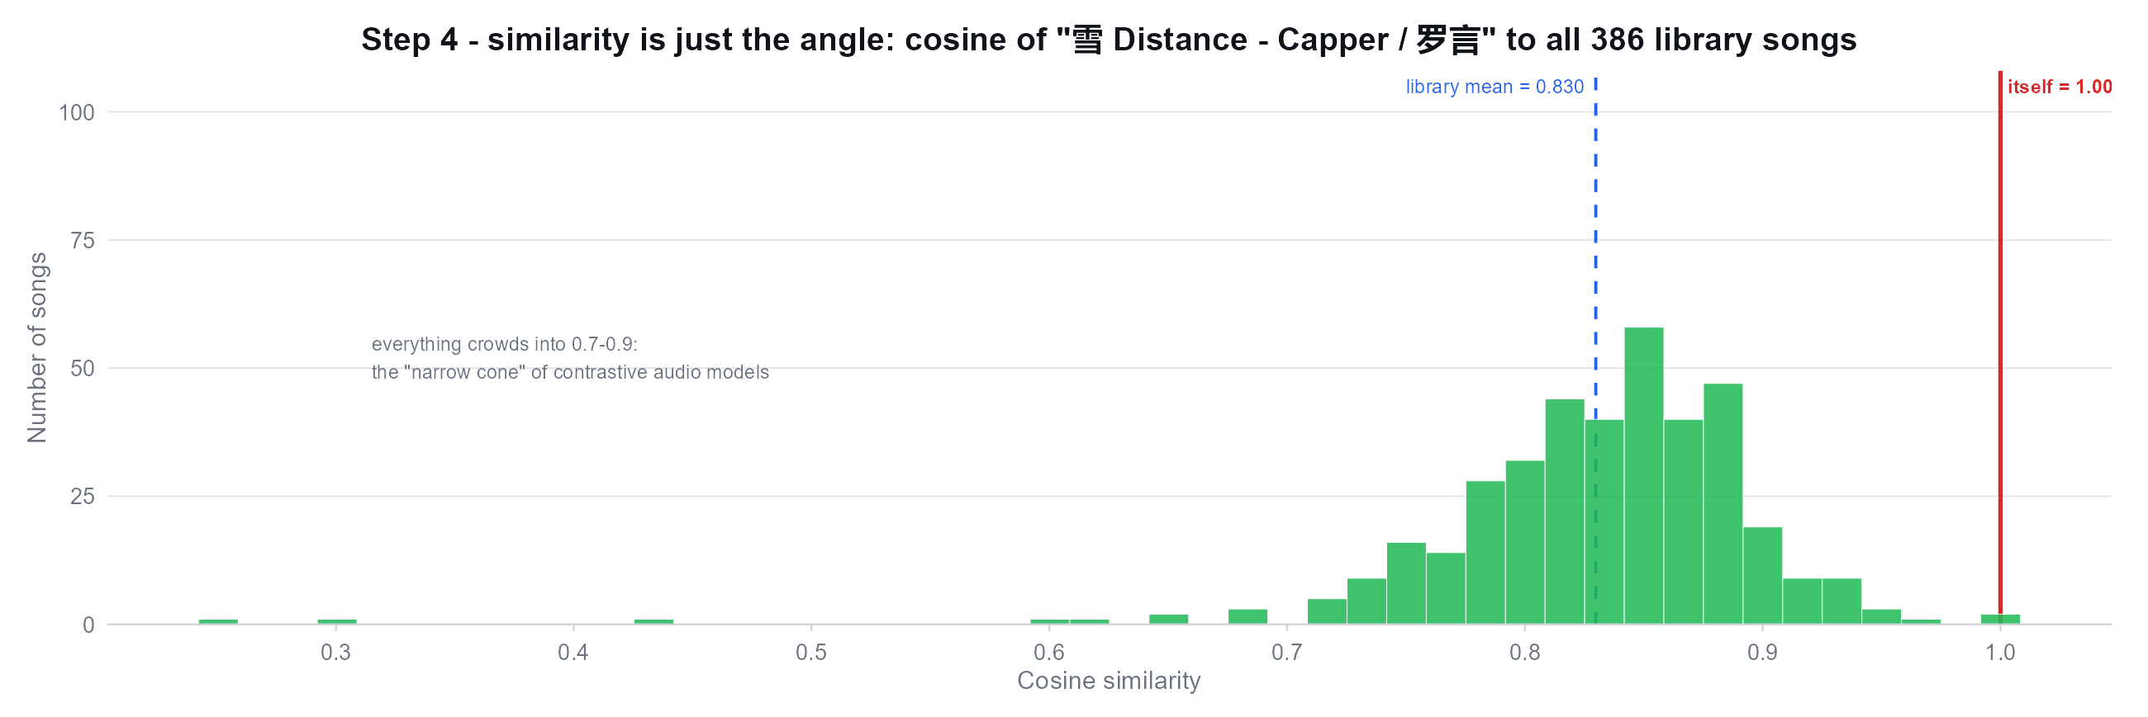
METHOD AND PIPELINE
How a song becomes a vector · ④ similarity = angle
Cosine only measures direction, not length.
Note the histogram: every library song sits at 0.7-0.9 (mean 0.830), not scattered around 0 - the “narrow cone effect” of contrastive audio models. It does not hurt ranking, but “similarity 0.85” never means “the same song”; only relative differences matter.
16

Slide 17
Part3
Data Analysis
Changepoints, correlations, genre drift — and the taste map

Slide 18
DATA ANALYSIS
Three changepoints — all p < 0.001
Year | Real-world event
2019 | Douyin reaches ~400M DAU; QQ launches the Douyin Hit chart (topId 60)
2020 | COVID-19 nationwide stay-at-home (Jan–Apr); TikTok passes 2B downloads
2022 | QQ launches the Guofeng Hot Songs chart (topId 65); post-COVID platform split
How we find them — R/05_changepoint.R
Stage 1 — BIC piecewise-linear fit. For each k ∈ {0…4}, fit a k-breakpoint piecewise-linear regression of yearly mean log-weeks-on-chart against year; BIC = n·log(RSS/n) + (k+3)·log(n) selects k = 3.
Stage 2 — Permutation test. Shuffle the yearly means 1,000×, refit k ∈ {0,1,2}, record each shuffle's minimum BIC; p = share of shuffled min-BIC ≤ observed. p < 0.001 → three changepoints are not noise.
Response: yearly mean log-weeks-on-chart — seven yearly means (2018–2024); k = 3 breakpoints → four segments.
Reading the 2020 break: post-lockdown acceleration, not the lockdown itself — COVID-Q1 was a 14-week industry contraction; the listening surge came in 2020-W27+ (R/15_covid_qq_features.R).
18

Slide 19
DATA ANALYSIS
Yearly offset from the 2018–19 baseline (Q1)
Toplist | 2018 | 2019 | 2020 | 2021 | 2022 | 2023 | 2024
Online Songs | -2 | +2 | +22 | +6 | +24 | +34 | +65
Mainland | +5 | -5 | +10 | -1 | +6 | +8 | -1
Hot Songs | -5 | +5 | +7 | +19 | -26 | – | –
Highlights
• Hot Songs 2022 = -26.3% — fewest songs broke into the top-10: hits rotated, fewer reached the front (the platform-split year).
• Online Songs 2024 = +64.9% — most top-10 reach in six years: the network / Douyin-crossover era.
• Mainland stays within ±10% — the chart front barely moves.
offset in percentage points vs the 2018–19 baseline (%)
How to read it — offset = per-year, per-toplist share of songs whose peak rank reaches the top-10, vs the 2018–19 baseline (R/16_yearly_offset.R). Positive = more songs break into the top-10 (rising hits); negative = fewer (rotating hits).
Changepoints say when the regime shifted; this heatmap says how big the shift was, per chart, per year. One sparse toplist (baseline coverage only in 2018) is omitted; Hot Songs 2023–24 are not shown in the source analysis.
19

Slide 20
DATA ANALYSIS
Cross-chart correlation — the 2022 flip
 | Hot Songs | Online | Mainland | EDM | Rap | Guofeng | Douyin
Hot Songs | 1.00 | 0.92 | 0.84 | -0.66 | -0.89 | 0.72 | -0.76
Online | 0.92 | 1.00 | 0.93 | -0.84 | 0.00 | 0.72 | 0.00
Douyin | -0.76 | 0.00 | 0.16 | -0.20 | -0.76 | 0.12 | 1.00
What flips
• Hot ↔ Douyin: +0.32 → -0.76 after the 2022 split.
• Hot ↔ Rap -0.89 — opposite rotation cycles.
• Online ↔ EDM -0.84 — opposite regimes.
The 2022 fingerprint: the Hot ↔ Douyin correlation flipped from +0.32 to -0.76 — Douyin hits stopped feeding the Hot Songs chart.
Correlation of yearly mean log-weeks-on-chart across QQ's seven toplists (R/07–08). Positive = two charts age songs in step; negative = one chart's staples are the other's fresh rotation. Green = positive, red = negative.
20

Slide 21
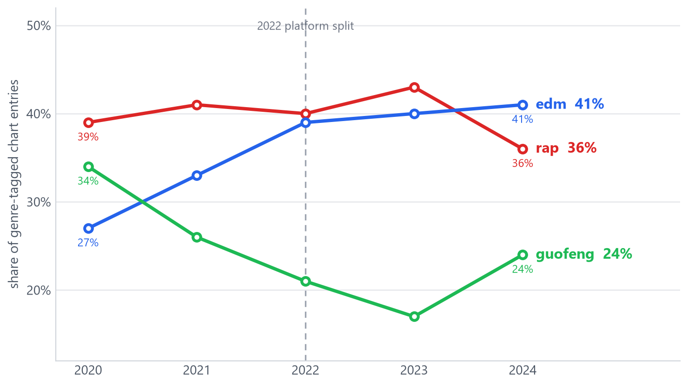
DATA ANALYSIS
Genre drift — edm up, guofeng down
What moved
• edm: the only genre that grew monotonically — 27% → 41% of tagged entries (2020 → 2024).
• guofeng: declined 34% → 24%; its dedicated QQ chart launched in 2022.
• rap: peaked at 43% in 2023, fell back to 36% in 2024.
Genre membership comes from official chart tags; the three genres partition the tagged subset.
Share of genre-tagged chart entries per year (rap + edm + guofeng ≈ 100%). Source: R/09_genre_drift.R — figure redrawn from the deck's table values in the deck palette.
21

Slide 22
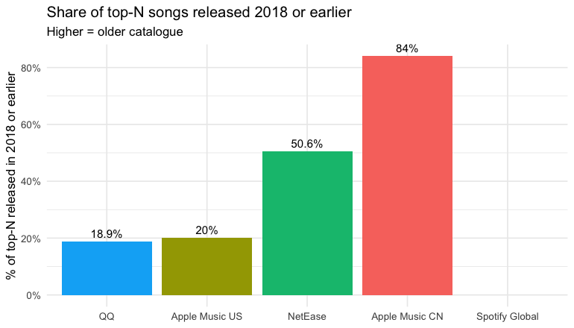
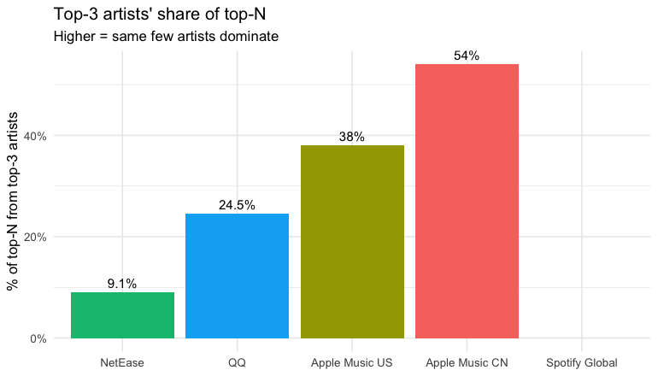
DATA ANALYSIS
Cross-region (Q2) — platform-conditional, not market-wide
Share of top-N released ≤ 2018 (higher = older catalogue)
Top-3 artists' share of top-N (higher = star concentration)
share_old (≤2018): QQ 18.9% · NetEase 50.6% · Apple CN 84.0% · Apple US 20.0%
top-3 artist share: QQ 24.5% · NetEase 9.1% · Apple CN 54.0% · Apple US 38.0% · artist Gini ≈ 0.32 on all four platforms
Key insight: 'old catalogue' + 'star concentration' are MORE extreme on Apple Music CN than on QQ — QQ's patterns are platform-conditional, not the Chinese-market pattern. Apple CN's top-3 = Jay Chou alone; NetEase's = many artists at 1–5 songs each.
22

Slide 23
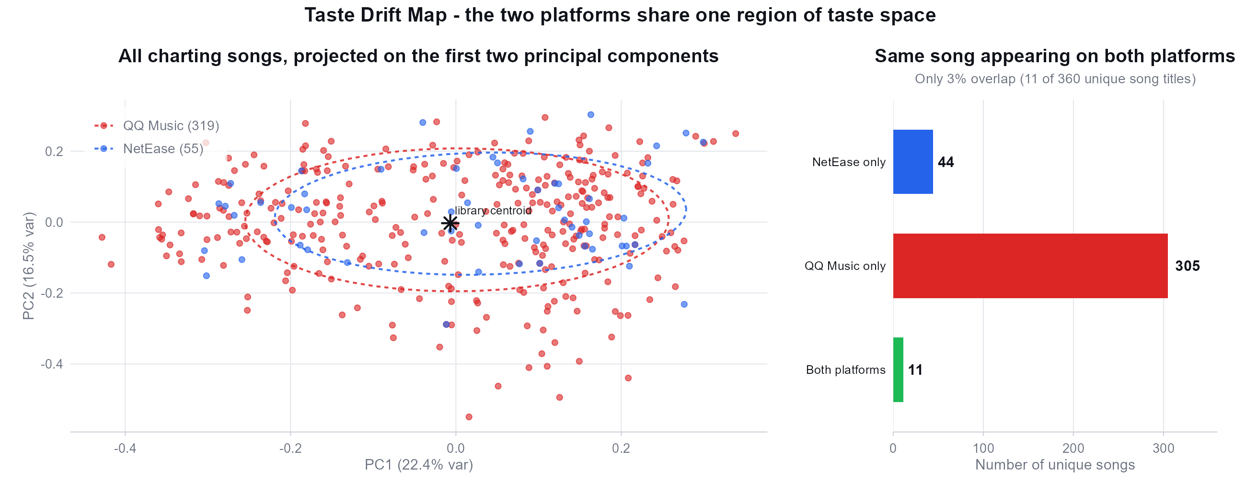
DATA ANALYSIS
The map: both platforms share one region
349 of 360 unique titles chart on one platform only, yet in vector space they all mix together - chart rosters differ, the style distribution of what gets picked does not.
23

Slide 24
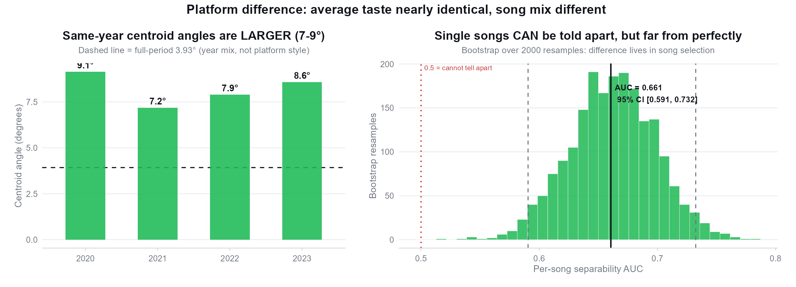
DATA ANALYSIS
Platform difference: averages identical, song mix different
Q1 answer: average taste is indistinguishable (full-period centroid angle 3.93°, inside the bootstrap noise band), but single songs are separable (AUC 0.66, 95% CI [0.59, 0.73]). Same-year angles (7-9°) exceed the full-period angle: the difference comes from year composition, not platform style.
24

Slide 25
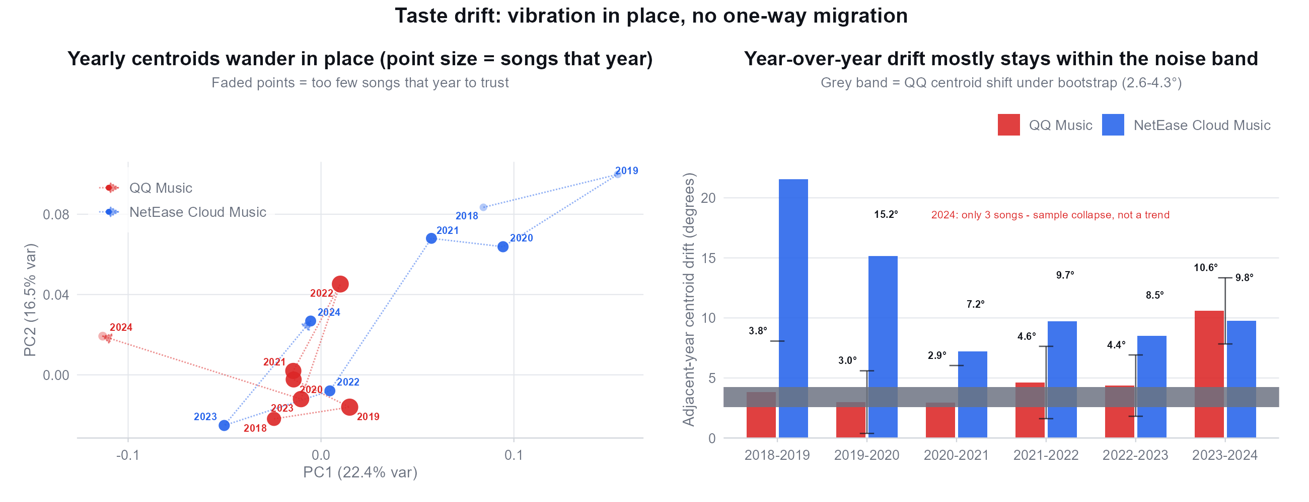
DATA ANALYSIS
How taste changes: vibration in place, no one-way drift
Q2 answer: total drift 2018→2023 is only 4.1° - smaller than a single year's swing (4.6°). Most year-over-year steps sit inside the bootstrap noise band (2.6-4.3°). NetEase 2018/19 jumps (21.6°/15.2°) are 2 songs compared to 2 songs - not interpretable.
25

Slide 26
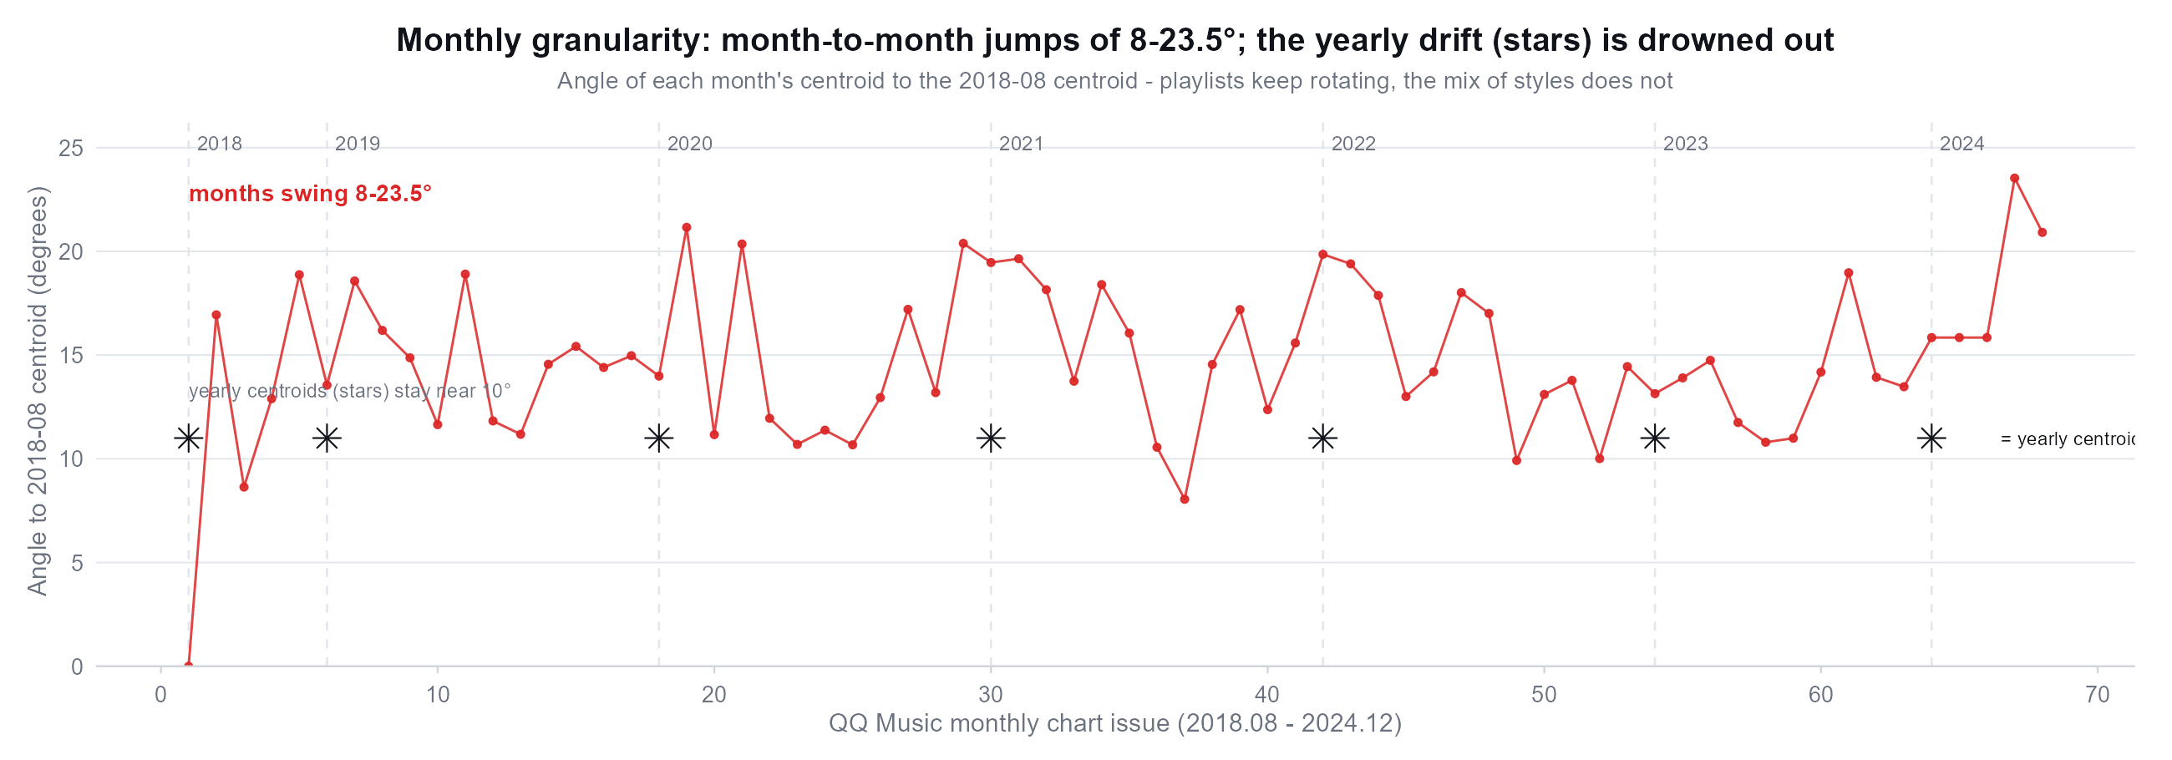
DATA ANALYSIS
Monthly granularity: fluctuation is the norm, trend is absent
Monthly centroids swing 8-23.5° against 2018-08, while yearly centroids (stars) hug the 10° line - the playlist keeps rotating, the mix of styles does not.
26

Slide 27
Part4
Insights & Limitations
What we learned — and what we cannot claim.

Slide 28
INSIGHTS & LIMITATIONS
Key Insights
01
Three regime shifts — 2019 · 2020 · 2022, all p < 0.001
Changepoints in QQ chart behaviour line up with the Douyin takeover, COVID-19, and the post-2022 platform split.
02
The 2022 structural flip
Hot ↔ Douyin correlation +0.32 → -0.76; edm grew monotonically (0.27 → 0.41) while guofeng declined (0.34 → 0.24).
03
Averages identical, song mixes different
349 of 360 titles chart on one platform only, yet their style distributions match (centroid 3.9°, inside the noise band; per-song AUC 0.66).
04
Vibration in place, not one-way drift
Six-year audio drift 4.1° is smaller than a single year's swing; monthly centroids oscillate 8–23.5° — songs rotate, the mix barely moves.
Also: COVID-Q1 2020 was a 14-week industry contraction, not listener-driven (surge came W27+); LOF vs Euclidean outliers overlap ~0% — complementary signals.
28

Slide 29
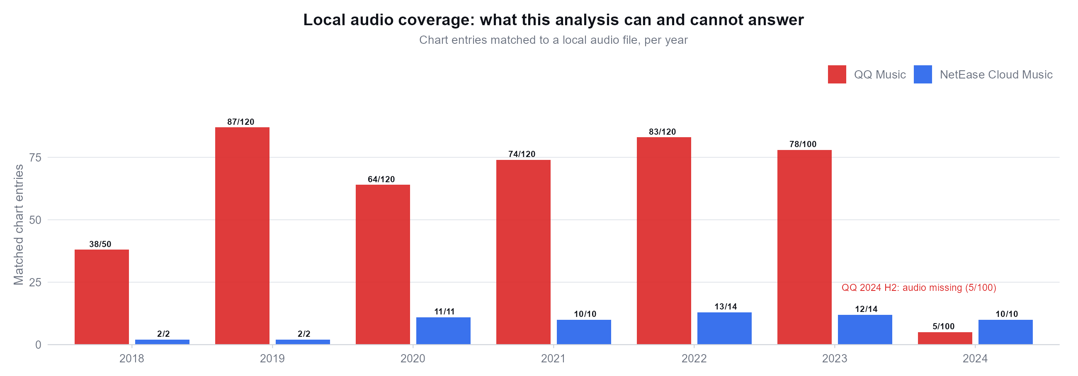
INSIGHTS & LIMITATIONS
What this analysis can and cannot answer
Three limitations we must state:
① QQ 2024 H2 audio is missing locally (5/100 chart entries → 3 unique songs), so that year's 10.6° jump is sample collapse; ② NetEase officially publishes only 1-2 songs for 2018/2019 - no yearly centroid possible; ③ NetEase has no monthly chart, so monthly fluctuation can only be measured on QQ.
29

Slide 30
Part5
Conclusion
Three answers, future works, references

Slide 31
CONCLUSION
Three questions, three answers
Q1
Regime shifts — yes
2019, 2020, 2022 are statistically significant regime shifts in QQ chart behaviour (BIC k = 3, permutation p < 0.001). Hot ↔ Douyin correlation flipped from +0.32 to strongly negative after 2022.
Q2
Platform-conditional, not market-wide — yes
The four platforms differ structurally in catalogue freshness and star concentration. QQ is the balanced Chinese platform; Apple Music CN is the most old-catalogue and star-driven.
Q3
The sound — stable
Average style is indistinguishable across platforms (3.9°, inside the noise band) and years (2018→2023 drift 4.1° < one year's swing). What changes is which songs chart — separable per song (AUC 0.66).
M
One pipeline, two lenses
Python fetch + R analysis + CLAP embeddings, reproducible end-to-end. Swap in new charts or audio and every figure regenerates.
FUTURE WORKS
① weekly cross-platform history, once any public source exposes it ② per-song play counts (login-gated) ③ larger licence-clean audio corpus + richer encoders (MERT / Jukebox)
Audio embeddings (CLAP) were listed as future work in the metadata-only draft — delivered in this presentation.
31

Slide 32
CONCLUSION
References
Serrà, J. et al. (2012). Measuring the evolution of contemporary western popular music. Scientific Reports.
Mauch, M. et al. (2015). The evolution of popular music: USA 1960–2010. Royal Society Open Science.
Li, Y. et al. (2023). MERT: acoustic music understanding model with large-scale self-supervised training. IJCAI. (cited for context)
Elizalde, B. et al. (2023). CLAP: learning audio concepts from natural language supervision. ICASSP. — source of all 512-d audio embeddings
Wu, Y. et al. (2022). HTS-AT: a hierarchical token-semantic audio transformer. ICASSP. — CLAP's audio encoder
Data & code. QQ / NetEase / Apple public endpoints · R 4.2.3 + renv (69 packages) · pandoc 3.1.13 · taste-map figures from r_project/ (R) + matplotlib.
Jiang Chuyang (3036589703) · Liu Yibo (3036589636) — HKU COMP2501 · Section 1SH · October 2026
32

Slide 33
Thank You
Have a nice day with your music player

