Slide 1
Listen to the Long Now
Chinese Chart – Listener Behavior Across Years
Presented by Jiang Chuyang Liu Yibo
October 2026

Slide 2
OVERVIEW
Agenda
01
Project Background What is it? Why is it important?
02
Method and Pipeline How a mp3 file becomes a vector?
03
Data Analysis Visual stories from the data
04
Insights & Limitations What we learned — and what we cannot claim
05
Conclusion Takeaways and next steps
2

Slide 3
Part1
Project Background
What is it? Why is it important?

Slide 4
Background
Motivation & Why it matters?
4

Slide 5
Background
Information Resources
4

Slide 6
Part2
Method and Pipeline
How a mp3 file becomes a vector?

Slide 7
Method and Pipeline
The Analytical Workflow
1
2
3
4
5
6

Slide 8
Method and Pipeline
Realization via Scripts
7

Slide 9
Part3
Data Analysis
Visual stories from the data.

Slide 10
Data Analysis
The Dataset at a Glance
9

Slide 11
Part4
Insights & Limitations
What we learned — and what we cannot claim.

Slide 12
FINDINGS
Key Insights
01
02
03
04
11

Slide 13
FINDINGS
Limitations & Ethical Notes
12

Slide 14
Part5
Conclusion
Takeaways

Slide 15
WRAP-UP
Conclusion
14

Slide 16
Thank You
Have a nice day with your music player

Slide 17
Part 6 · New analysis
Taste Drift Map
CLAP vectors of 374 charted songs - two questions, three answers

Slide 18
TASTE MAP · DATA
What data we used, and how it became vectors
01
Two charts
QQ Music monthly Top10, 730 entries (2018.8-2024.12) + NetEase Cloud Music annual song chart, 63 entries (2018-2024)
02
Matched to local audio
Normalized-title matching against local MP3s: QQ Music hit 429 entries / 319 songs (58.8%), NetEase 60 / 55 (95.2%)
03
Each song → a 512-dim vector
CLAP (laion/clap-htsat-unfused): 48 kHz mono → 10 s windows, 10 s hop → log-Mel spectrogram → HTS-AT encoder → window average → L2
04
374 unique songs, one shared space
Every vector lives in the same 512-dim space, so platforms and years are directly comparable. GPU vectorization: 4.7 min, 0 failures.
18

Slide 19
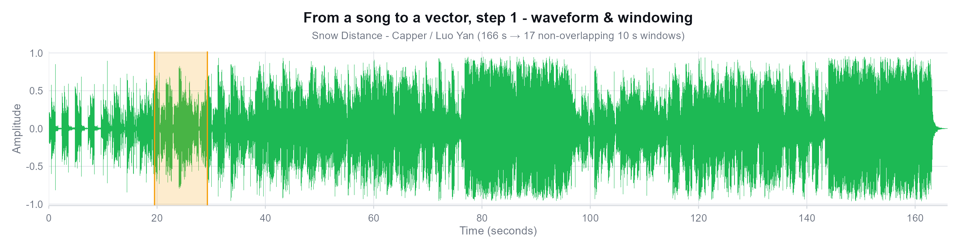
TASTE MAP · METHOD
How a song becomes a vector · ① waveform & windowing
Sample song: Snow Distance - Capper / Luo Yan (NetEase annual chart #1, 2023)
Why cut 10-second windows?
CLAP's audio encoder only accepts fixed-length input (~10 s). A 166 s song is cut into 17 non-overlapping windows; each window is encoded separately and averaged - so every section of the song is seen, not just the chorus.
19

Slide 20
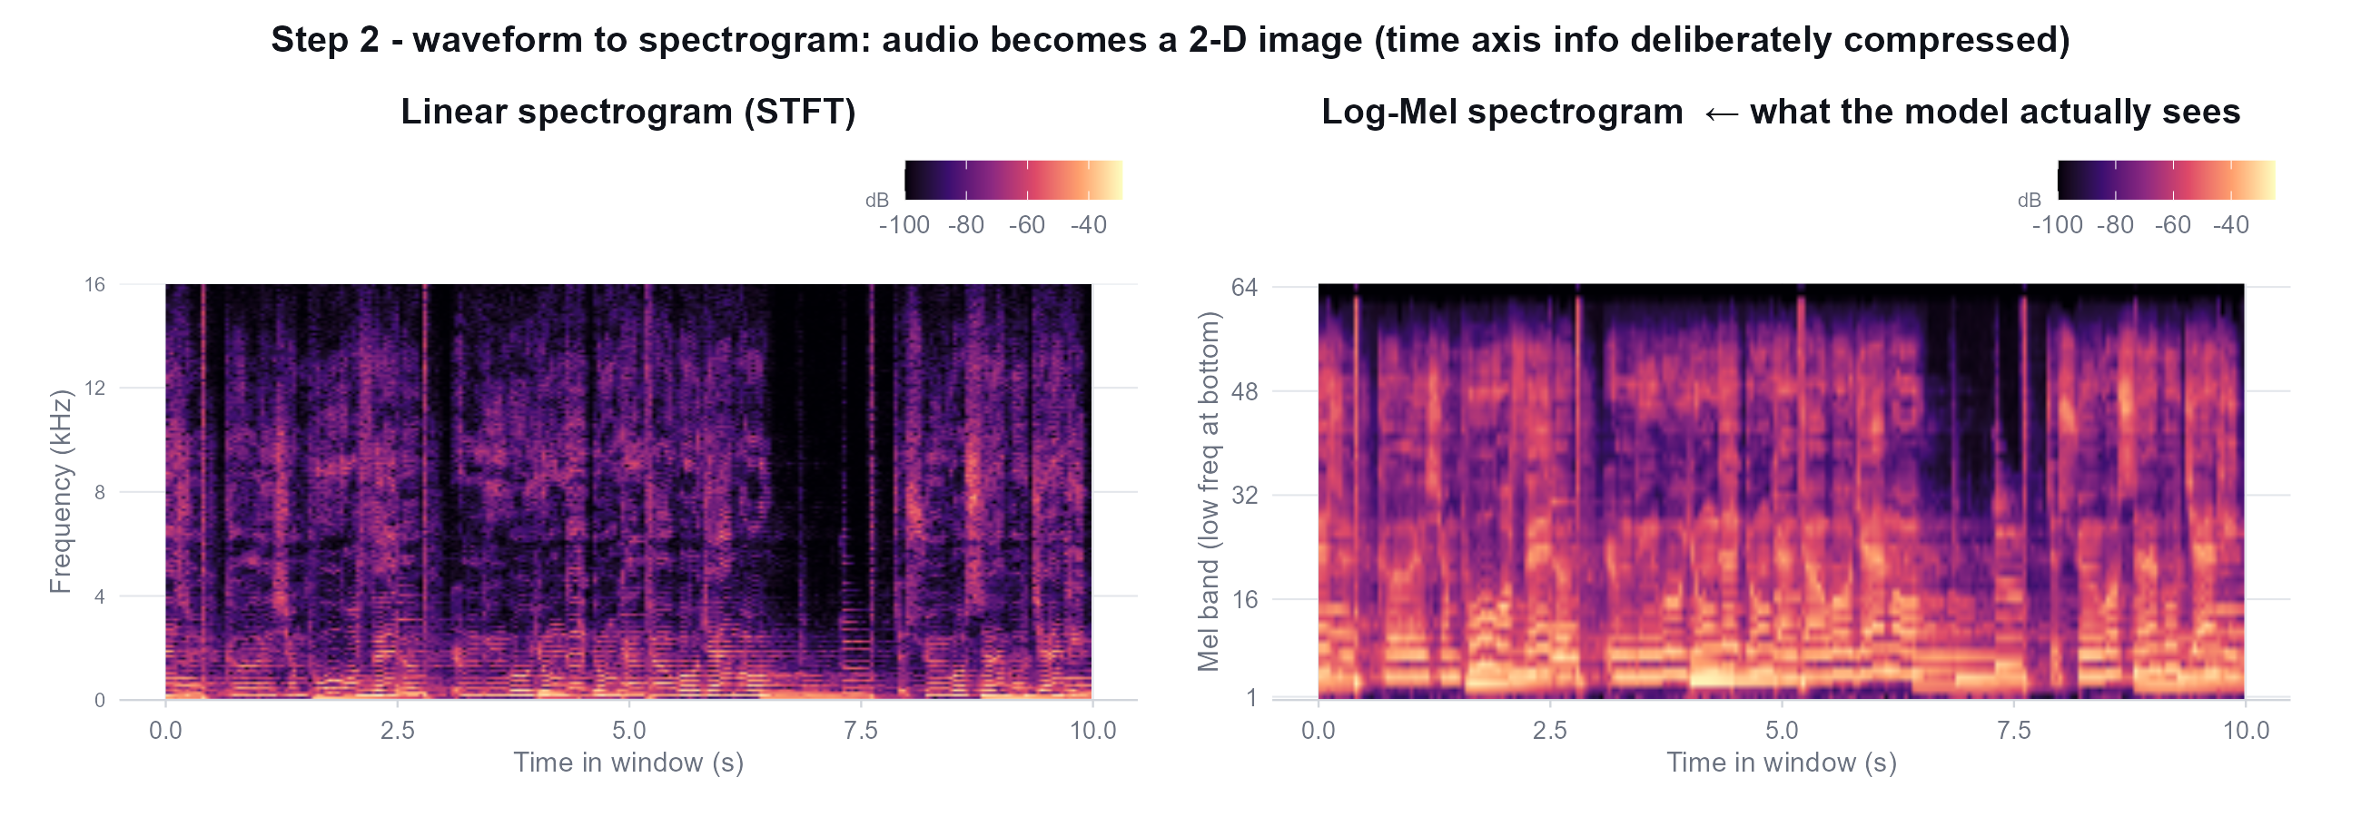
TASTE MAP · METHOD
How a song becomes a vector · ② waveform to spectrogram
The log-Mel spectrogram is the model's real input.
It warps linear frequency onto a scale that mimics the human ear (low-freq dense, high-freq sparse) and takes the log of magnitudes - that is how ears hear. From here on the model never sees the waveform again.
20

Slide 21
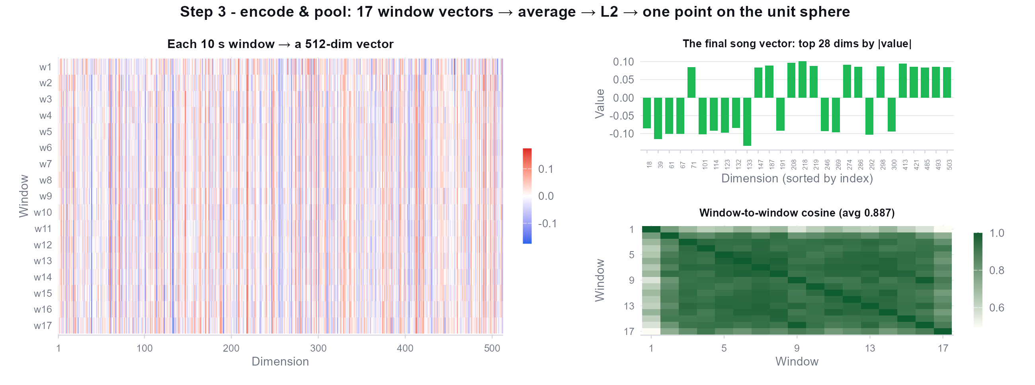
TASTE MAP · METHOD
How a song becomes a vector · ③ encode & pool
17 window vectors → average → L2 normalize → one song = one point in 512-dim space.
Window-to-window cosine averages 0.887 - sections of the same song are genuinely similar, so averaging is safe.
21

Slide 22
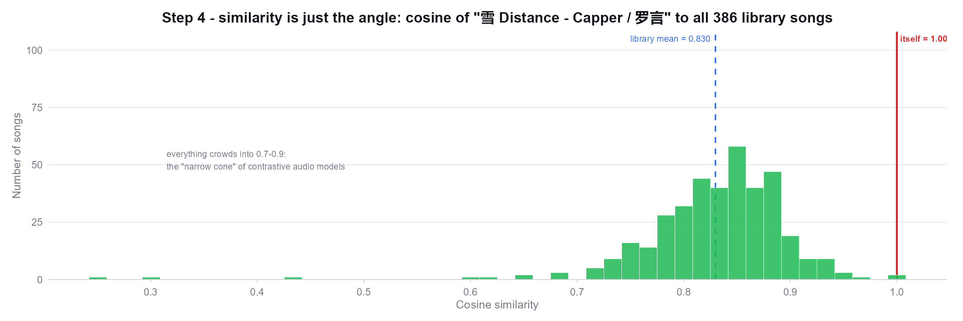
TASTE MAP · METHOD
How a song becomes a vector · ④ similarity = angle
Cosine only measures direction, not length.
Note the histogram: every library song sits at 0.7-0.9 (mean 0.830), not scattered around 0 - the “narrow cone effect” of contrastive audio models. It does not hurt ranking, but “similarity 0.85” never means “the same song”; only relative differences matter.
22

Slide 23
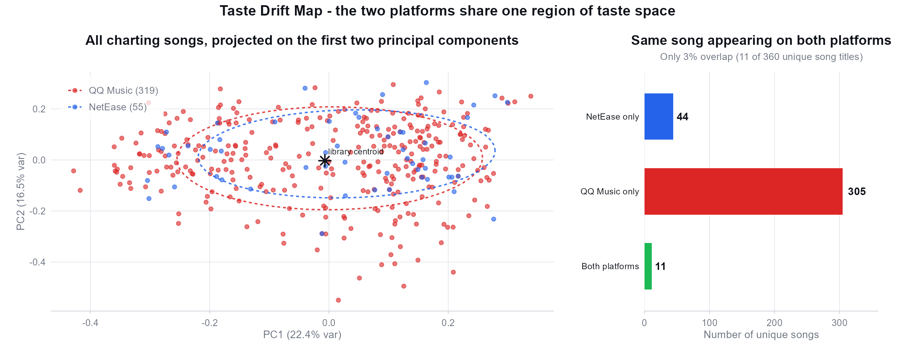
TASTE MAP · RESULT
The map: both platforms share one region
349 of 360 unique titles chart on one platform only, yet in vector space they all mix together - chart rosters differ, the style distribution of what gets picked does not.
23

Slide 24
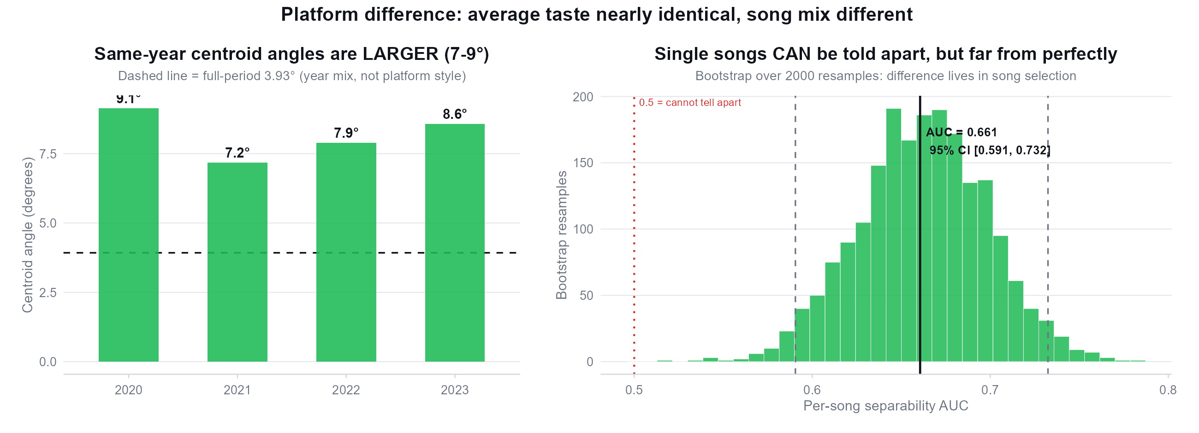
TASTE MAP · FINDING 1
Platform difference: averages identical, song mix different
Q1 answer: average taste is indistinguishable (full-period centroid angle 3.93°, inside the bootstrap noise band), but single songs are separable (AUC 0.66, 95% CI [0.59, 0.73]). Same-year angles (7-9°) exceed the full-period angle: the difference comes from year composition, not platform style.
24

Slide 25
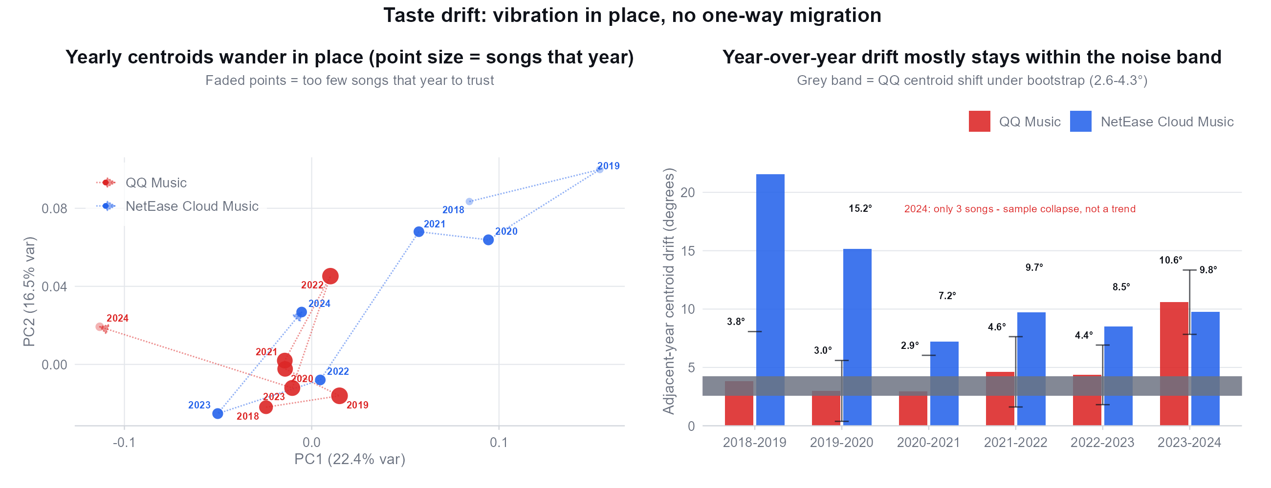
TASTE MAP · FINDING 2
How taste changes: vibration in place, no one-way drift
Q2 answer: total drift 2018→2023 is only 4.1° - smaller than a single year's swing (4.6°). Most year-over-year steps sit inside the bootstrap noise band (2.6-4.3°). NetEase 2018/19 jumps (21.6°/15.2°) are 2 songs compared to 2 songs - not interpretable.
25

Slide 26
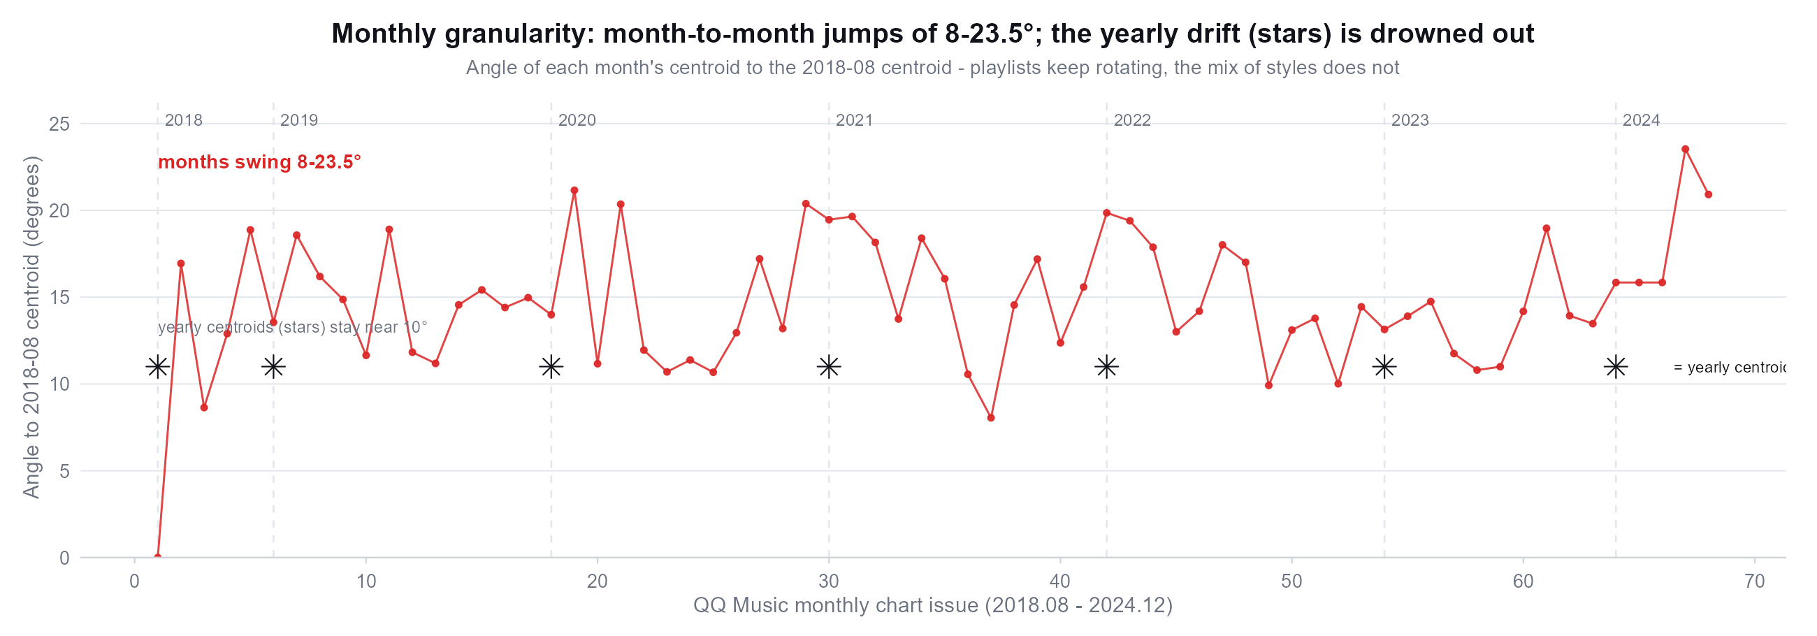
TASTE MAP · RESULT
Monthly granularity: fluctuation is the norm, trend is absent
Monthly centroids swing 8-23.5° against 2018-08, while yearly centroids (stars) hug the 10° line - the playlist keeps rotating, the mix of styles does not.
26

Slide 27
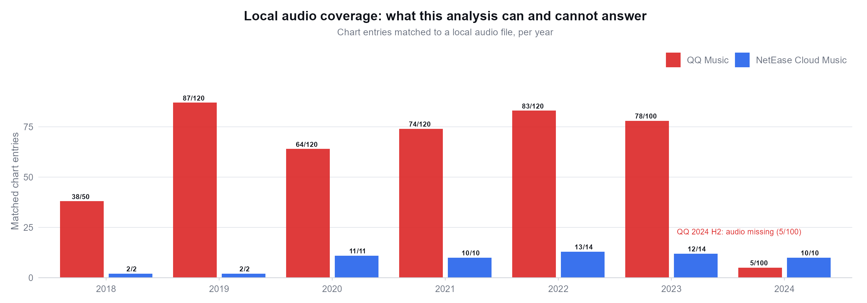
TASTE MAP · BOUNDARIES
What this analysis can and cannot answer
Three limitations we must state:
① QQ 2024 H2 audio is missing locally (5/100 chart entries → 3 unique songs), so that year's 10.6° jump is sample collapse; ② NetEase officially publishes only 1-2 songs for 2018/2019 - no yearly centroid possible; ③ NetEase has no monthly chart, so monthly fluctuation can only be measured on QQ.
27

Slide 28
TASTE MAP · SUMMARY
Three questions, three answers
Q1
Platform difference - averages identical, mixes different
Full-period centroid angle 3.93° (noise band 2.6-4.3°) → no real difference in average taste; per-song AUC 0.66 [0.59, 0.73] → which songs chart is systematically different; same-year angles 7-9° → difference comes from year composition, not platform style.
Q2
Taste change - vibration in place, no one-way migration
QQ Music 2018-2023 total drift 4.1° (smaller than one year's swing); monthly jumps 8-23.5°; NetEase 2020+ oscillates 7-10° yearly. Change happens in specific songs (rosters rotate almost completely), not in the average style.
Q3
Method - one song = one point on the 512-dim unit sphere
10 s windows → log-Mel spectrogram → HTS-AT encoder → window average → L2 normalize. Similarity = cosine (angle). All 374 songs share one space, so platforms and years are directly comparable.
Reproducible pipeline: swap in a new chart CSV + audio → export_for_r.py → R scripts (r_project/) regenerate every figure.
28

