Slide 1
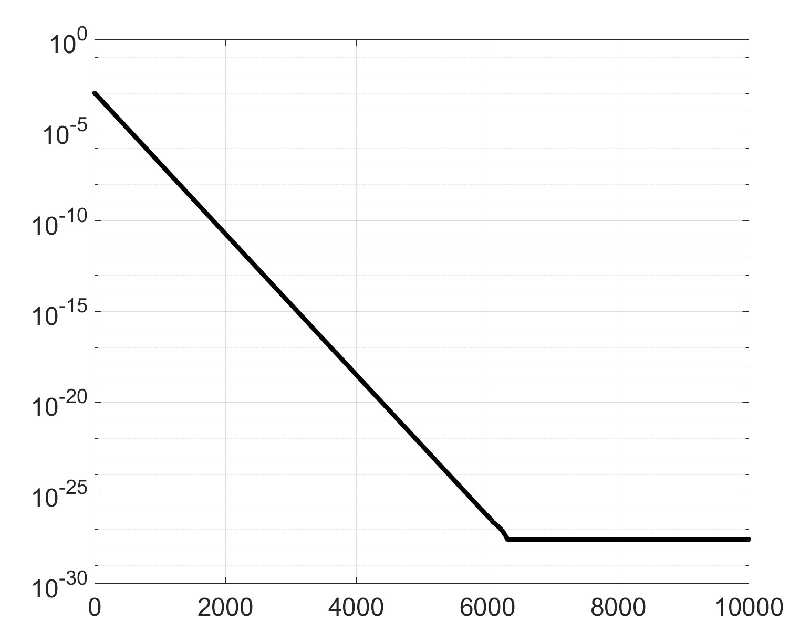
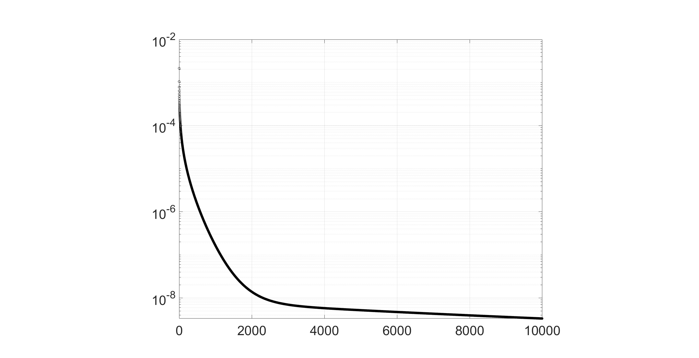
Lennard Jones potential
Quadratic potential
Generate data
Generate data
Estimate positions and parameters
Estimate positions and parameters
Guess ->
Guess ->
Output parameter set
Output parameter set

