Slide 1

Numerical Questions Computer Networks(CS31204)
Prof. Sudip Misra
Department of Computer Science and Engineering
Indian Institute of Technology Kharagpur
Email: smisra@sit.iitkgp.ernet.in Website: http://cse.iitkgp.ac.in/~smisra/ Research Lab: cse.iitkgp.ac.in/~smisra/swan/

Slide 2

Question No. 1
Bit-stuff the following frame payload:
Prof. Sudip Misra, IIT Kharagpur

Slide 3
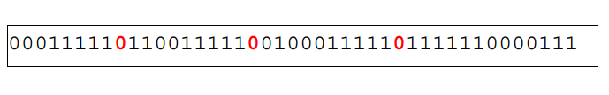
Solution
Prof. Sudip Misra, IIT Kharagpur

Slide 4
Question No. 2
Unstuff the following frame payload:
Prof. Sudip Misra, IIT Kharagpur

Slide 5
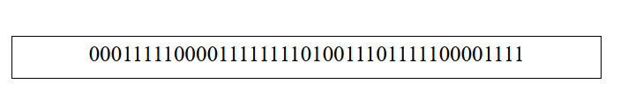
Solution
Prof. Sudip Misra, IIT Kharagpur

Slide 6
Question No. 3
Draw figure using the following scenario:
a. The first frame is sent and acknowledged. b. The second frame is sent and acknowledged, but the acknowledgment is lost. c. The second frame is resent, but it is timed-out. d. The second frame is resent and acknowledged.
Prof. Sudip Misra, IIT Kharagpur

Slide 7
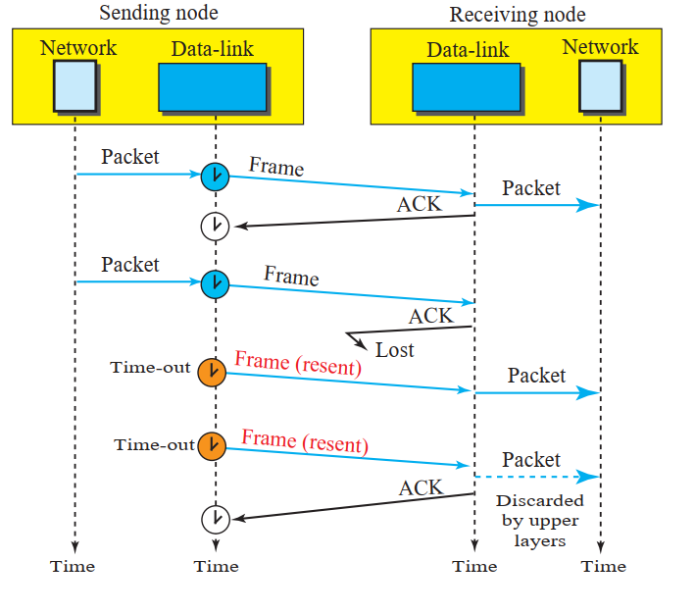
Solution
Prof. Sudip Misra, IIT Kharagpur

Slide 8
Question No. 4
Draw figure using the following scenario: a. Frame 0 is sent, but lost. b. Frame 0 is resent and acknowledged. c. Frame 1 is sent and acknowledged, but the acknowledgment is lost. d. Frame 1 is resent and acknowledged.
Prof. Sudip Misra, IIT Kharagpur

Slide 9
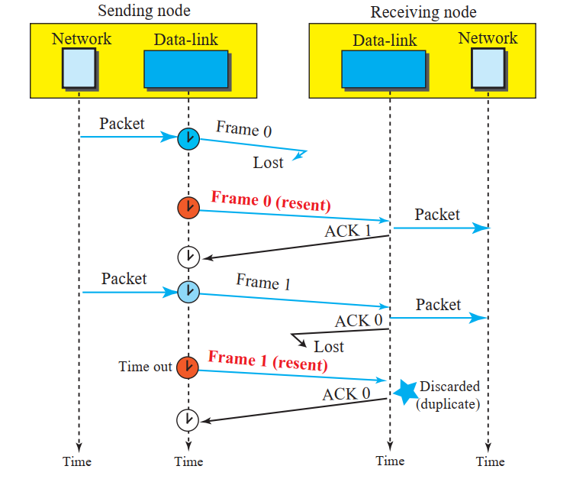
Solution
Prof. Sudip Misra, IIT Kharagpur

Slide 10
Question No. 5
Assume that a voice channel occupies a bandwidth of 4 kHz. We need to multiplex 10 voice channels with guard bands of 500 Hz using FDM. Calculate the required bandwidth.
Prof. Sudip Misra, IIT Kharagpur

Slide 11
Solution
To multiplex 10 voice channels, we need nine guard bands. The required bandwidth is then B = (4 KHz) × 10 + (500 Hz) × 9 = 44.5 KHz
Prof. Sudip Misra, IIT Kharagpur

Slide 12
Question No. 6
We need to transmit 100 digitized voice channels using a passband channel of 20 KHz. Each digitized voice channel has a data rate of 64 Kbps. What should be the ratio of bits/Hz if we use no guard band?
Prof. Sudip Misra, IIT Kharagpur

Slide 13
Solution
The bandwidth allocated to each voice channel is 20 KHz / 100 = 200 Hz. Each digitized voice channel has a data rate
of 64 Kbps. This means that our modulation technique uses 64,000/200 = 320 bits/Hz.
Prof. Sudip Misra, IIT Kharagpur

Slide 14
Question No. 7
We need to use synchronous TDM and combine 20 digital sources, each of 100 Kbps. Each output slot carries 1 bit from each digital source, but one extra bit is added to each frame for synchronization. Answer the following questions:
a. What is the size of an output frame in bits?
b. What is the output frame rate?
c. What is the duration of an output frame?
d. What is the output data rate?
e. What is the efficiency of the system (ratio of useful bits to the total bits)?
Prof. Sudip Misra, IIT Kharagpur

Slide 15
Solution
a. Each output frame carries 1 bit from each source plus one extra bit for synchronization. Frame size = 20 × 1 + 1 = 21 bits.
b. Each frame carries 1 bit from each source. Frame rate = 100,000 frames/s.
c. Frame duration = 1 /(frame rate) = 1 /100,000 = 10 ms.
d. Data rate = (100,000 frames/s) × (21 bits/frame) = 2.1 Mbps
e. In each frame 20 bits out of 21 are useful. Efficiency = 20/21= 95%
Prof. Sudip Misra, IIT Kharagpur

Slide 16
Question No. 8
We have 14 sources, each creating 500 8-bit characters per second. Since only some of these sources are active at any moment, we use statistical TDM to combine these sources using character interleaving. Each frame carries 6 slots at a time, but we need to add 4-bit addresses to each slot. Answer the following questions:
a. What is the size of an output frame in bits?
b. What is the output frame rate?
c. What is the duration of an output frame?
d. What is the output data rate?
Prof. Sudip Misra, IIT Kharagpur

Slide 17
Solution
a. Frame size = 6 × (8 + 4) = 72 bits.
b. We can assume that we have only 6 input lines. Each frame needs to carry one character from each of these lines. This means that the frame rate is 500 frames/s.
c. Frame duration = 1 /(frame rate) = 1 /500 = 2 ms.
d. Data rate = (500 frames/s) × (72 bits/frame) = 36 kbps.
Prof. Sudip Misra, IIT Kharagpur

Slide 18
Question No. 9
Four channels are multiplexed using TDM. If each channel sends 100 bytes/s and we multiplex 1 byte per channel, show the frame traveling on the link, the size of the frame, the duration of a frame, the frame rate, and the bit rate for the link.
Prof. Sudip Misra, IIT Kharagpur

Slide 19
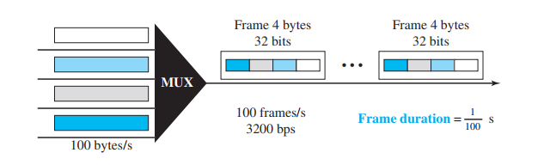
Solution
Each frame carries 1 byte from each channel; the size of each frame, therefore, is 4 bytes, or 32 bits. Because each channel is sending 100 bytes/s and a frame carries 1 byte from each channel, the frame rate must be 100 frames per second. The duration of a frame is therefore 1/100 s. The link is carrying 100 frames per second, and since each frame contains 32 bits, the bit rate is 100 × 32, or 3200 bps. This is actually 4 times the bit rate of each channel, which is 100 × 8 = 800 bps.
Prof. Sudip Misra, IIT Kharagpur

Slide 20
Question No. 10
Suppose a device in a pure Aloha network is transmitting packets of data that are 1,000 bits in length. The speed of 500m channel is 2*10⁸m/s. What is the vulnerable time of the device's transmission?
Prof. Sudip Misra, IIT Kharagpur

Slide 21
Solution
Vulnerable Time = 2* (Distance) / (Speed)
Vulnerable Time = 2* (500m) / (2* 10⁸) = 5μs
So the vulnerable time of the device's transmission is 5μs.
Prof. Sudip Misra, IIT Kharagpur

Slide 22
Question No. 11
Suppose a device in a slotted Aloha network is transmitting packets of data that are 1,000 bits in length. The speed of 1km channel is 2*10⁸m/s. What is the vulnerable time of the device's transmission?
Prof. Sudip Misra, IIT Kharagpur

Slide 23
Solution
Vulnerable Time = Propagation Time= Distance / Speed
Vulnerable Time = (1000m) / (2* 10⁸) = 5μs
So the vulnerable time of the device's transmission is 5μs.
Prof. Sudip Misra, IIT Kharagpur

Slide 24
Question No. 12
In a pure Aloha network with G = 1/2, how is the throughput affected in each of the following cases?
G is increased to 1.
b. G is decreased to 1/4.
Prof. Sudip Misra, IIT Kharagpur

Slide 25
Solution
In a pure Aloha, the throughput at G = 1/2 is 18.4% (maximum value).
a. When G = 1, the throughput is decreased to 13.5%. b. When G = 1/4, the throughput is decreased to 15.2%.
Prof. Sudip Misra, IIT Kharagpur

Slide 26
Question No.13
Assume the propagation delay in a broadcast network is 5 μs and the frame transmission time is 10 μs. a. How long does it take for the first bit to reach the destination? b. How long does it take for the last bit to reach the destination after the first bit has arrived? c. How long is the network involved with this frame (vulnerable to collision)?
Prof. Sudip Misra, IIT Kharagpur

Slide 27
Solution
The last bit is 10 μs behind the first bit. a. It takes 5 μs for the first bit to reach the destination. b. The last bit arrives at the destination 10 μs after the first bit. c. The network is involved with this frame for 5 + 10 = 15 μs.
Prof. Sudip Misra, IIT Kharagpur

Slide 28
Thank You!!!

