Slide 1



Deterministic Finite Automata
Wade Towns, Abigail Riley, Hamza Salahuddin

Slide 2
Contents
DFA
Intro to DFAs
Purpose of a DFA
Java
Accepted & Denied String Pictures
Python
Accepted & Denied String Pictures

Slide 3
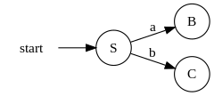
What is a DFA?
A Deterministic Finite Automaton (DFA) is a theoretical model of computation used to represent and control a finite number of states. It consists of five elements which are listed below:
States: Q
Alphabet: Σ
Transition Function: δ
Start State: q₀
Accept States: F

Slide 4
Why do we use DFAs
DFAs are foundational in theoretical computer science and practical applications, providing a structured way to model and analyze systems and processes. They play a crucial role in various domains, from compiler design to automated verification and beyond.

Slide 5
Text File
{0,1,2}
{w,x,y,z}
w
{z}
(w,0)->x
(w,1)->w
(w,2)->w
(x,0)->x
(x,1)->y
(x,2)->w
(y,0)->x
(y,1)->w
(y,2)->z
(z,0)->z
(z,1)->z
(z,2)->z
String accepted - any combination of the binary string "012"
String denied - any combination that is the not binary string "012"

Slide 6
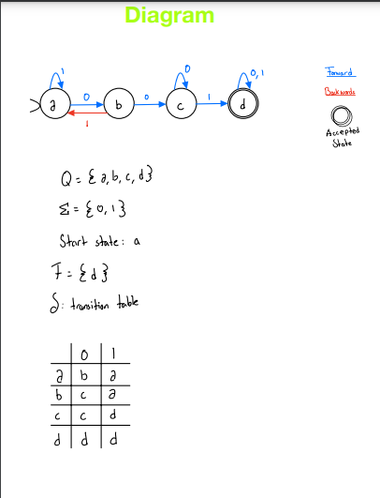
State Diagram & Regular Language Explanation from sample dfa
This is a DFA that recognizes the regular language over {0,1} that contains the substring 001.
Regular expression: 001(0|1)*

Slide 7
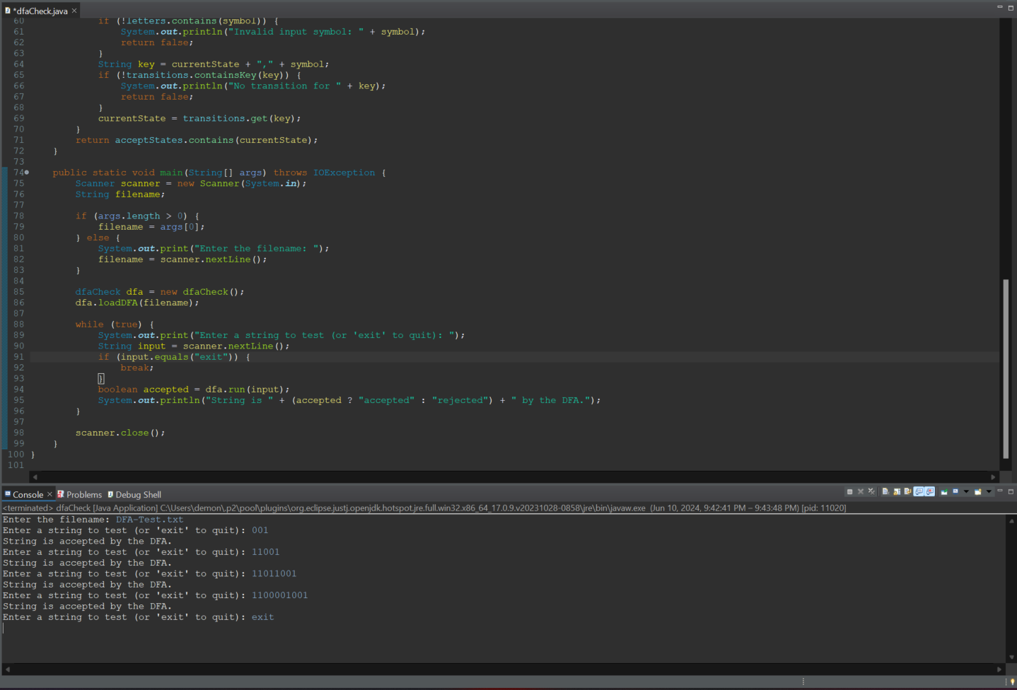
Sample DFA Accepted - Java
This is a DFA that recognizes the regular language over {0,1} that contains the substring 001.

Slide 8
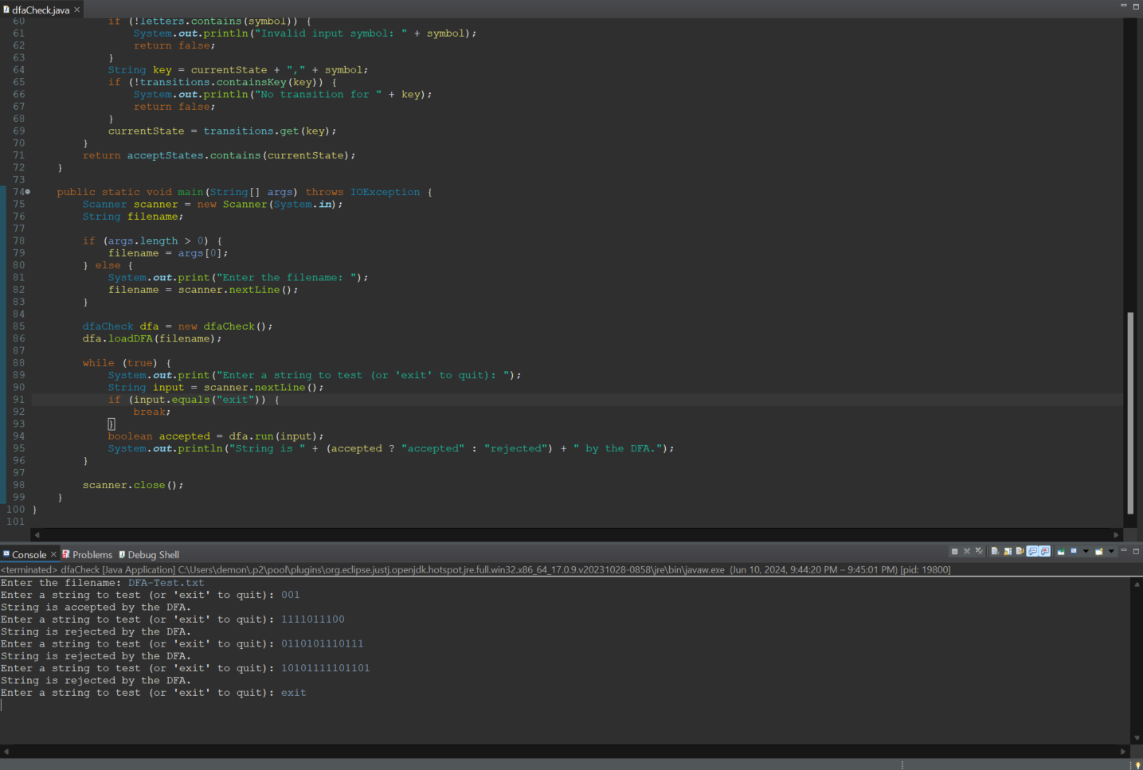
SAMPLE DFA REJECTED - Java
This is a DFA that recognizes the regular language over {0,1} that contains the substring 001.

Slide 9
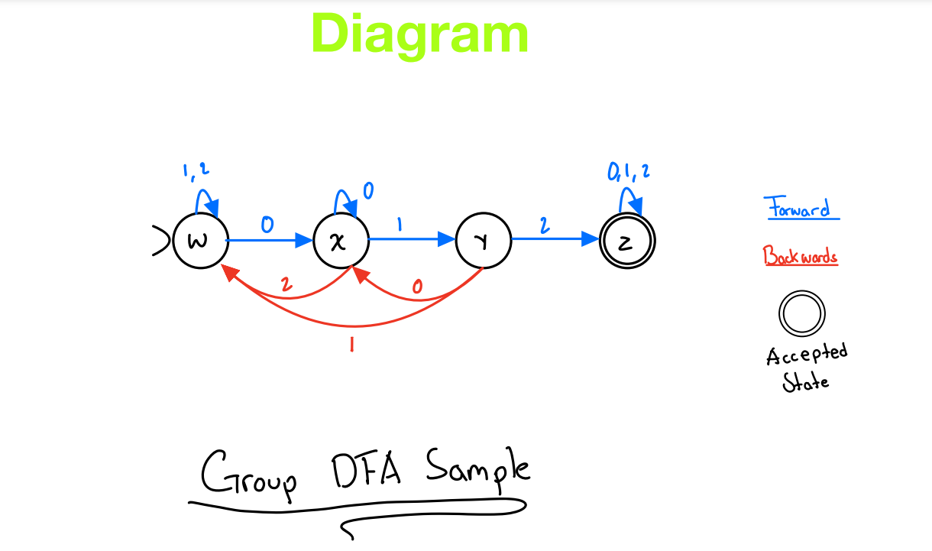
State Diagram & Regular Language Explanation
This is a DFA that recognizes the regular language over {0,1,2} that contains the substring 012.
Regular Expression:
(1|2)*0 ∙ (0* ∙ 1 ∙ (1|2)*0 ∙ (0|1)*2(0|1|2)*)

Slide 10
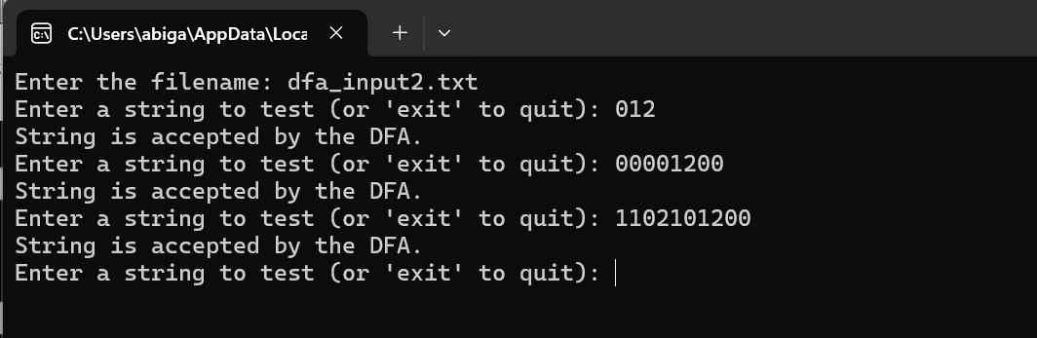
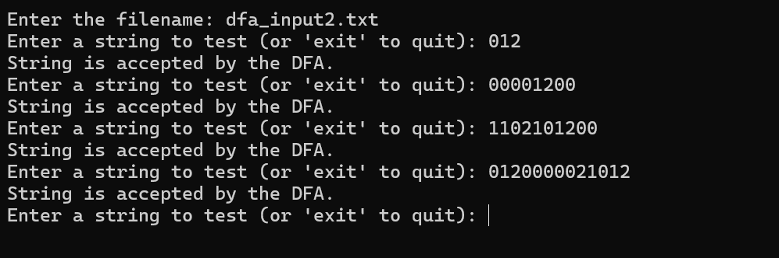
Accepted Strings - Python

Slide 11
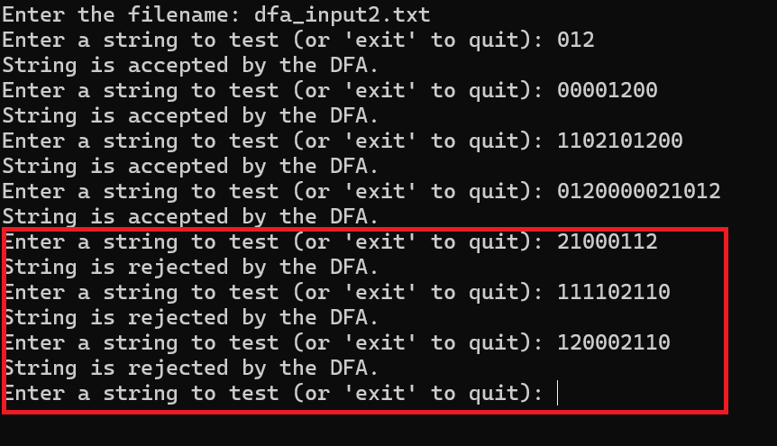
Rejected Strings - Python

Slide 12
Conclusion
A DFA is a simple yet powerful model that underpins many concepts in computer science, especially in the theory of computation and language processing.
They provide a framework for understanding and working with regular languages, contribute to efficient algorithm design, and serve as a basis for advancing to more sophisticated computational models. Their deterministic and finite nature makes them both powerful and practical for numerous applications in technology and computation.

