Slide 1
Classification of Inflammatory Bowel Disease Using Microbial Taxonomic Abundance
Final dataset: HMP2 / IBDMDB metagenomic taxonomic profiles
Final prediction task: binary IBD vs nonIBD
Contributor: Hamza Salahuddin

Slide 2
Problem and Motivation
IBD includes Crohn's disease and ulcerative colitis
Diagnosis can require invasive and expensive procedures
Gut microbiome profiles may provide useful non-invasive screening support
Project goal: test whether microbial taxonomic abundance can classify IBD vs nonIBD
Clinical priority: missing true IBD cases is more costly than flagging extra follow-up cases

Slide 3
Milestone 1 Retrospective
Original milestone direction used a smaller MLRepo-style microbiome dataset
Recovered working subset: 74 merged samples and 3,677 microbial features
Label counts: 59 Crohn's disease and 15 Healthy
Milestone 1 established feasibility, basic EDA, and the project motivation
Main limitation: too few samples for a strong final claim

Slide 4
Dataset Pivot After Milestone 2
Final dataset changed to HMP2 / IBDMDB for stronger evidence and better metadata
Lloyd-Price et al. (2019) justified the HMP2 / IBDMDB dataset and showed strong IBD-associated microbial dysbiosis
Source files used:
hmp2_metadata_2018-08-20.csv
taxonomic_profiles_3.tsv.gz
Final merged modeling table: 1,638 samples from 130 participants
Diagnosis counts: 750 CD, 459 UC, 429 nonIBD
Final target: binary IBD vs nonIBD, with CD and UC collapsed into IBD

Slide 5
Preprocessing and Leakage Control
Kept metagenomics samples only
Morgan et al. (2012) and Gevers et al. (2014) supported the biological plausibility of microbiome-based IBD classification
Merged metadata and taxonomy by sample ID
Used genus-level features for interpretability
Raw genus features: 187
Selected features after training-only prevalence filtering: 78
Applied log1p transformation to reduce skew and sparsity
Used participant-aware train/test split to prevent leakage
Train/test split: 1,333 train samples and 305 test samples
Participant overlap between train and test: 0

Slide 6
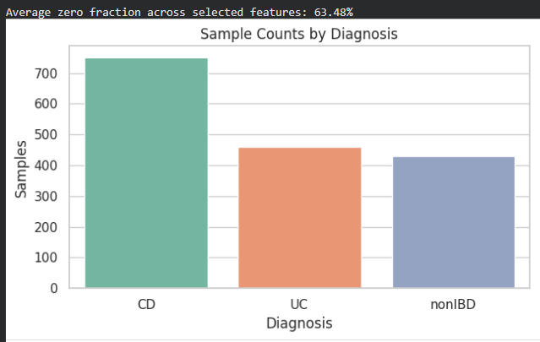
Sample Counts by Diagnosis
The diagnosis count chart shows the original three-label composition of the final HMP2 dataset
Crohn's disease is the largest group, followed by ulcerative colitis, then nonIBD controls
This chart shows why the raw data are naturally imbalanced before collapsing to the binary target

Slide 7
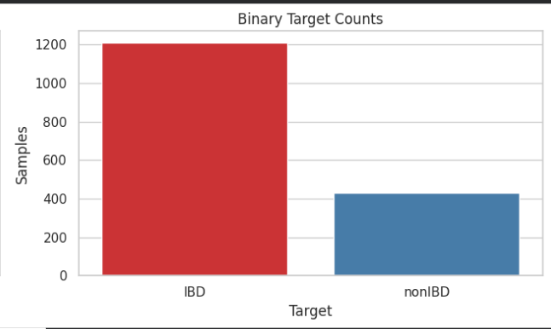
Binary Target Counts
The binary target chart shows the actual prediction task used for modeling: IBD vs nonIBD
CD and UC were combined into the positive class IBD, while nonIBD remained the negative class
The chart confirms that IBD is the majority class, which is why accuracy alone is not enough for evaluation

Slide 8
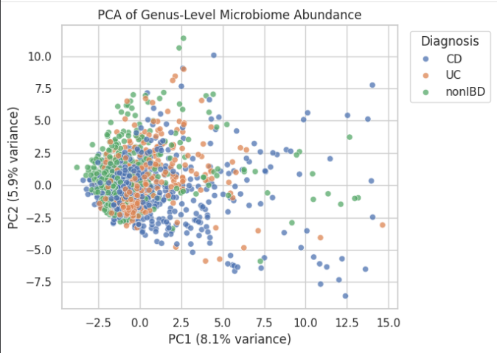
PCA of Genus-Level Microbiome Abundance
The groups show overlap, which means the classification problem is not trivially separable by eye
Even with overlap, the spread suggests there is still structure in the microbiome data that supervised models can learn from
The PCA scatter plot projects high-dimensional genus abundance data into two principal components for visualization

Slide 9
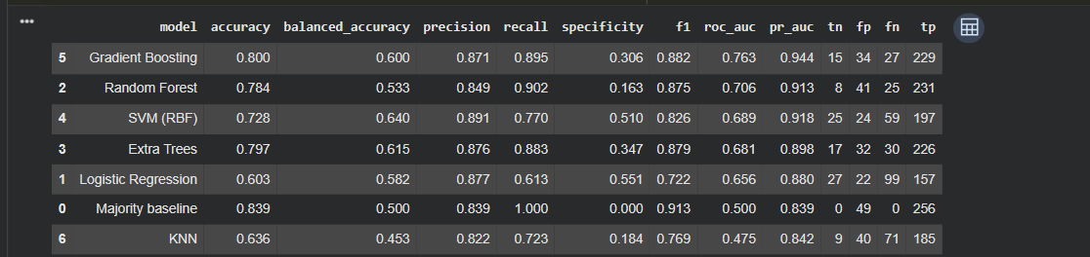
Model Comparison Table
The model comparison table evaluates each classifier on the same held-out test set
Gradient Boosting achieved the best ROC-AUC, while the majority baseline showed why high raw accuracy can be misleading in imbalanced data
This table supports choosing the final model based on recall, specificity, balanced accuracy, and ranking performance rather than accuracy alone

Slide 10
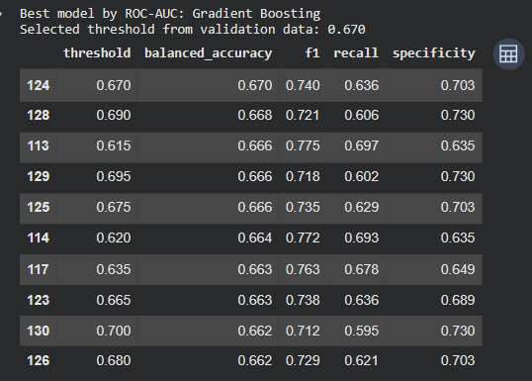
Threshold Tuning Summary
The threshold tuning table shows how changing the classification cutoff changes recall and specificity
The default threshold favored very high IBD recall but weak nonIBD specificity
A tuned threshold of 0.67 produced a more balanced tradeoff, making the final model more clinically interpretable

Slide 11
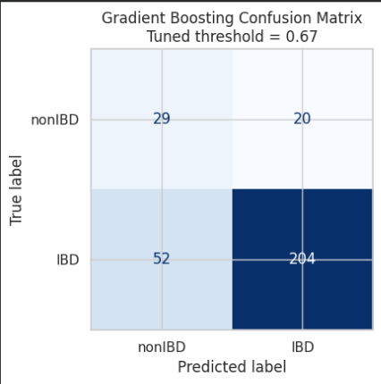
Confusion Matrix with Tuned Threshold
It records 29 true negatives, 20 false positives, 52 false negatives, and 204 true positives
This figure gives the clearest single summary of the model's real classification behavior after threshold tuning
The confusion matrix shows the final tuned Gradient Boosting predictions on the untouched test set

Slide 12
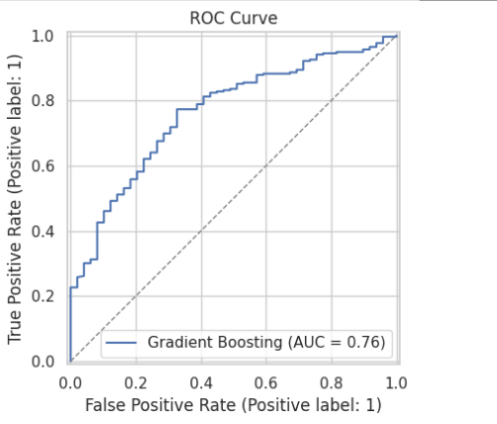
ROC Curve
The Gradient Boosting model achieved an ROC-AUC of about 0.76, which indicates meaningful discrimination above random guessing
This curve is useful because it evaluates ranking quality independently of the final chosen threshold
The ROC curve shows the tradeoff between true positive rate and false positive rate across all possible thresholds

Slide 13
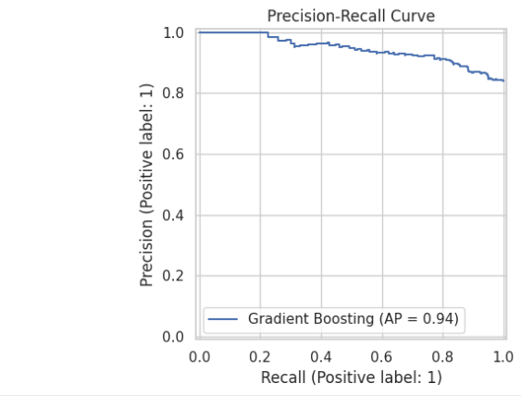
Precision-Recall Curve
It is especially useful in imbalanced classification because it focuses on positive-class detection quality
The high average precision indicates that the model maintains strong precision across a broad range of recall values
The precision-recall curve shows how precision changes as recall changes across thresholds for the IBD class

Slide 14
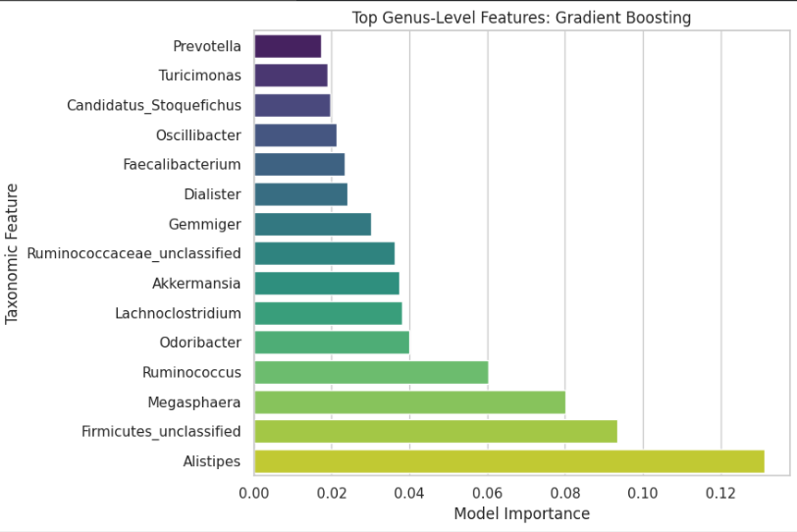
Top Genus-Level Features: Gradient Boosting
Genera such as Alistipes, Firmicutes_unclassified, Megasphaera, and Ruminococcus were among the strongest predictive signals in this dataset
These are model-derived importance scores, so they support biological interpretation but do not prove causal relationships
The feature importance chart identifies the genera that contributed most to the final Gradient Boosting predictions

Slide 15
Orange Visualization
Orange was used as a supporting comparison environment for the exported final dataset
The same binary target and selected microbial features were used to compare standard classifiers visually
Orange results serve as an extra validation layer and presentation-friendly comparison, not the primary final model source

Slide 16
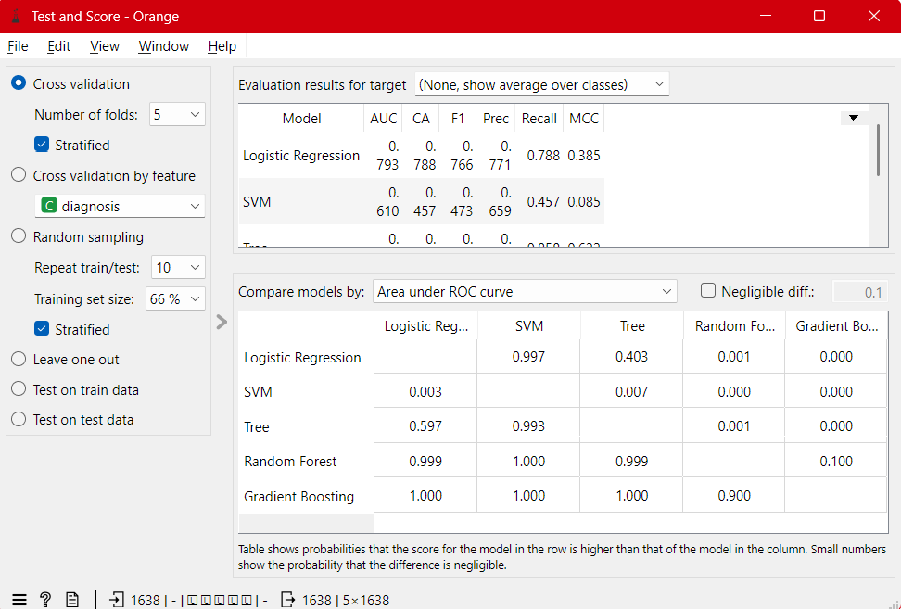
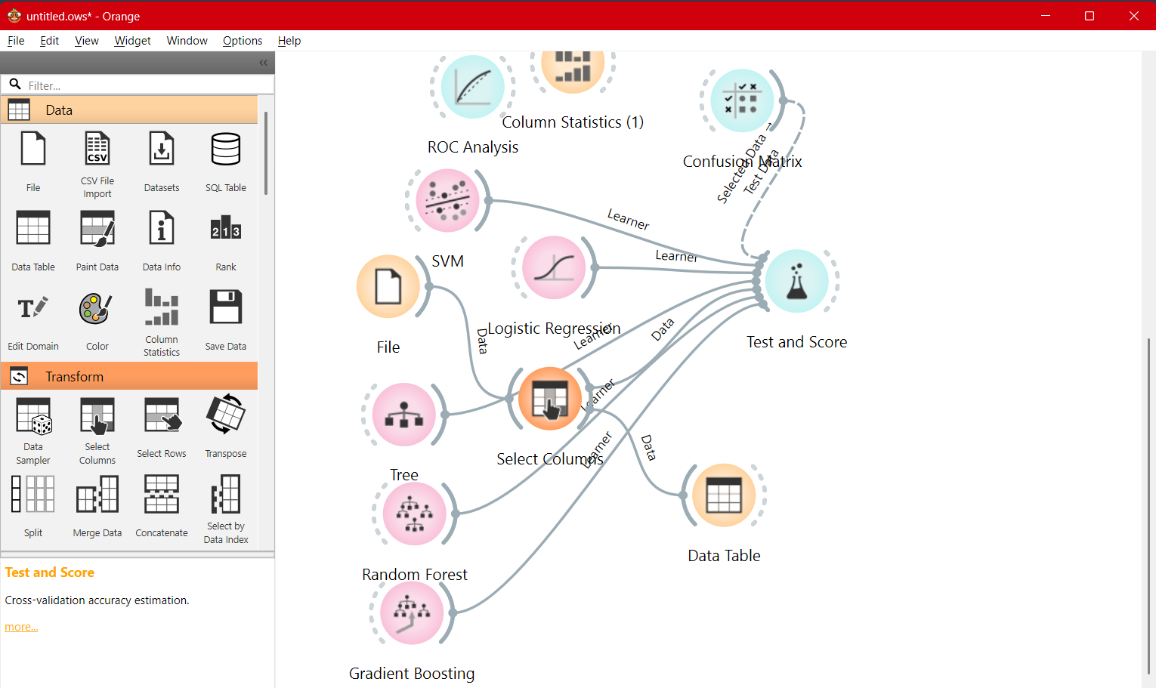
Orange Results

Slide 17
Literature connection
Lloyd-Price et al. (2019) justified the HMP2 / IBDMDB dataset and showed strong IBD-associated microbial dysbiosis
Morgan et al. (2012) and Gevers et al. (2014) supported the biological plausibility of microbiome-based IBD classification
Manandhar et al. (2021) supported supervised ML for IBD microbiome prediction
Nguyen et al. (2022) motivated careful validation and cautious claims

Slide 18
Conclusion and Future work
Microbial taxonomic abundance contains useful predictive signal for IBD vs nonIBD classification
Gradient Boosting gave the strongest ranking performance in this pipeline
Threshold tuning improved the tradeoff between IBD recall and nonIBD specificity
This is a research-support screening model, not a clinical diagnostic tool
external validation, alternative transformations, additional feature types, and subject-level longitudinal modeling

