Slide 1
Gulfstream: AI 3d Model Generation
Computer Science Capstone
Hamza Salahuddin, Llicel Lopez, Gustavo Lopez, Ryan Chapman & Caleb Kenney

Slide 2

Context
Gulfstream is widely regarded as a leader in the business aviation industry. The company is very well known for selling business (private) jets to clients.
Their product lineup consists almost entirely of luxury business jets (e.g., G400, G700), which are specifically built for private travel and customized interiors.
Currently, Gulfstream's designers rely on traditional 3D modeling workflows when performing interior design tailored to client specifications.

Slide 3
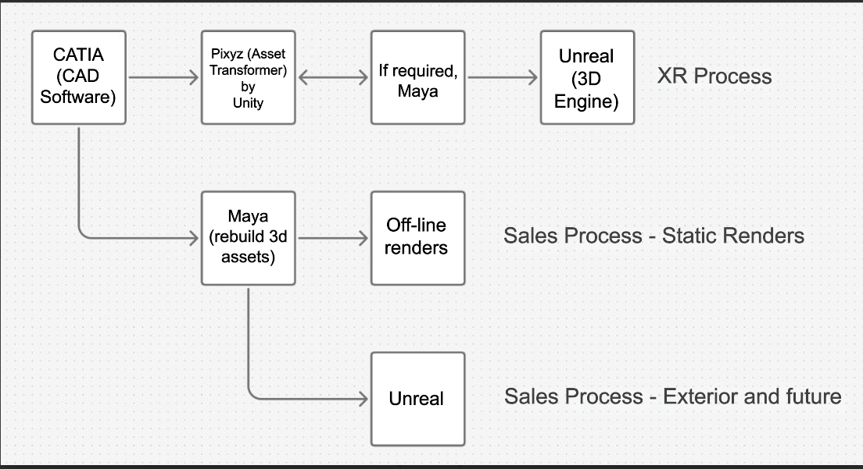
Gulfstream's Workflow

Slide 4
The Problem
Time | Labor | Service
Utilizing traditional 3D software is time-consuming. Basic 3D objects can take up to a full day to model and render. Complex configurations often require weeks to months to fully develop. | Utilizing traditional 3D software is labor-intensive. Designers repeatedly remodel, refine, and compare results to optimize quality. Each iteration requires manual intervention and re-rendering, creating a slow workflow. | Clients seeking custom interiors face long iterative cycles, which delays decision-making and reduces engagement.

Slide 5


The Solution
According to Render Edge Studio, AI-enhanced workflows can reduce rough draft render times from 4–12 hours to as little as 15–90 seconds—representing a 95–99% reduction in rendering time.
The proposed application is an interactive, AI-powered 3D modeling tool.
Users can describe objects and design layouts in natural language or upload reference images, and the system will generate editable, textured 3D models.

Slide 6
Key Features

Slide 7
Dual 3D generation Services
Local Hardware-Dependent
Trellis (Text/Image → 3D Model) Z-images enhancement pipeline (sub-step): Enhances important visual details in generated images before final 3D reconstruction, helping create smoother surfaces, cleaner object shapes, and more stable 3D models. TripoSR (Image → 3D Model)
Cloud (New) Hardware-Independent
ModelsLab (Text/Image → 3D Model): A fully managed "AI as a Service" platform that provides cheap, fast, high-quality 3D asset generation. GPU and other compute resources are handled virtually. 3D generation tasks are executed via API calls.

Slide 8
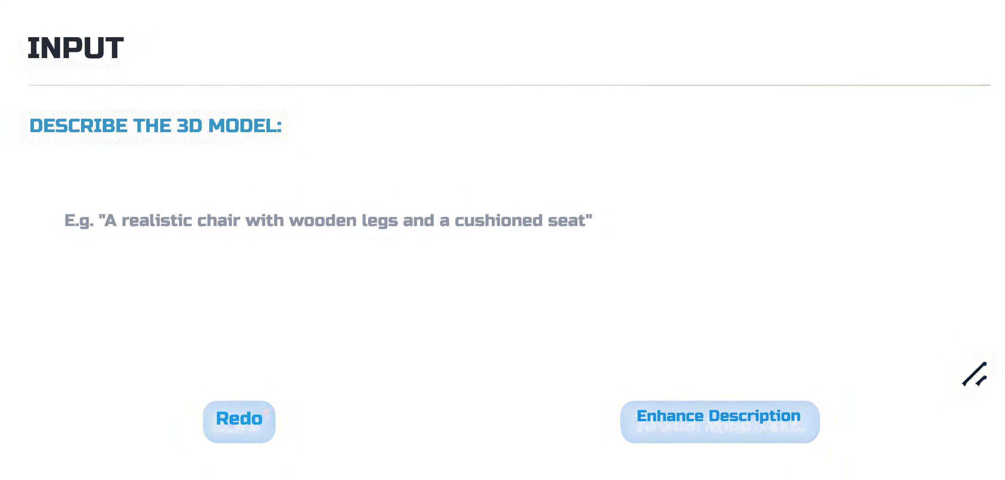
AI-Enhanced object Descriptions
Users can type a description of the 3D asset they want to generate.
(New): An OpenAI-powered agent can transform text prompts into structured, technically detailed 3D asset specification, fine-tuned for realism.

Slide 9
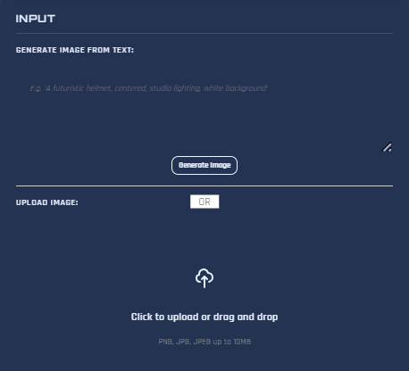
Image Creation & Upload
Users can upload a reference image of the 3D asset they want to generate.
(New): An OpenAI-powered agent can interpret text prompts and transforms them into highly detailed images for 3D model construction.

Slide 10

Automated Normalization (New)
Generated meshes are automatically processed using Blender (an open-source 3D software) scripts, where transformations such as scaling, orientation, and origin alignment are applied consistently with Unreal Engine standards.
Pivot-centered alignment
Grounded base positioning
Standardized axis orientation (Z-up)

Slide 11
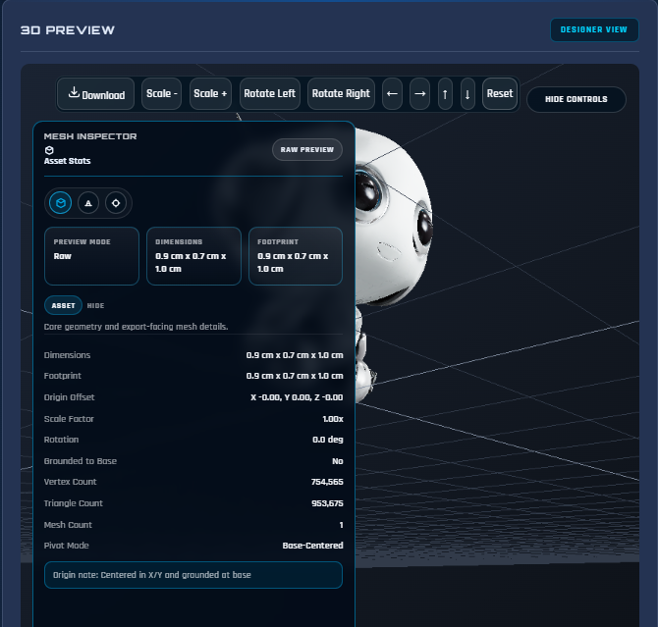
Interactive Post-Processing
(Updated) Mesh Inspector: A real-time 3D visualization environment with full camera controls (orbit, zoom, pan) and transform tools (scale, rotate, translate) for validating generated models. It exposes asset statistics (dimensions, vertices, etc), normalization status, and texture readiness.
(New) Texture Baking: UI controls for adjusting key physically-based rendering (PBR) properties such as base color, roughness, and metalness.
Supports real-time preview of material changes on the 3D model within the viewer.

Slide 12
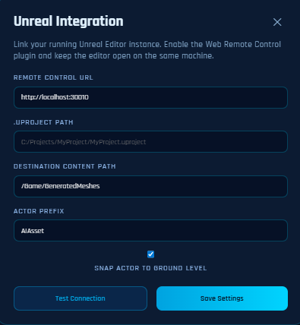
Unreal Engine Export
Users can export generated 3D meshes from the browser into an active Unreal Engine session.
Handles automated mesh transfer, enabling:
Seamless sending of model files to Unreal
Reduced manual import/export workflow
Faster iteration between generation and scene placement

Slide 13

Reflection

Slide 14
Demo

