Slide 1


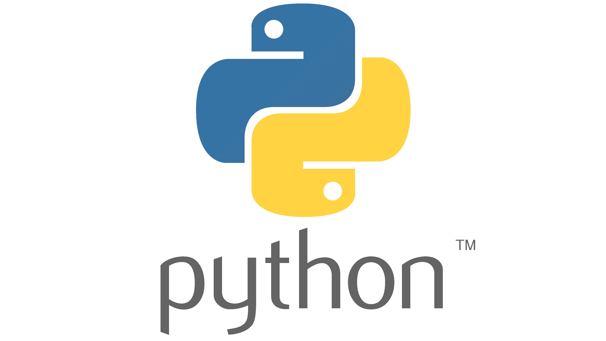


Find the Ant
Name: Hamsini Shivakumar
Supervisor: Riccardo Poli
Find the Ant is a single-player logic-based computer game that helps children and adults improve their strategy skills. Based on similar games such as Minesweeper and Battleships, Find the Ant is a 2D PC board game played on a N x N grid and made up of 3 levels.
AIM:
The game aims to uncover the squares to find the ant with the help of pheromones (they tell how long ago the ant was in the square)!
FUTURE IMPROVEMENTS
Adding different skin choice
Implementing computer (AI) vs player
Player vs player
Different shaped boards
Different game modes
Game controls: Mouse
FEATURES
3 levels (Easy, Medium and Hard)
Different colour pheromones representing different days
Highscore
Why make this game:
Unique game that isn’t anywhere else and the gaming industry is growing rapidly
Enhancing my creative skills

