Slide 1
Low Pass Filter
1.A low pass filter is a filter that allows signals with low pass frequencies to pass from input to output while rejecting frequecncies above passbandfrequency.
2.It can be a combination of capacitance, inductance or resistance intended to produce high attenuation above a specified frequency and little or no attenuation below that frequency.

Slide 2
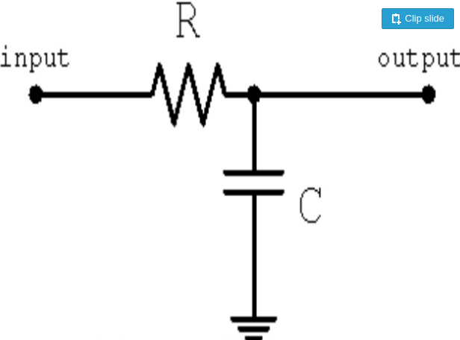
Simple RC Low Pass Filter
A simple RC low pass filter can be made by connecting together in series a single resistor with single capacitor. In this type of filter arrangement Vin is applied to series combination and Vout is taken across capacitor only.

Slide 3
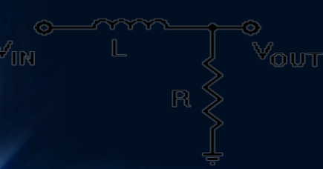
Simple RL Low pass filter
Made by connecting inductor and resistor in series and output is taken across the resistor.

Slide 4
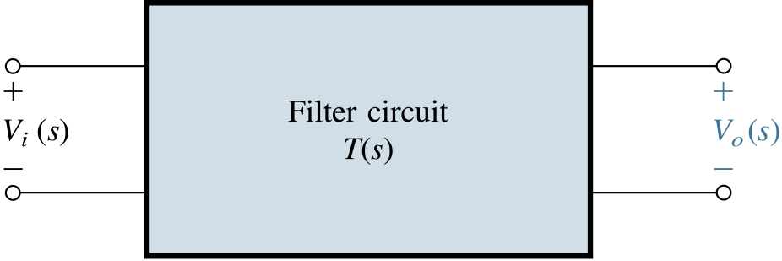
Filter Transmission, Types and Specification
Linear Filters

Slide 5
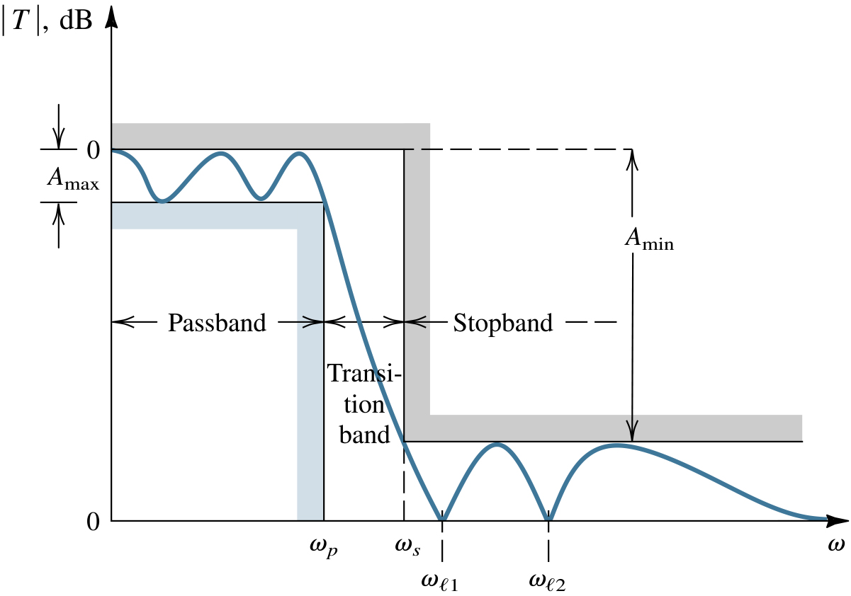
Specification of the transmission characteristics of a low-pass filter. The magnitude response of a filter that just meets specifications is also shown.
Filter Specification
Frequency-Selection function
  Passing
  Stopping
  Pass-Band
  Low-Pass
  High-Pass
  Band-Pass
  Band-Stop
  Band-Reject
Summary – Low-pass specs
-the passband edge, wp
-the maximum allowed variation in passband, Amax
-the stopband edge, ws
-the minimum required stopband attenuation, Amin
Passband ripple
Ripple bandwidth

