Slide 1
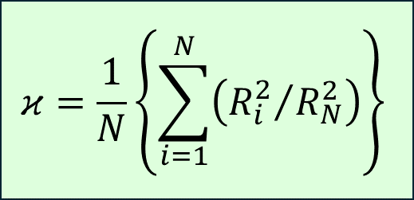
Y
S
Ranking
Inputs
S₁
S₂
S₃
S_{N}
Extraction
[S₁, S_{2,} S₃, …, S_{N}]
Encode
Encoding
[X₁, X_{2,} X₃, …, X_{N}]
ML
Fitting
[R²₁, R²_{2,} R²₃, …, R²_{N}]
$$κ=\frac{1}{N}\left\{\sum_{i=1}^{N}{\left({R_{i}^{2}}/{R_{N}^{2}}\right)}\right\}$$
Evaluate

