Slide 1
Understanding the ggplot Syntax
The syntax for constructing ggplots could be puzzling
The main difference is that, unlike base graphics, ggplot works with dataframes and not individual vectors.
All the data needed to make the plot is typically be contained within the dataframe supplied to the ggplot()
itself or can be supplied to respective geoms.
The second noticeable feature is:
We keep enhancing the plot by adding more layers (and themes)
to an existing plot created using the ggplot() function.

Slide 3
# turn off scientific notation like 1e+06
Setup options(scipen=999)
library(ggplot2)
# load the data #
data("midwest", package = "ggplot2midwest ")
# alt source #
<- read.csv("http://goo.gl/G1K41K")
Init Ggplot
# area and poptotal are columns in 'midwest'
ggplot(midwest, aes(x=area, y=poptotal))

Slide 4
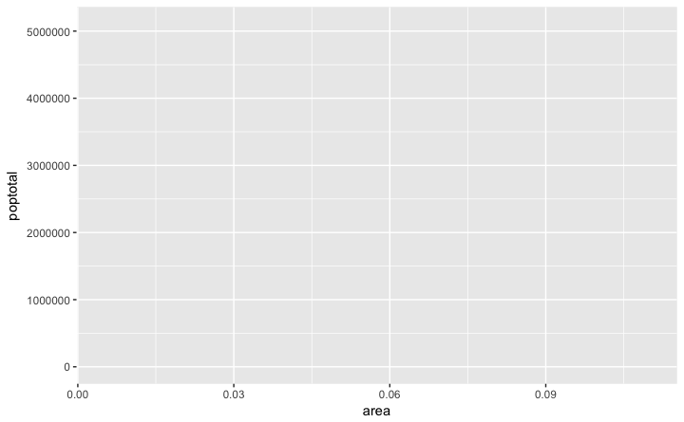

Slide 5
A blank ggplot is drawn.
Even though the x and y are specified, there are no points or lines in it.
This is because, ggplot doesn’t assume that you meant a scatterplot or a line chart to be drawn.
I have only told ggplot
what dataset to use and what columns should be used for X and Y axis.
I haven’t explicitly asked it to draw any points.
Also note that aes() function is used to specify the X and Y axes.
That’s because, any information that is part of the source dataframe has to be specified inside the aes() function.

Slide 6
How to Make a Simple Scatterplot
Let’s make a scatterplot on top of the blank ggplot
by adding points using a geom layer called geom_point.
library(ggplot2)
ggplot(midwest, aes(x=area, y=poptotal)) + geom_point()

Slide 7
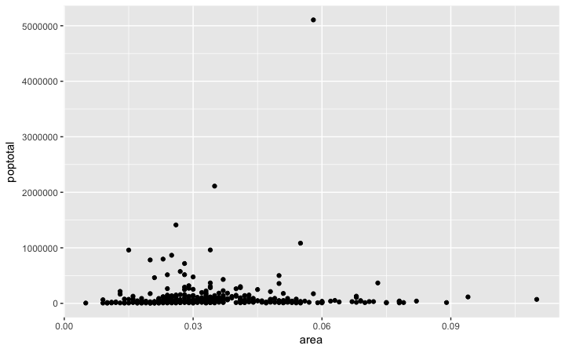

Slide 8
We got a basic scatterplot, where each point represents a county.
However, it lacks some basic components such as the plot title, meaningful axis labels etc.
Moreover most of the points are concentrated on the bottom portion of the plot,
how to rectify these in upcoming steps.
Like geom_point(),
For now, let’s just add a smoothing layer usinggeom_smooth(method='lm').
Since the method is set as lm (short for linear model), it draws the line of best fit.
library(ggplot2)
# set se=FALSE to turnoff confidence bands
g <- ggplot(midwest, aes(x=area, y=poptotal)) + geom_point() + geom_smooth(method="lm")
plot(g)

Slide 9
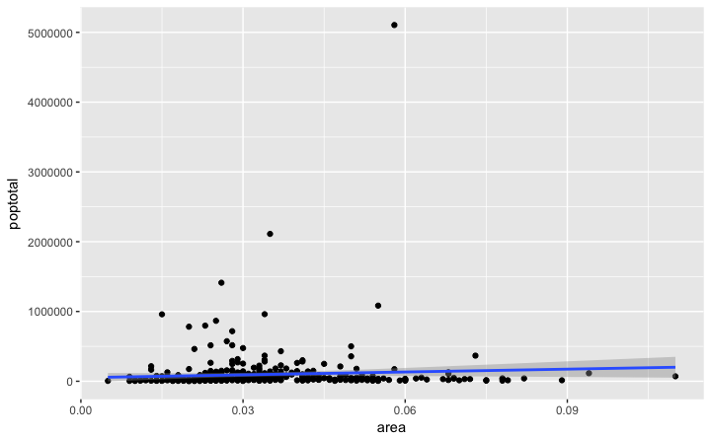

Slide 10
The line of best fit is in blue.
Can you find out what other method options are available for geom_smooth?
(note: see ?geom_smooth).
You might have noticed that majority of points lie in the bottom of the chart which doesn’t really look nice.
So, let’s change the Y-axis limits to focus on the lower half.

Slide 11
3. Adjusting the X and Y axis limits
The X and Y axis limits can be controlled in 2 ways.
Method 1: By deleting the points outside the range
This will change the lines of best fit or smoothing lines as compared to the original data.
This can be done by xlim() and ylim().
You can pass a numeric vector of length 2 (with max and min values) or just the max and min values itself.

Slide 12
library(ggplot2)
# set se=FALSE to turnoff confidence bands
g <- ggplot(midwest, aes(x=area, y=poptotal)) + geom_point() + geom_smooth (method="lm")
# Delete the points outside the limits
g + xlim(c(0, 0.1)) + ylim(c(0, 1000000))
# deletes points
# g + xlim(0, 0.1) + ylim(0, 1000000) # deletes points

Slide 13
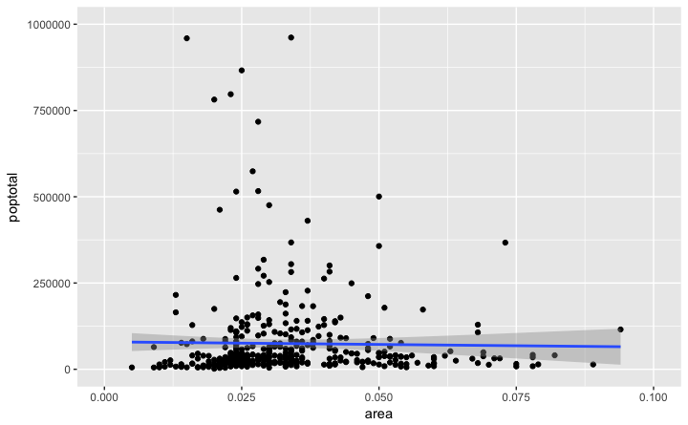

Slide 14
In this case, the chart was not built from scratch but rather was built on top of g.
This is because, the previous plot was stored as g,
a ggplot object, which when called will reproduce the original plot.
Using ggplot, you can add more layers, themes and other settings on top of this plot.
Did you notice that the line of best fit became more horizontal compared to the original plot?
This is because, when using xlim() and ylim(), the points outside the specified range are deleted
and will not be considered while drawing the line of best fit (using geom_smooth(method='lm')).

Slide 15
Method 2: Zooming In
The other method is to change the X and Y axis limits by zooming in to the region of interest without deleting the points.
This is done using coord_cartesian().
Let’s store this plot as g1.
library(ggplot2)
# set se=FALSE to turnoff confidence bands
g <- ggplot(midwest, aes(x=area, y=poptotal)) + geom_point() + geom_smooth(method="lm")
# Zoom in without deleting the points outside the limits.
# As a result, the line of best fit is the same as the original plot.
g1 <- g + coord_cartesian(xlim=c(0,0.1), ylim=c(0, 1000000))
# zooms in
plot(g1)

Slide 16
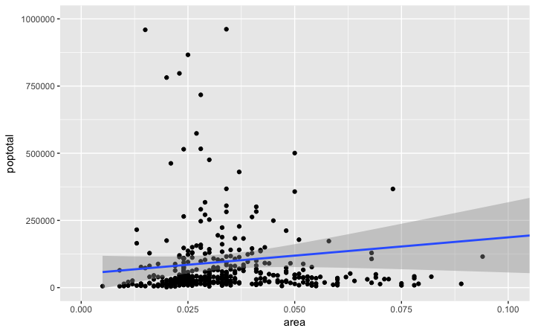

Slide 17
How to Change the Title and Axis Labels
This can be done in one go using the labs() function with title, x and y arguments.
Another option is to use the ggtitle(), xlab()and ylab().
library(ggplot2)
# set se=FALSE to turnoff confidence bands
g <- ggplot(midwest, aes(x=area, y=poptotal)) + geom_point() + geom_smooth(method="lm")
# zooms in
g1 <- g + coord_cartesian(xlim=c(0,0.1), ylim=c(0, 1000000))
# Add Title and Labels
g1 + labs(title="Area Vs Population", subtitle="From midwest dataset", y="Population", x="Area", caption="Midwest Demographics")
# or
g1 + ggtitle("Area Vs Population", subtitle="From midwest dataset") + xlab("Area") + ylab("Population")

Slide 18
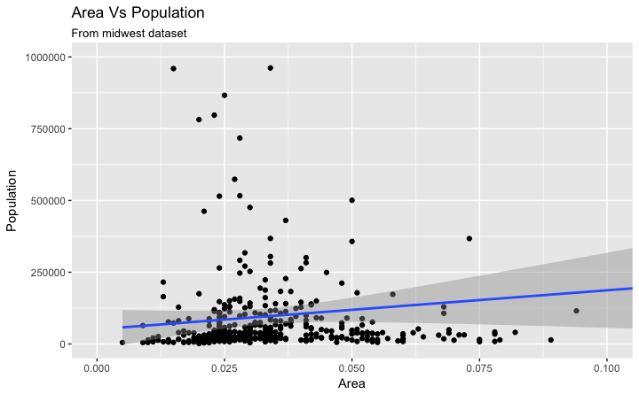

Slide 19
# Full Plot call
library(ggplot2)
ggplot(midwest, aes(x=area, y=poptotal)) + geom_point() + geom_smooth(method="lm") + coord_cartesian(xlim=c(0,0.1), ylim=c(0, 1000000)) + labs(title="Area Vs Population", subtitle="From midwest dataset", y="Population", x="Area", caption="Midwest Demographics")

Slide 20
How to Change the Color and Size of Points
How to Change the Color and Size To Static?
We can change the aesthetics of a geom layer by modifying the respective geoms.
library(ggplot2)
# Set static color and size for points
ggplot(midwest, aes(x=area, y=poptotal)) + geom_point(col="steelblue", size=3) +
# change the color of line
geom_smooth(method="lm", col="firebrick“, size=6) +
coord_cartesian(xlim=c(0, 0.1), ylim=c(0, 1000000)) + labs(title="Area Vs Population", subtitle="From midwest dataset", y="Population", x="Area", caption="Midwest Demographics")

Slide 21
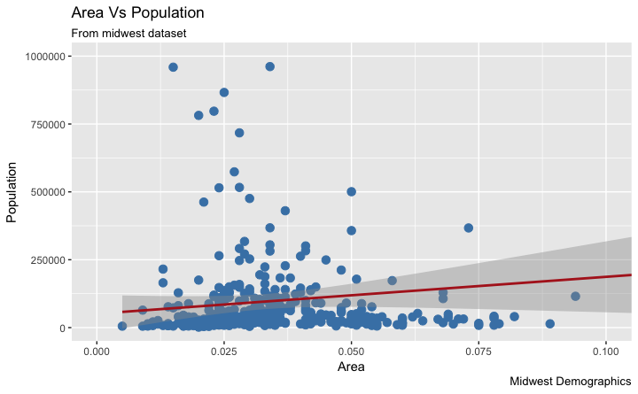

Slide 22
How to Change the Color To Reflect Categories in Another Column?
Suppose if we want the color to change based on another column in the source dataset
it must be specified inside the aes() function.
library(ggplot2)
# Set color to vary based on state categories.
gg <- ggplot(midwest, aes(x=area, y=poptotal)) + geom_point(aes(col=state), size=3) + geom_smooth(method="lm", col="firebrick", size=2) + coord_cartesian(xlim=c(0, 0.1), ylim=c(0, 1000000)) + labs(title="Area Vs Population", subtitle="From midwest dataset", y="Population", x="Area", caption="Midwest Demographics") plot(gg)

Slide 23
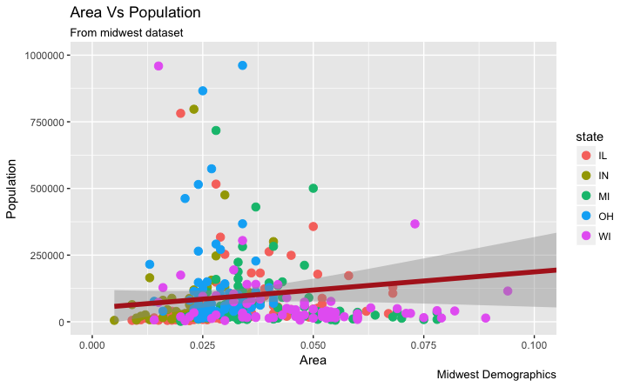

Slide 24
Now each point is colored based on the state it belongs because of aes(col=state).
Not just color, but size, shape, stroke (thickness of boundary) and fill (fill color) can be used to discriminate groupings.
As an added benefit, the legend is added automatically.
If needed, it can be removed by setting the legend.
position to None from within a theme() function.
# remove legend
gg + theme(legend.position="None")
Also, You can change the color palette entirely.
# change color palette
gg + scale_colour_brewer(palette = "Set1")

Slide 25
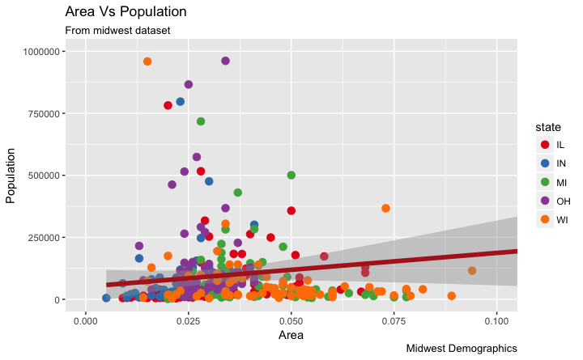

Slide 26
RColorBrewer package
More of such palettes can be found in the RColorBrewer package
library(RColorBrewer)
# show 10 palettes
head(brewer.pal.info, 10)
#> maxcolors category colorblind
#> BrBG 11 div TRUE
#>PiYG 11 div TRUE
#> PRGn 11 div TRUE
#> PuOr 11 div TRUE
#> RdBu 11 div TRUE
#> RdGy 11 div FALSE
#> RdYlBu 11 div TRUE
#> RdYlGn 11 div FALSE
#> Spectral 11 div FALSE
#> Accent 8 qual FALSE

Slide 27
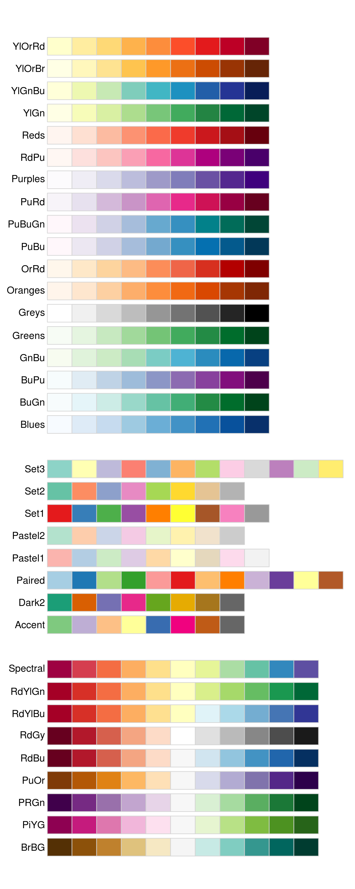

Slide 28
How to Change the X Axis Texts and Ticks Location
How to Change the X and Y Axis Text and its Location?
This involves two aspects: breaks and labels.
Step 1: Set the breaks The breaks should be of the same scale as the X axis variable.
scale_x_continuous
because, the X axis variable is a continuous variable.
Had it been a date variable,
scale_x_date could be used.
Like scale_x_continuous()
an equivalent scale_y_continuous() is available for Y axis.

Slide 29
library(ggplot2)
# Base plot
+ # Set color to vary based on state categories.
gg<-ggplot(midwest,aes(x=area,y=poptotal))+geom_ point(aes(col=state),size=3)+geom_smooth(method="lm", col="firebrick", size=2) + coord_cartesian(xlim=c(0, 0.1),ylim=c(0,1000000))+labs(title="AreaVsPopulation", subtitle="From midwest dataset", y="Population", x="Area", caption="Midwest Demographics")
#Changebreaks
gg + scale_x_continuous(breaks=seq(0, 0.1, 0.01))

Slide 30


Slide 31
Step 2: Change the labels
You can optionally change the labels at the axis ticks.
labels take a vector of the same length as breaks.
setting the labels to alphabets from a to k
gg<-ggplot(midwest,aes(x=area,y=poptotal))+geom_ point(aes(col=state),size=3)+geom_smooth(method="lm", col="firebrick", size=2) + coord_cartesian(xlim=c(0, 0.1),ylim=c(0,1000000))+labs(title="AreaVsPopulation", subtitle="From midwest dataset", y="Population", x="Area", caption="Midwest Demographics")
# Change breaks + label
gg + scale_x_continuous(breaks=seq(0, 0.1, 0.01), labels = letters[1:11])

Slide 32
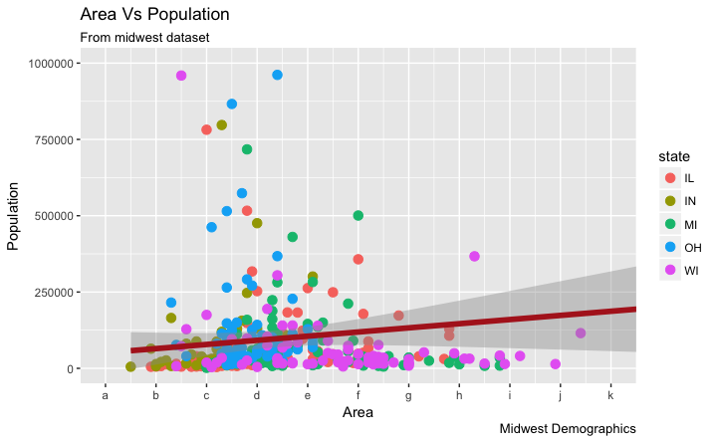

Slide 33
If you need to reverse the scale
use scale_x_reverse().

Slide 34
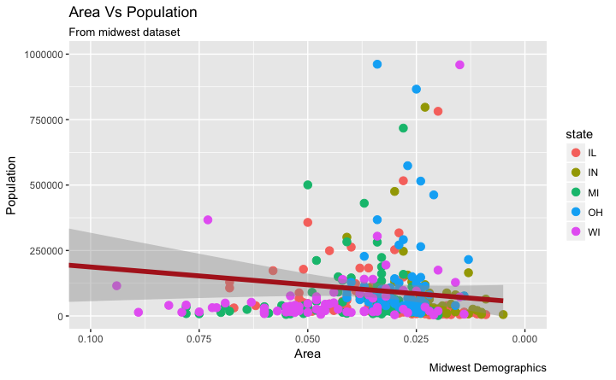

Slide 35
How to Customize the Entire Theme in One Shot using Pre-Built Themes?
we can change the entire theme itself using pre-built themes. The help page ?
theme_bw shows all the available built-in themes.
This again is commonly done in couple of ways.
Use the theme_set() to set the theme before drawing the ggplot.
Note that this setting will affect all future plots.
Draw the ggplot and then add the overall theme setting
theme_bw()

Slide 36
# method 1:
Using theme_set()
# not run
theme_set(theme_classic ())
gg
# method 2: Adding theme Layer itself.
gg + theme_bw() + labs(subtitle="BW Theme")
gg + theme_classic() + labs(subtitle="Classic Theme")

Slide 37
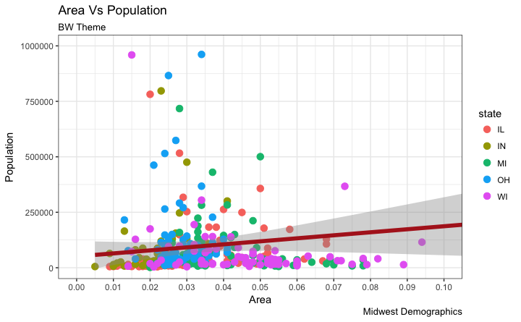

Slide 38
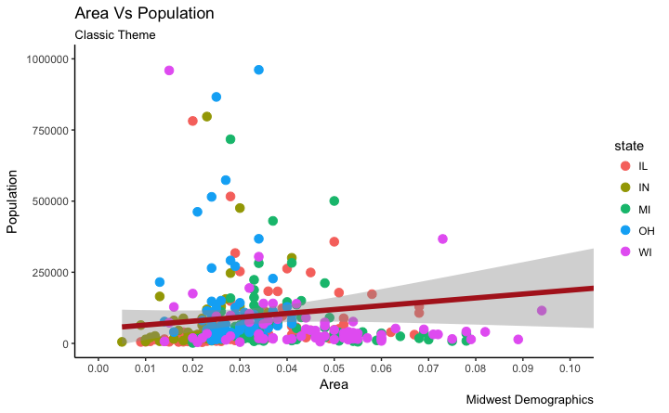

Slide 39
Customizing the look and feel
How to accomplish your plot customization tasks in detail.
Adding Plot and Axis Titles
Plot and axis titles and the axis text are part of the plot’s theme.
Therefore, it can be modified using the theme() function.
The theme() function accepts one of the four element_type()
Since the plot and axis titles are textual components,
element_text() is used to modify them.
Below, I have changed the size, color, face and line-height.
The axis text can be rotated by changing the angle.

Slide 40
library(ggplot2)
# Base Plot
gg <- ggplot(midwest, aes(x=area, y=poptotal)) + geom_point(aes(col=state, size=popdensity)) + geom_smooth(method="loess", se=F) + xlim(c(0, 0.1)) + ylim(c(0, 500000)) + labs(title="Area Vs Population", y="Population", x="Area", caption="Source: midwest")
# Modify theme components -------------------------------------------
# title plot.subtitle
gg + theme(plot.title=element_text(size=20,
face="bold", family="American Typewriter", color="tomato", hjust=0.5, lineheight=1.2),
# subtitle

Slide 41
plot.subtitle =element_text(size=15, family="American Typewriter", face="bold", hjust=0.5),
# caption
plot.caption=element_text(size=15),
# X axis title
axis.title.x=element_text(vjust=10, size=15axis. ),
# Y axis title
title.y=element_text(size=15),
# X axis text
axis.text.x=element_text(size=10, angle = 30, vjust=.5),
# Y axis text
axis.text.y=element_text(size=10 ))

Slide 42
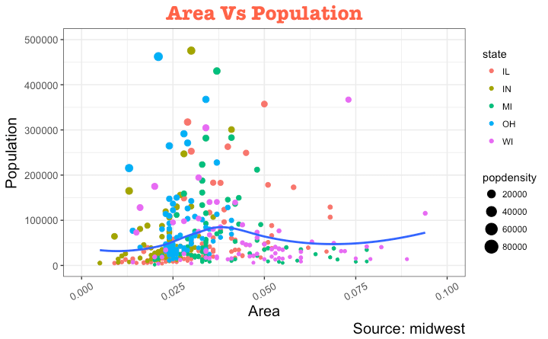

Slide 43
vjust, controls the vertical spacing between title (or label) and plot.
hjust, controls the horizontal spacing. Setting it to 0.5 centers the title.
family, is used to set a new font
face, sets the font face (“plain”, “italic”, “bold”, “bold.italic”)

Slide 44
Modifying Legend
Whenever your plot’s
geom (like points, lines, bars, etc) is set to change
the aesthetics (fill, size, col, shape or stroke)
based on another column, as in
geom_point(aes(col=state, size=popdensity)),
a legend is automatically drawn.
If you are creating a geom where the aesthetics are static, a legend is not drawn by default.
In such cases you might want to create your own legend manually.
Let’s now change the legend title.
We have two legends, one each for color and size.
The size is based on a continuous variable while the color is based on a categorical(discrete) variable.
There are 3 ways to change the legend title

Slide 45
Method 1: Using labs()
library(ggplot2)
# Base Plot
gg<-ggplot(midwest, aes(x=area, y=poptotal)) +geom_point(aes(col=state, size=popdensity)) +geom_smooth(method="loess",se=F)+xlim(c(0, 0.1)) + ylim(c(0, 500000)) + labs(title="Area VsPopulation",y="Population",x="Area",caption="Source:midwest")
# modify legend title
gg + labs(color="State", size="Density")

Slide 46
Method 2: Using guides()
library(ggplot2)
# Base Plot
gg <- ggplot(midwest, aes(x=area, y=poptotal)) + geom_point(aes(col=state, size=popdensity)) + geom_smooth(method="loess", se=F) + xlim(c(0, 0.1)) + ylim(c(0, 500000)) + labs(title="Area Vs Population",y="Population",x="Area",caption="Source:midwest")
# modify legend title
gg <- gg + guides(color=guide_legend("State"), size=guide_legend("Density"))
plot(gg)

Slide 47
Method 3: Using scale_aesthetic_vartype() format
The format of scale_aestheic_vartype()
allows you to turn off legend for one particular aesthetic, leaving the rest in place.
This can be done just by setting guide=FALSE.
For example, if the legend is for size of points based on a continuous variable,
then scale_size_continuous() would be the right function to use.
library(ggplot2)
# Base Plot
gg<-ggplot(midwest,aes(x=area,y=poptotal)) + geom_point(aes(col=state, size=popdensity)) + geom_smooth(method="loess", se=F) + xlim(c(0, 0.1)) + ylim(c(0, 500000)) + labs(title="Area Vs Population", y="Population", x="Area", caption="Source: midwest")
# Modify Legend
gg + scale_color_discrete(name="State")
# turn off legend for size
gg+scale_color_discrete(name="State")+scale_size_continuous(name = "Density", guide = FALSE)

Slide 48
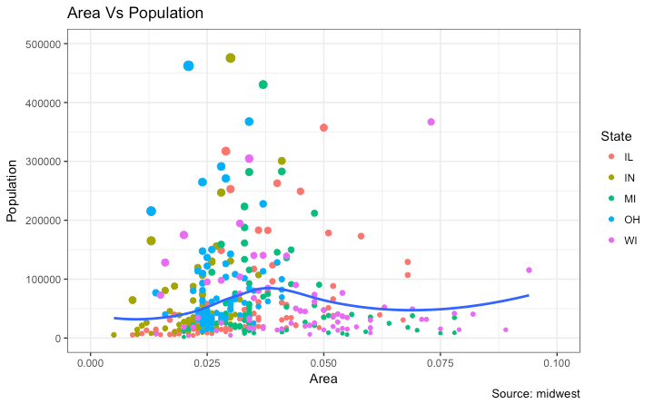

Slide 49
How to Change Legend Labels and Point Colors for Categories
This can be done using the respective scale_aesthetic_manual() function.
The new legend labels are supplied as a character vector to the labels argument.
If you want to change the color of the categories,
it can be assigned to the values argument
library(ggplot2)
# Base Plot
gg<-ggplot(midwest,aes(x=area,y=poptotal))+geom_ point(aes(col=state,size=popdensity))+geom_smooth (method="loess", se=F) + xlim(c(0, 0.1)) + ylim(c(0, 500000)) + labs(title="Area Vs Population", y="Population", x="Area", caption="Source: midwest")

Slide 50
gg + scale_color_manual(name="State", labels = c("Illinois",
"Indiana",
"Michigan",
"Ohio",
"Wisconsin"),
values = c("IL"="blue",
"IN"="red",
"MI"="green",
"OH"="brown",
"WI"="orange"))

Slide 51
