Slide 1
DBMS

Slide 2
What is Data?
Data is a collection of a distinct small unit of information.
It can be used in a variety of forms like text, numbers, media, bytes, etc. it can be stored in pieces of paper or electronic memory, etc.
Word 'Data' is originated from the word 'datum' that means 'single piece of information.’
It is plural of the word datum.

Slide 3
Database
A database is an organized collection of data, so that it can be easily accessed and managed.
A collection of inter-related data used to retrieve, insert and delete the data efficiently.
It is also used to organize the data in the form of a table, schema, views, and reports, etc.
For example: The college Database organizes the data about the admin, staff, students and faculty etc.
Using the database, we can easily retrieve, insert, and delete the information.

Slide 4
Database Management System
Database management system is a software which is used to manage the database. For example: MYSQL, Oracle, etc.
DBMS provides an interface to perform various operations like database creation, storing data in it, updating data, creating a table in the database and a lot more.
It provides protection and security to the database.
In the case of multiple users, it also maintains data consistency.
DBMS allows users the following tasks:
Data Definition: It is used for creation, modification, and removal of definition that defines the organization of data in the database.
Data Updation: It is used for the insertion, modification, and deletion of the actual data in the database.
Data Retrieval: It is used to retrieve the data from the database which can be used by applications for various purposes.
User Administration: It is used for registering and monitoring users, maintain data integrity, enforcing data security, dealing with concurrency control, monitoring performance and recovering information corrupted by unexpected failure.

Slide 5
Characteristics of DBMS
It uses a digital repository established on a server to store and manage the information.
Provide a clear and logical view of the process that manipulates data.
Contains automatic backup and recovery procedures.
Contains ACID properties which maintain data in a healthy state in case of failure.
Reduce the complex relationship between data.
Support manipulation and processing of data.
Provide security of data.
View the database from different viewpoints according to the requirements of the user.

Slide 6
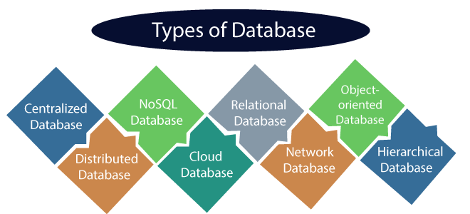
Types of Databases

Slide 7
Centralized Database
It is the type of database that stores data at a centralized database system.
Users can access the stored data from different locations through several applications.
These applications contain the authentication process to let users access data securely.
An example of a Centralized database can be Central Library that carries a central database of each library in a college/university.
Advantages of Centralized Database
It has decreased the risk of data management, i.e., manipulation of data will not affect the core data.
Data consistency is maintained as it manages data in a central repository.
It provides better data quality, which enables organizations to establish data standards.
It is less costly because fewer vendors are required to handle the data sets.
Disadvantages of Centralized Database
The size of the centralized database is large, which increases the response time for fetching the data.
It is not easy to update such an extensive database system.
If any server failure occurs, entire data will be lost, which could be a huge loss.

Slide 8
Distributed Database
Unlike a centralized database system, in distributed systems, data is distributed among different database systems of an organization.
These database systems are connected via communication links.
Such links help the end-users to access the data easily.
Distributed database system can further be divided into:
Homogeneous DDB: Those database systems which execute on the same operating system and use the same application process and carry the same hardware devices.
Heterogeneous DDB: Those database systems which execute on different operating systems under different application procedures, and carries different hardware devices.
Advantages of Distributed Database
Modular development is possible in a distributed database, i.e., the system can be expanded by including new computers and connecting them to the distributed system.
One server failure will not affect the entire data set.

Slide 9
Relational Database
This database is based on the relational data model, which stores data in the form of rows(tuple) and columns(attributes), and together forms a table(relation).
A relational database uses SQL for storing, manipulating, as well as maintaining the data.
E.F. Codd invented the database in 1970.
Each table in the database carries a key that makes the data unique from others.
Examples of Relational databases are MySQL, Microsoft SQL Server, Oracle, etc.

Slide 10
Properties of Relational Database
There are following four commonly known properties of a relational model known as ACID properties, where:
A means Atomicity: This ensures the data operation will complete either with success or with failure. It follows the 'all or nothing' strategy. For example, a transaction will either be committed or will abort.
C means Consistency: If we perform any operation over the data, its value before and after the operation should be preserved. For example, the account balance before and after the transaction should be correct, i.e., it should remain conserved.
I means Isolation: There can be concurrent users for accessing data at the same time from the database. Thus, isolation between the data should remain isolated. For example, when multiple transactions occur at the same time, one transaction effects should not be visible to the other transactions in the database.
D means Durability: It ensures that once it completes the operation and commits the data, data changes should remain permanent.

Slide 11
NoSQL Database
Non-SQL/Not Only SQL is a type of database that is used for storing a wide range of data sets.
It is not a relational database as it stores data not only in tabular form but in several different ways.
It came into existence when the demand for building modern applications increased.
Thus, NoSQL presented a wide variety of database technologies in response to the demands.
We can further divide a NoSQL database into the following four types:
Key-value storage: It is the simplest type of database storage where it stores every single item as a key (or attribute name) holding its value, together.
Document-oriented Database: A type of database used to store data as JSON-like document. It helps developers in storing data by using the same document-model format as used in the application code.
Graph Databases: It is used for storing vast amounts of data in a graph-like structure. Most commonly, social networking websites use the graph database.
Wide-column stores: It is similar to the data represented in relational databases. Here, data is stored in large columns together, instead of storing in rows.

Slide 12
Cloud Database
A type of database where data is stored in a virtual environment and executes over the cloud computing platform.
It provides users with various cloud computing services (SaaS, PaaS, IaaS, etc.) for accessing the database.
There are numerous cloud platforms, but the best options are:
Amazon Web Services(AWS)
Microsoft Azure
Kamatera
PhonixNAP
ScienceSoft
Google Cloud SQL, etc.

Slide 13
Object-oriented Databases
The type of database that uses the object-based data model approach for storing data in the database system.
The data is represented and stored as objects which are similar to the objects used in the object-oriented programming language.

Slide 14
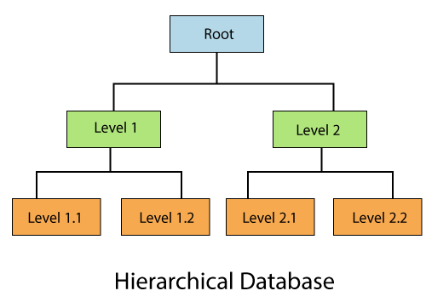
Hierarchical Databases
It is the type of database that stores data in the form of parent-children relationship nodes.
Here, it organizes data in a tree-like structure.

Slide 15
Network Databases
It is the database that typically follows the network data model.
Here, the representation of data is in the form of nodes connected via links between them.
Unlike the hierarchical database, it allows each record to have multiple children and parent nodes to form a generalized graph structure.

Slide 16
Advantages of DBMS
Controls database redundancy: It can control data redundancy because it stores all the data in one single database file and that recorded data is placed in the database.
Data sharing: In DBMS, the authorized users of an organization can share the data among multiple users.
Easier Maintenance: It can be easily maintainable due to the centralized nature of the database system.
Reduce time: It reduces development time and maintenance need.
Backup: It provides backup and recovery subsystems which create automatic backup of data during failures and restores the data if required.
multiple user interface: It provides different types of user interfaces like graphical user interfaces, application program interfaces etc.

Slide 17
Disadvantages of DBMS
Cost of Hardware and Software: It requires a high speed of data processor and large memory size to run DBMS software.
Size: It occupies a large space of disks and large memory to run them efficiently.
Complexity: Database system creates additional complexity and requirements.
Higher impact of failure: Failure is highly impacted the database because in most of the organization, all the data stored in a single database and if the database is damaged due to electric failure or database corruption then the data may be lost forever.

Slide 18
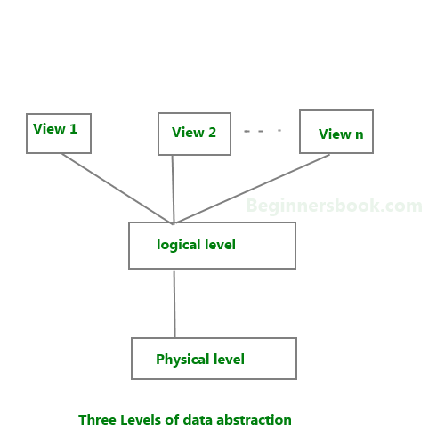
Data Abstraction in DBMS
Database systems are made-up of complex data structures. To ease the user interaction with database, the developers hide internal irrelevant details from users. This process of hiding irrelevant details from user is called data abstraction.

Slide 19
Physical level: This is the lowest level of data abstraction. It describes how data is actually stored in database. You can get the complex data structure details at this level.
Logical level: This is the middle level of 3-level data abstraction architecture. It describes what data is stored in database.
View level: Highest level of data abstraction. This level describes the user interaction with database system.

Slide 20
Example
store customer information in a customer table.
At physical level these records can be described as blocks of storage (bytes, gigabytes, terabytes etc.) in memory. These details are often hidden from the programmers.
At the logical level these records can be described as fields and attributes along with their data types, their relationship among each other can be logically implemented. The programmers generally work at this level because they are aware of such things about database systems.
At view level, user just interact with system with the help of GUI and enter the details at the screen, they are not aware of how the data is stored and what data is stored; such details are hidden from them.

Slide 21
Instance and schema in DBMS
DBMS Schema-Design of a database is called the schema. Schema is of three types: Physical schema, logical schema and view schema.
The design of a database at physical level is called physical schema, how the data stored in blocks of storage is described at this level.
Design of database at logical level is called logical schema, programmers and database administrators work at this level, at this level data can be described as certain types of data records gets stored in data structures, however the internal details such as implementation of data structure is hidden at this level.
Design of database at view level is called view schema. This generally describes end user interaction with database systems.

Slide 22
DBMS Instance
The data stored in database at a particular moment of time is called instance of database.
Database schema defines the variable declarations in tables that belong to a particular database; the value of these variables at a moment of time is called the instance of that database.

Slide 23
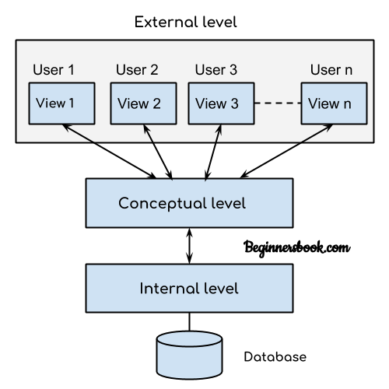
DBMS – Three Level Architecture

Slide 24
External level
It is also called view level.
The reason this level is called “view” is because several users can view their desired data from this level which is internally fetched from database with the help of conceptual and internal level mapping.
The user doesn’t need to know the database schema details such as data structure, table definition etc. user is only concerned about data which is what returned back to the view level after it has been fetched from database (present at the internal level).
External level is the “top level” of the Three Level DBMS Architecture.

Slide 25
Conceptual level
It is also called logical level. The whole design of the database such as relationship among data, schema of data etc. are described in this level.
Database constraints and security are also implemented in this level of architecture. This level is maintained by DBA (database administrator).

Slide 26
Internal level
This level is also known as physical level. This level describes how the data is actually stored in the storage devices. This level is also responsible for allocating space to the data. This is the lowest level of the architecture.

Slide 27
DBMS Architecture
The DBMS design depends upon its architecture.
The basic client/server architecture is used to deal with a large number of PCs, web servers, database servers and other components that are connected with networks.
The client/server architecture consists of many PCs and a workstation which are connected via the network.
DBMS architecture depends upon how users are connected to the database to get their request done.

Slide 28
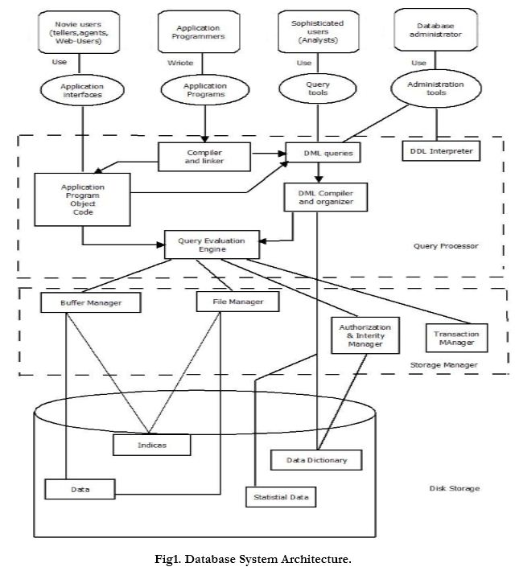

Slide 29
Database Users:
Users are differentiated by the way they expect to interact with the system:
Application programmers:
Application programmers are computer professionals who write application programs. Application programmers can choose from many tools to develop user interfaces.
Rapid application development (RAD) tools are tools that enable an application programmer to construct forms and reports without writing a program.
Sophisticated users:
Sophisticated users interact with the system without writing programs. Instead, they form their requests in a database query language.
They submit each such query to a query processor, whose function is to break down DML statements into instructions that the storage manager understands.
Specialized users :
Specialized users are sophisticated users who write specialized database applications that do not fit into the traditional data-processing framework.
Among these applications are computer-aided design systems, knowledge base and expert systems, systems that store data with complex data types (for example, graphics data and audio data), and environment-modelling systems.
Naïve users :
Naive users are unsophisticated users who interact with the system by invoking one of the application programs that have been written previously.
For example, a bank teller who needs to transfer $50 from account A to account B invokes a program called transfer. This program asks the teller for the amount of money to be transferred, the account from which the money is to be transferred, and the account to which the money is to be transferred.
DBA

Slide 30
Database Administrator:
Coordinates all the activities of the database system. The database administrator has a good understanding of the enterprise’s information resources and needs.
Database administrator's duties include:
Schema definition: The DBA creates the original database schema by executing a set of data definition statements in the DDL.
Storage structure and access method definition.
Schema and physical organization modification: The DBA carries out changes to the schema and physical organization to reflect the changing needs of the organization, or to alter the physical organization to improve performance.
Granting user authority to access the database: By granting different types of authorization, the database administrator can regulate which parts of the database various users can access.
Specifying integrity constraints.
Monitoring performance and responding to changes in requirements.

Slide 31
Query Processor:
The query processor will accept query from user and solves it by accessing the database.
Parts of Query processor:
DDL interpreter
This will interprets DDL statements and fetch the definitions in the data dictionary.
DML compiler
a. This will translates DML statements in a query language into low level instructions that the query evaluation engine understands.
b. A query can usually be translated into any of a number of alternative evaluation plans for same query result DML compiler will select best plan for query optimization.
Query evaluation engine
This engine will execute low-level instructions generated by the DML compiler on DBMS.

Slide 32
Storage Manager/Storage Management:
A storage manager is a program module which acts like interface between the data stored in a database and the application programs and queries submitted to the system.
Thus, the storage manager is responsible for storing, retrieving and updating data in the database.
The storage manager components include:
Authorization and integrity manager: Checks for integrity constraints and authority of users to access data.
Transaction manager: Ensures that the database remains in a consistent state although there are system failures.
File manager: Manages the allocation of space on disk storage and the data structures used to represent information stored on disk.
Buffer manager: It is responsible for retrieving data from disk storage into main memory. It enables the database to handle data sizes that are much larger than the size of main memory.
Data structures implemented by storage manager.
Data files: Stored in the database itself.
Data dictionary: Stores metadata about the structure of the database.
Indices: Provide fast access to data items.

Slide 33
Data dictionary
Data dictionary is an inventory of data elements in a database or data model with detailed description of its format, relationships, meaning, source and usage.
A data dictionary is a collection of descriptions of the data objects or items in a data model for the benefit of programmers and others who need to refer to them.
A data dictionary contains
a list of all files in the database
the number of records in each file
and the names and types of each field.
Most database management systems keep the data dictionary hidden from users to prevent them from accidentally destroying its contents.
Elements of Data Dictionary
Data dictionary is a table with data elements (columns) as rows and their attributes as columns.
Specific attributes vary depending on the purpose of the data dictionary.
Essential elements
Data dictionary has 2 essential elements:
List of tables (or entities)
List of columns (or fields, or attributes)

Slide 34
Types of Data Dictionary
Active Data Dictionary
The DBMS software manages the active data dictionary automatically.
The modification is an automatic task and most RDBMS has active data dictionary.
It is also known as integrated data dictionary.
Passive Data Dictionary
Managed by the users and is modified manually when the database structure change.
Also known as non-integrated data dictionary.

Slide 35
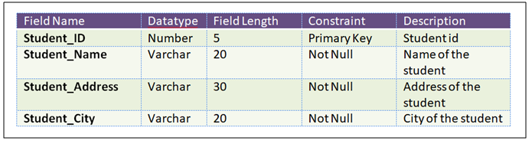
Example-Data Dictionary
Student_ID | Student_Name | Student_Address | Student_City

Slide 36
Meta Data
Metadata is simply defined as data about data.
It means it is a description and context of the data.
It helps to organize, find and understand data.
For example:
Every time you take a photo with today’s cameras a bunch of metadata is gathered and saved with it.
Such as
File name
Size of the file
Date and time
Camera settings etc.
Meta data in Relational database: Relational databases store and provide access not only data but also metadata in a structure called data dictionary or system catalog. It holds information about:
tables,
columns,
data types,
table relationship,
constraints etc.

Slide 37
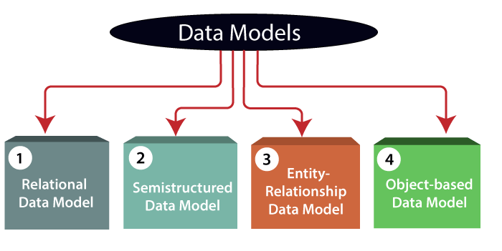
Data Models
Data models define how the logical structure of a database is modelled.
Data models define how data is connected to each other and how they are processed and stored inside the system.

Slide 38
Why use Data Model?
Ensures that all data objects required by the database are accurately represented.
Omission of data will lead to creation of faulty reports and produce incorrect results.
A data model helps to design the database at the conceptual, physical and logical levels.
Data Model structure helps to define the relational tables, primary and foreign keys and stored procedures.
It provides a clear picture of the base data and can be used by database developers to create a physical database.
It is also helpful to identify missing and redundant data.
Though the initial creation of data model is laborious and time consuming, in the long run, it makes your IT infrastructure upgrade and maintenance cheaper and faster.

Slide 39
Types of Data Model
1) Relational Data Model:
This type of model designs the data in the form of rows and columns within a table.
Thus, a relational model uses tables for representing data and in-between relationships.
Tables are also called relations.
This model was initially described by Edgar F. Codd, in 1969.
The relational data model is the widely used model which is primarily used by commercial data processing applications.

Slide 40
Types of Data Model
2) Entity-Relationship Data Model:
An ER model is the logical representation of data as objects and relationships among them.
These objects are known as entities, and relationship is an association among these entities.
This model was designed by Peter Chen and published in 1976.
It was widely used in database designing.
A set of attributes describe the entities.
For example, student_name, student_id describes the 'student' entity.
A set of the same type of entities is known as an 'Entity set', and the set of the same type of relationships is known as 'relationship set'.

Slide 41
Types of Data Model
3) Object-based Data Model:
An extension of the ER model with notions of functions, encapsulation, and object identity.
This model supports a rich type system that includes structured and collection types.
In 1980, various database systems following the object-oriented approach were developed.
Here, the objects are nothing but the data carrying its properties.

Slide 42
Types of Data Model
4) Semi-structured Data Model:
This type of data model is different from the other three data models.
The semi-structured data model allows the data specifications at places where the individual data items of the same type may have different attributes sets.
The Extensible Markup Language, also known as XML, is widely used for representing the semi-structured data.
Although XML was initially designed for including the markup information to the text document, it gains importance because of its application in the exchange of data.

Slide 43
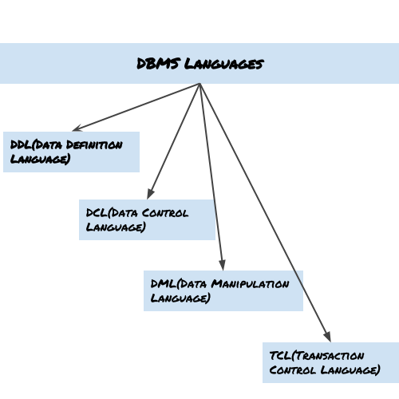
DBMS languages
Database languages are used to read, update and store data in a database. There are several such languages that can be used for this purpose; one of them is SQL.
Types of DBMS languages:

Slide 44
Data Definition Language (DDL)
DDL is used for specifying the database schema. It is used for creating tables, schema, indexes, constraints etc. in database.
The operations that we can perform on database using DDL:
To create the database instance – CREATE
To alter the structure of database – ALTER
To drop database instances – DROP
To delete tables in a database instance – TRUNCATE
To rename database instances – RENAME
To drop objects from database such as tables – DROP
To Comment – Comment

Slide 45
Data Manipulation Language (DML)
DML is used for accessing and manipulating data in a database. The following operations on database comes under DML:
To read records from table(s) – SELECT
To insert record(s) into the table(s) – INSERT
Update the data in table(s) – UPDATE
Delete all the records from the table – DELETE

Slide 46
Data Control language (DCL)
DCL is used for granting and revoking user access on a database –
To grant access to user – GRANT
To revoke access from user – REVOKE
In practical data definition language, data manipulation language and data control languages are not separate language, rather they are the parts of a single database language such as SQL.

Slide 47
Transaction Control Language(TCL)
The changes in the database that we made using DML commands are either performed or rollbacked using TCL.
To persist the changes made by DML commands in database – COMMIT
To rollback the changes made to the database – ROLLBACK

Slide 48
DBA
A Database Administrator (DBA) is individual or person responsible for controlling, maintenance, coordinating, and operation of database management system.
Managing, securing, and taking care of database system is primary responsibility.
They are responsible for authorizing access to database, coordinating, capacity, planning, installation, and monitoring uses and for acquiring and gathering software and hardware resources as and when needed.
Their role also varies from configuration, database design, migration, security, troubleshooting, backup, and data recovery.
Database administration is major and key function in any firm or organization that is relying on one or more databases.
They are overall commander of Database system.

Slide 49
Responsibilities of DBA
Installing and upgrading the database server and application tools
Allocating system storage and planning storage requirements for the database system
Modifying the database structure, as necessary, from information given by application developers
Enrolling users and maintaining system security
Ensuring compliance with database vendor license agreement
Controlling and monitoring user access to the database
Monitoring and optimizing the performance of the database
Planning for backup and recovery of database information
Maintaining archived data
Backing up and restoring databases
Contacting database vendor for technical support
Generating various reports by querying from database as per need
Managing and monitoring data replication

Slide 50
Data Independence
Data independence can be explained using the three-schema architecture.
Data independence refers characteristic of being able to modify the schema at one level of the database system without altering the schema at the next higher level.
There are two types of data independence:
Logical data independence
Physical data independence

Slide 51
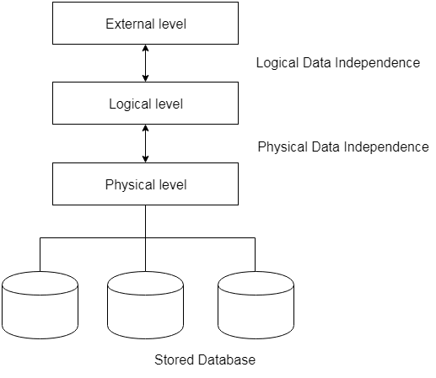
Data Independance

Slide 52
Physical Data Independance
Physical data independence allows changes in the physical storage devices or organisation of the files to be made without requiring changes in the conceptual view or any of the external views.
If we do any changes in the storage size of the database system server, then the Conceptual structure of the database will not be affected.
Thus, the files may migrate from one type of physical media to another or the file structure may change without any need for changes in the application programs.
For example, in case we want to change or upgrade the storage system itself − suppose we want to replace hard-disks with SSD − it should not have any impact on the logical data or schemas.

Slide 53
Logical Data Independence
Logical data is data about database, that is, it stores information about how data is managed inside.
For example, a table (relation) stored in the database and all its constraints, applied on that relation.
Logical data independence implies that application programs need not be changed if fields are added to an existing record; nor do they have to be changed if fields not used by application programs are deleted.
If we do some changes on table format, it should not change the data residing on the disk
Logical data independence indicates that the conceptual schema can be changed without affecting the existing external schemas.

Slide 54
ER Modelling
An Entity–relationship model (ER model) describes the structure of a database with the help of a diagram, which is known as Entity Relationship Diagram (ER Diagram).
An ER model is a design or blueprint of a database that can later be implemented as a database.
It develops a conceptual design for the database.
The main components of E-R model are: entity set and relationship set.
An ER diagram shows the relationship among entity sets.
An entity set is a group of similar entities and these entities can have attributes.
In terms of DBMS, an entity is a table or attribute of a table in database, so by showing relationship among tables and their attributes, ER diagram shows the complete logical structure of a database.

Slide 55
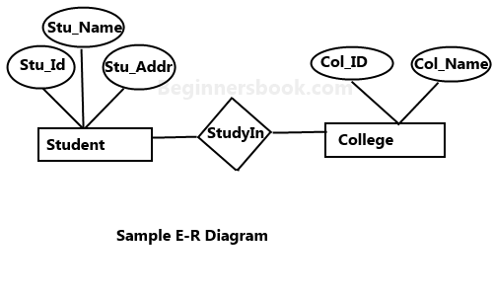
Example

Slide 56
Components of ER Diagram
Entity
Weak Entity
Strong Entity
Attribute
Single valued
Multivalued attribute(mobile No.)
Composite attribute(name=fname+lname)
Derived attribute
Relation
One to one
One to many
Many to one
Many to many

Slide 57
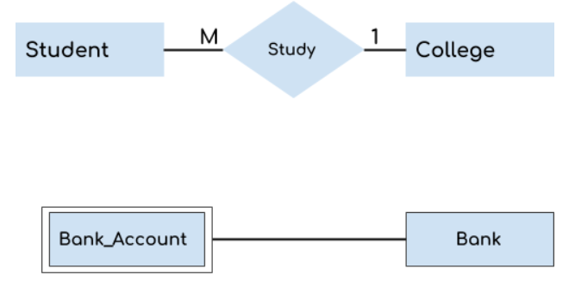
Entity
An entity may be any object, class, person or place.
In the ER diagram, an entity can be represented as rectangles.
Consider an organization as an example- manager, product, employee, department etc. can be taken as an entity.
Types of entities
Weak
Strong

Slide 58

Weak and Strong Entity
Weak Entity-
An entity that depends on another entity called a weak entity.
The weak entity doesn't contain any key attribute of its own.
The weak entity is represented by a double rectangle.
Strong entity- An entity that has a key attribute is called strong entity and represented by rectangle.

Slide 59
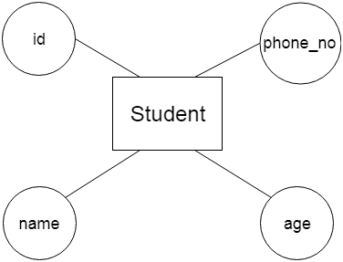
Attribute
The attribute is used to describe the property of an entity. Eclipse is used to represent an attribute.
For example, id, age, contact number, name, etc. can be attributes of a student.

Slide 60
Types of attributes
1. Key attribute 2. Simple and Composite attribute 3. Single Valued and Multivalued attribute 4. Derived attribute

Slide 61
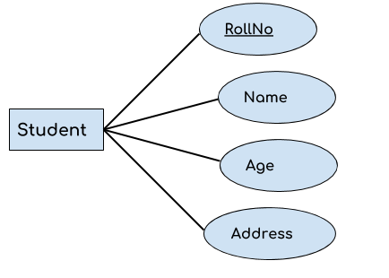
Key Attribute
A key attribute can uniquely identify an entity from an entity set.
For example, student roll number can uniquely identify a student from a set of students.
Key attribute is represented by oval same as other attributes however the text of key attribute is underlined.

Slide 62
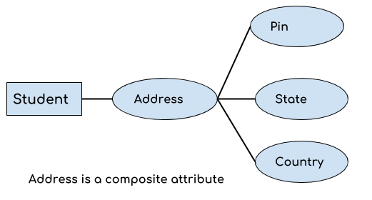
Simple and Composite attribute:
If an attribute cannot be divided into simpler components, it is a simple attribute.
Example for simple attribute : employee_id of an employee.
An attribute that is a combination of other attributes is known as composite attribute.
For example, In student entity, the student address is a composite attribute as an address is composed of other attributes such as pin code, state, country.

Slide 63
Single and Multivalued attribute:
If an attribute can take only a single value for each entity instance, it is a single valued attribute. example for single valued attribute : age of a student. It can take only one value for a particular student.
An attribute that can hold multiple values is known as multivalued attribute.
It is represented with double ovals in an ER Diagram.
For example – A person can have more than one phone numbers so the phone number attribute is multivalued.

Slide 64
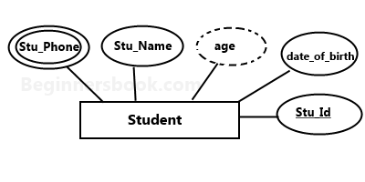
Derived Attribute
A derived attribute is one whose value is dynamic and derived from another attribute.
It is represented by dashed oval in an ER Diagram.
For example – Person age is a derived attribute as it changes over time and can be derived from another attribute (Date of birth).

Slide 65
Relationship
A relationship is represented by diamond shape in ER diagram, it shows the relationship among entities.
There are four types of relationships: 1. One to One 2. One to Many 3. Many to One 4. Many to Many

Slide 66
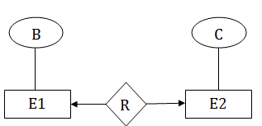
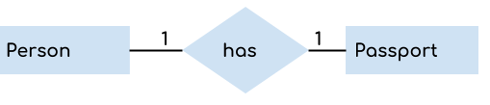
One to one relationship
When a single instance of an entity is associated with a single instance of another entity then it is called one to one relationship.
For example, a person has only one passport and a passport is given to one person.

Slide 67
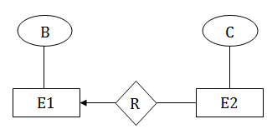
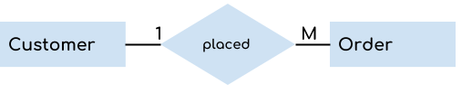
One to Many Relationship
When a single instance of an entity is associated with more than one instances of another entity then it is called one to many relationship.
For example – a customer can place many orders but a order cannot be placed by many customers.

Slide 68
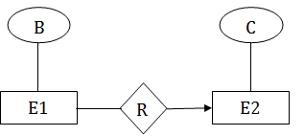

Many to One Relationship
When more than one instances of an entity is associated with a single instance of another entity then it is called many to one relationship.
For example – many students can study in a single college but a student cannot study in many colleges at the same time.

Slide 69
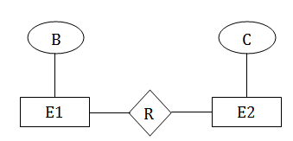

Many to Many Relationship
When more than one instances of an entity is associated with more than one instances of another entity then it is called many to many relationship.
For example, a student can be assigned to many projects and a project can be assigned to many students.

Slide 70
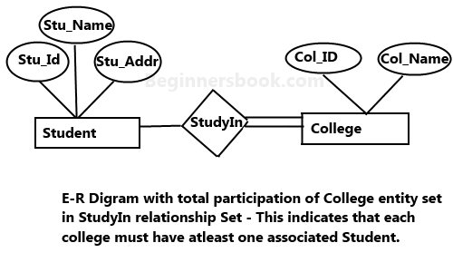
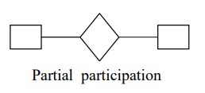
Partial and Total Participation of an Entity set
Partial participation
Consider the relationship - Employee is head of the department.
Here all employees will not be the head of the department.
Only one employee will be the head of the department.
In other words, only few instances of employee entity participate in the relationship. So employee entity's participation is partial in the said relationship.
A Total participation of an entity set represents that each entity in entity set must have at least one relationship in a relationship set.
For example: In the below diagram each college must have at-least one associated Student.

Slide 71
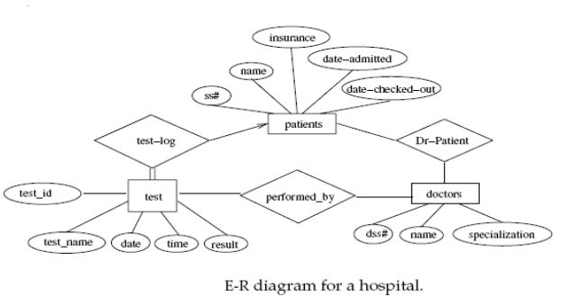
Example-E-R diagram for hospital

Slide 72
Advantages and Disadvantages of ER Modeling
Advantages
ER Modeling is simple and easily understandable.
It is represented in business users language and it can be understood by non-technical specialist.
Intuitive and helps in Physical Database creation.
Can be generalized and specialized based on needs.
Can help in database design.
Gives a higher level description of the system
Disadvantages
Physical design derived from E-R Model may have some amount of ambiguities or inconsistency.
Sometime diagrams may lead to misinterpretations

Slide 73
Keys
Keys play an important role in the relational database.
Used to uniquely identify any record or row of data from the table.
Used to establish and identify relationships between tables.
For example: In Student table, ID is used as a key because it is unique for each student. In PERSON table, passport_number, license_number, SSN are keys since they are unique for each person.

Slide 74
Types of Keys
Candidate key
Primary key
Foreign key
Alternate key
Super key

Slide 75
Keys
Candidate Key: The minimal set of attribute which can uniquely identify a tuple is known as candidate key. For Example, STUD_NO in STUDENT relation.
The value of Candidate Key is unique and non-null for every tuple.
There can be more than one candidate key in a relation. For Example, STUD_NO as well as STUD_PHONE both are candidate keys for relation STUDENT.
The candidate key can be simple (having only one attribute) or composite as well. For Example, {STUD_NO, COURSE_NO} is a composite candidate key for relation STUDENT_COURSE.
Super Key: The set of attributes which can uniquely identify a tuple is known as Super Key. For Example, STUD_NO, (STUD_NO, STUD_NAME) etc.
Adding zero or more attributes to candidate key generates super key.
A candidate key is a super key but vice versa is not true.
Primary Key: There can be more than one candidate key in a relation out of which one can be chosen as primary key. For Example, STUD_NO as well as STUD_PHONE both are candidate keys for relation STUDENT but STUD_NO can be chosen as primary key (only one out of many candidate keys).

Slide 76
Continue..
Alternate Key: The candidate key other than primary key is called as alternate key. For Example, STUD_NO as well as STUD_PHONE both are candidate keys for relation STUDENT but STUD_PHONE will be alternate key (only one out of many candidate keys).
Foreign Key: If an attribute can only take the values which are present as values of some other attribute, it will be foreign key to the attribute to which it refers.
The relation which is being referenced is called referenced relation and corresponding attribute is called referenced attribute and
the relation which refers to referenced relation is called referencing relation and corresponding attribute is called referencing attribute.
Referenced attribute of referenced relation should be primary key for it. For Example, STUD_NO in STUDENT_COURSE is a foreign key to STUD_NO in STUDENT relation.

Slide 77
Advanced ER-diagram
Abstraction is the simplification mechanism used to hide extra details of a set of objects.
It allows one to concentrate on the properties that are of interest to the application.
There are two main abstraction mechanism used to model information:
Generalization
Specialization

Slide 78
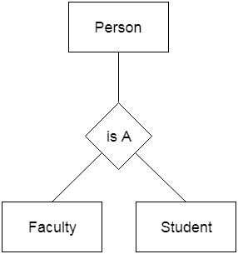
Generalization
Generalization is the abstracting process of viewing set of objects as a single general class by concentrating on the general characteristics of the constituent sets while suppressing or ignoring their differences.
Generalization is like a bottom-up approach in which two or more entities of lower level combine to form a higher level entity if they have some attributes in common.
In generalization, an entity of a higher level can also combine with the entities of the lower level to form a further higher level entity.
Generalization is more like subclass and superclass system, but the only difference is the approach. Generalization uses the bottom-up approach.
In generalization, entities are combined to form a more generalized entity, i.e., subclasses are combined to make a superclass.
For instance, student is a generalization of graduate or undergraduate, full-time or part-time students.
Similarly, employee is generalization of the classes of objects cook, waiter, and cashier.
Generalization is an IS_A relationship; therefore, manager IS_AN employee, cook IS_AN employee, waiter IS_AN employee, and so forth.

Slide 79
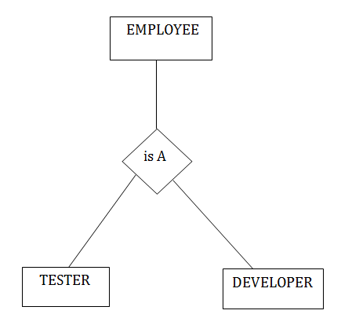
Specialization
Specialization is a top-down approach, and it is opposite to Generalization. In specialization, one higher level entity can be broken down into two lower level entities.
Specialization is used to identify the subset of an entity set that shares some distinguishing characteristics.
Normally, the superclass is defined first, the subclass and its related attributes are defined next, and relationship set are then added.

Slide 80
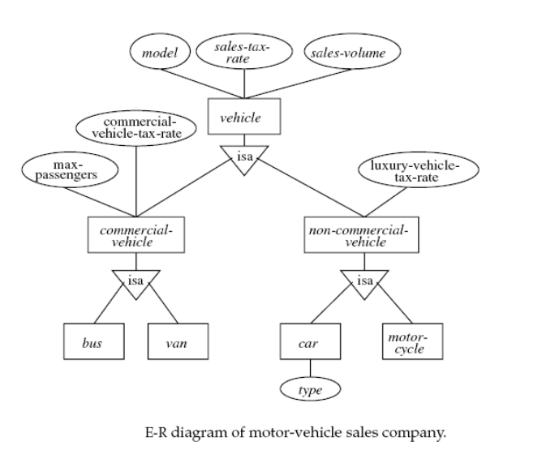
Example-Generalization and specilization

Slide 81
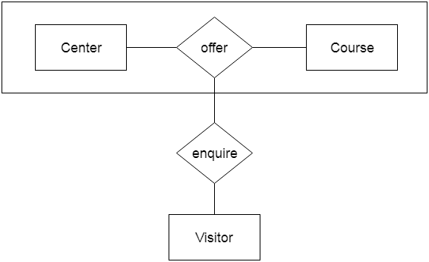
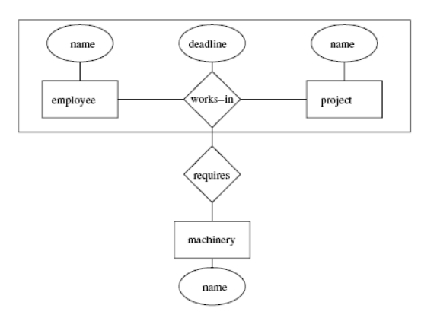
Aggregation
In aggregation, the relation between two entities is treated as a single entity. In aggregation, relationship with its corresponding entities is aggregated into a higher level entity.

Slide 82
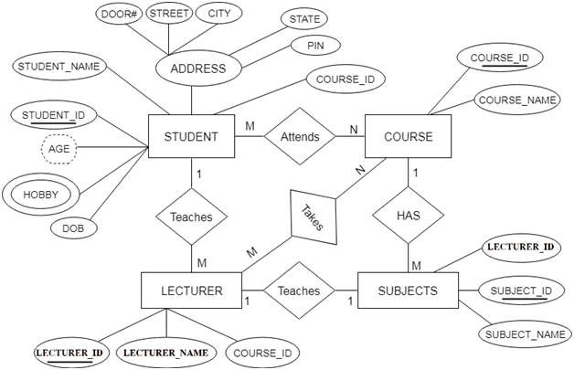
Where Aggregation is required?

Slide 83
Reduction of ER diagram to Table
Entity type becomes a table.
All single-valued attribute becomes a column for the table.
A key attribute of the entity type represented by the primary key.
The multi-valued attribute is represented by a separate table.
Composite attribute represented by components.
Derived attributes are not considered in the table.
Using these rules, you can convert the ER diagram to tables and columns and assign the mapping between the tables.

Slide 84
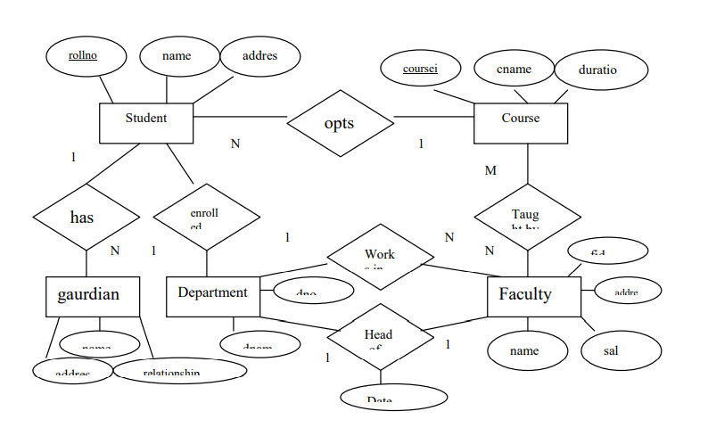
ER- Diagram For College Database

Slide 85
Conversion of entity sets:
1. For each strong entity type E in the ER diagram, we create a relation R containing all the single attributes of E.
The primary key of the relation R will be one of the key attribute of R.
STUDENT(rollno (primary key),name, address)
FACULTY(id(primary key),name ,address, salary)
COURSE(course-id,(primary key), course_name, duration)
DEPARTMENT(dno(primary key),dname)
2. for each weak entity type W in the ER diagram, we create another relation R that contains all simple attributes of W.
If E is an owner entity of W then key attribute of E is also include In R.
This key attribute of R is set as a foreign key attribute of R.
Now the combination of primary key attribute of owner entity type and partial key of the weak entity type will form the key of the weak entity type GUARDIAN((rollno,name) (primary key),address,relationship)

Slide 86
Conversion of relationship sets
One-to-one relationship:
For each 1:1 relationship type R in the ER-diagram involving two entities E1 and E2 we choose one of entities(say E1) preferably with total participation and add primary key attribute of another E as a foreign key attribute in the table of entity(E1).
Include all the simple attributes of relationship type R in E1 if any,
For example, the department relationship has been extended to include head-id and attribute of the relationship.
DEPARTMENT(D_NO,D_NAME,HEAD_ID,DATE_FROM)

Slide 87
Conversion of relationship sets:
One-to-many relationship:
For each 1:n relationship type R involving two entities E1 and E2, we identify the entity type (say E1) at the n-side of the relationship type R and include primary key of the entity on the other side of the relation (say E2) as a foreign key attribute in the table of E1.
Include all simple attribute
For example: The works in relationship between the DEPARTMENT and FACULTY.
For this relationship choose the entity at N side, i.e, FACULTY and add primary key attribute of another entity DEPARTMENT, ie, DNO as a foreign key attribute in FACULTY.
FACULTY(CONSTAINS WORKS_IN RELATIOSHIP) (ID,NAME,ADDRESS,BASIC_SAL,DNO)
Many-to-many relationship:
For each m:n relationship type R, we create a new table (say S) to represent R, We also include the primary key attributes of both the participating entity types as a foreign key attribute in s.
Any simple attributes of the m:n relationship type is also included as attributes of S.
For example: The M:n relationship taught-by between entities COURSE; and FACULTY shod be represented as a new table. The structure of the table will include primary key of COURSE and primary key of FACULTY entities.
TAUGHT-BY(ID (primary key of FACULTY table),course-id (primary key of COURSE table)

Slide 88
Conversion of relationship sets:
N-ary relationship:
For each n-ary relationship type R where n>2, create a new table S to represent R
Include as foreign key attributes in s the primary keys of the relations that represent the participating entity types.
We also include any simple attributes of the n-ary relationship type as attributes of S.
The primary key of S is usually a combination of all the foreign keys that reference the relations representing the participating entity types
customer
loan
Loan sanction
employee

Slide 89
Conversion of relationship sets:
Multi-valued attributes:
For each multivalued attribute ‘A’, we create a new relation R that includes an attribute corresponding to plus the primary key attributes k of the relation that represents the entity type or relationship that has as an attribute.
The primary key of R is then combination of A and k. For example, if a STUDENT entity has rollno,name and phone number where phone numer is a multivalued attribute then create table PHONE(rollno,phoneno) where primary key is the combination,
In the STUDENT table we need not have phone number, instead it can be simply (rollno,name) only.

Slide 90
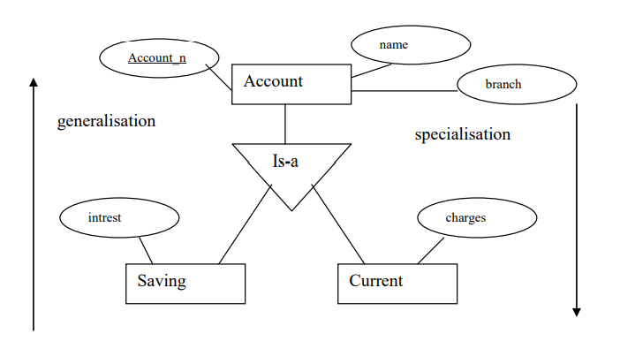
Conversion of relationship sets:
Converting Generalization /specification hierarchy to tables:
A simple rule for conversion may be to decompose all the specialized entities into table in case they are disjoint,
for example, create 3 table as:
Account(account_no,name,branch,balance)
Saving account(account-no,intrest)
Current_account(account-no,charges)

Slide 91
SQL
SQL is Structured Query Language, which is a computer language for storing, manipulating and retrieving data stored in a relational database.
SQL is the standard language for Relational Database System. All the Relational Database Management Systems (RDMS) like MySQL, MS Access, Oracle, Sybase, Informix, Postgres and SQL Server use SQL as their standard database language.

Slide 92
Why SQL?
SQL is widely popular because it offers the following advantages −
Allows users to access data in the relational database management systems.
Allows users to describe the data.
Allows users to define the data in a database and manipulate that data.
Allows to embed within other languages using SQL modules, libraries & pre-compilers.
Allows users to create and drop databases and tables.
Allows users to create view, stored procedure, functions in a database.
Allows users to set permissions on tables, procedures and views.

Slide 93
Characteristics of SQL
SQL is extremely flexible.
SQL uses a free form syntax that gives the ability to user to structure the SQL statements in a best suited way.
It is a high level language.
It receives natural extensions to its functional capabilities.
It can execute queries against the database.

Slide 94
Advantages of SQL
SQL provides a greater degree of abstraction than procedural language.
It is coded without embedded data-navigational instructions.
It enables the end users to deal with a number of database management systems where it is available.
It retrieves quickly and efficiently huge amount of records from a database.
No coding required while using standard SQL.

Slide 95
DDL
DDL stands for Data Definition Language.
It is a language used for defining and modifying the data and its structure.
It is used to build and modify the structure of your tables and other objects in the database.
DDL commands are as follows, 1. CREATE 2. DROP 3. ALTER 4. RENAME 5. TRUNCATE These commands can be used to add, remove or modify tables within a database.
DDL has pre-defined syntax for describing the data.

Slide 96
CREATE COMMAND
CREATE TABLE <table_name> ( column_name1 datatype, column_name2 datatype, . . . column_name_n datatype );

Slide 97
DROP COMMAND
DROP command allows to remove entire database objects from the database.
It removes entire data structure from the database.
It deletes a table, index or view.
Syntax: DROP TABLE <table_name>; OR DROP DATABASE <database_name>;

Slide 98
ALTER COMMAND
An ALTER command allows to alter or modify the structure of the database.
It modifies an existing database object.
Using this command, you can add additional column, drop existing column and even change the data type of columns.
Syntax: ALTER TABLE <table_name> ADD <column_name datatype>;

Slide 99
RENAME COMMAND
RENAME command is used to rename an object.
It renames a database table.
Syntax: RENAME TABLE <old_name> TO <new_name>;

Slide 100
TRUNCATE COMMAND
TRUNCATE command is used to delete all the rows from the table permanently.
It removes all the records from a table, including all spaces allocated for the records.
This command is same as DELETE command, but TRUNCATE command does not generate any rollback data.
Syntax: TRUNCATE TABLE <table_name>; Example: TRUNCATE TABLE employee;

Slide 101
SQL Data Manipulation Language (DML)
Introduction to DML
DML stands for Data Manipulation Language.
It is a language used for selecting, inserting, deleting and updating data in a database.
It is used to retrieve and manipulate data in a relational database.
DML commands are as follows, 1. SELECT 2. INSERT 3. UPDATE 4. DELETE DML performs read-only queries of data.

Slide 102
Basic Structure
Basic structure of an SQL expression consists of select, from and where clauses.
select clause lists attributes to be copied - corresponds to relational algebra project.
from clause corresponds to Cartesian product - lists relations to be used.
where clause corresponds to selection predicate in relational algebra.
Typical query has the form
select A1,A2, A3,....from r1,r2,r3,..... where P
where each Ai represents an attribute, each ri a relation, and P is a predicate.
This query is equivalent to the relational algebra expression:
ΠA1,A2, ..., An(P(r1r2...rm))

Slide 103
Structure of DML statement
Select [attributelist][*] from [relations/tables]
where [predicate/condition]
Insert into tablename ([attributelist])values(value1,value2,....)
OR
Insert into tablename values(value1,value2,....))
Delete * from tablename where predicate

Slide 104
Aggregate Functions
These functions operate on the multiset of values of a column of arelation, and return a value
avg: average value
min: minimum value
max:maximum value
sum: sum of values
count: number of values

Slide 105
Find the average account balance at the Perryridge branch.
select avg(balance) from account where branch-name= “Perryridge”
Find the number of tuples in the customer relation.
select count(*) from customer
Find the number of depositors in the bank.
select count(distinctcustomer-name) from depositor

Slide 106
SET Operations in SQL
SQL supports few Set operations which can be performed on the table data. These are used to get meaningful results from data stored in the table, under different special conditions.
UNION
UNION ALL
INTERSECT
MINUS

Slide 107
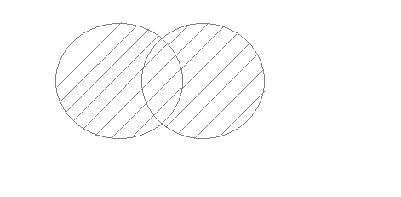
UNION Operation
UNION is used to combine the results of two or more SELECT statements. However it will eliminate duplicate rows from its resultset. In case of union, number of columns and datatype must be same in both the tables, on which UNION operation is being applied.

Slide 108
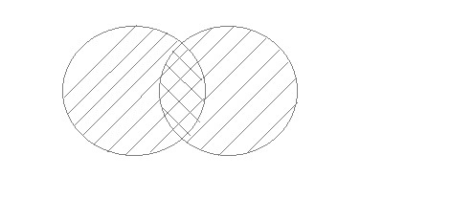
UNION ALL
This operation is similar to Union. But it also shows the duplicate rows.

Slide 109
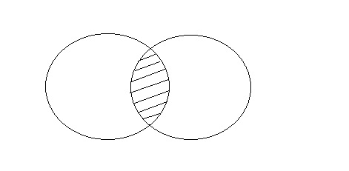
INTERSECT
Intersect operation is used to combine two SELECT statements, but it only retuns the records which are common from both SELECT statements. In case of Intersect the number of columns and datatype must be same.

Slide 110
The First table
ID | NAME
1 | abhi
2 | adam
The Second table
ID | NAME
2 | adam
3 | Chester
Result of MINUS will be
ID | NAME
2 | adam

Slide 111
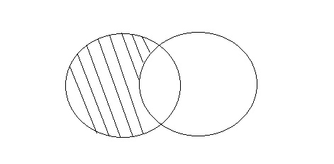
Set difference(MINUS)
The Minus operation combines results of two SELECT statements and return only those in the final result, which belongs to the first set of the result.(returns unique records from table1)

Slide 112
The First table
ID | NAME
1 | abhi
2 | adam
The Second table
ID | NAME
2 | adam
3 | Chester
Result of MINUS will be
ID | NAME
1 | abhi

Slide 113
nested sub queries
A Subquery or Inner query or a Nested query is a query within another SQL query and embedded within the WHERE clause.
A subquery is used to return data that will be used in the main query as a condition to further restrict the data to be retrieved.
Subqueries can be used with the SELECT, INSERT, UPDATE, and DELETE statements along with the operators like =, <, >, >=, <=, IN, BETWEEN, etc.

Slide 114
There are a few rules that subqueries must follow −
Subqueries must be enclosed within parentheses.
A subquery can have only one column in the SELECT clause, unless multiple columns are in the main query for the subquery to compare its selected columns.
An ORDER BY command cannot be used in a subquery, although the main query can use an ORDER BY. The GROUP BY command can be used to perform the same function as the ORDER BY in a subquery.
Subqueries that return more than one row can only be used with multiple value operators such as the IN operator.
A subquery cannot be immediately enclosed in a set function.
The BETWEEN operator cannot be used with a subquery. However, the BETWEEN operator can be used within the subquery.

Slide 115
SELECT column_name [, column_name ] FROM table1 [, table2 ] WHERE column_name OPERATOR (SELECT column_name [, column_name ] FROM table1 [, table2 ] [WHERE])

Slide 116
Using GRANT and REVOKE
Data Control Language(DCL) is used to control privileges in Database. To perform any operation in the database, such as for creating tables, sequences or views, a user needs privileges. Privileges are of two types,
System: This includes permissions for creating session, table, etc and all types of other system privileges.
Object: This includes permissions for any command or query to perform any operation on the database tables.
GRANT: Used to provide any user access privileges or other priviliges for the database.
REVOKE: Used to take back permissions from any user.

Slide 117
Transaction Control language(TCL)
Transaction Control Language(TCL) commands are used to manage transactions in the database.
These are used to manage the changes made to the data in a table by DML statements.
It also allows statements to be grouped together into logical transactions.
COMMIT command
COMMIT command is used to permanently save any transaction into the database.
When we use any DML command like INSERT, UPDATE or DELETE, the changes made by these commands are not permanent, until the current session is closed, the changes made by these commands can be rolled back.
To avoid that, we use the COMMIT command to mark the changes as permanent. Sql> commit;

Slide 118
ROLLBACK command
This command restores the database to last commited state. It is also used with SAVEPOINT command to jump to a savepoint in an ongoing transaction.
If we have used the UPDATE command to make some changes into the database, and realise that those changes were not required, then we can use the ROLLBACK command to rollback those changes, if they were not commited using the COMMIT command.
SQL>ROLLBACK TO savepoint_name;

Slide 119
SAVEPOINT command
SAVEPOINT command is used to temporarily save a transaction so that you can rollback to that point whenever required.

