Slide 1
ENGI 301 Clap-on LED Light Strip PCB Proposal
11/16/21
Haruto Sasajima

Slide 2
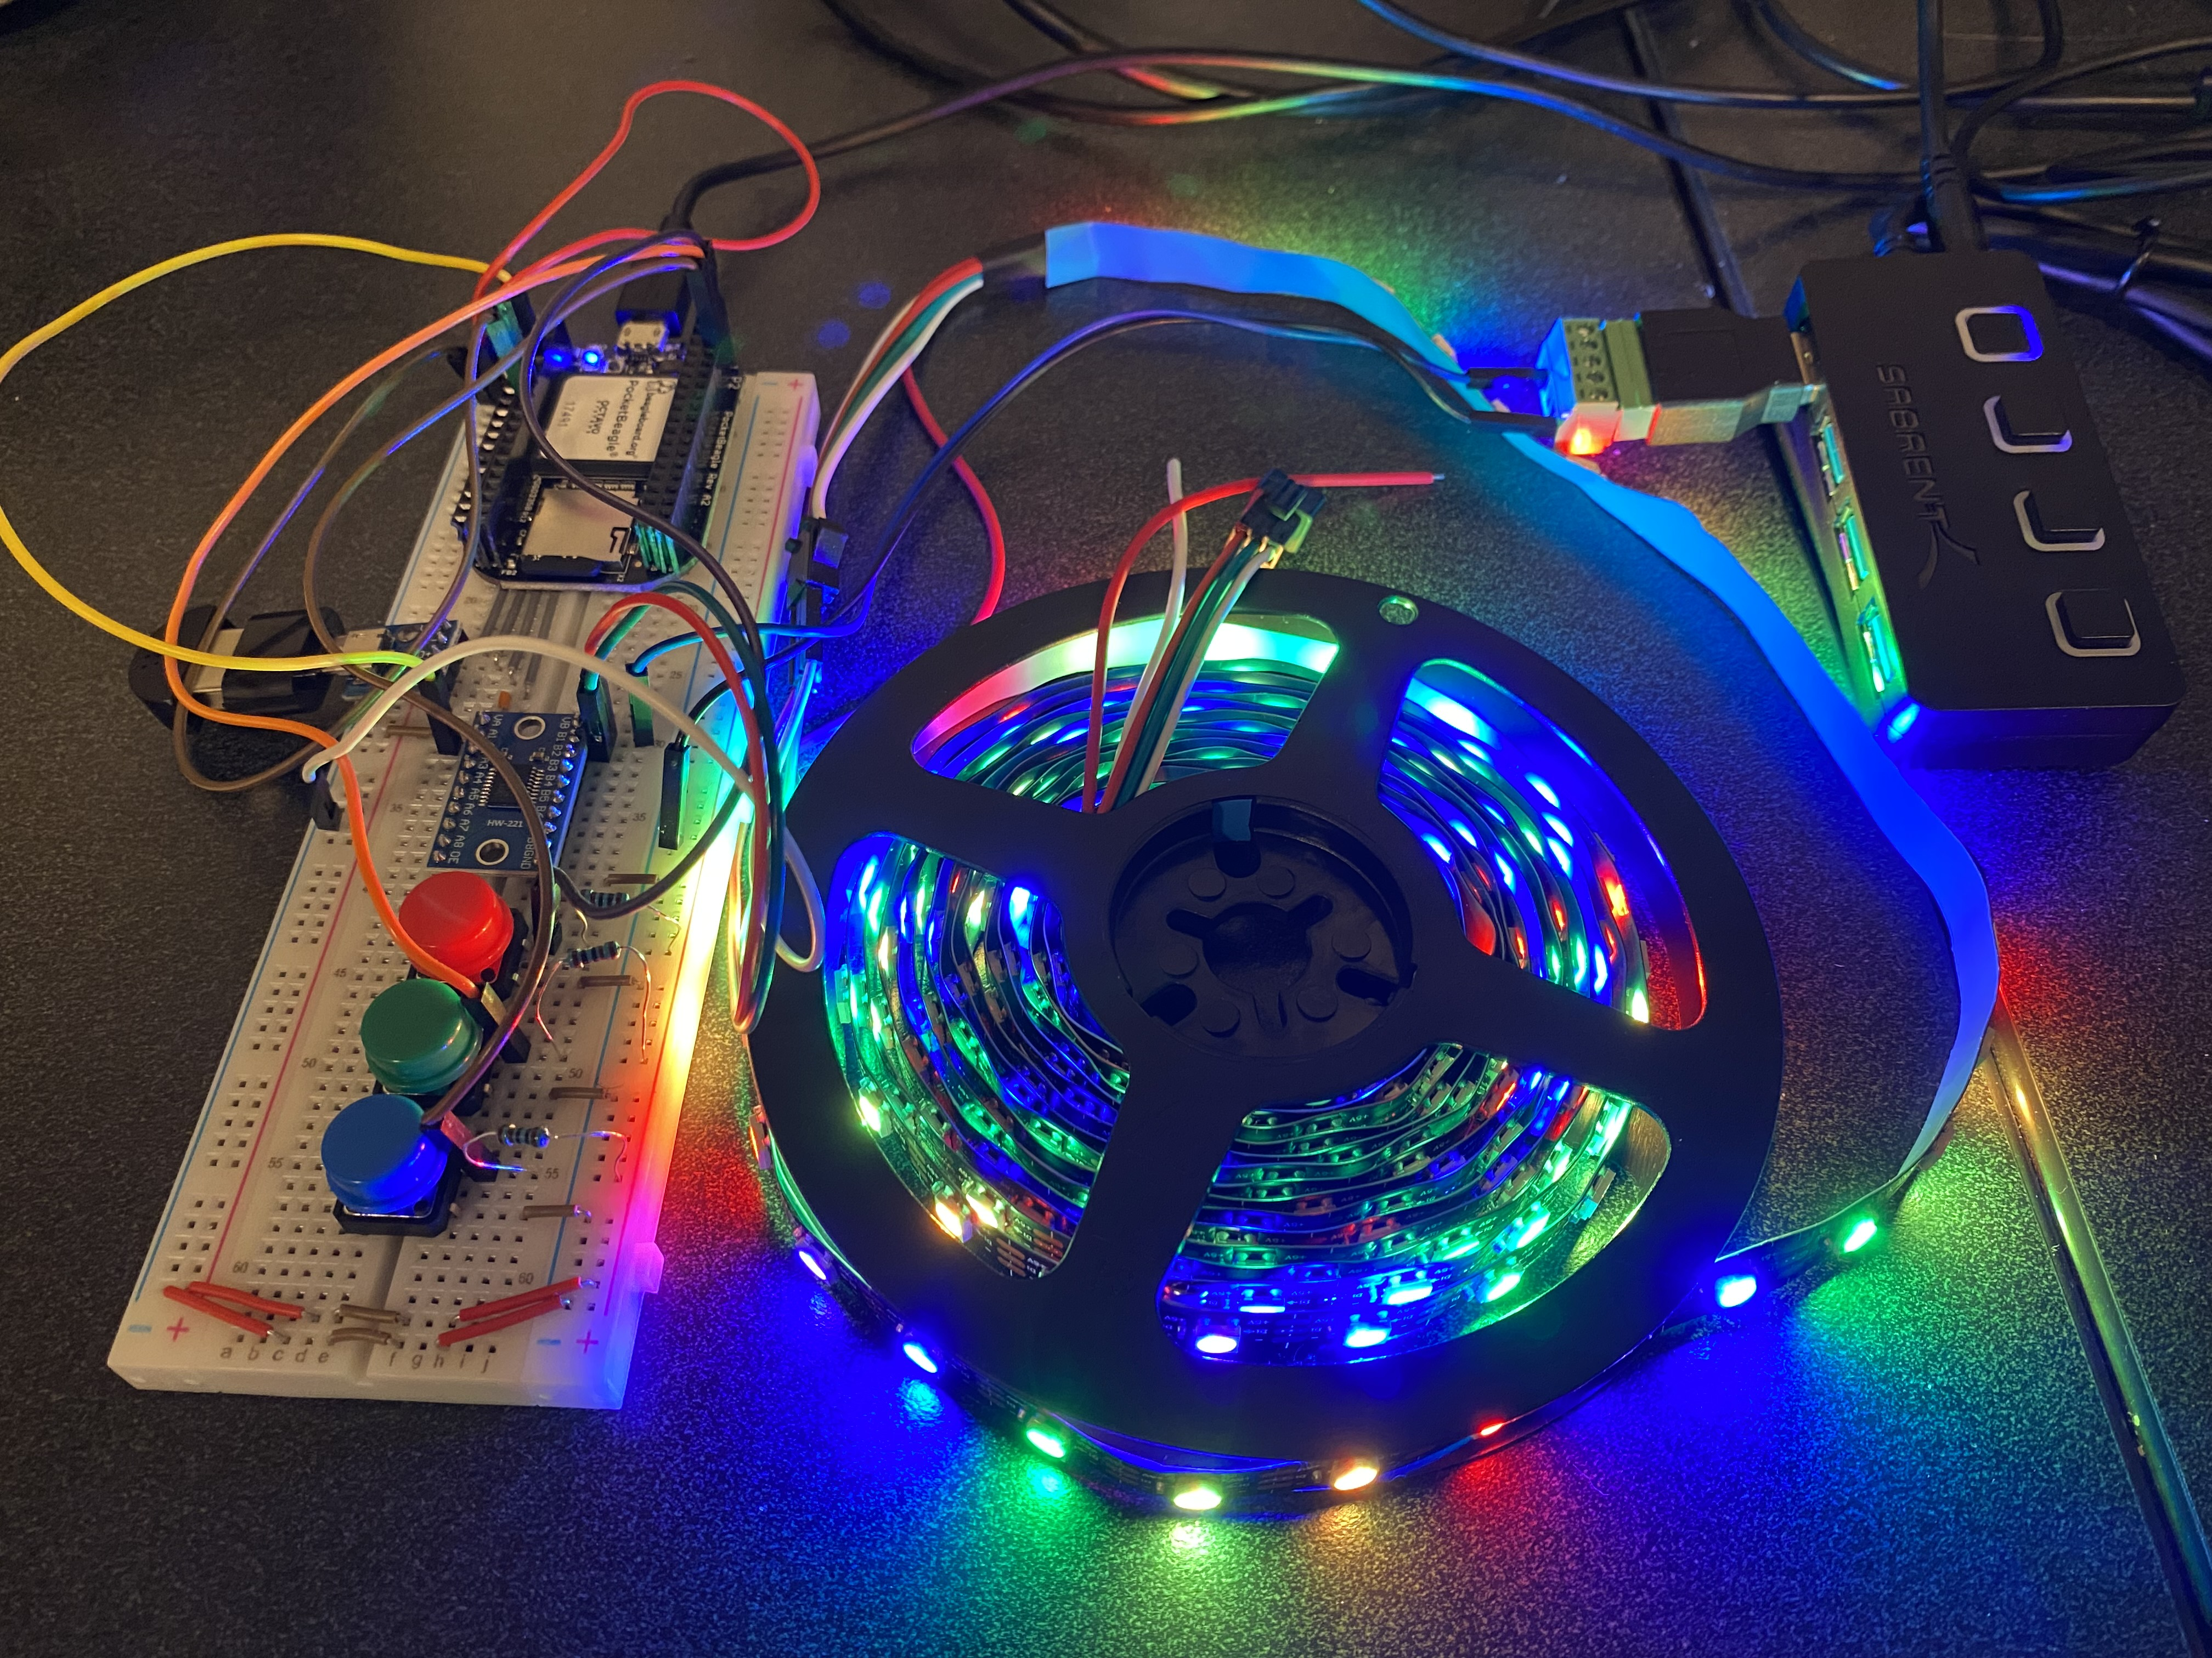
Background Information
Proposal
To make a PCB for an LED strip that is able to be turned on and off by clapping. It also includes buttons that correspond with different color settings.
A detailed walkthrough of the device can be found here:
https://www.hackster.io/hs49/clap-on-led-light-strip-6bed85
https://github.com/hs49rice/ENGI301/tree/main/project_01

Slide 3
System Block Diagram
USB Hub
PocketBeagle
Level Shifter
(TXS0108E)
LED Light Strip
Micro USB Port
USB1
GPIO (P1.08)
USB A Microphone
Button
GPIO (P2.02)
GPIO (P2.04)
GPIO (P2.06)
Button
Button

Slide 4
Mechanical Block Diagram
3”
.25”
.5”
.1”
Power Supply USB Port
.25”
Level Shifter
.5”
Pocket Beagle
.5”
.25”
1”
Micro USB hub
USB
2.5”
.1”
Button
.1”
Button
.1”
Button
.5”
1”
LED Strip Connector
.25”
1.5”
FRONT
BACK

Slide 5
Components Required
USB Hub
TXS0108E Level Shifter
Micro USB port
3-pin 100-mil Strip LED connector
Buttons
Pocket Beagle
1k Ohm Resistors

