Slide 1
ENGI 301 Clap-on LED Light Strip PCB Proposal
11/16/21
Haruto Sasajima

Slide 2
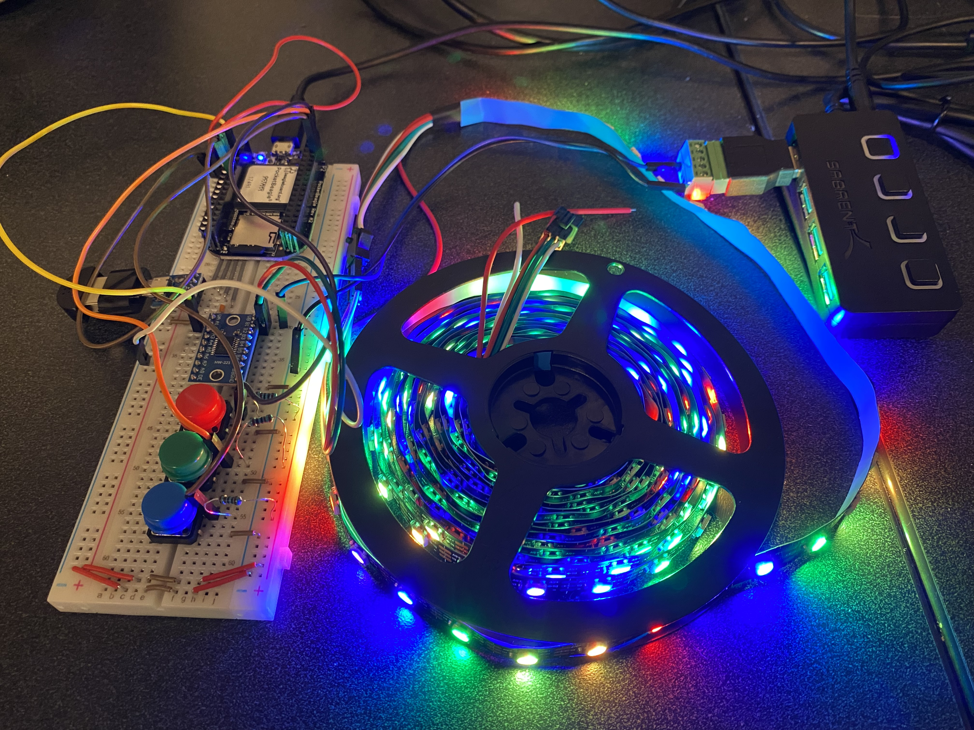
Background Information
Proposal
To make a PCB for an LED strip that is able to be turned on and off by clapping. It also includes buttons that correspond with different color settings.
A detailed walkthrough of the device can be found here:
https://www.hackster.io/hs49/clap-on-led-light-strip-6bed85
https://github.com/hs49rice/ENGI301/tree/main/project_01

Slide 3
System Block Diagram
USB Hub
PocketBeagle
Level Shifter
(TXS0108E)
LED Light Strip
Micro USB Port
USB1
GPIO (P1.08)
USB A Microphone
Button
GPIO (P2.02)
GPIO (P2.04)
GPIO (P2.06)
Button
Button

Slide 4
Mechanical Block Diagram
2750mil
300mil
550 mil
USB
500mil
Pocket Beagle
500 mil
300 mil
Level Shifter
475mil
Button
Button
Button
275mil
50mil
500mil
1500mil
150 mil
LED
Connector
150mil
300 mil
500mil
100 mil
300 mil
1.5”
FRONT
BACK

Slide 5
Components Required
USB Hub
TXS0108E Level Shifter
3-pin 100-mil Strip LED connector
3 push buttons
Pocket Beagle
1k Ohm Resistors

