Slide 1
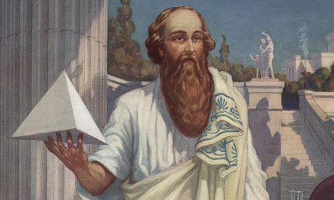
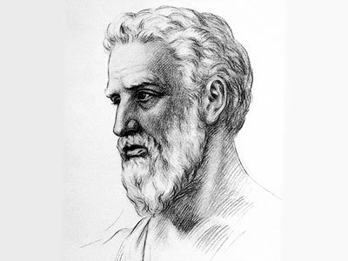
Pythagoras

Slide 2
Contents
Biography
Strings and pitch
Proof of Pythagoras’ theorem

Slide 3
Biography
A brief summary about Pythagoras’ life and his contributions to maths, astronomy and music. Not much is known about his private life as he lived almost 3000 years ago, but his teachings have lived on to this day helping us to understand more about this world we live in.
Bibliography
http://www.mathopenref.com/pythagoras.html
http://mathforum.org/dr.math/faq/faq.pythagorean.html
http://www.slideshare.net/992751/pythagorass-effect-on-our-world-today-presentation

Slide 4
Pythagoras was born in 570 BC, Samos, Greece and died in Metapontum, Italy. In the year 495 BC.
As well as working in Mathematics, Pythagoras also worked in areas like music and astronomy. In music he taught students about intervals, harmonies and octaves. He also found out that the movements of planets created sounds as well.
One of his famous quotes is;
"Through Vibration comes Motion
Through Motion comes Color
Through Color comes Tone"
He is linking vibration and tone together by explaining that to achieve motion you must have vibration , like a car.
Motion creates colour, like whether a star is moving towards us or away, it is either a red or a blue colour.
Colours have different tones like dark red and light red. There are also tones in music which was one the areas Pythagoras was interested in.
But if you are looking at it in a direct way, guitar strings vibrate to create sound, or tone.

Slide 5
A theorem discovered by Pythagoras lets us calculate any side of a right angled triangle if we know the other two of sides. The formula is;
Example:
I wanted a new TV and knew that there was a nice TV in the shop that was 70cm diagonally and 50cm long. I needed to make sure that it would fit the space I had left for it.
TV’s are measured diagonally so I needed to measure my space to make sure the TV would fit. The space I had was 50cm by 40cm.
= (40x40)+(50x50)
= 1600+2500
= 4100
c = 4100 squared
c = 61.03cm The TV was too big.
c = a + b
2 2 2
b
c
a
c = a + b
2 2 2
40cm
50cm

Slide 6
Astronomy was one of the areas in which Pythagoras was interested in. He taught his students that the movement of planets traveling through the universe created sounds. He also said that those who trained would be able to hear it.
Pythagoras said that the other planets were all spheres and that the sun and planets revolved around the earth.
Pythagoras taught that earth was a sphere the centre of the universe. He also said that stars and planets were spheres, while a planet’s path was circular. He also recognized that ‘the evening star’ and ‘the morning star’ were actually the planet Venus.
Pythagoras contributed to our understating of geometry and trigonometry. This consisted of angles, triangles, area, proportion, polygons and polyhedra.

Slide 7
Pythagorean universe
Jupiter
Sun
Moon
Earth
Venus
Mercury
Mars
Saturn
Pythagoras taught his students that earth was the centre of the universe.

Slide 8
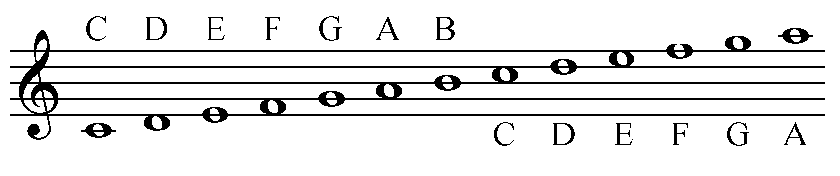
Strings and Pitch
Although Pythagoras was not a musician, he is now, generally credited for the discovery of the diatonic scale.
No one really knows how Pythagoras started on this as he was not a musician, but a myth has been made up to help explain this.
http://www.sacred-texts.com/eso/sta/sta19.htm
http://www.justonic.com/pythagoras.html
2nd interval
1 octave

Slide 9

Myth (Summary):
While thinking about the problem of harmony, Pythagoras passed a blacksmiths shop where the workmen were pounding a piece of metal. Depending on where the hammer struck, it produced a different sound. Pythagoras went in and carefully examined the tools taking note of their weight.
He went home and tried to replica
what he saw at the blacksmiths’.
By dangling pieces of string the same
length and adding different weights to
the end the strings he stuck the strings
and listened to the sound.
He found that strings 1 & 4 were an octave different to each other because they were half the weight.
Wood
1
2
3
4
Strings
weights
12 9 8 6 pounds
Different octaves on a piano
Click

Slide 10
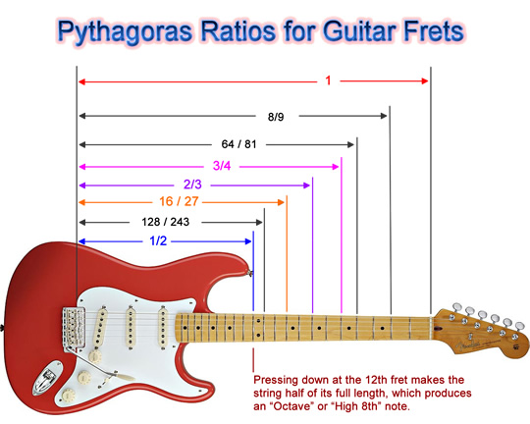

He found that using the ratio of 2:1 weight/length produced 1 octave.
By using the ratios;
3:2 (eg. C to G)
4:3 (eg. C to F)
Pythagoras was able to figure out all the different intervals starting from the 2nd interval to the 8th interval (1 octave).
Pythagoras had found that a notes pitch, depended on the length of the string.
Will produce a higher sound.
Will produce a lower sound.
1 octave
Click
Proof

Slide 11
Pythagoras’ Theorem
Using this theorem you can find the length of any side of a right-angled triangle, if you know the length of the other two sides.
It is a very useful tool to use but how did he even find it?
To find that out, we must do a mathematical proof.
http://www.mathsisfun.com/geometry/pythagorean-theorem-proof.html

Slide 12
Algebra is one of the ways to prove Pythagoras’ theorem.
Area of whole square is;
Total area=(a+b)(a+b)
Area of smaller square
= c x c
= c
Area of 1 triangle= 1/2ab
Area of all triangles= 4 (1/2ab) = 2ab
Smaller square (area) + small triangles (area)
= c + 2ab
a
b
a
b
c
c
c
c
b
2
a
b
a
2

Slide 13
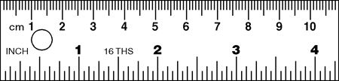
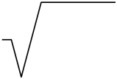
Simplify
(a+b)(a+b) = c + 2ab Equation
a + 2ab + b = c + 2ab Expand
a + b = c Pythagoras’ theorem!
Example
c = a + b formula
c = 6 + 4 substitution
c = 36 + 16 working out
c = 52
c = 7.22 units answer
2
2 2 2
2 2 2
2 2 2
Unknown
c
2 2 2
6
2
4

Slide 14
The End
Koniec
La fin
El final
La fine
Sfarsit
Son
Sonunda
Ende

