Slide 1

KKB Redemption Arc
Project the Bletchley code breaker

Slide 2
Teammates
Hussein Abumelih – Scrum Trainer
Bozhidar Dimitrov – Developer
Anton Slavov – Developer
Jacqueline Yordanova – Documentation
Kaloyan Yordanov – Code Checker
Volen Mateev – Quality Engineer

Slide 3





For the implementation

Slide 4
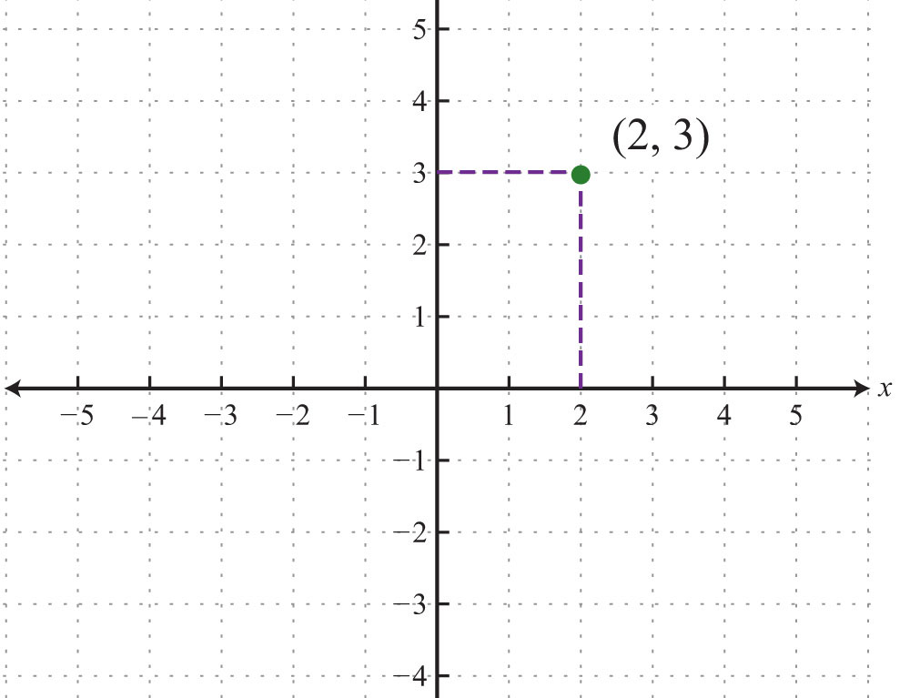

About the project
The program asks the player to guess the coordinates of the ship
If the player has 13 guesses
If he doesn't estimate it in 13 guesses he lose, otherwise he wins

Slide 5

Further goals and enchantments
Code optimization
Better organization

Slide 6

Conclusion
There is no doubt that this project was completed with a lot of intensive effort, time and organization. During the whole project development phase, we came face to face with practically applicable aspect of programming which may guide us in developing future projects.
This Photo by Unknown author is licensed under CC BY-SA-NC.

Slide 7



Thank you for your attention!

