Slide 1


Slide 2
TEAMMATES
Hussein Abumelih - Scrum Trainer / Developer
Anton Slavov - Developer Back-End

Slide 3
Contents
1.Topic
2.Summary
Goal
Main stages in accomplishment of the project:
Planning
Realization
4.Going through the code
Time management
3.Main problems during realization
Working with files

Slide 4
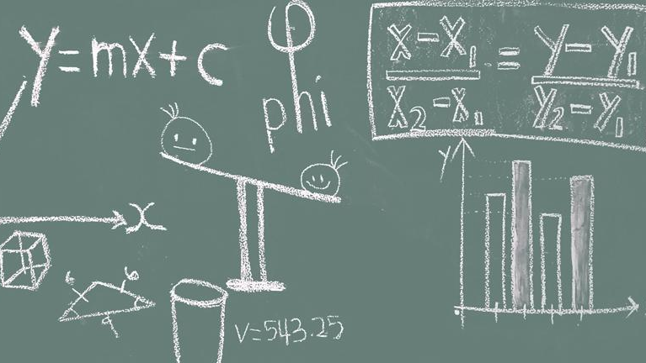
Summary
This Photo by Unknown author is licensed under CC BY.

Slide 5

Goal
Goal - To implement a chosen algorithm that searches for a word in a list and sorts the results by proximity

Slide 6
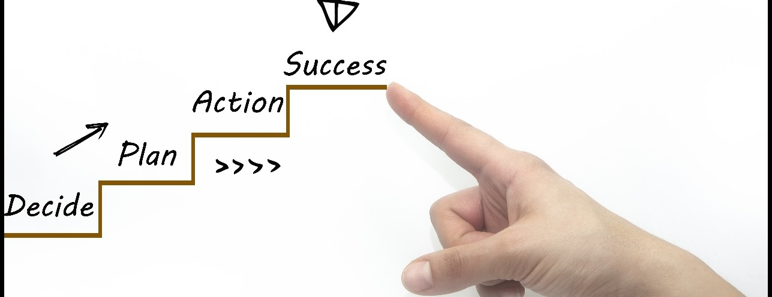
Main stages in accomplishment of the project

Slide 7

Difficulties during realisation

Slide 8

Going through the project
This Photo by Unknown author is licensed under CC BY-NC-ND.

Slide 9
THANK YOU FOR YOUR ATTENTION!

