Slide 1
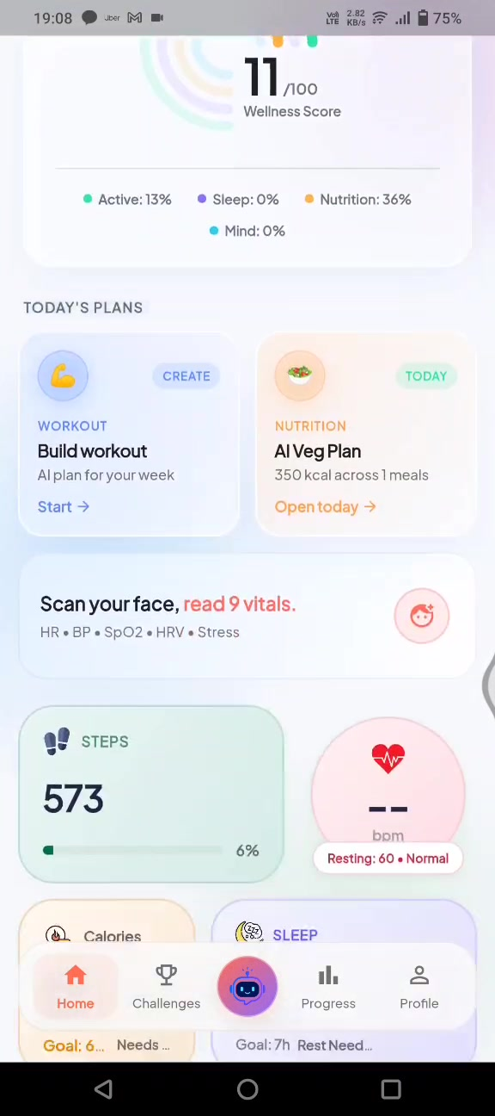

USER FLOW · FROM APP DEMO VIDEO
How a user
moves through
MediFit.
Sign up → Home → SOS & Gym → Plans → Log health
→ AI Buddy chat → Challenges → Progress → Profile
MediFit Wellness360

Slide 2
End-to-end journey map
Primary path from the demo video, plus AI Buddy chat — log data, health updates, and Q&A.
01
02
03
04
05
06
07
08
Auth
Home
Safety
Plans
Log
AI Chat
Engage
Profile
Create account
or social login
Score, goals,
plans hub
SOS + gym
QR check-in
Workout &
nutrition AI
Water, food,
metrics
Log data &
health Q&A
Challenges &
progress
Identity &
preferences
MediFit Wellness360 · User Flow · 2/15

Slide 3
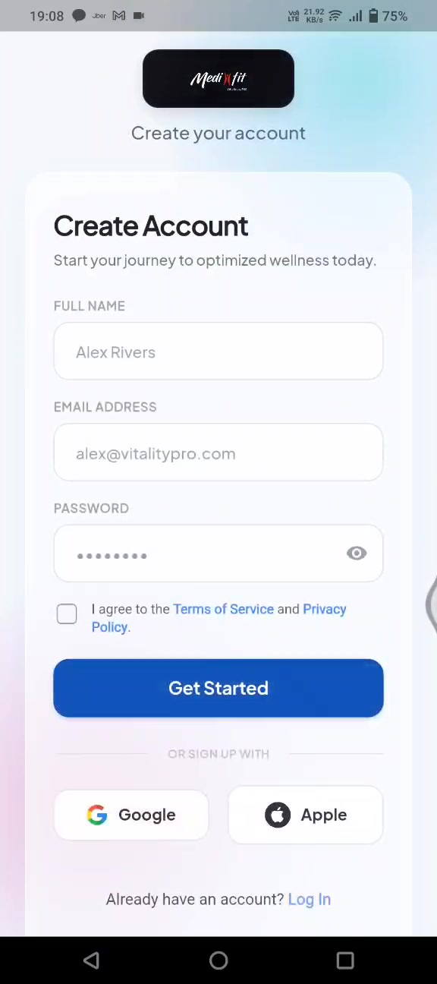

STEP 01 · AUTH
Create account
& enter the app.
Demo opens on Create Account. User can also use Google or Apple, then land on Home.
Next
Home
Dashboard
Full name, email, password
Terms & privacy acceptance
Google / Apple social signup
Existing users → Log In
MediFit Wellness360 · User Flow · 3/15

Slide 4




02 · Home — daily command center
Everything starts here: wellness score, quick actions, today’s plans, bottom nav.
SOS & Gym tiles
Daily Wellness Score
One-tap emergency and gym QR entry from the top of Home.
Ring score 0–100 across Active, Sleep, Nutrition, Mind.
Today’s Plans
Bottom navigation
Workout plan card + Nutrition plan card with open / start.
Home · Challenges · AI Buddy chat · Progress · Profile.
MediFit Wellness360 · User Flow · 4/15

Slide 5
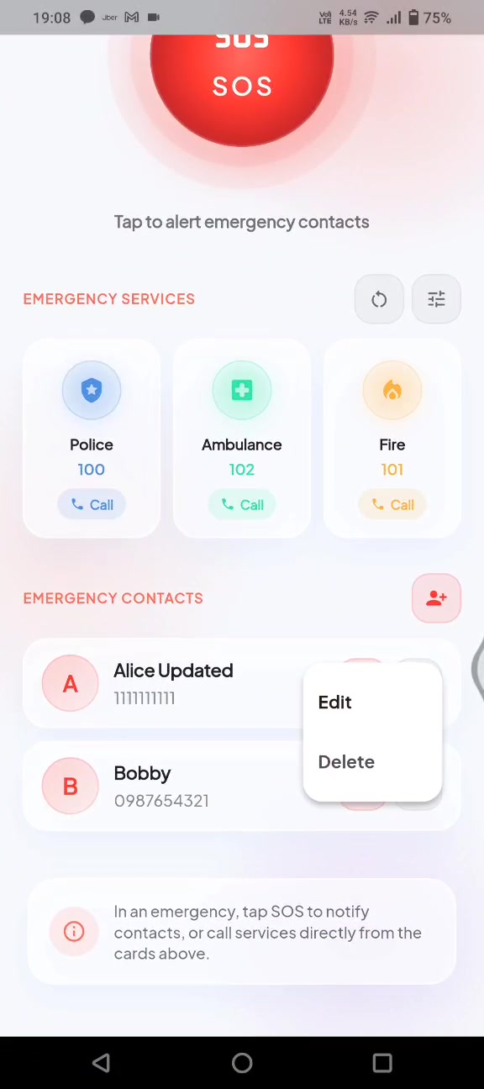
STEP 03A · SAFETY
SOS Emergency flow
Home → SOS tile → one-tap alert + services + contacts.
1
Large SOS button
Tap to alert emergency contacts
2
Emergency services
Police 100 · Ambulance 102 · Fire 101
3
Personal contacts
Add / call saved emergency people
4
Confirm feedback
Toast confirms numbers updated
MediFit Wellness360 · User Flow · 5/15

Slide 6
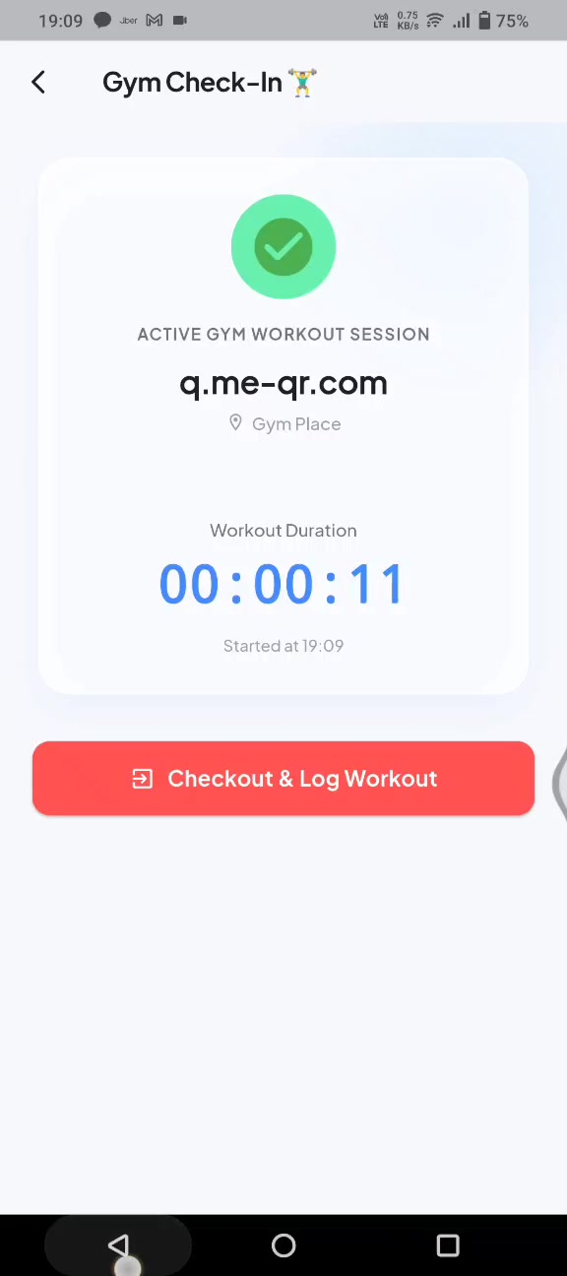
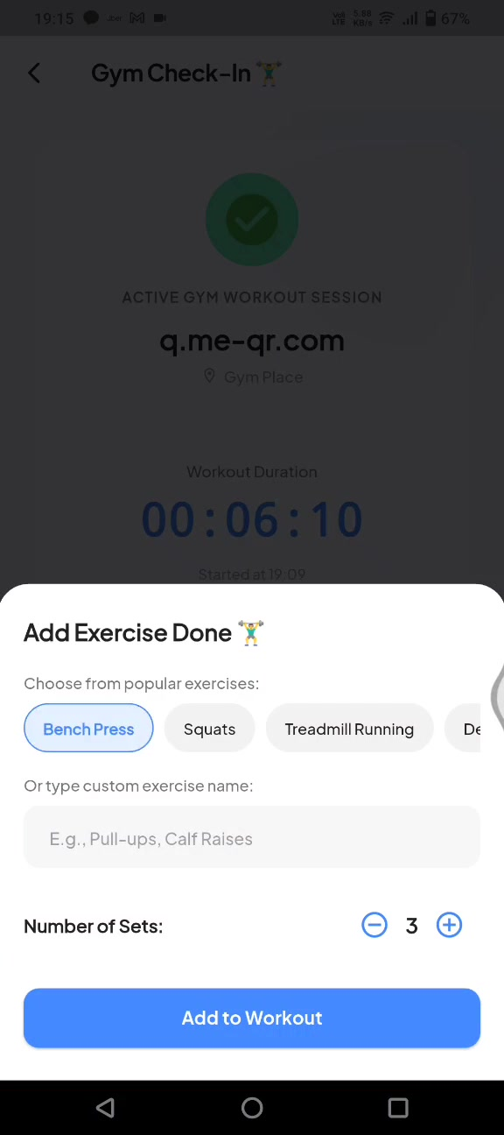
03B · Gym QR check-in & checkout
Home → Gym → scan QR → live timer → log exercises → checkout.
1
Scan partner gym QR
JSON preferred: name + place
2
Active session timer
Duration + gym name shown
3
Home shows GYM ACTIVE
Live countdown tile on dashboard
4
Checkout & log
Add exercises/sets → Checkout & Log
MediFit Wellness360 · User Flow · 6/15

Slide 7
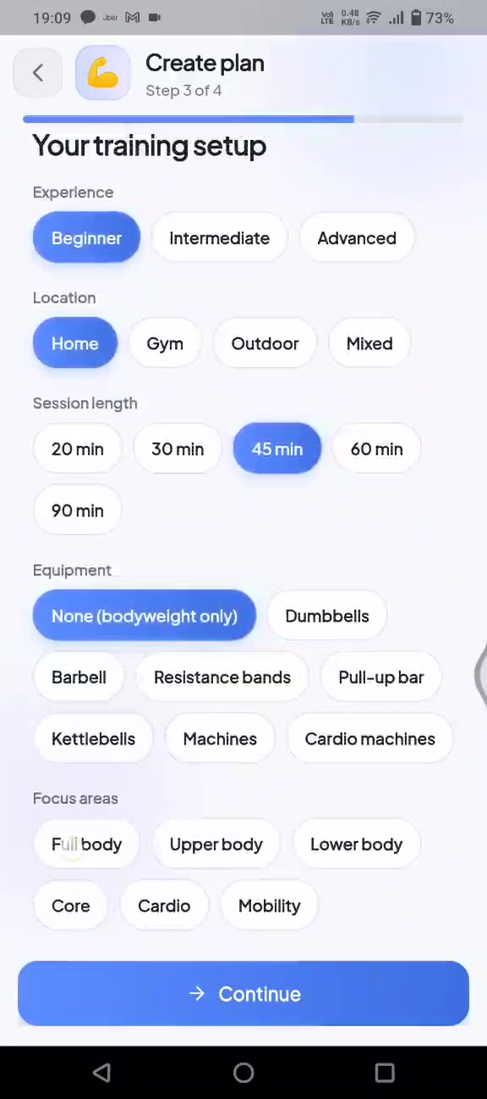
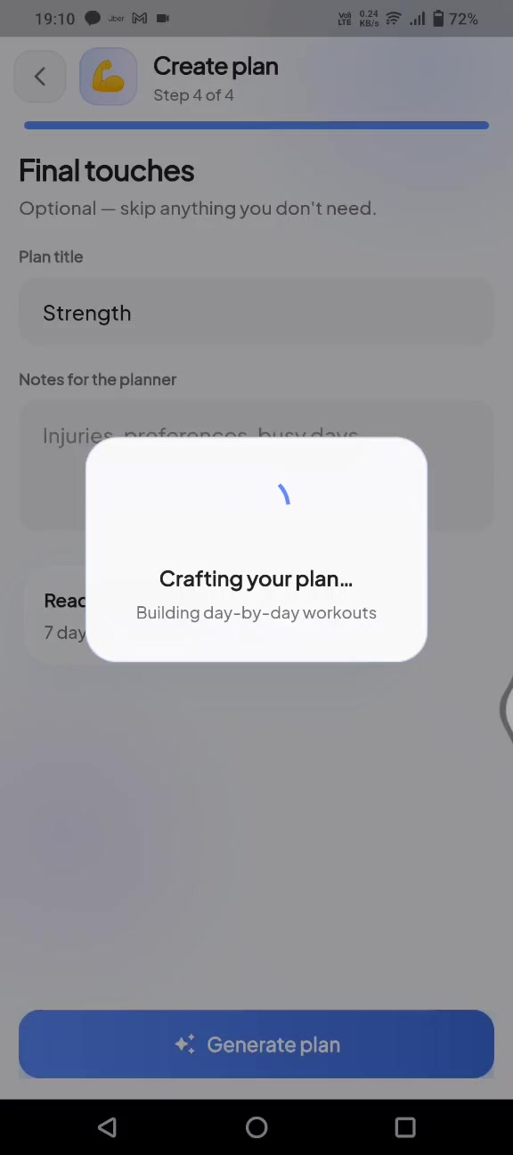
04A · Create workout plan (AI)
Home → Workout card → Create plan → 4-step wizard → generated Strength plan.
1–2
Goal & setup
Primary goal e.g. Build muscle; intensity & duration.
3–4
Final touches
Plan title (e.g. Strength), notes, generate.
AI
Crafting plan…
Backend builds day-by-day workouts.
Done
Strength plan
Exercises, sets, muscle tags, instructions.
MediFit Wellness360 · User Flow · 7/15

Slide 8
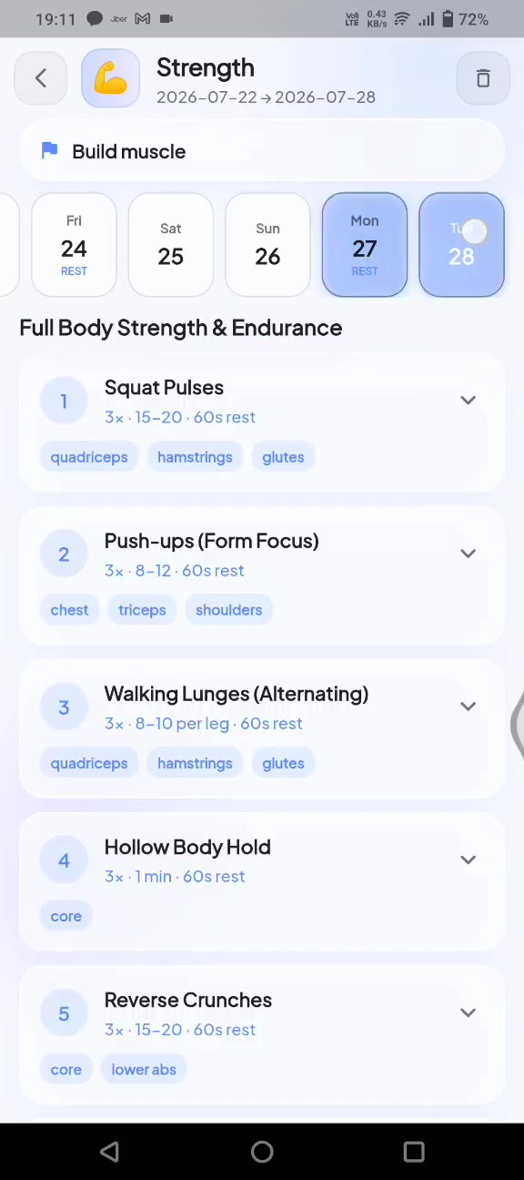
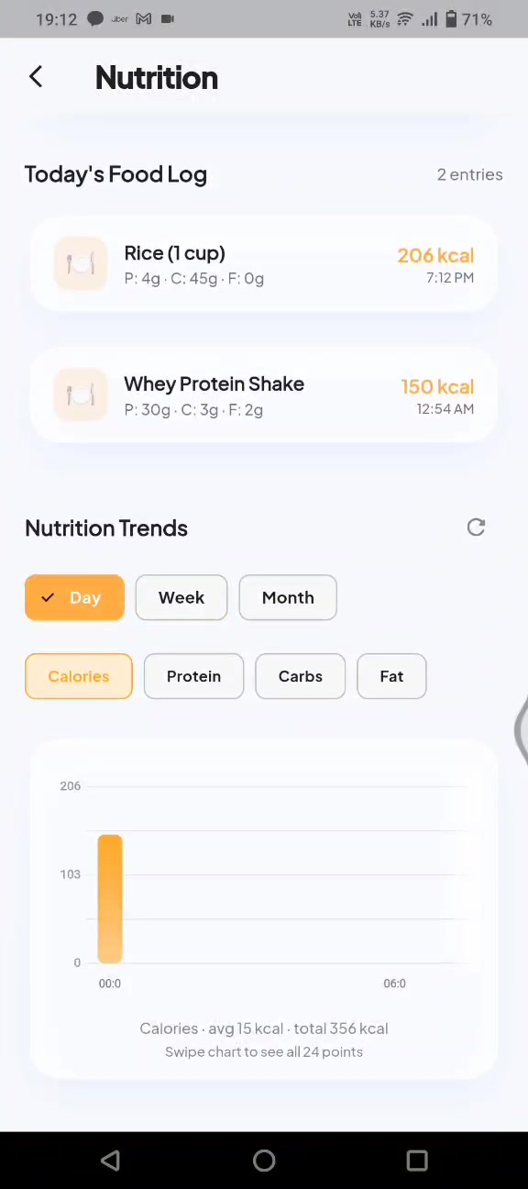
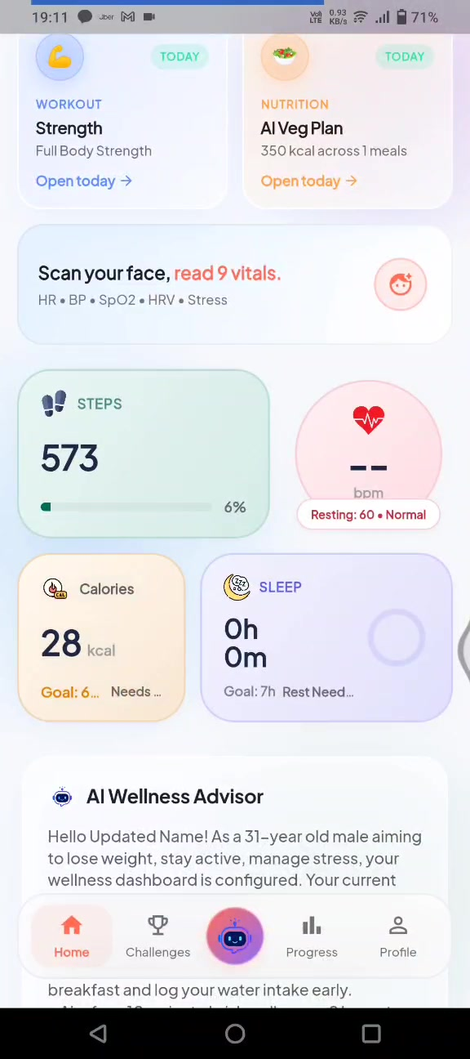
04B–05 · Nutrition plans, food log & hydration
Meals from AI plans, quick food logging, and water tracker with cup / bottle / flask.
Nutrition Plans
Food logging
Hydration
AI Veg Plan, meal macros, create new plan
Quick-add foods + custom entries + trends
Visual bottle, +250/+500/+750 ml, history
MediFit Wellness360 · User Flow · 8/15

Slide 9
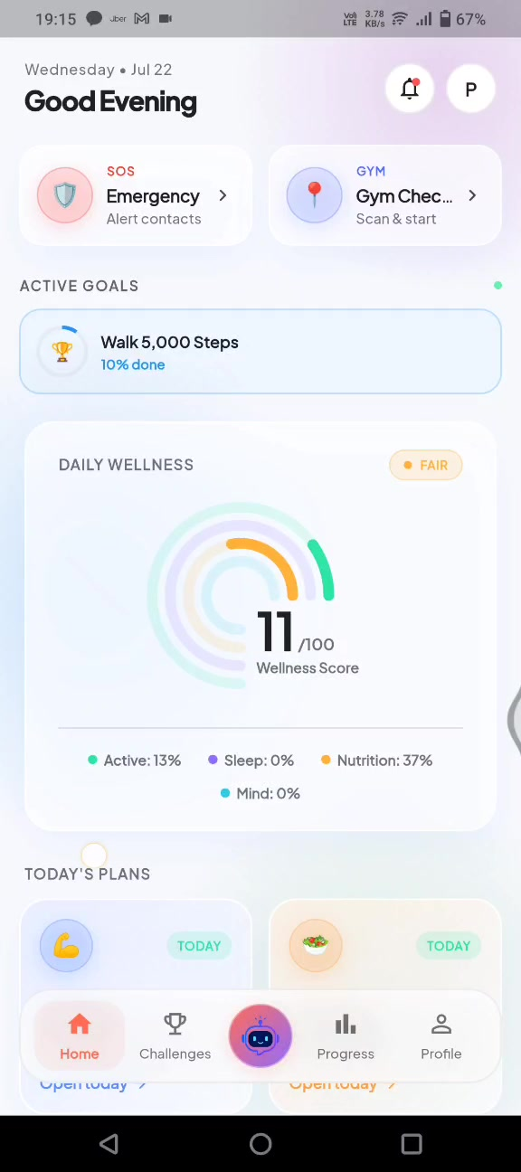
STEP 05 · INSIGHTS
Metric deep-dives
Steps & calories open historical analysis with AI Wellness Buddy tips.
1
Steps detail
Daily history, below-target flags, AI walking advice.
2
Calories detail
Period + combined burn, activity trend chart.
3
AI Buddy insight
Inline card: personal tip based on averages.
MediFit Wellness360 · User Flow · 9/15

Slide 10
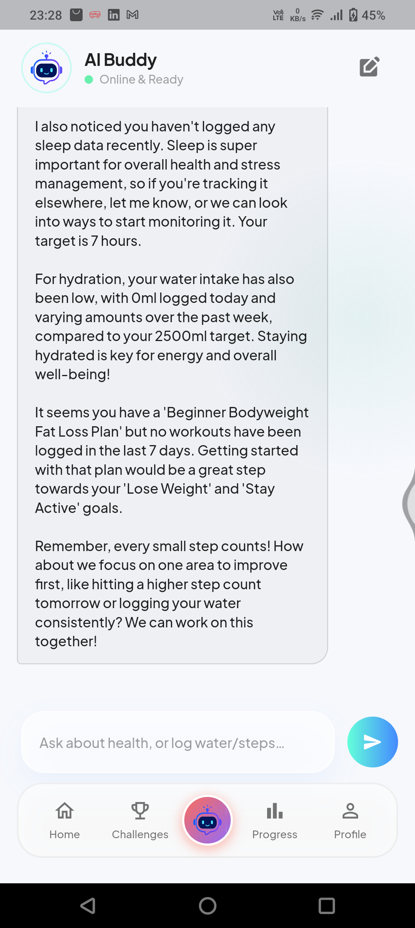



STEP 06 · AI BUDDY
Chat that acts on your health.
Center tab loads AI Buddy chat — history restores on open. Users talk naturally to log data, get updates, or ask health questions.
Chat loads instantly
Log data via chat
Opens last conversation (or a fresh greeting). “New chat” starts a clean thread.
Say “log 500 ml water” or “add 2000 steps” — AI confirms and writes logged_actions.
Health updates
Any health query
Ask “assess my health score” — buddy reviews score, sleep, hydration, plans & goals.
Sleep tips, burn 500 kcal, water targets, routines — free-form Q&A with context.
MediFit Wellness360 · User Flow · 10/15

Slide 11
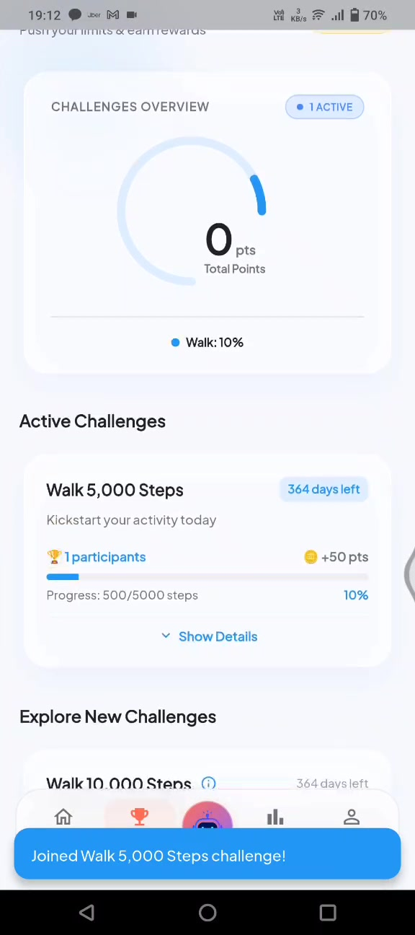
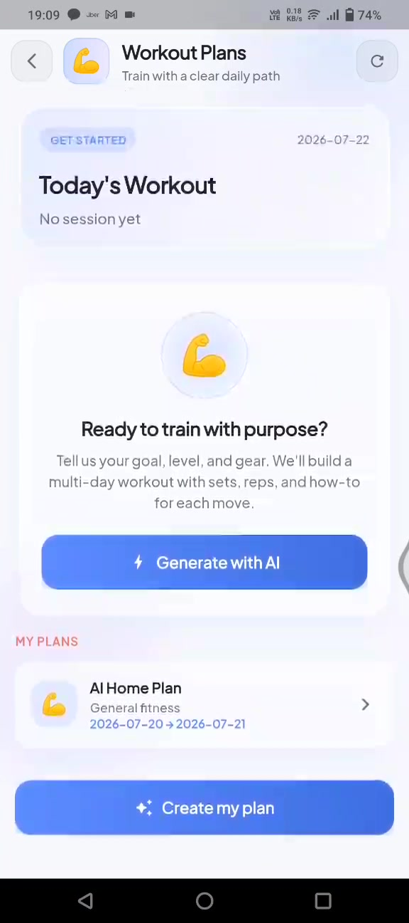
STEP 07 · ENGAGE
Challenges &
rewards.
Tab: Challenges. Join a challenge, track progress on Home and Challenges, earn points.
Overview: total points + active count
Explore: Walk 5k / 10k, Drink 2L…
Join Challenge → progress bar
Points & rank shown on active card
Active goal mirrored on Home
MediFit Wellness360 · User Flow · 11/15

Slide 12
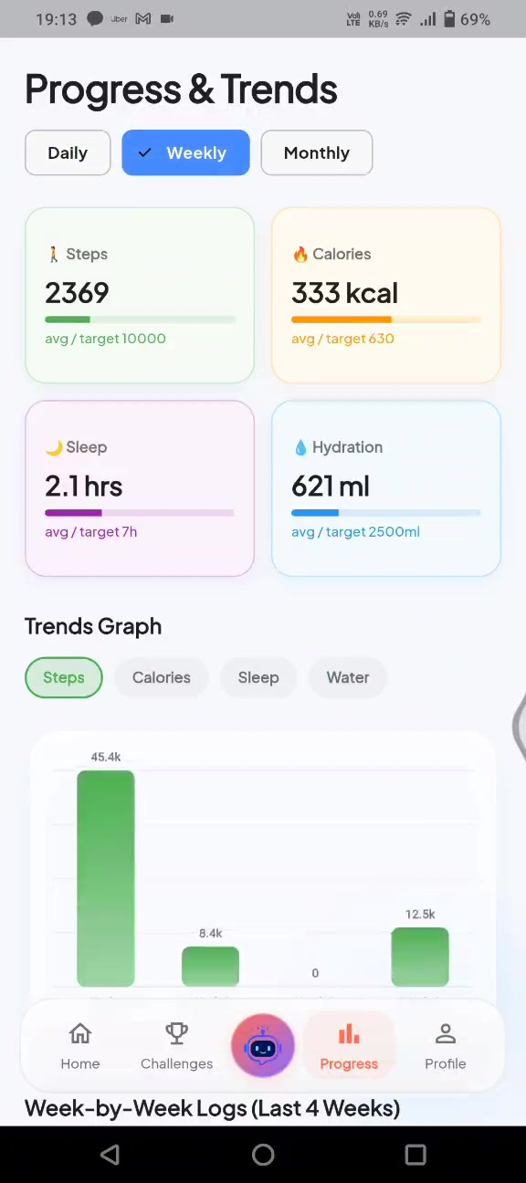
07B · Progress & trends
Tab: Progress — Daily / Weekly / Monthly views for steps, calories, sleep, water.
Summary cards
Trends graph
Steps, kcal, sleep hours, hydration vs targets.
Toggle Steps / Calories / Sleep / Water charts.
Day-by-day logs
Range switch
Last 7 days with per-day metric chips.
Daily, Weekly, Monthly aggregation.
MediFit Wellness360 · User Flow · 12/15

Slide 13
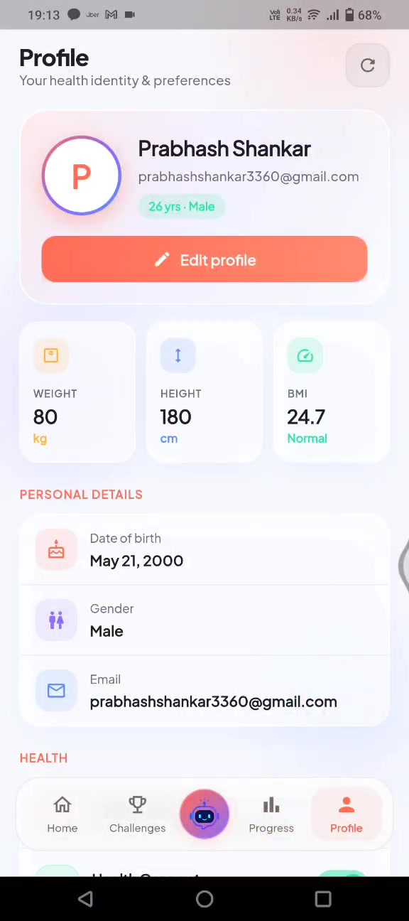
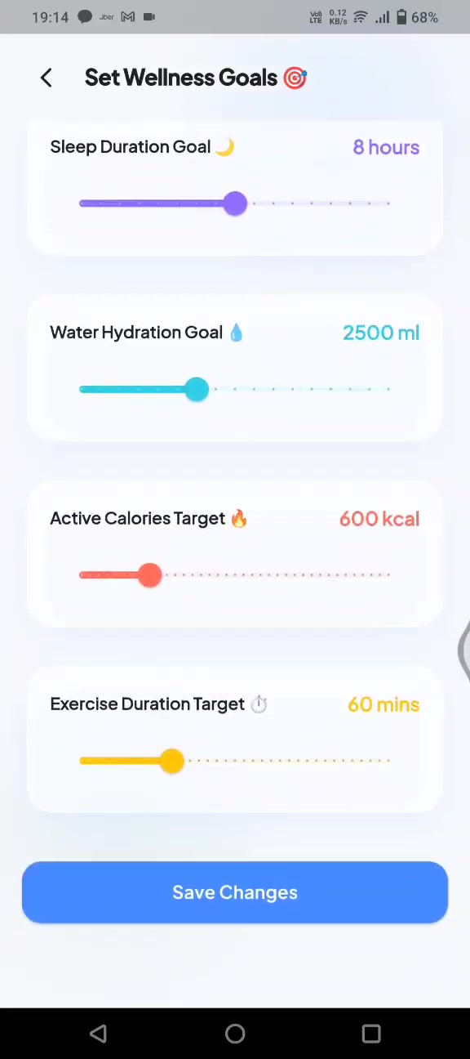
08 · Profile & preferences
Edit identity, body metrics, Health Connect, goals, and notification toggles.
1
Edit Profile sheet
Name, DOB, gender, height, weight → Save
2
BMI card
Auto BMI + Normal / other status
3
Health goals
Steps, water, sleep, calorie targets
4
Health Connect
Toggle auto-sync of wearable data
5
Notifications
AI tips, hydration, sleep, activity, challenges, daily digest
MediFit Wellness360 · User Flow · 13/15

Slide 14
Complete navigation model
Hub-and-spoke from Home + 5-tab shell. Center tab = AI Buddy chat (log, updates, Q&A).
SOS
HOME HUB
Challenges
Gym QR
Progress
Bottom tabs
1. Home
Workout Plan
AI Buddy Chat
2. Challenges
3. AI Buddy ★
4. Progress
Nutrition Plan
Profile
5. Profile
MediFit Wellness360 · User Flow · 14/15

Slide 15
Flow in one line
From sign-up to daily habit loop.
Auth
→
Home
→
Safety
→
Plans
→
Log
→
AI Chat
→
Engage
→
Profile
Hub-first design
AI Buddy chat
Home is the control center for score, plans, SOS, and gym.
Center tab chat: log water/steps, get score updates, ask any health question.
AI-assisted plans
Close the loop
Workout & nutrition plans generated in a guided wizard.
Chat or screens to log → Challenges → Progress → Profile.

