Slide 1
EDES 301
PCB Project
Hamza Saeed
Due 12/16/2025 @ 11:59pm

Slide 2
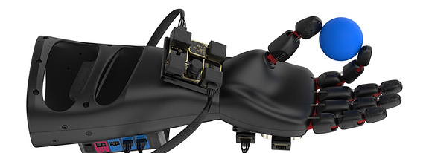
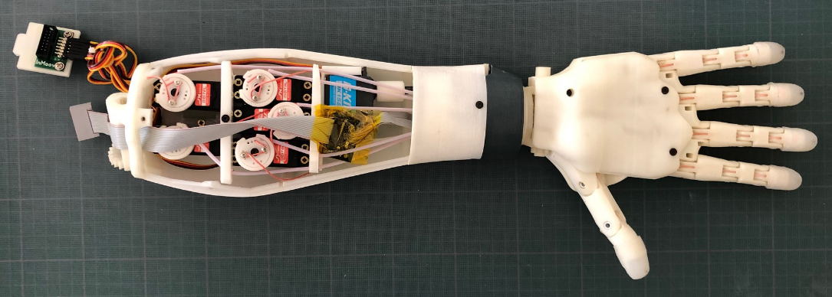


Mission: Develop a robotic hand desk ornament controlled by a PocketBeagle with 5 independently actuated fingers.
Based on open-source InMoov platform
Utilizes servo motors, springs, and pulleys to actuate finger movement
Fingers adjustable via potentiometers
Base integrates PocketBeagle, Potentiometers, power supply
Inspired by and will further my senior design project
Aiming to develop skills in translating programming instruction to mech. action.
Improvements: 1) CAD modifications for mount ability, weight reduction. 2) Pose control via potentiometers

Slide 3
System Block Diagram
Five Potentiometers
PocketBeagle
AIN[0-4]
Finger Motors
Pointer
Laptop
USB0
Middle
I2C
Ring
Pinky
Power Brick
Adafruit PCA9685 16-Channel Servo Driver
Thumb

Slide 4
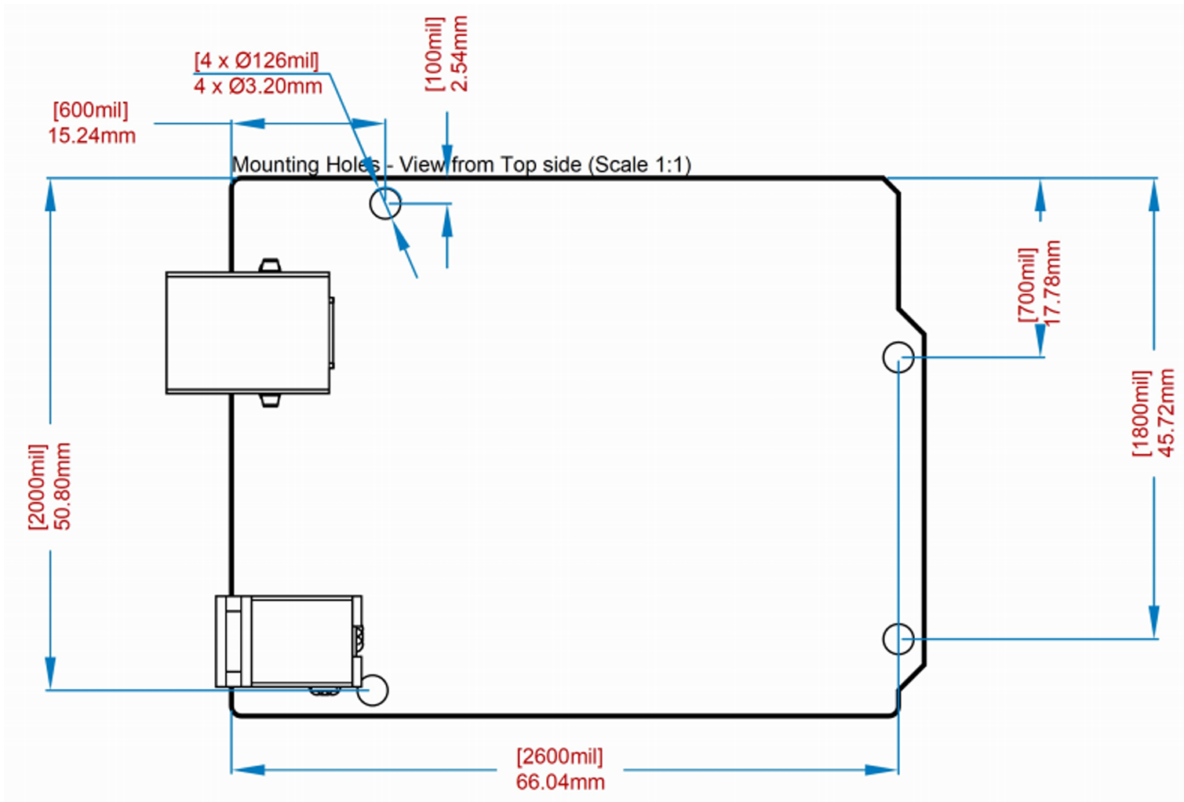




Mechanical Drawing
3”
Filter/Amplification
.25”
Hex Display
.5”
2”
Electrode Input
Button
Buzzer
Potentiometer
Pot
1.5”
FRONT
FRONT
BACK
BACK

