Slide 1
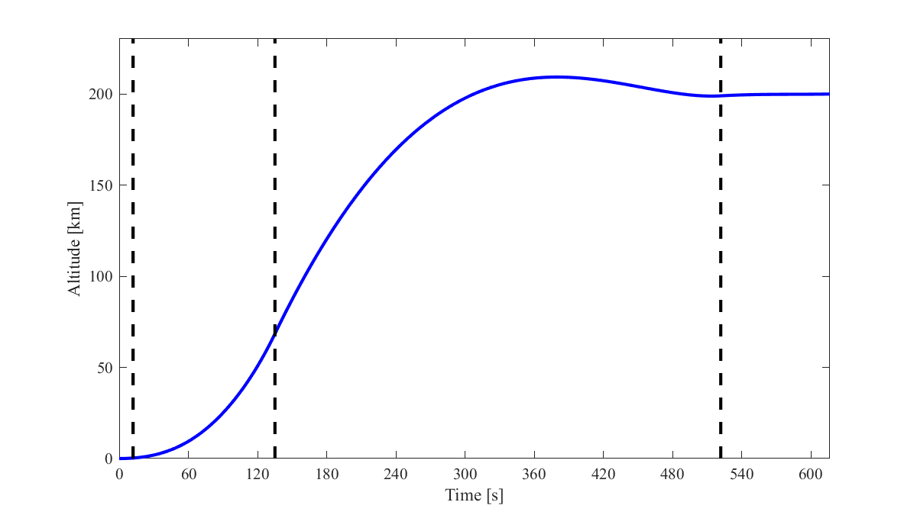
2nd Stage MECO,
3rd Stage Ignition
7.3 km/s Velocity
Vertical Liftoff
1° Pitch
1st Stage MECO,
2nd Stage Ignition,
Pitch to θ

Slide 2
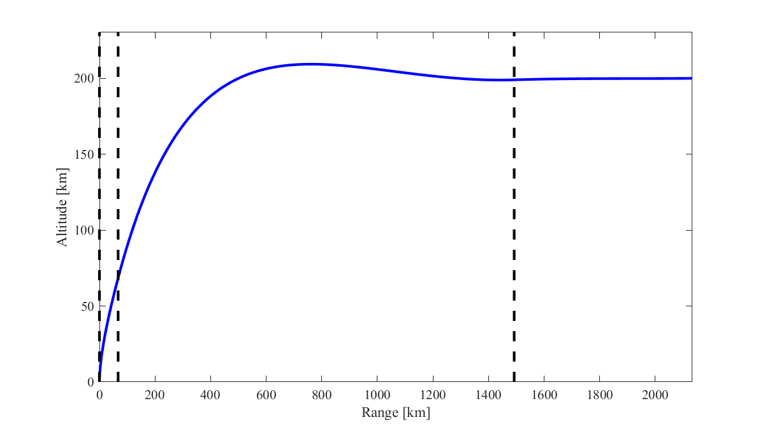
2nd Stage MECO,
3rd Stage Ignition
7.3 km/s Velocity
1st Stage MECO,
2nd Stage Ignition,
Pitch to θ
1° Pitch
Vertical Liftoff

Slide 3
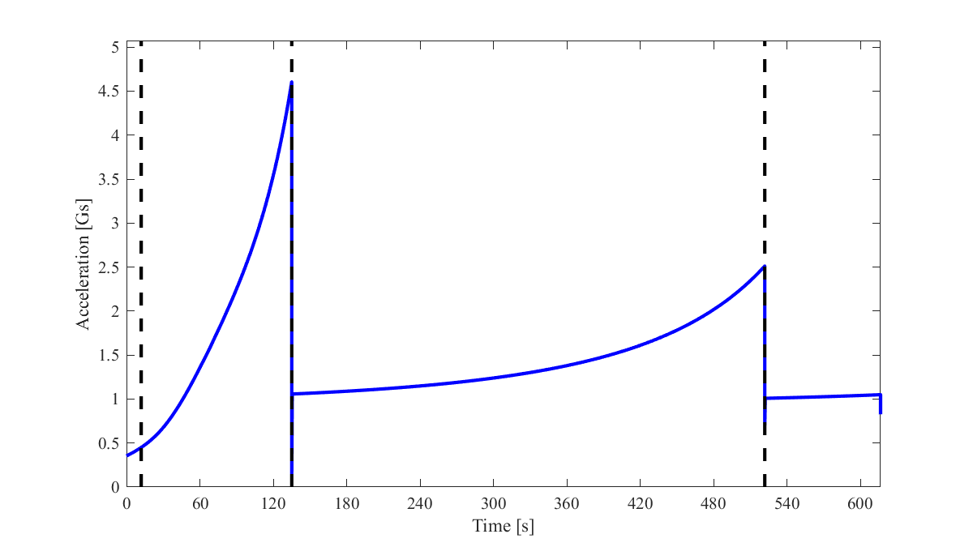
1st Stage MECO
2nd Stage MECO
Vertical Liftoff
7.3 km/s Velocity
2nd Stage Ignition,
Pitch to θ
3rd Stage Ignition
1° Pitch

