Slide 1
ML - Stock Price Forecasting
54 - Harkishan Singh (2017233)

Slide 2
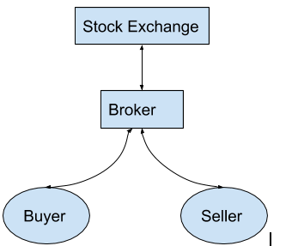
Introduction/Problem
Stock market is a medium through which the financial and business activities around the companies are funded by the retail investors.
To buy a stock of a company, a person will have to approach a stock broker where the investor asks for placement of his/her order on the stock exchange.
The problem we are looking to solve is to predict the future prices of the stock using ML techniques so that we can get a good return on our investment.

Slide 3
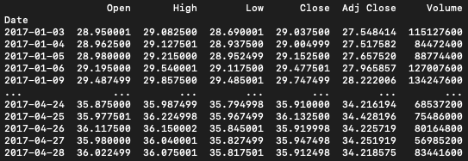
DataSet Collection
Historic price of stocks can be collected through several APIs available on the internet (yahoo-finance, google-finance).
Some of the financial data which can’t be collected directly from the APIs can be collected manually (EPS, EBIDTA, debt etc.)

Slide 4
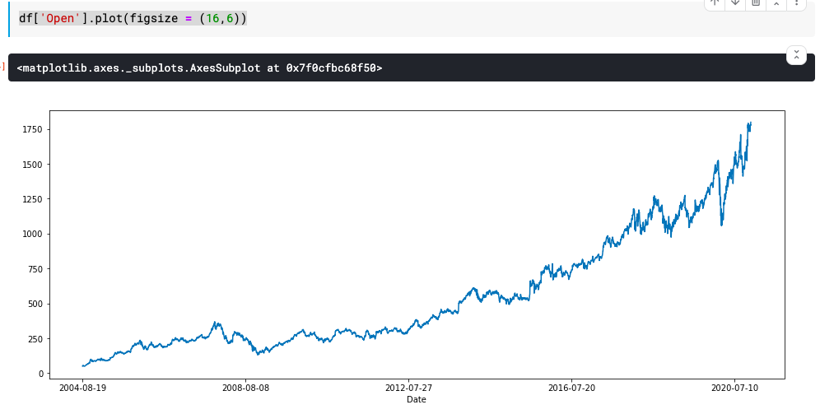
Google stock history

Slide 5
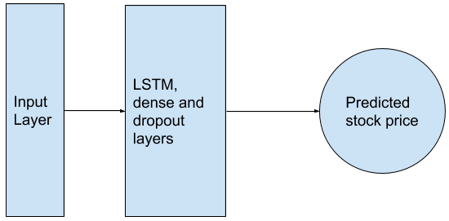
Model
LSTM (Long Term Short Memory) layers and dropout layers in a sequential model is used.
Input layer contains historical stock prices and financials of the company.
Output of the model is a single node → predicted stock price.

Slide 6
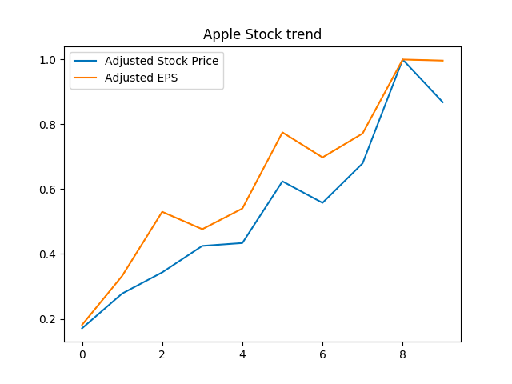
Financials
Following graph shows strong relationship between EPS (Earnings per share) and stock price of Apple.

Slide 7
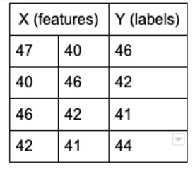

Processing the Dataset

Slide 8
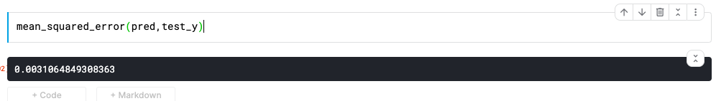
Evaluation
For window size of 10

Slide 9
References
https://www.researchgate.net/publication/259240183_A_Machine_Learning_Model_for_Stock_Market_Prediction#:~:text=The%20successful%20prediction%20of%20a,machine%20(LS%2DSVM).
https://www.analyticsvidhya.com/blog/2020/10/reinforcement-learning-stock-price-prediction/
https://www.youtube.com/watch?v=lncoLfue_Y4

Slide 10
Thank You

