Slide 1
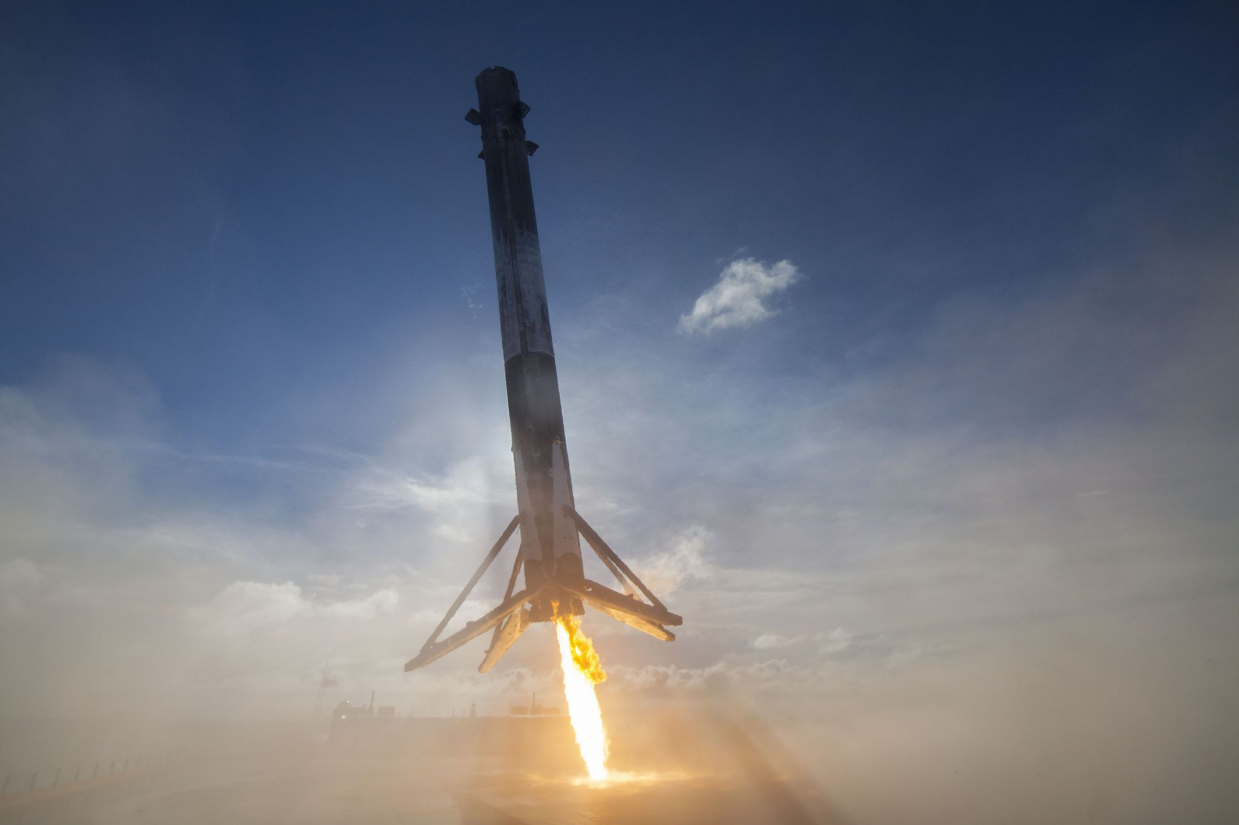

Haifa Al-Nasi
02-5-2023

Slide 2

Outline
Executive Summary
Introduction
Methodology
Results
Conclusion
Appendix

Slide 3
In this final project, we will use various machine learning classification techniques to forecast whether the first stage of the SpaceX Falcon 9 rocket will land successfully.
The main steps in this project include:
Data collection, wrangling, and formatting
Exploratory data analysis
Interactive data visualization
Machine learning prediction
According to our charts, there is a relationship between certain characteristics of the rocket launches and whether they succeed or fail.
We have also determined that the decision tree algorithm may be the most effective machine learning method for predicting the successful landing of the Falcon 9 first stage.
Executive Summary

Slide 4
Introduction
In this capstone , we will predict if the Falcon 9 first stage will land successfully. SpaceX advertises Falcon 9 rocket launches on its website with a cost of 62 million dollars; other providers cost upward of 165 million dollars each, much of the savings is because SpaceX can reuse the first stage . Therefore if we can determine if the first stage will land, we can determine the cost of a launch. This information can be used if an alternate company wants to bid against SpaceX for a rocket launch.
The majority of unsuccessful landings are intentional. On occasion, SpaceX will execute a controlled landing in the ocean.
The main question that we are trying to answer is , for a given set of features about Falcon 9 rocket launch which includes its payload mass, orbit type, launch site, and so on, will the first stage of the rocket land successfully?

Slide 5
Data collection, wrangling, and formatting, using
SpaceX API
Web scraping
Exploratory data analysis (EDA), using
Pandas and Numpy
SQL
Data visualization, using:
Matplotlib and Seaborn
Folium
Dash
Machine learning prediction , using
Logistic regression
Support vector machine(SVM)
Decision tree
K-nearest neighbors(KNN)
Methodology

Slide 6
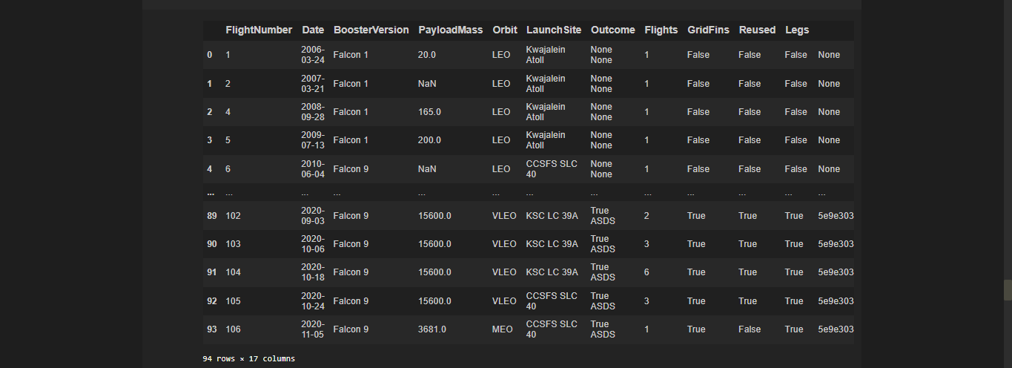
METHODOLOGY 1 Data collection, wrangling, and formatting
SpaceX API
The API used is https://api.spacexdata.com/v4/rockets/
The API provides data about many types of rocket launches done by SpaceX, the data is therefore filtered to include only Falcon9 launches.
Every missing value in the data is replaced by the mean of the column that the missing value belongs to .
We end up with 90 rows or instances and 17 columns or features. The picture below shows the first few rows of the data:

Slide 7
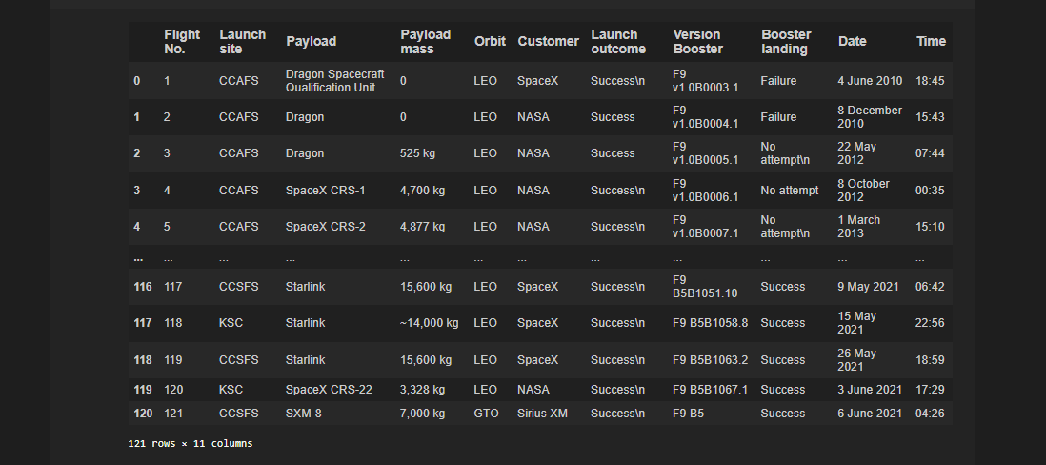
METHODOLOGY 1 Data collection, wrangling, and formatting
Web scraping
The data is scraped from https://en.wikipedia.org/w/index.php?title=List_of_Falcon_9_and_Heavy_launches&oldid=1027686922
The website contains only the data about Falcon9 launches.
We end up with 121 rows or instances and 11 columns or features. The picture below shows the first few rows of data:

Slide 8
METHODOLOGY 1 Data collection, wrangling, and formatting
The data is later processed so that there are no missing entries and categorical features are encoded using on-hot encoding.
An extra column called 'Class' is also added to the data frame . The column 'Class' contains 0 if a given launch is failed and 1 if it is successful.
In the end , we end up with 90 rows or instances and 83 columns or features

Slide 9


METHODOLOGY 2 Exploratory Data Analysis (EDA)
Pandas and NumPy
Functions from the Pandas and NumPy libraries are used to derive basic information about the data collected, which includes :
The number of launches on each launch site
The number of occurrence of each orbit
The number and occurrence of each mission outcome
SQL
The data is quired using SQL to answer several questions about the data such as:
The names of the unique launch sites in the space mission
The total payload mass carried by boosters launched by NASA (CRS)
The average payload mass carried by booster version F9 v1.1

Slide 10
METHODOLOGY 3 Data Visualization
Matplotlib and Seaborn
Functions from the Matplotlib and Seaborn libraries are used to visualize the data through scatterplots, bar charts, and line charts.
The plots and charts are used to understand more about the relationships between several features, such as:
The relationships between flight number and launch site
The relationship between payload mass and launch site
The relationship between success rate and orbit type
Folium
Functions from the Folium libraries are used to visualize the data through interactive maps.
The Folium library is used to :
Mark All launch sites on a map
Mark the successeded launches and failed launches for each site on the map
Mark the distance between a launch site to its proximities such as the nearest city, railway, or highway

Slide 11
METHODOLOGY 3 Data Visualization
Dash
Functions from Dash are used to generate an interactive site where we can toggle the input using a dropdown menu and a range slider .
Using a pie chart and a scatterplot, the interactive site shows:
The total success launches from each launch site .
The correlation between payload mass and mission outcome (success or failure) for each launch site.

Slide 12
METHODOLOGY 4 Machine Learning Prediction
Functions from Scikit-learn library are used to create our machine learning models.
The machine learning prediction phase includes the following steps:
Standardizing the data
Splitting the data into training and test data
Creating machine learning models, which include:
Logistic regression
Support vector machine (SVM)
Decision tree
K nearest neighbours (KNN)
Fit the models on the training set
Find the best combination of hyperparameters for each model
Evaluate the models based on their accuracy scores and confusion matrix

Slide 13
RESUTLS
The results are split into 5 sections:
SQL(EDA with SQL)
Matplotlib and seaborn(EDA with Visualization)
Folium
Dash
Predictive Analysis
In all of the graphs that follow, class 0 represents a failed launch outcome while class 1 represents a successful launch outcome.

Slide 14
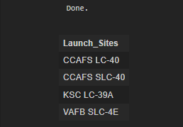
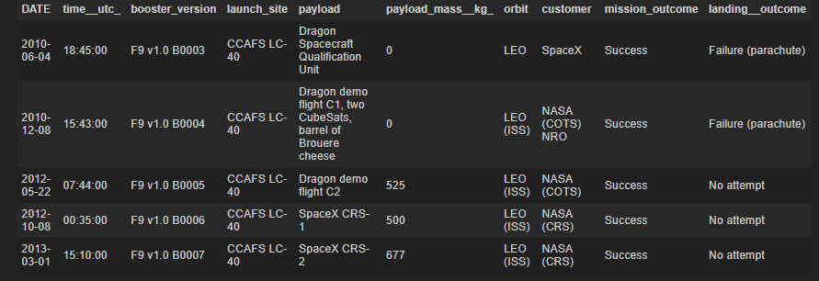
RESULTS 1 SQL (EDA with SQL)
The names of the unique launch sites in the space mission:
5 records where launch sites begin with 'CCA'

Slide 15



RESULTS 1 SQL (EDA with SQL)
The total payload mass carried by boosters launched by NASA(CRS)
The average payload mass carried by booster version F9 v1.1
The date when first successful landing outcome in ground pad was achived

Slide 16
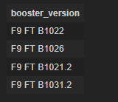

RESULTS 1 SQL (EDA with SQL)
The names of the boosters which have success in drone ship and have payload mass greater than 4000 but less than 6000
The total number of successful and failure mission outcomes

Slide 17
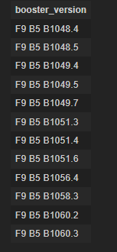
RESULTS 1 SQL (EDA with SQL)
The names of the boosters which have carried the maximum payload mass

Slide 18

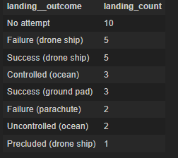
RESULTS 1 SQL (EDA with SQL)
The failed landing outcomes in drone ship, their booster versions, and launch site names for in year 2015
The count of landing outcomes between the date 2010-06-04 and 2017-04-20, in descending order

Slide 19
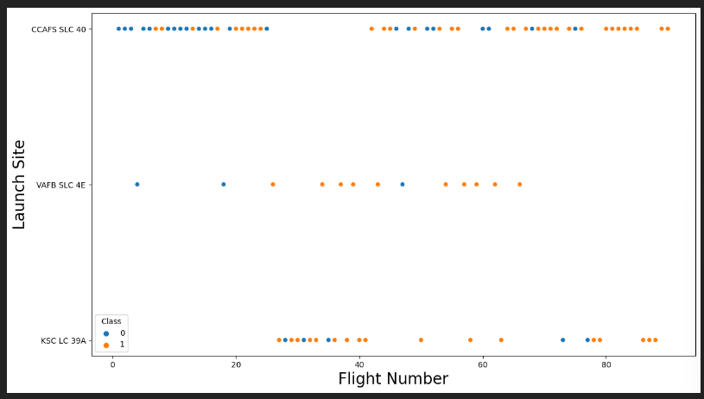
RESUTLS 2 Matplotlib and Seaborn (EDA with Visualization)
The relationship between flight number and launch site

Slide 20
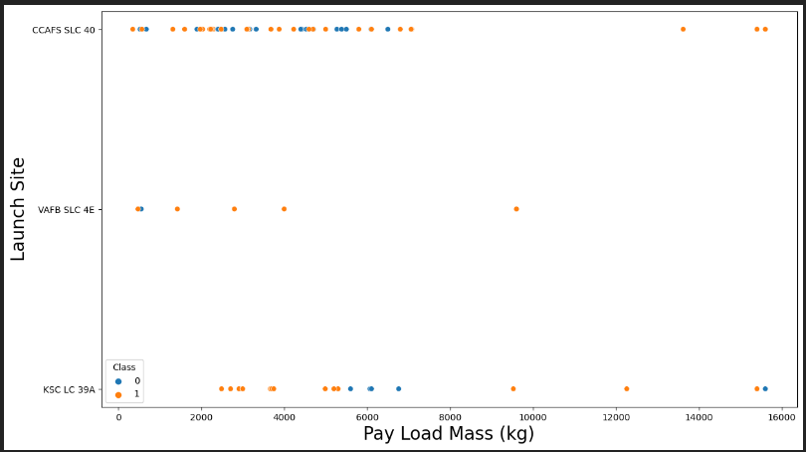
RESUTLS 2 Matplotlib and Seaborn (EDA with Visualization)
The relationship between payload mass and launch site

Slide 21
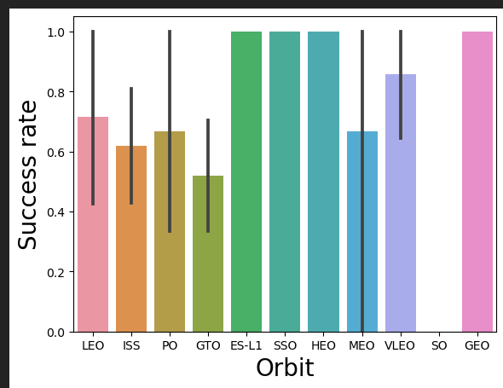
RESUTLS 2 Matplotlib and Seaborn (EDA with Visualization)
The relationship between success rate and orbit type

Slide 22
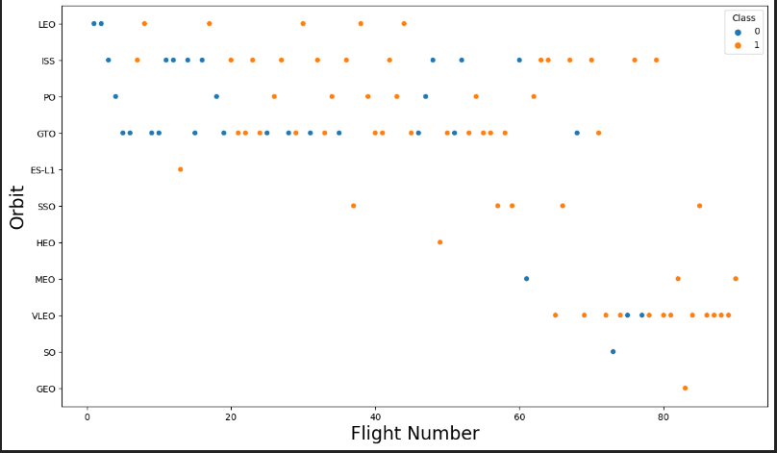
RESUTLS 2 Matplotlib and Seaborn (EDA with Visualization)
The relationship between flight number and orbit type

Slide 23
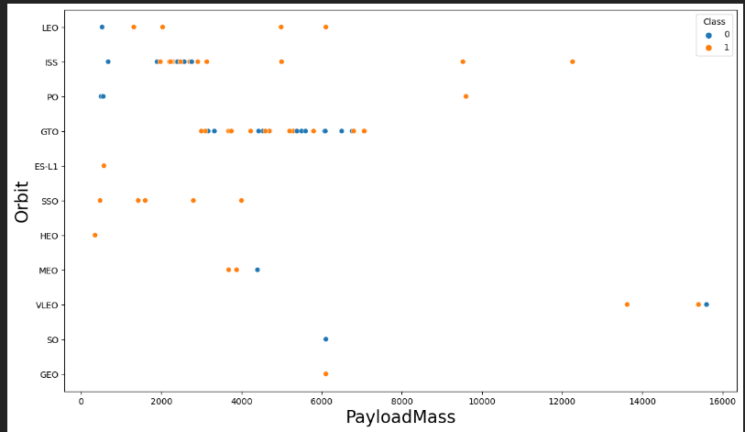
RESUTLS 2 Matplotlib and Seaborn (EDA with Visualization)
The relationship between payload mass and orbit type

Slide 24
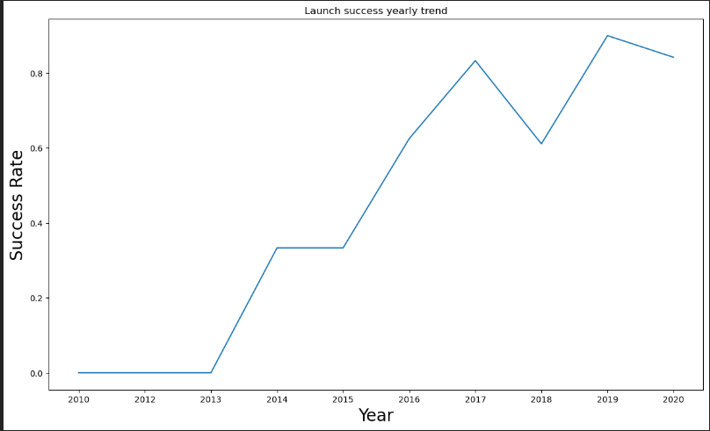
RESUTLS 2 Matplotlib and Seaborn (EDA with Visualization)
The launch success yearly trend

Slide 25
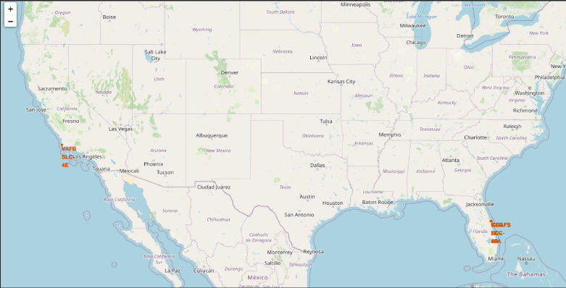
RESUTLS 3 Folium
All launch sites on map

Slide 26
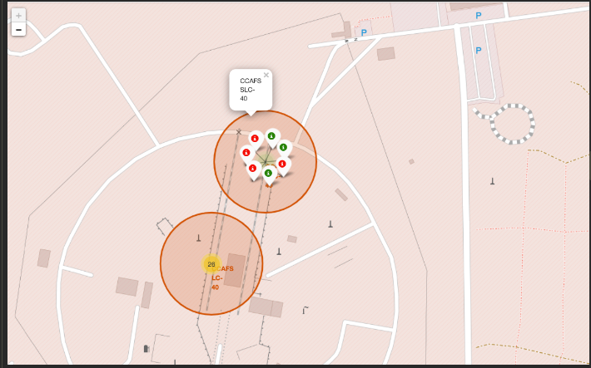
RESUTLS 3 Folium
The succeeded launches and failed launches for each site on map
If we zoom in one of the launch site, we can see green and red tags . Each tag represents a successful launch while each red tag represents a failed launch

Slide 27
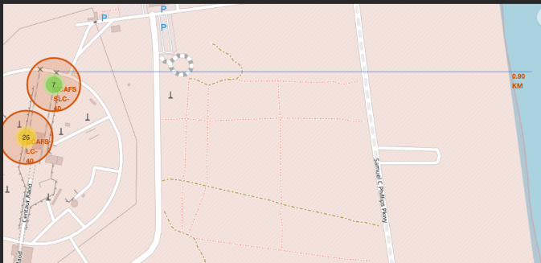
RESUTLS 3 Folium
The distance between a launch site to its proximities such as the nearest city, railway, or highway
The picture below shows the distance between the VAFB SLC-4E launch site and the nearest coastline

Slide 28
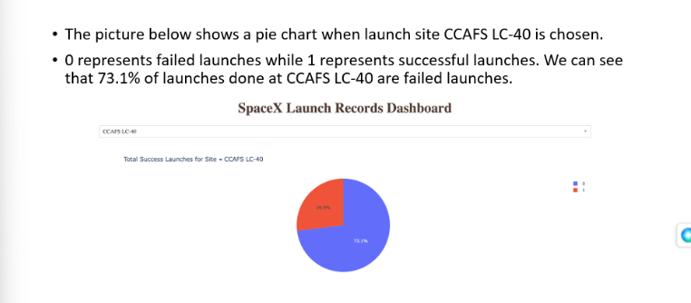
RESUTLS 4 Dash
The picture below shows a pie chart when launch site CCAFS LC-40 is chosen.
0 represents failed launches while 1 represents successful launches . We can see that 73.1% of launches done at CCAFS LC-40 are failed launches.

Slide 29
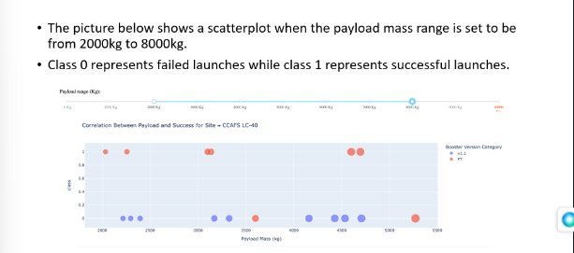
RESUTLS 4 Dash
The image below displays a scatterplot with the payload mass range set between 2000kg and 8000kg.
Message received. The picture below shows a scatterplot where the payload mass range is set from 2000kg to 8000kg.
Class 0 represents failed launches while class 1 represents successful launches .

Slide 30
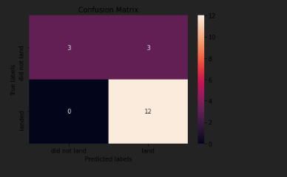
RESUTLS 5 Predictive Analysis
Logistic regression
GridSearchCV best score: 0.8464285714285713
Accuracy score on test set: 0.83333333333333334
Confusion matrix:

Slide 31
RESUTLS 5 Predictive Analysis
Support vector machine (SVM)
GridSearchCV best score: : 0.8482142857142856
Accuracy score on test set: 0.83333333333333334
Confusion matrix:

Slide 32
RESUTLS 5 Predictive Analysis
Decision tree
GridSearchCV best score: : 0.8892857142857142
Accuracy score on test set: 0.83333333333333334
Confusion matrix:

Slide 33
RESUTLS 5 Predictive Analysis
K nearest neighbours (KNN)
GridSearchCV best score: : 0.8482142857142858
Accuracy score on test set: 0.83333333333333334
Confusion matrix:

Slide 34
RESULTS 5 Predictive Analysis
When we compare the results of all four models, we can see that they all have the same accuracy score and confusion matrix when evaluated on the test set.
As a result, we use their GridSearchCV best scores to rank them. Based on these scores, the models are ranked in the following order, with the first being the best and the last being the worst:
Decision tree (with a GridSearchCV best score of 0.8892857142857142).
K nearest neighbours, KNN (GridSearchCV best score: 0.8482142857142858)
Support vector machine, SVM(GridSearchCV best score : 0.8482142857142856)
Logistic regression (GridSearchCV best score : 0.8464285714285713)

Slide 35
DISCUSSION
From the data visualization section, it is apparent that certain features may be correlated with the mission outcome in various ways. For instance, for heavy payloads, the success rate of landings or positive landing rate is higher for orbit types such as Polar, LEO, and ISS. However, for GTO orbit type, this distinction is not as clear since both positive and negative landing rates (unsuccessful missions) are present.
Each feature may have a specific impact on the final outcome of the mission. However, it is difficult to determine exactly how each of these features affects the mission outcome. Nonetheless, we can use some of these features to predict whether a mission will be successful or not.

Slide 36
CONCLUSION
In this project, our goal is to forecast whether the first stage of a given Falcon 9 launch will land successfully in order to estimate the cost of the launch.
Each characteristic of a Falcon 9 launch, such as its payload mass or orbit type, may have a specific impact on the success of the mission.
We use a variety of machine learning techniques to analyze patterns in historical Falcon 9 launch data and create predictive models that can forecast the outcome of a Falcon 9 launch.
Of the four machine learning algorithms we used, the decision tree algorithm produced the most accurate predictive model. .

Slide 37
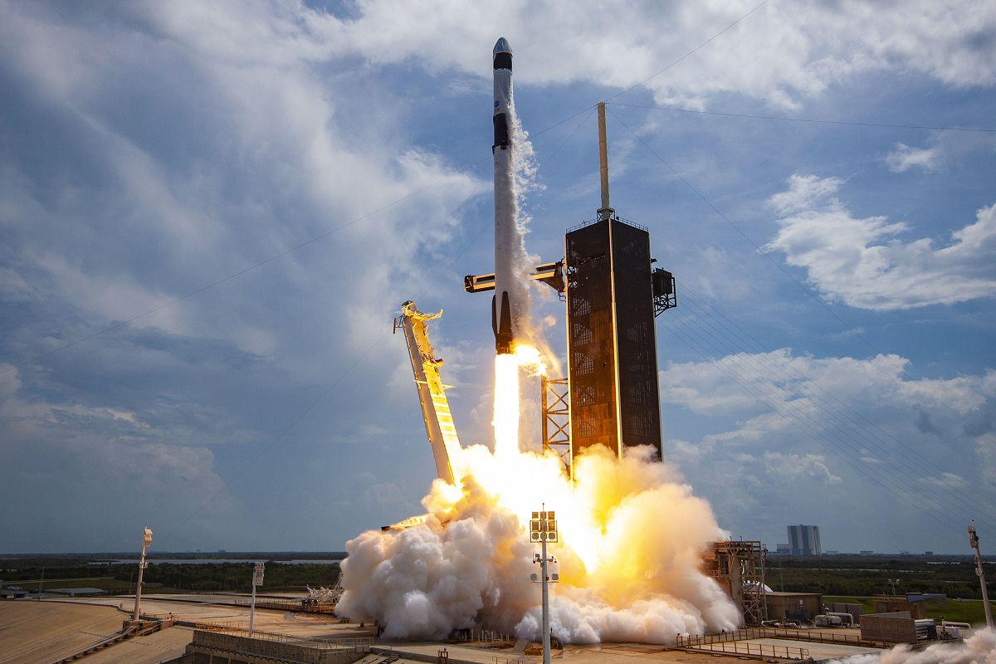
Thank you ! :)

