Slide 1
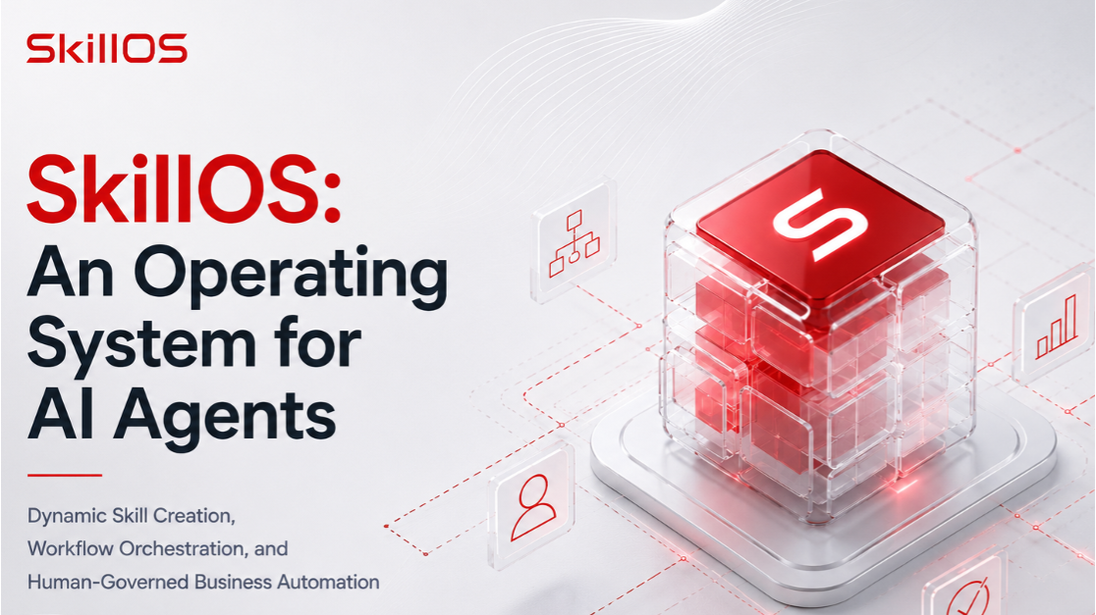
Notes:
Hello everyone! I’m excited to present SkillOS.
Many AI agents today are limited by the tools they already have. When a user requests something outside that toolset, developers often need to stop and implement a new capability. For startups, where requirements change quickly, this slows down development and experimentation.

Slide 2
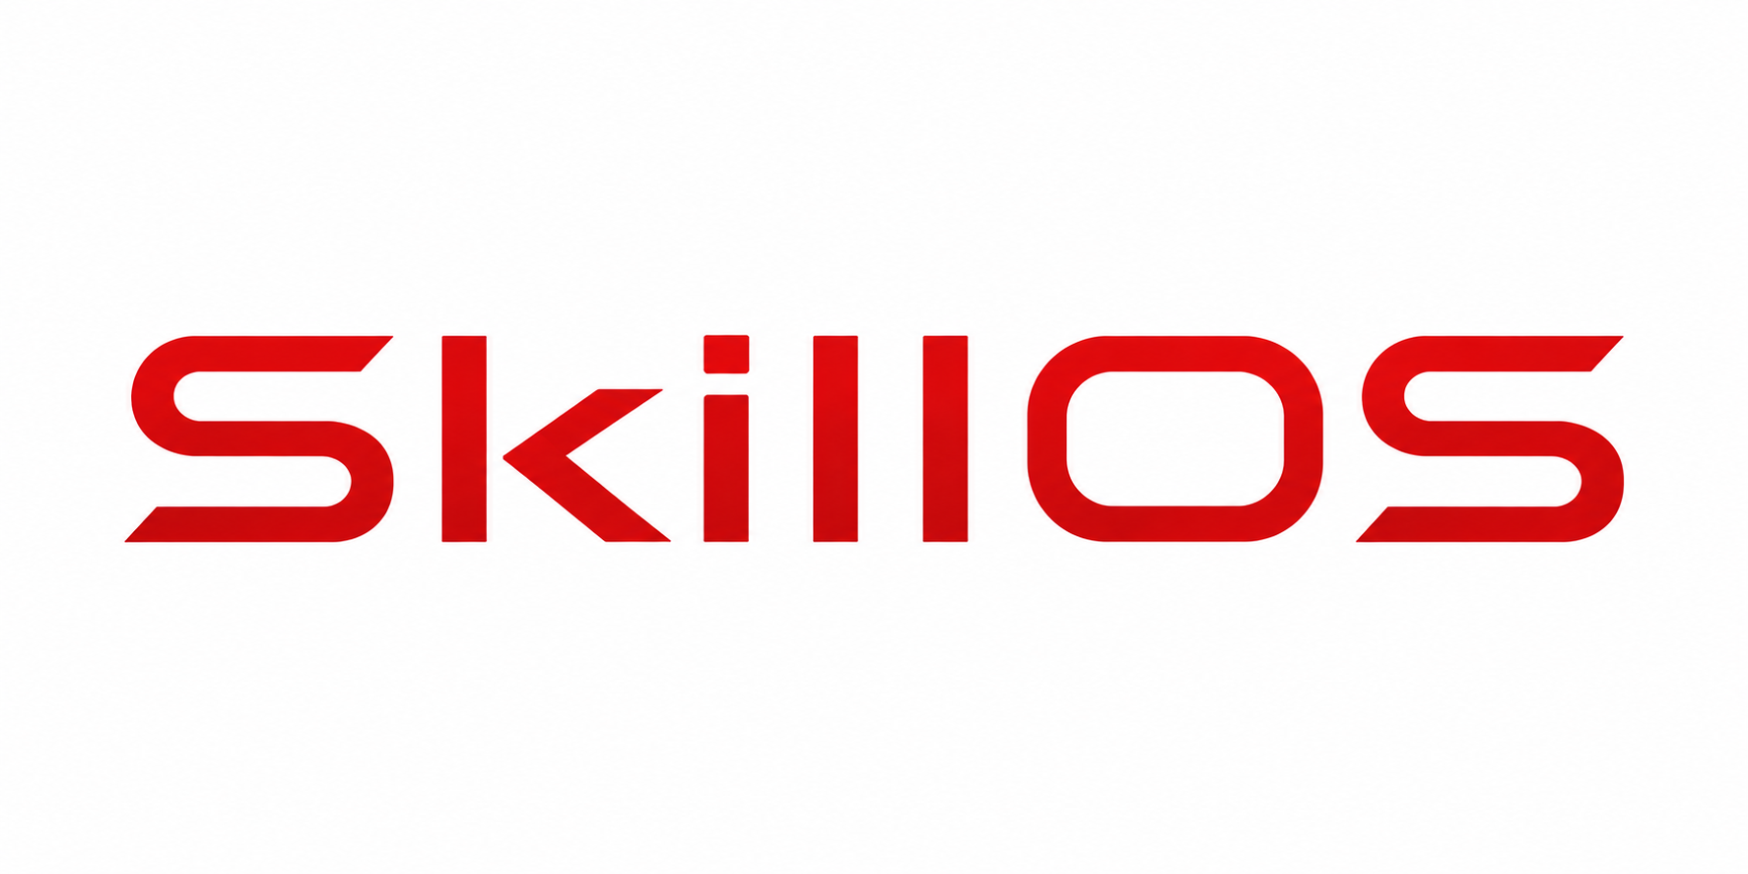
Agents can:
plan tasks
make decisions
coordinate multiple steps
interact with external systems
Notes:
That’s where agents can help. Instead of simply responding to prompts, agents can plan tasks, make decisions, coordinate multiple steps, and interact with external systems.

Slide 3
SkillOS
use existing skills
create new reusable skills
Notes:
SkillOS builds on this idea by allowing agents not only to use existing skills, but also to create new reusable skills when they’re missing.

Slide 4
SkillOS is an experimental operating system for AI agents that transforms business requests into structured, reusable workflows.

Slide 5
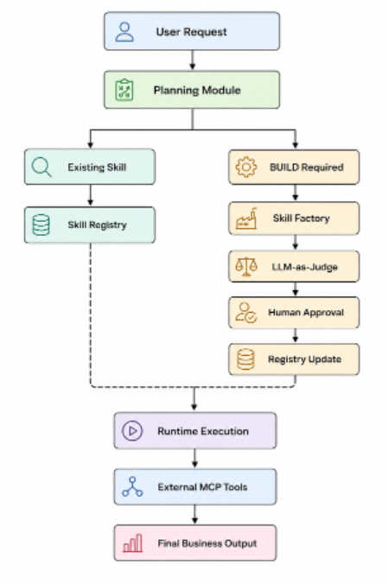
Notes:
As shown in the architecture, every request first goes to the Planning Module. If a suitable skill already exists, it is reused. Otherwise, SkillOS generates a new skill, evaluates it with an LLM-as-Judge, requests human approval, registers it, and then executes it through isolated runtime modules. It can also connect to external services through Model Context Protocol, or MCP.

Slide 6
Technology | Purpose in SkillOS
Google ADK (Agent Development Kit) | Framework for building and executing AI agents and reusable skills.
Google Gemini | General-purpose LLM used for planning, orchestration, and reasoning.
Google Gemma | Open-weight LLM used for skill generation and agent execution.
OpenAI Models (e.g., o4-mini) | Used for evaluation, structured reasoning, and LLM-as-Judge tasks.
Pydantic | Validates structured inputs and outputs using Python data models.
YAML-based Skill Definitions | Stores reusable SKILL.md metadata, registry entries, and skill configuration.
GitHub MCP (Model Context Protocol) | Creates repositories, commits files, and publishes generated web applications through MCP tools.
Notes:
I built SkillOS in a Kaggle notebook using Google ADK, Gemini, Gemma, OpenAI models, Pydantic, YAML-based skill definitions, and GitHub MCP for repository management and website publishing.
Now, let’s see SkillOS in action.

