Slide 1

HR Analytics – Employee Attrition Insights
Project: Employee Attrition Analysis
Tools: SQL & Power BI
Goal: Identify key drivers of employee turnover

Slide 2
Overall Attrition Insight
The organization shows a noticeable attrition rate
Employee turnover is significant enough to require HR action
Retention strategies are necessary to reduce workforce loss

Slide 3
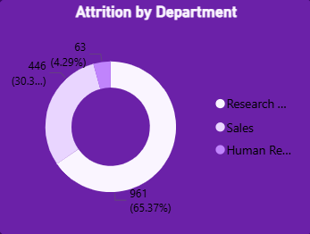
Attrition by Department
Some departments experience higher attrition than others
Indicates possible workload, management, or culture issues
HR should investigate high-risk departments

Slide 4
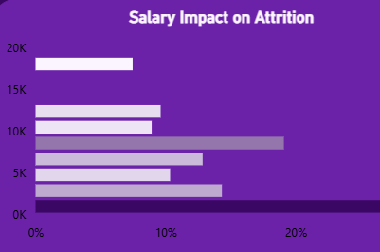
Salary Impact on Attrition
Lower salary groups show higher attrition rates
Employees with higher salaries tend to stay longer
Compensation is a key factor influencing retention

Slide 5
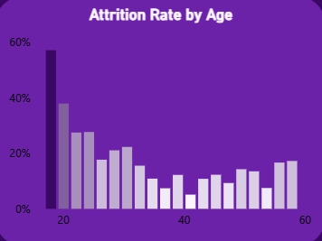
Attrition by Age Group
Young employees have the highest attrition rate
Mid-age employees show moderate stability
Senior employees are the most stable group

Slide 6
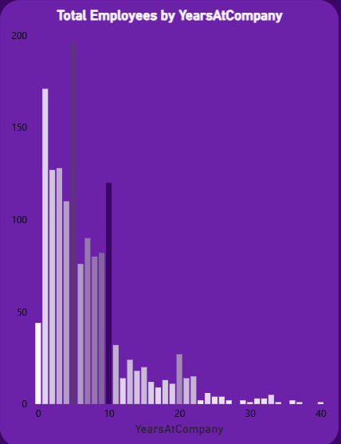
Tenure Insight
Employees tend to leave within early years of joining
Average tenure before leaving is relatively low
Indicates onboarding or early experience issues

Slide 7
Key Drivers of Attrition
Low salary
Younger age group
Specific high-risk departments
Short tenure (early-stage employees)

Slide 8
Business Recommendations
Review salary structure for low-income employees
1
Improve onboarding and early employee experience
2
Focus retention strategies on young employees
3
Investigate high-attrition departments
4

