Slide 1
COMPUTER NETWOKRS
INTERNET TRAFFIC CLASSIFICATION

Slide 2
INTRODUCTION
The classification of traffic flows in today’s IP networks has become an important research area with the adoption of Machine Learning (ML) techniques and Software Defined Networking (SDN) principles. Traditional methodologies including identifying traffic based on port number and payload inspection are not effective due to the dynamic and encrypted nature of current traffic. In our project will attempt to utilize Supervised and Unsupervised ML algorithms to classify flows by their required bandwidth, required QoS, and their application based on various flow level details as features.
Traffic classification is an process which categorizes computer network traffic according to various parameters (for example, based on port number or protocol) into a number of traffic classes. Each resulting traffic class can be treated differently in order to differentiate the service implied for the data generator or consumer.

Slide 3
As mentioned earlier, traffic classification using Machine Learning is a growing trend in the network analytics domain. One application of these techniques is in “cybersecurity”. Large datasets produced from enormous Internet traffic flows are difficult to process and analyze, even for talented experts in the field using sophisticated tools. In addition, ML classification and clustering of flows can help identify network hotspots and potential bottlenecks.
* For this project 4 types of traffic were considered :
Domain Name System (DNS)
Telnet
Ping
Voice

Slide 4
CHALLENGES
The classifier analyzers must deal with the increasing amount of traffic and transmission rates.
Researchers are looking for lightweight algorithms with little computational cost
The growing trend of traffic encryption and protocol encapsulation in the network poses further challenges and Application developers continue to invent new ways to prevent traffic being filtered and detected.
These reasons were the motivation for researchers to move toward applying ML techniques to classify network traffic based on statistical and behavioral features.
In fact, the majority of ML techniques which are used for IP traffic classification focus on the use of supervised and unsupervised learning (clustering), while a few use hybrid techniques (semi-supervised). Roughen et al.applied ML algorithms, Nearest Neighbors (NN), Linear Discriminate Analysis (LDA) and Quadratic Discriminant Analysis (QDA) to classify IP traffic based on the statistical signature approach.

Slide 5
METHODOLOGY
Step 1 : Network Traffic capture - Using Distributed Internet traffic generator D-IGT.
Step 2 : Feature Extraction Selection.
Step 3 : Training Process Data Sampling - The dataset is divided in the ratio 70%-30% such that the train dataset consists of 70% of data and the testing dataset consists of remaining 30% data.
Step 4 : Implementation of Algorithm – Logistic regression and K-Means clustering.
Step 5 : Result and Observation.

Slide 6
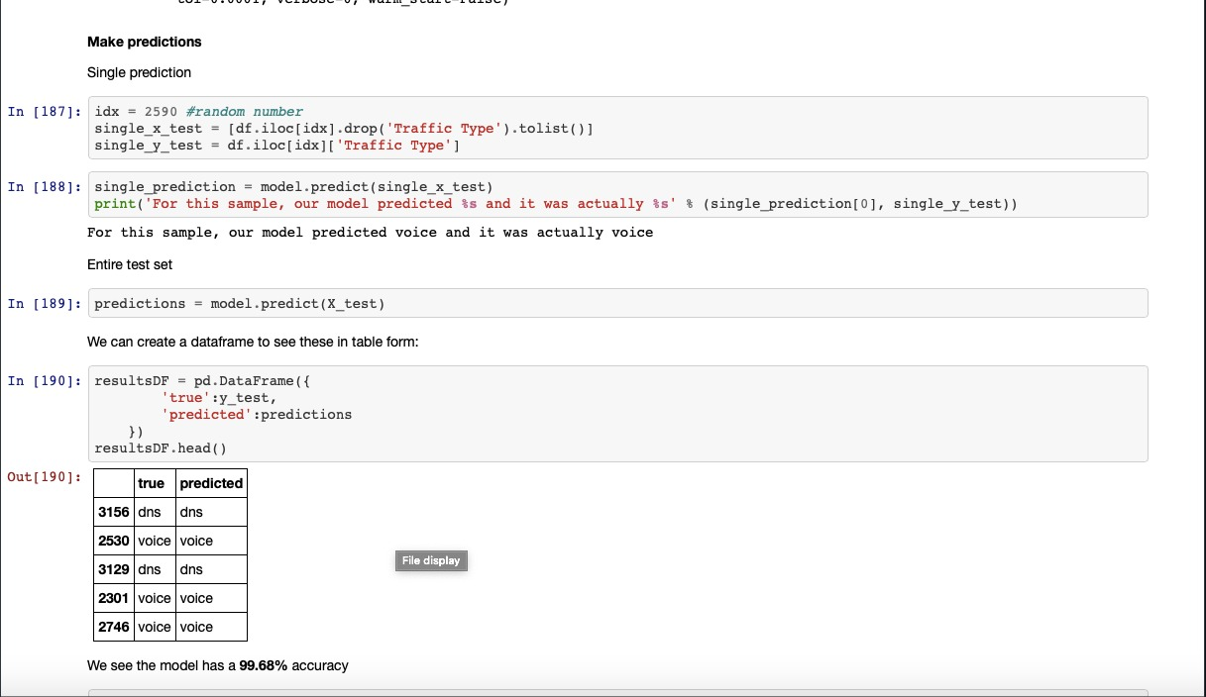

Slide 7
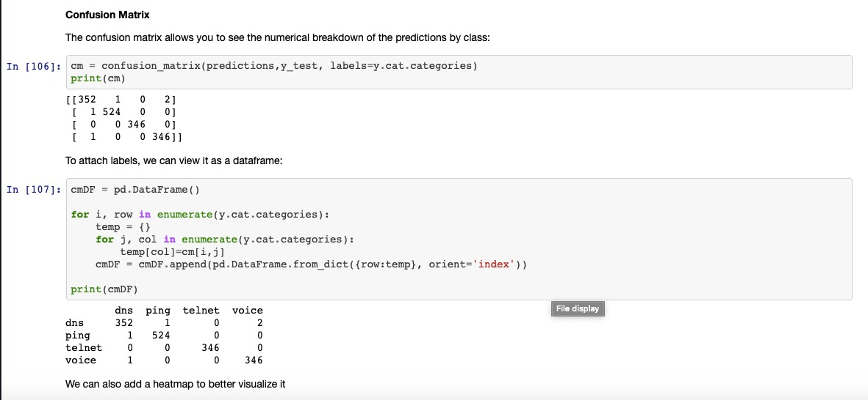
Ping
Voice
DNS
Telnet

Slide 8
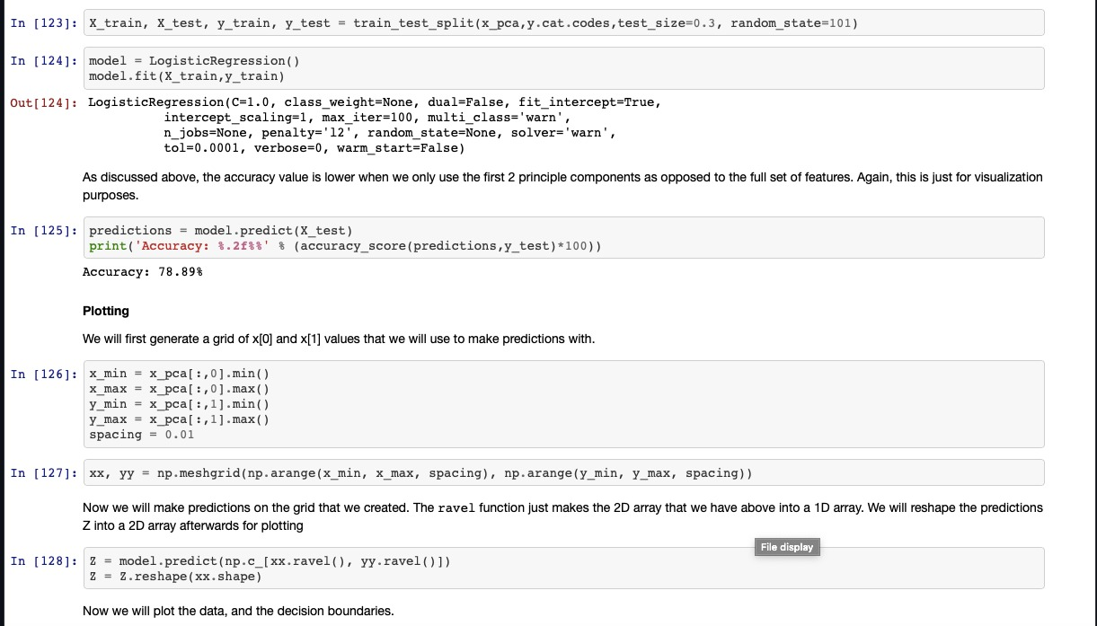

Slide 9
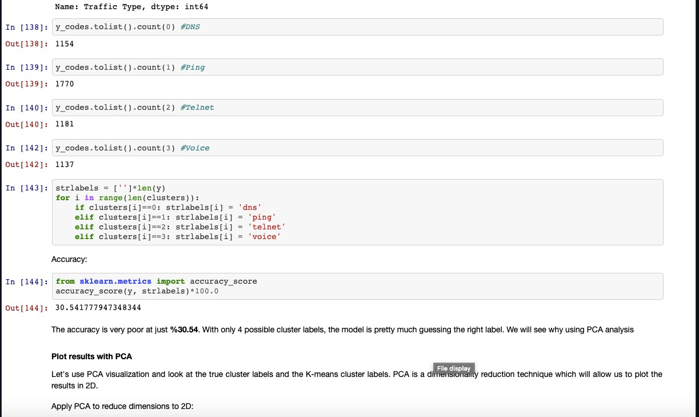

Slide 10
RESULT
In comparison to K-Means Clustering, Logistic Regression works considerably better in classifying traffic flows (telnet, DNS, ping, speech) in SDN based networks into matching class labels, as shown by the confusion matrix and the preceding graphs.
In Logistic regression the model has an accuracy of
99.68 percent and K-Means clustering has 30.54 percent.

Slide 11
CONCLUSION
After analyzing network data acquired by SDN controllers, classifying traffic in the considered SDN-based networks, and integrating the model into a software-defined networking platform, we have come to the conclusion that Logistic In terms of classifying traffic flows (telnet, etc. ), regression works considerably better. SDN-based networks' DNS, ping, and voice) into matching class names in comparison to K-Means clustering.
Therefore, Logistic Regression can be used for traffic classification in SDN environment.

