Slide 1
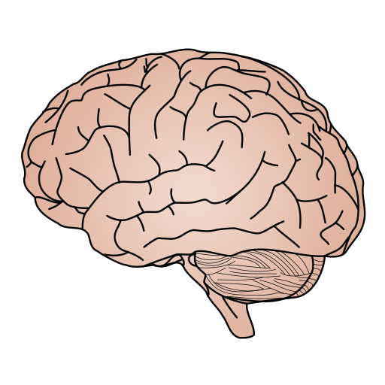
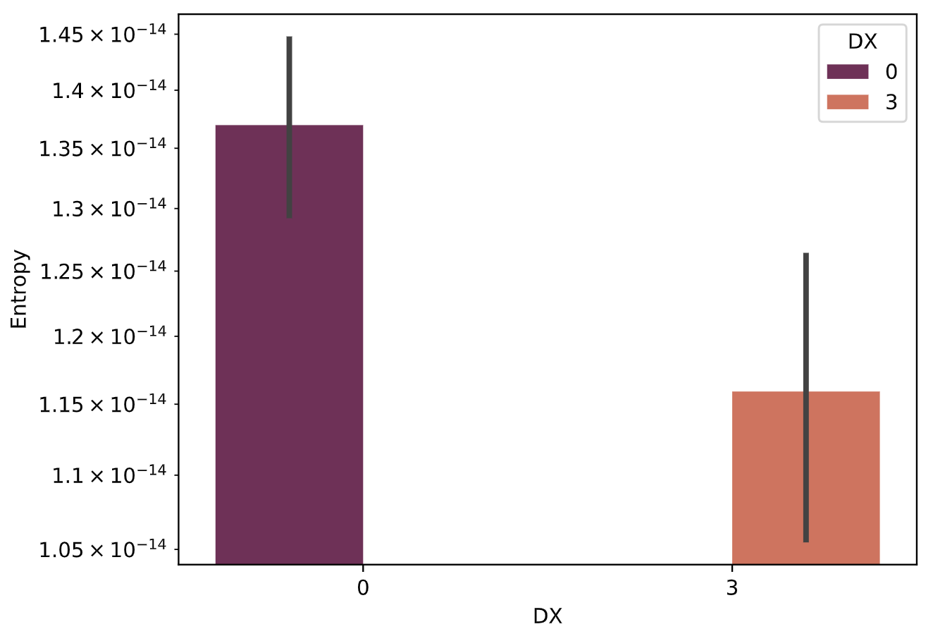
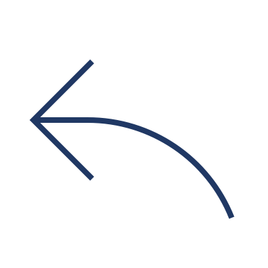

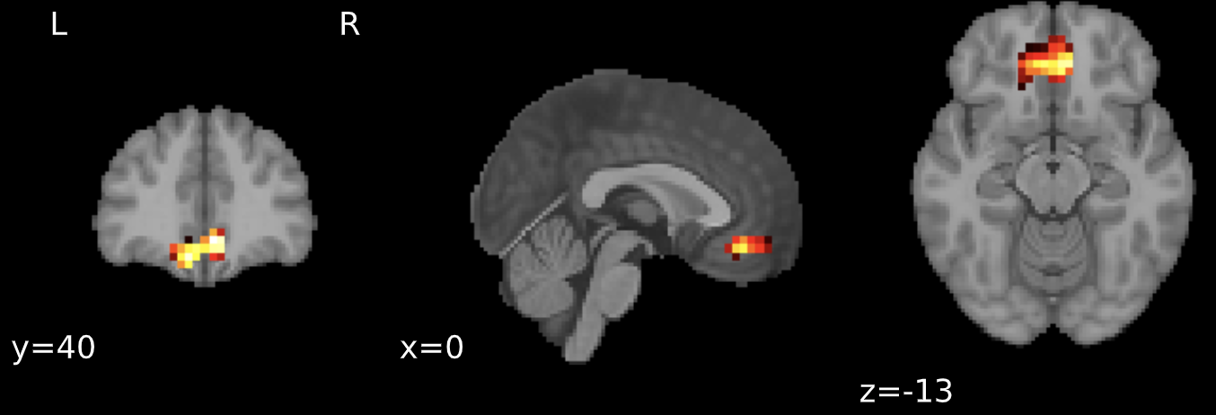
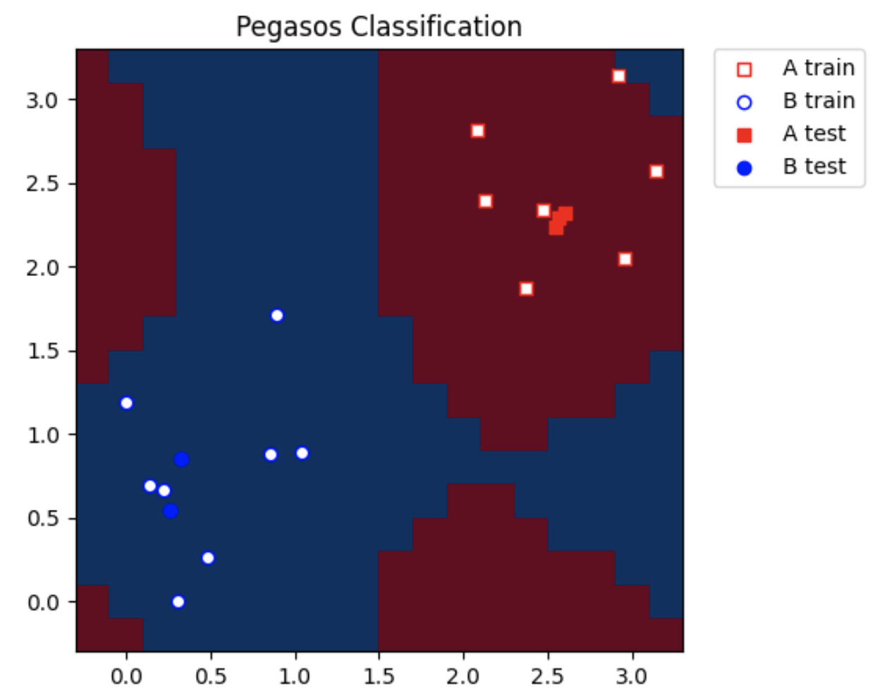
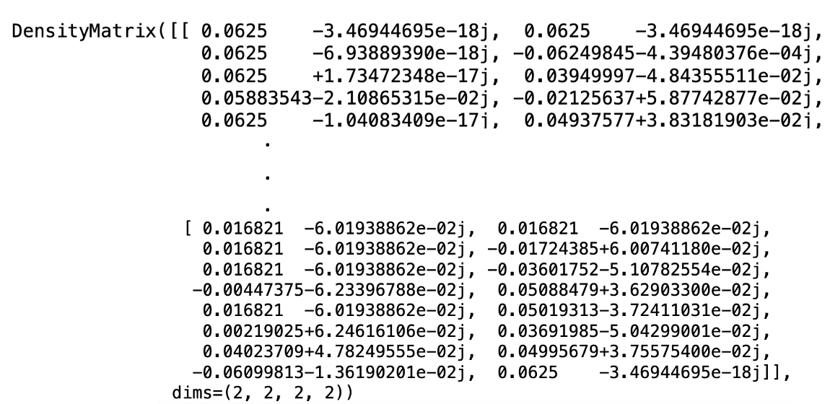

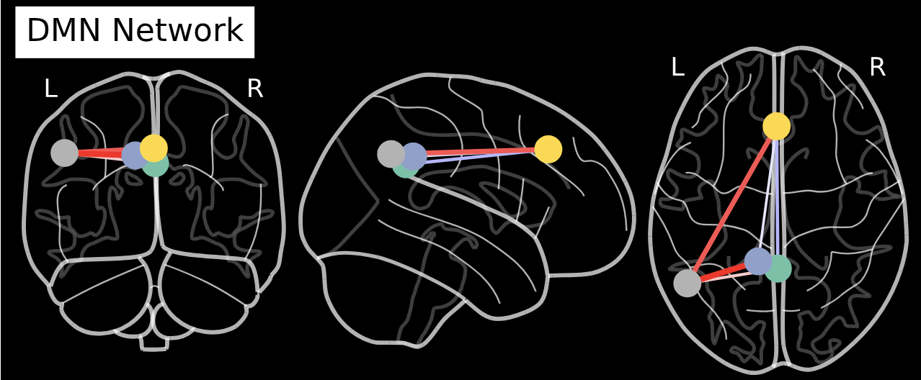
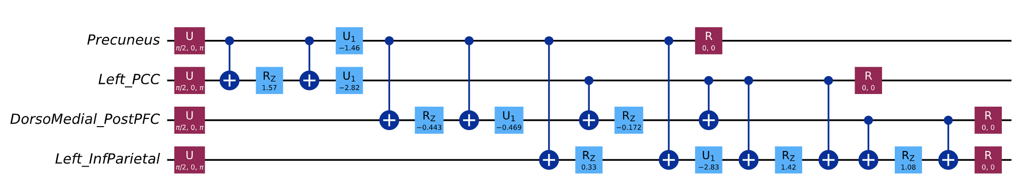
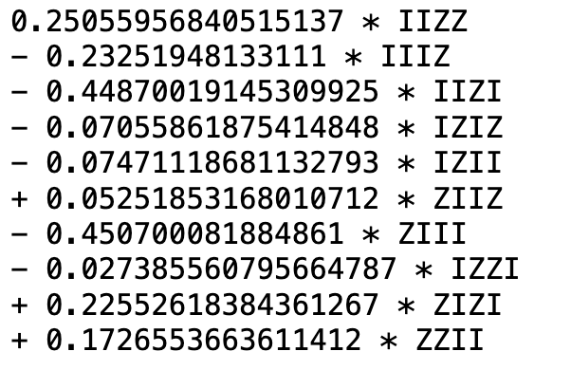
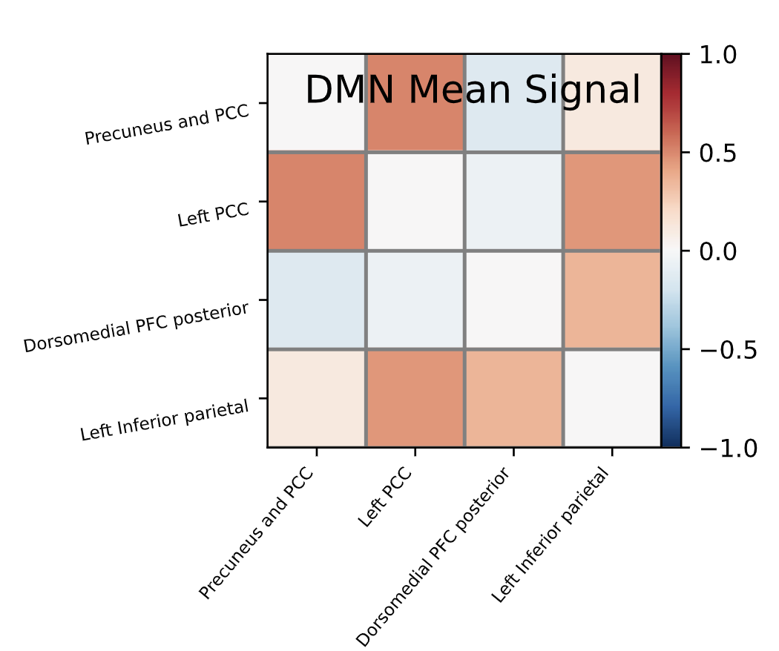
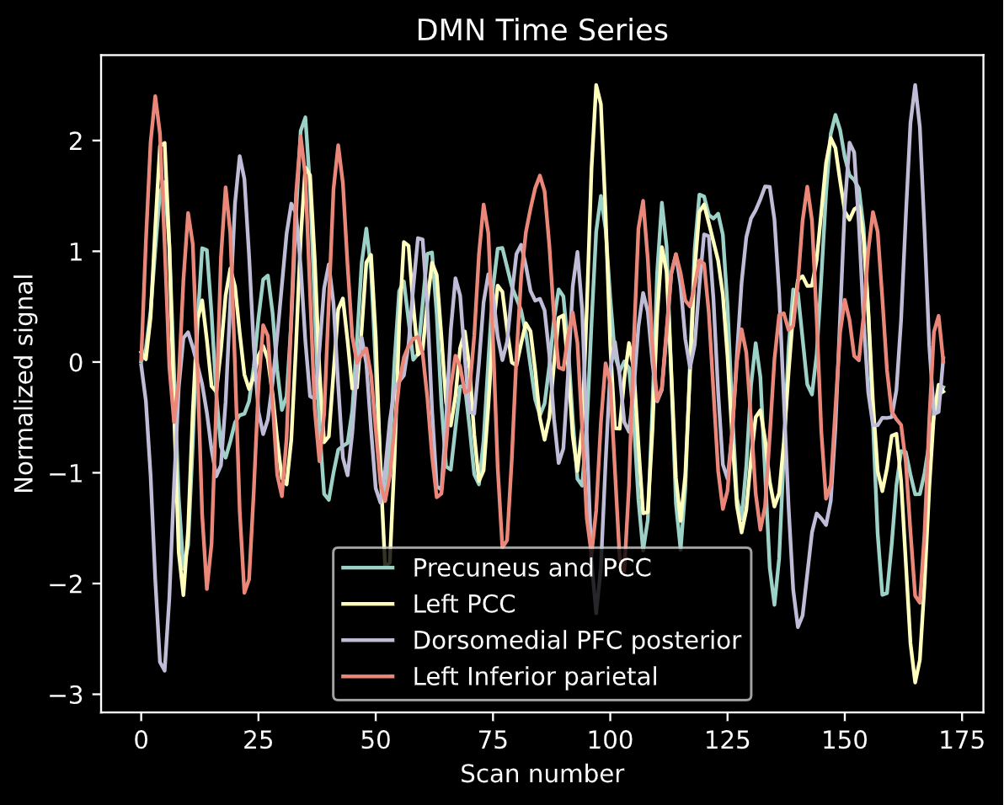
Capture resting state
neuronal activity for Typically Developing Children and those affected by ADHD
*
Augment the phenotype data
with entropy to achieve higher
prediction accuracy in Pegasos
QSVC classifier
Compare the entropies
of TDC vs ADHD data
S(ρ)=−Tr[ρlog(ρ)]
Calculate the
Von Neumann entropy of ρ
Identify seeds/Regions of Interest
(ROIs)
Extract time series from f-MRI for ROIs
Construct QAOA Ansatz
and find its density matrix(ρ)
Convert QP to QUBO and obtain the Ising Hamiltonian
Generate Quadratic Program(QP) for the partial correlation matrix
Find Partial correlation between the ROIs
* Picture Courtesy: Wikimedia

