Slide 1
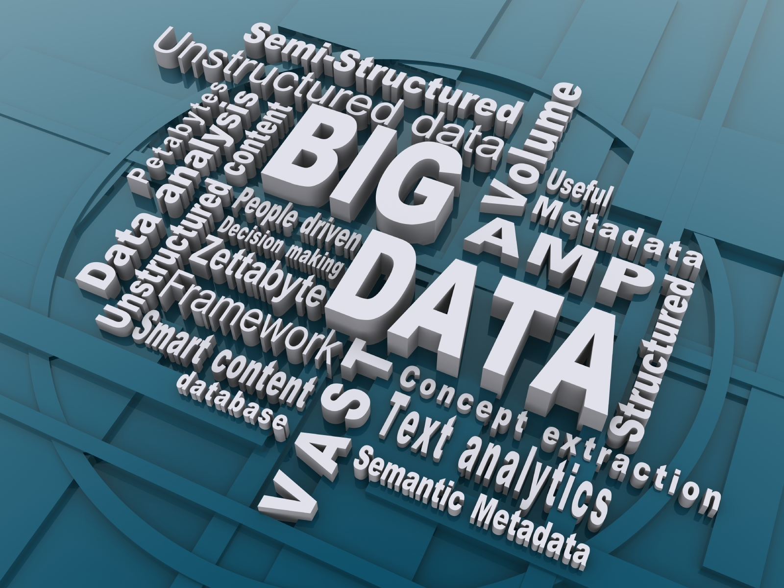
BIG DATA

Slide 2
Content
Introductions
What is Big Data
Characteristic of Big Data
Big Data sources
Tools used in Big Data
Application of Big Data
Risks of Big Data
Benefits of Big Data
How Big Data Impact on IT
Future of Big Data
Course curriculm

Slide 3
Introduction
Big Data may well be the Next Big Thing in the IT world.
Big data burst upon the scene in the first decade of the 21st century.
The first organizations to embrace it were online and startup firms. Firms like Google, eBay, LinkedIn, and Facebook were built around big data from the beginning.
Like many new information technologies, big data can bring about dramatic cost reductions, substantial improvements in the time required to perform a computing task, or new product and service offerings.

Slide 4
What is BIG DATA?
‘Big Data’ is similar to ‘small data’, but bigger in size
but having data bigger it requires different approaches:
Techniques, tools and architecture
an aim to solve new problems or old problems in a better way
Big Data generates value from the storage and processing of very large quantities of digital information that cannot be analyzed with traditional computing techniques.

Slide 5
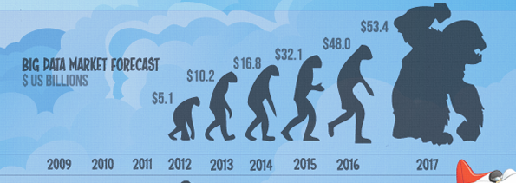
What is BIG DATA
Walmart handles more than 1 million customer transactions every hour.
• Facebook handles 40 billion photos from its user base.
• Decoding the human genome originally took 10years to process; now it can be achieved in one week.

Slide 6
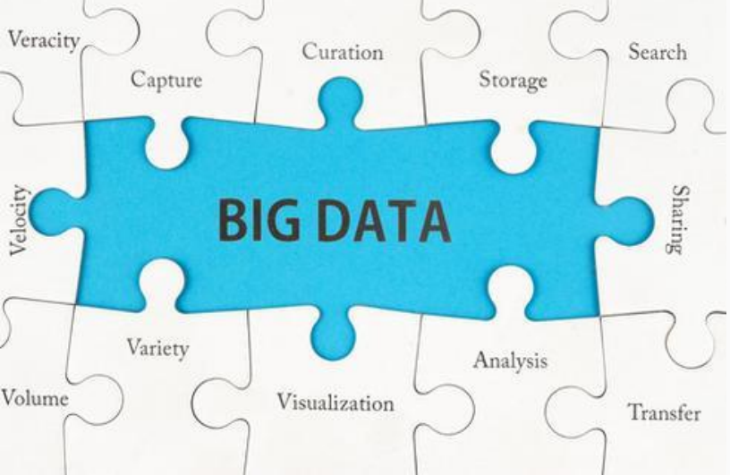
Notes:
6

Slide 7
Characteristics of BigData - 1
Volume: Typically measured in petabytes or smaller, when the size exceeds the physical limits of vertical scalability of your conventional data management platforms. (Note what is big to a mid-sized retailer, may be small for a Telco.)
Variety: The large number of many different formats that make integration complex, as this includes structured, semi-structured and unstructured data. This is one of the component measures of complexity.
Velocity: The rate at which data arrives and changes. This has an impact if there are small decision windows – it becomes a major driver for streamlining business processes.
Veracity: A measure of the (un)predictability of inherently imprecise data types. (As an example, how accurate are the sentiment scores that are assigned based on voice tone?)

Slide 8
Characteristics of BigData - 2
Variability: A measure of the number of options and interpretations possible. (As an example, for how many reasons could an on-line user have terminated a session – or have had it terminated – just before check-out?) When related to the structure of the relationship between data entities, this also reflects complexity.
Value: The inherent value in monetary terms that it adds to the organisation, measured in terms of increased sales, reduced churn, improved segmentation, more targeted products, etc. The calculation for value added should include costs incurred too, net present value, etc, etc.
Sparseness: A measure of the low density of valuable content in the Big Data. -

Slide 9
1st Character of Big Data Volume
A typical PC might have had 10 gigabytes of storage in 2000.
Today, Facebook ingests 500 terabytes of new data every day.
Boeing 737 will generate 240 terabytes of flight data during a single flight across the US.
The smart phones, the data they create and consume; sensors embedded into everyday objects will soon result in billions of new, constantly-updated data feeds containing environmental, location, and other information, including video.

Slide 10
2nd Character of Big Data Velocity
Clickstreams and ad impressions capture user behavior at millions of events per second
high-frequency stock trading algorithms reflect market changes within microseconds
machine to machine processes exchange data between billions of devices
infrastructure and sensors generate massive log data in real-time
on-line gaming systems support millions of concurrent users, each producing multiple inputs per second.

Slide 11
3rd Character of Big Data Variety
Big Data isn't just numbers, dates, and strings. Big Data is also geospatial data, 3D data, audio and video, and unstructured text, including log files and social media.
Traditional database systems were designed to address smaller volumes of structured data, fewer updates or a predictable, consistent data structure.
Big Data analysis includes different types of data

Slide 12
Storing Big Data
Analyzing your data characteristics
Selecting data sources for analysis
Eliminating redundant data
Establishing the role of NoSQL
Overview of Big Data stores
Data models: key value, graph, document, column-family
Hadoop Distributed File System
HBase
Hive

Slide 13
Selecting Big Data stores
Choosing the correct data stores based on your data characteristics
Moving code to data
Implementing polyglot data store solutions
Aligning business goals to the appropriate data store

Slide 14
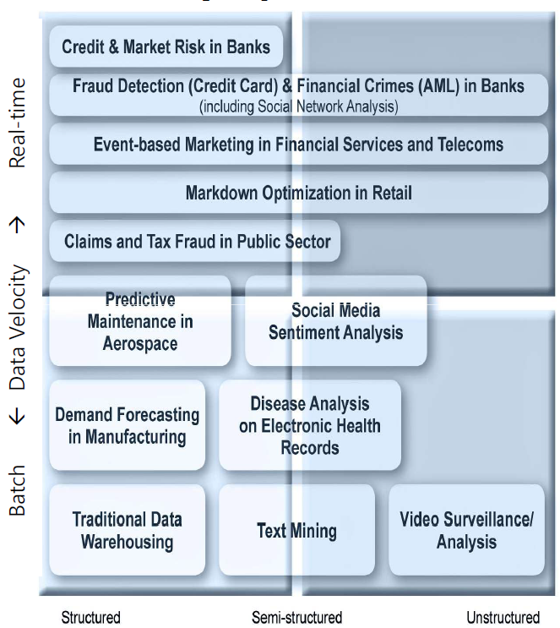
The Structure of Big Data
Structured
Most traditional data sources
Semi-structured
Many sources of big data
Unstructured
Video data, audio data

Slide 15
Why Big Data
Growth of Big Data is needed
Increase of storage capacities
Increase of processing power
Availability of data(different data types)
Every day we create 2.5 quintillion bytes of data; 90% of the data in the world today has been created in the last two years alone

Slide 16
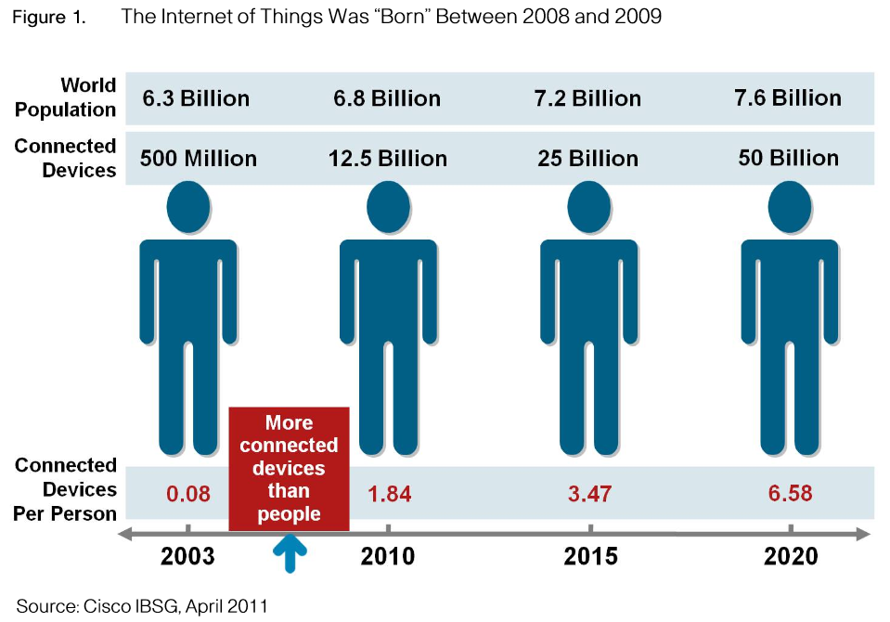
Why Big Data
FB generates 10TB daily
Twitter generates 7TB of data
Daily
IBM claims 90% of today’s
stored data was generated
in just the last two years.

Slide 17

How Is Big Data Different?
1) Automatically generated by a machine
(e.g. Sensor embedded in an engine)
2) Typically an entirely new source of data
(e.g. Use of the internet)
3) Not designed to be friendly
(e.g. Text streams)
4) May not have much values
Need to focus on the important part

Slide 18
Big Data sources
Users
Application
Large and growing files
(Big data files)
Systems
Sensors

Slide 19
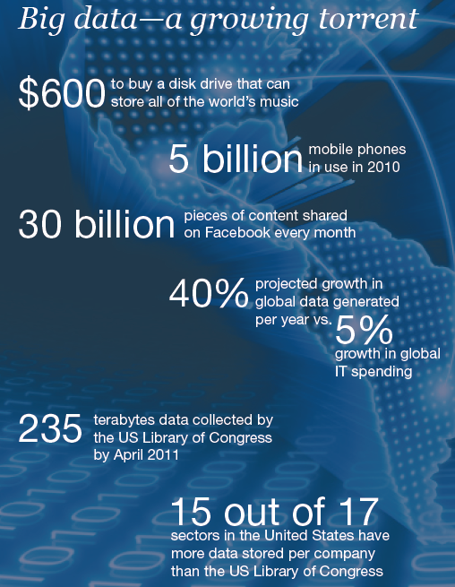
Data generation points Examples
Mobile Devices
Microphones
Readers/Scanners
Science facilities
Programs/ Software
Social Media
Cameras

Slide 20
Big Data Analytics
Examining large amount of data
Appropriate information
Identification of hidden patterns, unknown correlations
Competitive advantage
Better business decisions: strategic and operational
Effective marketing, customer satisfaction, increased revenue

Slide 21
Types of tools used in Big-Data
Where processing is hosted?
Distributed Servers / Cloud (e.g. Amazon EC2)
Where data is stored?
Distributed Storage (e.g. Amazon S3)
What is the programming model?
Distributed Processing (e.g. MapReduce)
How data is stored & indexed?
High-performance schema-free databases (e.g. MongoDB)
What operations are performed on data?
Analytic / Semantic Processing

Slide 22
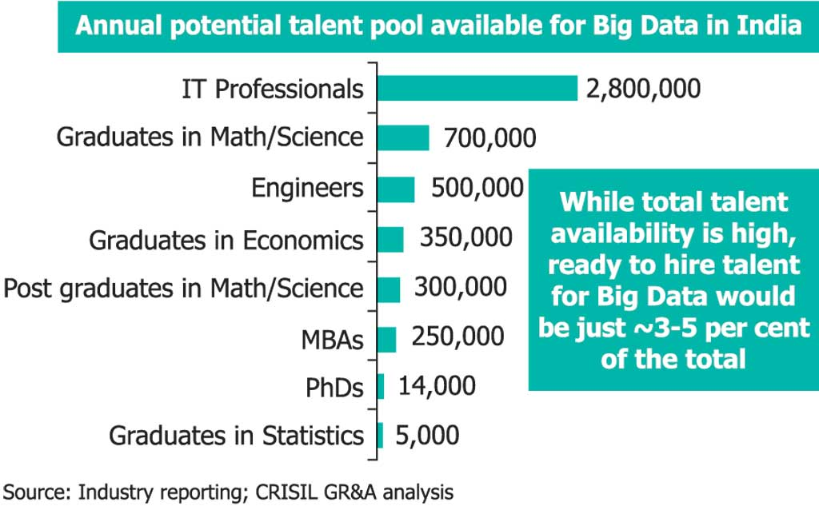
Potential Value of Big Data
$300 billion potential annual value to US health care.
$600 billion potential annual consumer surplus from using personal location data.
60% potential in retailers’ operating margins.

Slide 23
India – Big Data
Gaining attraction
Huge market opportunities for IT services
(82.9% of revenues) and analytics firms
(17.1 % )
Current market size is $200 million. By 2016 $1
billion
The opportunity for Indian service providers lies
in offering services around Big Data
implementation and analytics for global
multinationals

Slide 24
Benefits of Big Data
Real-time big data isn’t just a process for storing petabytes or exabytes of data in a data warehouse, It’s about the ability to make better decisions and take meaningful actions at the right time.
Fast forward to the present and technologies like Hadoop give you the scale and flexibility to store data before you know how you are going to process it.
Technologies such as MapReduce,Hive and Impala enable you to run queries without changing the data structures underneath.

Slide 25
Benefits of Big Data
Our newest research finds that organizations are using big data to target customer-centric outcomes, tap into internal data and build a better information ecosystem.
Big Data is already an important part of the $64 billion database and data analytics market
It offers commercial opportunities of a comparable
scale to enterprise software in the late 1980s
And the Internet boom of the 1990s, and the social media explosion of today.

Slide 26
Future of Big Data
$15 billion on software firms only specializing in data management and analytics.
This industry on its own is worth more than $100 billion and growing at almost 10% a year which is roughly twice as fast as the software business as a whole.
In February 2012, the open source analyst firm Wikibon released the first market forecast for Big Data , listing $5.1B revenue in 2012 with growth to $53.4B in 2017
The McKinsey Global Institute estimates that data volume is growing 40% per year, and will grow 44x between 2009 and 2020.

