Slide 1
Hadoop Introduction

Slide 2
Introduction
Hadoop is a large-scale distributed batch processing infrastructure. While it can be used on a single machine, its true power lies in its ability to scale to hundreds or thousands of computers, each with several processor cores. Hadoop is also designed to efficiently distribute large amounts of work across a set of machines - Yahoo
In a nutshell - It is an open source java framework for creating and running distributed applications with vast amount of data on a cluster of commodity Hardware.
It was created by Apache Nutch Team (Doug Cutting).

Slide 3
What is a Distributed System
Definition: A distributed system is a piece of software that ensures that, a collection of independent computers that appears to its users as a single coherent system.
Example Distributed Systems –
Searching
Spam filter
Indexing
Crawling
Sorting
Data Analytics
Machine Learning
Predictive Analysis
Logs Processing
ClickStream Processing

Slide 4
Why Distributed System?
Just because of the fact that the data that need to be processed to derive information out of the data is large.
How large? Orders of magnitude larger than many existing systems work with. Hundreds of gigabytes of data constitute the low end of BigData-scale.
At this scale, it is likely that the input data set will not even fit on a single computer's hard drive, much less in memory, hence we need to process the data in Distributed fashion.

Slide 5
Challenges in Distributed systems
Performing large-scale computation is difficult. To work with this volume of data requires distributing parts of the problem to multiple machines to handle in parallel. Whenever multiple machines are used in cooperation with one another, the probability of failures rises. In a single-machine environment, failure is not something that program designers explicitly worry about very often: if the machine has crashed, then there is no way for the program to recover anyway.

Slide 6
Challenges in Distributed systems
In a distributed system, partial failures are an expected and common occurrence.
Networks can experience partial or total failure if switches and routers break down.
Data may not arrive at a particular point in time due to unexpected network congestion.
Individual compute nodes may overheat, crash, experience hard drive failures, or run out of memory or disk space.
Data may be corrupted, or maliciously or improperly transmitted.
Multiple implementations or versions of client software may speak slightly different protocols from one another.
Clocks may become desynchronized, lock files may not be released, parties involved in distributed atomic transactions may lose their network connections part-way through, etc.
In each of these cases, the rest of the distributed system should be able to recover from the component failure or transient error condition and continue to make progress.
Providing above resilience is a major software engineering challenge, we have seen a glimpse of some of the above in our earlier ClickStream analytics app.
Check out - https://en.wikipedia.org/wiki/Fallacies_of_distributed_computing

Slide 7
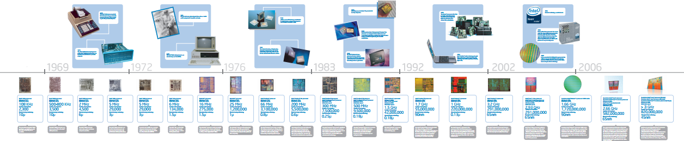
Then why use a Distributed system?
Moore's Law states that the number of transistors that can be placed in a processor will double approximately every two years, for half the cost.
While we can still double the number of transistors per unit area at this pace, this does not necessarily result in faster single-threaded performance.
For example, in the case of Intel processors we are at ~2-3GHz speed since the last 10 years.
New processor architectures now focus on embedding many smaller CPUs or "cores" onto the same physical device. This allows multiple threads to process twice as much data in parallel, but at the same speed at which they operated previously.

Slide 8
Then why use a Distributed system?
Lets assume that we have a thousand CPU core single machine, even then we cannot gain much mileage in processing because it is not be possible to deliver input data to these processing cores fast enough for processing.
Individual hard drives can only sustain read speeds between 60-100 MB/second.
Storage is getting cheaper over time, but speeds have not been increasing over time at par with the pace of processor speed (refer to last two slides).
Optimistically assuming the upper limit of 100 MB/second, and assuming four independent I/O channels are available to the machine, that provides 400 MB of data every second.
A 1 terabyte data set (1048576MB) would thus take ~43 minutes to just read the data!
In this case all the1000cores of CPU would enter into idling state waiting for I/O.
With 100 separate machines each with 4 I/O channels on the job, this drops to 26seconds!

Slide 9
Hadoop Approach
Hadoop is designed to efficiently process large volumes of data by connecting many commodity computers together to work in parallel.
The theoretical 1000-CPU machine that we spoke about earlier would cost a very large amount of money, far more than 1,000 single-CPU or 250 quad-core machines.
Hadoop ties these smaller and more reasonably priced machines together into a single cost-effective compute cluster.

Slide 10
Features of Hadoop
Accessible - Hadoop runs on large clusters of commodity machines or on cloud computing services.
Robust – Hadoop runs on commodity hardware, it is architected with the assumption of frequent hardware malfunctions. It can gracefully handle most such failures.
Fault-tolerant – The is no single point of failure
Simple - Hadoop allows users to quickly write efficient parallel code
Reliable – There is no loss of data, re-launches tasks
Scalable - Hadoop scales linearly to handle larger data by adding more nodes to the cluster.

Slide 11
Core Hadoop
Single Use System
Batch Apps
Multi Purpose Platform
Batch, Interactive, Online, Streaming, …
HADOOP 1.0
HADOOP 2.0
MapReduce
(data processing)
Others
MapReduce
(cluster resource management
& data processing)
YARN
(cluster resource management)
HDFS
(redundant, reliable storage)
HDFS2
(redundant, highly-available & reliable storage)

Slide 12

Core Hadoop Components
Applications Run Natively in Hadoop
BATCH
(MapReduce)
INTERACTIVE
(Tez)
ONLINE
(HBase)
STREAMING
(Storm, S4,…)
GRAPH
(Giraph)
IN-MEMORY
(Spark)
HPC MPI
(OpenMPI)
OTHER
(Search)
(Weave…)
YARN (Cluster Resource Management)
HDFS2 (Redundant, Reliable Storage)
Page 12

Slide 13
HDFS
Hadoop Distributed File System.
Stores files in blocks across many nodes in a cluster.
Replicates the blocks across nodes for durability.
Master/Slave architecture

Slide 14
HDFS
Not fully POSIX compliant.
No file updates.
Write once, read many times.
Large blocks, sequential read patterns.
Designed for batch processing.

Slide 15
HDFS Design Goals
The major design principles or assumptions in the Hadoop Distributed
File System design are:
Hardware Failure
Streaming Data Access
Large files
Simple Coherency Model
Data Localization
Fault – tolerant
Deploy on Commodity Hardware
Reliable and High throughput
Heterogeneous Hardware and Software platforms

Slide 16
HDFS Master Components
NameNode –
Runs on a single node as a master process
Holds file metadata (which blocks are where)
Directs client access to files in HDFS
SecondaryNameNode
Not a hot failover
Maintains a copy of the NameNode metadata

Slide 17
HDFS Slave Componets
DataNode
Generally runs on all nodes in the cluster
Block creation/replication/deletion/reads
Takes orders from the NameNode

Slide 18
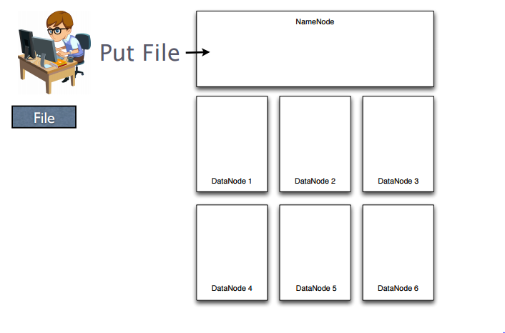
HDFS Illustrated

Slide 19
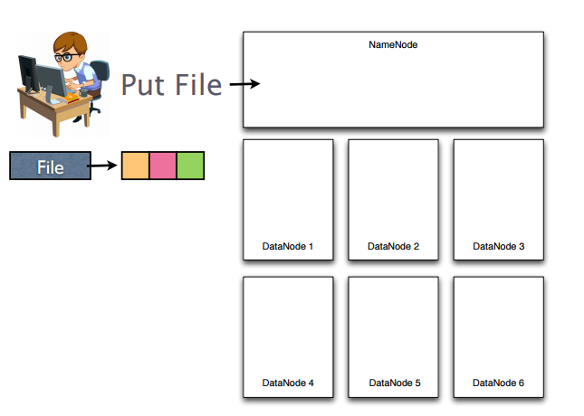
HDFS Illustrated -2

Slide 20
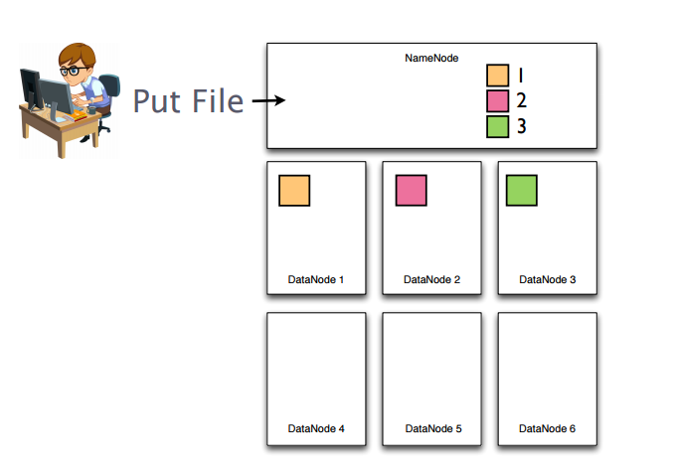
HDFS Illustrated -3

Slide 21
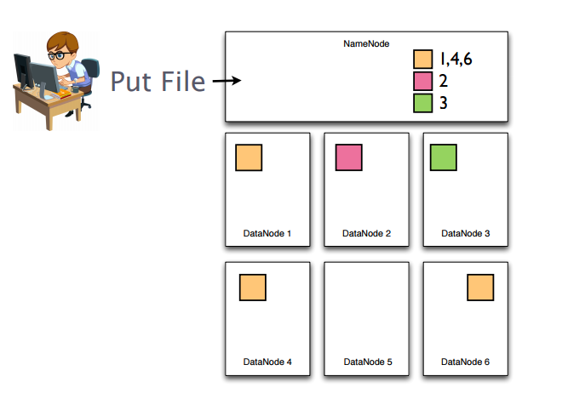
HDFS Illustrated -4

Slide 22
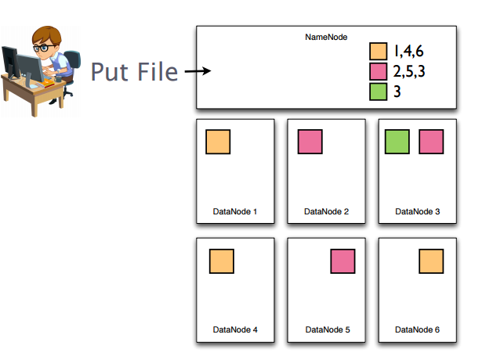
HDFS Illustrated -5

Slide 23
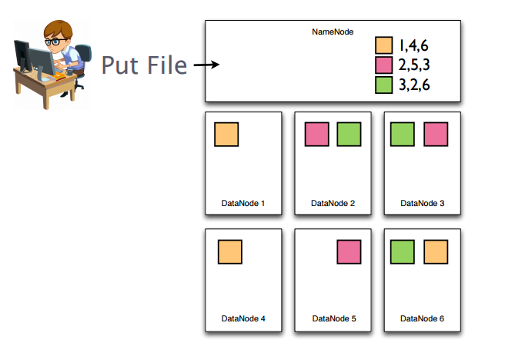
HDFS Illustrated -6

Slide 24
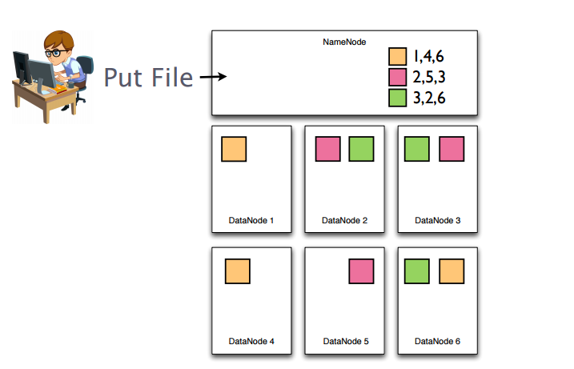
HDFS Illustrated -7

Slide 25
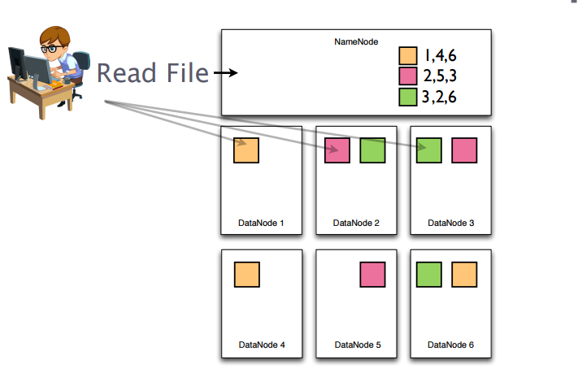
HDFS Illustrated -8

Slide 26
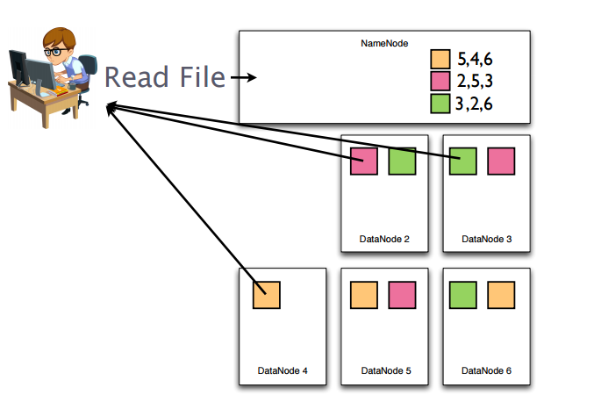
HDFS Illustrated -9 (Failure scenario)
Blocks stored in failed nodes are automatically rebalanced, and NameNode metadata is updated after rebalance

Slide 27
In Action
Setup Hadoop on your laptops/desktops
Windows
Linux
AWS

Slide 28
Hadoop Cluster Setup
We have three modes for running Hadoop.
Local mode
Pseudo Distributed mode
Distributed Mode
Local Mode:
Local mode is running Map Reduce on local file system of machine. This mode works on Single machine only.
There is no HDFS, instead it is the local file system that is used.
We cannot achieve all Map Reduce features
All daemons are running in one JVM Process.
It is useful developing map reduce programs on small set of data. All the error and log messages are written to console.

Slide 29
Contd..
Pseudo Distributed Mode:
It is Hadoop cluster of one node.
All the Hadoop components are run as individual java processes.
There is no software difference compared to Hadoop Fully Distributed cluster. It has only hardware differences (adding more nodes).
This just like staging, running the our jobs before deploying these jobs running on actual production cluster.
This mode has Web UI for monitoring job status, file counters
All the errors are logged to Console.
I All log messages are logged to log files instead of console.
All the components have their own log file names like hadoop-host-namenode.log, datanode.log, etc…
All user level debugging messages are logged to stdout, stderr files under userlogs directory of logs.

Slide 30
Contd..
Fully Distributed Mode
This actual production level cluster.
Contains more than one node.
In Production level cluster, Name Node selection very important because it is going to handle large no of files. So we have choose High RAM and high through put I/O Channels.
Adding nodes, running balancer scripts.
Removing nodes safely from the cluster.
Integrate any one of the Scheduler for scheduling the multiple jobs.
This works on any distributed file system (S3, HDFS..)

Slide 31
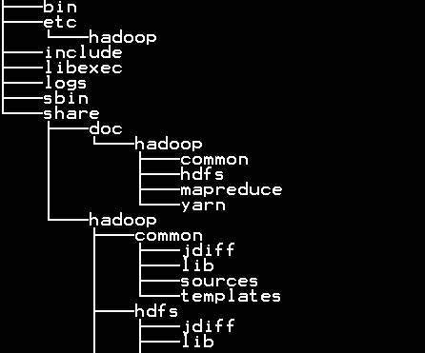
Hadoop Directory Structure
Pick Hadoop 2.6 version for windows from iXaT DropBox, copy to your windows host and unzip –
On Internet https://www.dropbox.com/s/9m29cxbxae6q739/hdp2.6.rar?dl=0
For ixAT lab : \\ixatlabmaster\IXATShare\hadoop102\WindowsBuild_Hadoop
bin – scripts to interact with HDFS,Mapred,Yarn
etc/hadoop – Configuration Files
Include – header files for C++
libexec - Configuration Scripts
logs – User/Component Logs
sbin – scripts to start/stop components
share – documents, libraries etc…
Set the below environment variables to start using –
HADOOP_HOME to the container path
Add bin and sbin to PATH variable
Hadoop runs on Java and hence have JDK (>=1.6) installed before you do any ops
Set JAVA_HOME to the dir where you have installed JDK to

Slide 32
Running in Pseudo Dist mode
1. Modify core-site.xml (can be found in etc/hadoop dir)
2. Modify hdfs-site.xml (can be found in etc/hadoop dir), replace E:/hdp2.6 to the path where you have unzipped Hadoop to
<configuration>
<property>
<name>fs.defaultFS</name>
<value>hdfs://127.0.0.1:8020</value>
</property>
</configuration>
<configuration>
<property>
<name>dfs.replication</name>
<value>1</value>
</property>
<property>
<name>dfs.http.address</name>
<value>127.0.0.1:50070</value>
</property>
<property>
<name>dfs.webhdfs.enabled</name>
<value>true</value>
<description>to enable webhdfs</description>
<final>true</final>
</property>
<property>
<name>dfs.namenode.name.dir</name>
<value>file:/E:/hdp2.6/data/dfs/namenode</value>
</property>
<property>
<name>dfs.datanode.data.dir</name>
<value>file:/E:/hdp2.6/data/dfs/datanode</value>
</property>
</configuration>
3. Open a command prompt and set environment vars (again modify e:\hdp2.6 to the ones on your box)
Set JAVA_HOME=E:\JDK1.7
set HADOOP_HOME=E:\hdp2.6
set PATH=E:\hdp2.6\bin;E:\hdp2.6\sbin;%PATH%
4. Prepare HDFS by running the below command
hdfs namenode -format
5. Start HDFS by running the below command
start-dfs.cmd

Slide 33
Use HDFS Shell for File Operations
Easy to use command line interface.
Create, copy, move, and delete files.
Administrative duties - chmod, chown, chgrp.
Set replication factor for a file.
Head, tail, cat to view files.

Slide 34
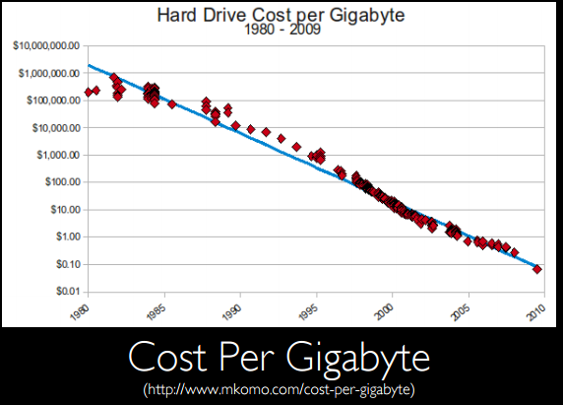
Appendix - Storage Costs

Slide 35
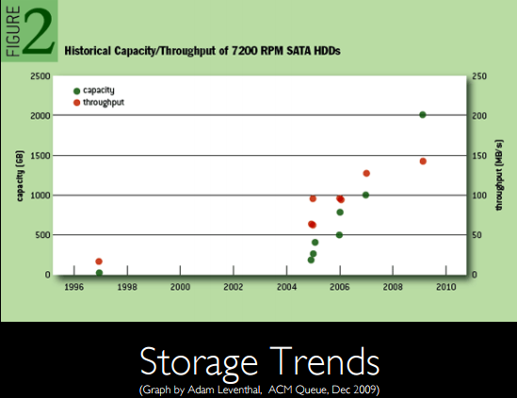
Appendix - Storage Speeds

