Slide 1
More HDFS

Slide 2
Components - NameNode
DFS Master “Namenode”
Manages the file system namespace
Controls read/write access to files
Manages block replication
Checkpoints namespace and journals namespace changes for reliability
Metadata of Name node in Memory
– The entire metadata is in main memory
– No demand paging of FS metadata
Types of Metadata:
List of files, file and chunk namespaces; list of blocks, location of replicas; file attributes etc.

Slide 3
Components - DataNode
Serve read/write requests from clients
Perform replication tasks upon instruction by namenode
Data nodes act as:
1) A Block Server
– Stores data in the local file system
– Stores metadata of a block (e.g. CRC)
– Serves data and metadata to Clients
2) Block Report: Periodically sends a report of all existing blocks to the NameNode
3) Periodically sends heartbeat to NameNode (detect node failures)
4) Facilitates Pipelining of Data (to other specified DataNodes)

Slide 4
Components – Secondary NNode
• Copies FsImage and Transaction Log from NameNode to a temporary directory
• Merges FSImage and Transaction Log into a new FSImage in temporary directory
• Uploads new FSImage to the NameNode
– Transaction Log on NameNode is purged
An (in)Famous Parody on SNN - https://vimeo.com/15782414

Slide 5
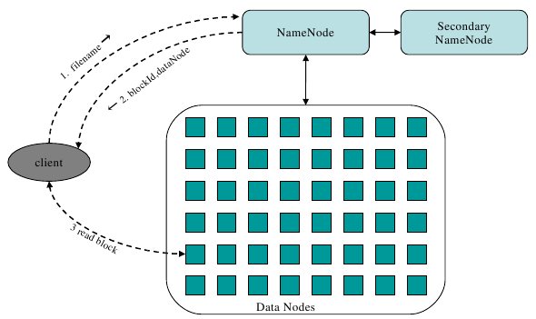
Architecture – v1.x
• NameNode: filename, offset­> block­id, block ­> datanode
• DataNode: maps block ­> local disk
• Secondary NameNode (Checkpoint NameNode): periodically merges edit logs
Block is also called chunk

Slide 6
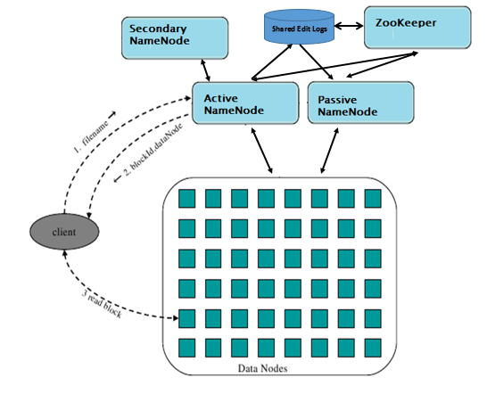
Architecture – v2.x
• NameNode: filename, offset­> block­id, block ­> datanode
• DataNode: maps block ­> local disk
• Passive NameNode – the standby NameNode
• Zookeeper – the Coordinator
• Secondary NameNode (Checkpoint NameNode): periodically merges edit logs
Block is also called chunk

Slide 7
Java API
Configuration conf = new Configuration();
FileSystem fs = FileSystem.get(conf);
Path filenamePath = new Path("/a.txt");
if (fs.exists(filenamePath)) {
fs.delete(filenamePath);
}
FSDataOutputStream out = fs.create(filenamePath);
out.writeUTF("Hello, this is some content from a java program");
out.close();
FSDataInputStream in = fs.open(filenamePath);
String messageIn = in.readUTF();
System.out.print(messageIn);
in.close();

Slide 8
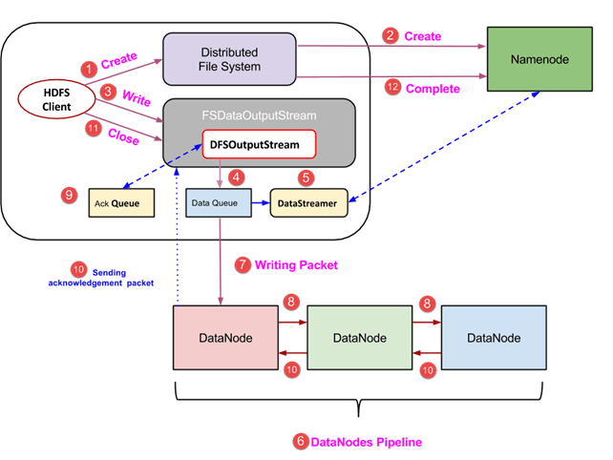
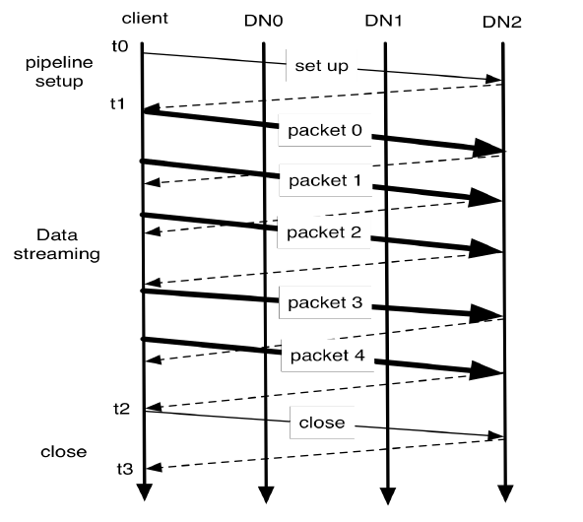
HDFS Write pipeline
Replicated DN’s

Slide 9
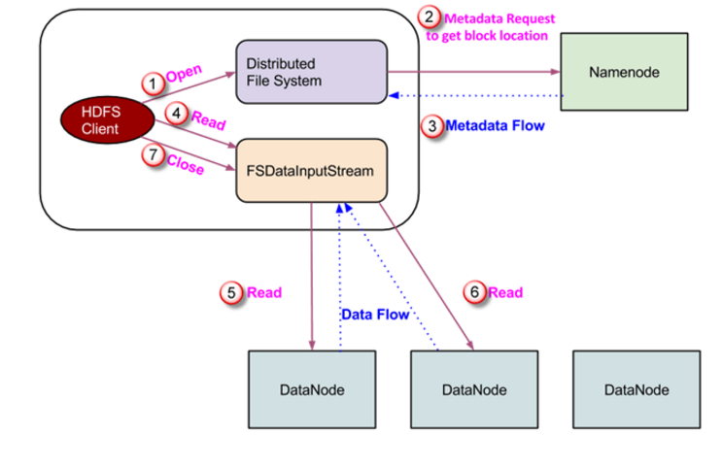
HDFS Read pipeline
Blocks on DN’s

