Slide 1
Constraining BSM (Simplified) models with SM measurements
Jon Butterworth, David Grellscheid (IPPP), Michael Krämer (Aachen), David Yallup
CERN workshop on (re)interpreting the results of new physics searches at the LHC
17 June 2016

Slide 2
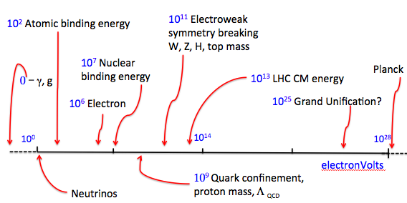
The Standard Model

Slide 3
The Standard Model
Is there anything out there?

Slide 4

The Standard Model
Is there anything out there?
Tread carefully
High energies, high luminosities, model independence…
Here be dragons

Slide 5
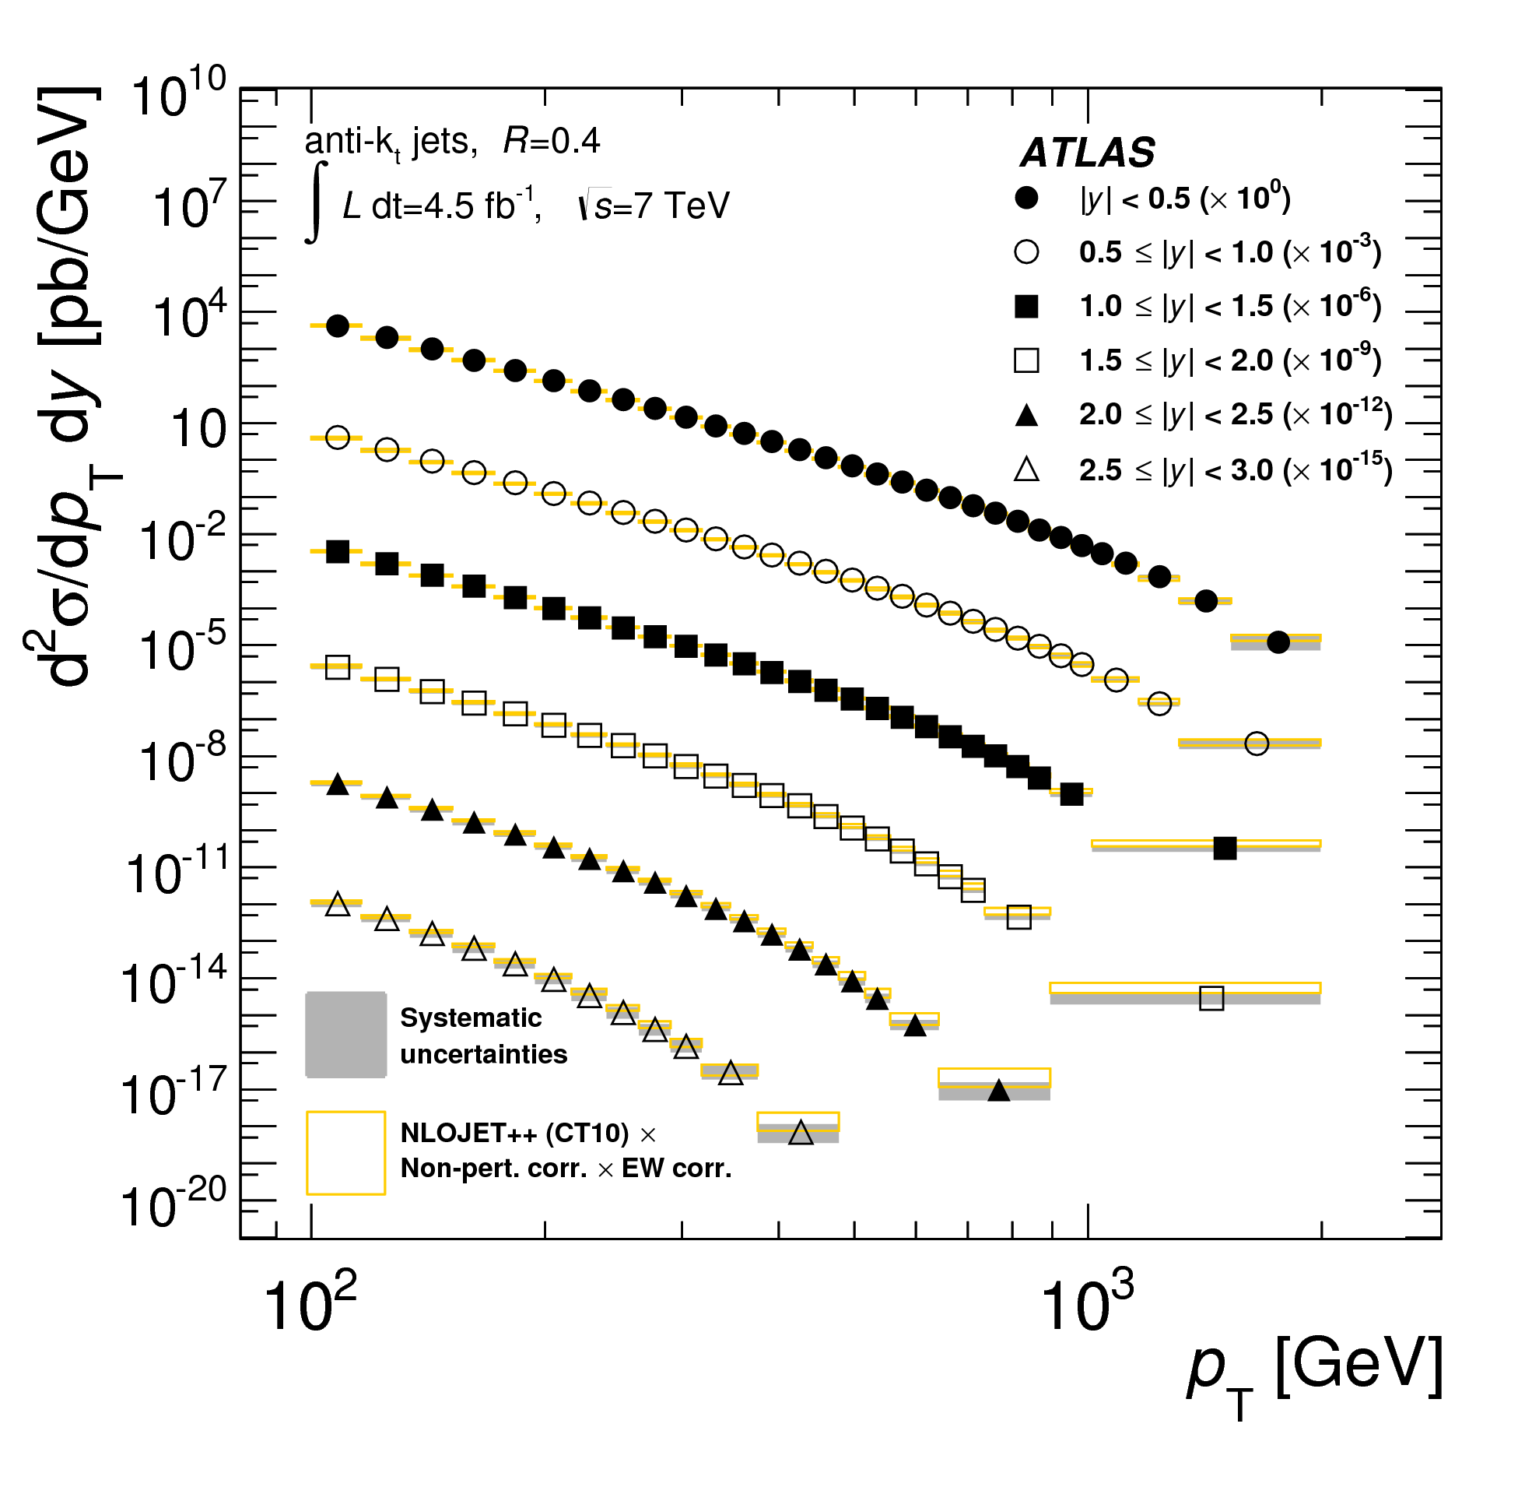
Precision ‘Standard Model’ Measurements
They should not (and mostly do not) assume the SM
They agree with the SM
Thus they can potentially exclude extensions

Slide 6
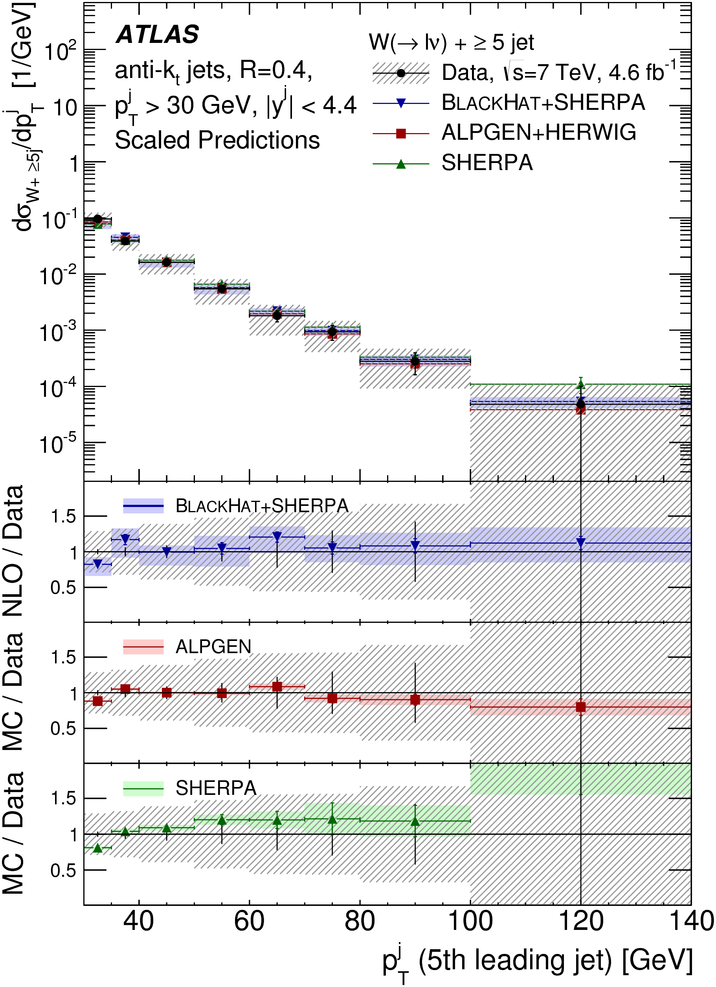
Precision ‘Standard Model’ Measurements
They should not (and mostly do not) assume the SM
They agree with the SM
Thus they can potentially exclude extensions

Slide 7

Simplified Model(s)
Effective lagrangian including minimal new couplings and particles
Our starter example: leptophobic Z’ with vector coupling to u,d quarks, axial vector to a DM candidate ψ.

Slide 8
Key tools:
UFO interface
BSM Model in FeynRules
Final State Particles
New processes in Herwig7
Exclusion
Rivet, and data from HepData

Slide 9
Strategy
Use measurements shown to agree with the Standard Model
Not a search! Guaranteed not to find anything
Will be slower, but more comprehensive and model independent
Assume the data = the background!

Slide 10
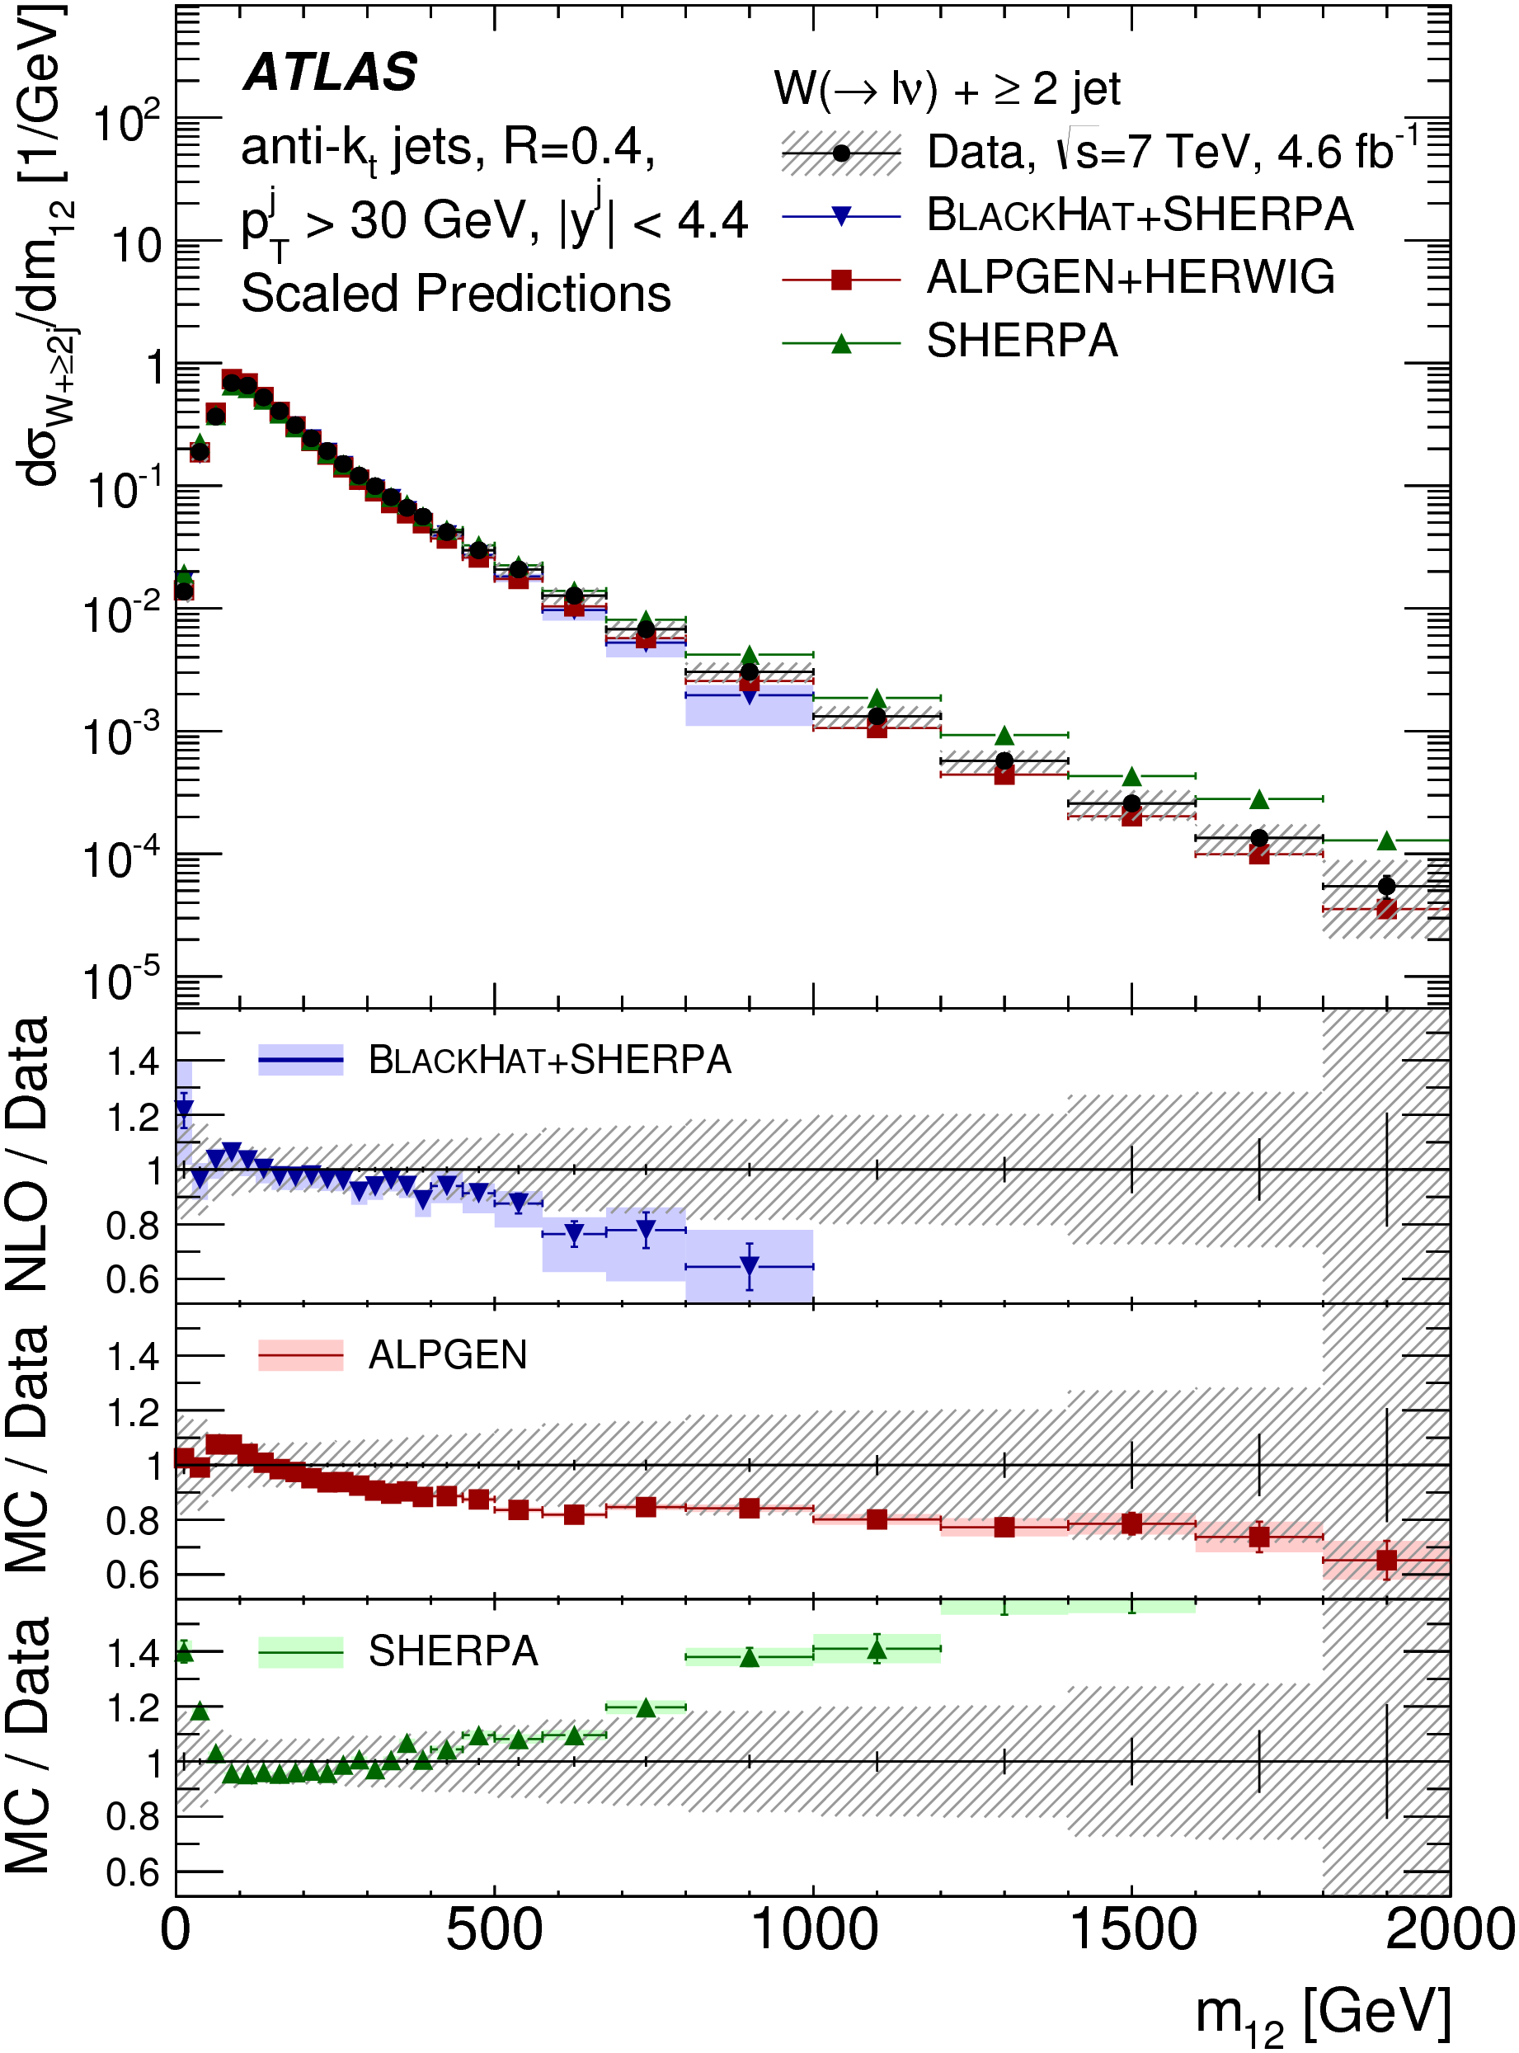
Will miss this kind of thing…

Slide 11
Strategy
Use measurements shown to agree with the Standard Model
Not a search! Guaranteed not to find anything
Will be slower, but more comprehensive and model independent
Assume the data = the background!
Key for constraining new models if there is a signal (unintended consequences)
Key for constraining scale of new physics if there is no signal

Slide 12
Statistics
Construct likelihood function using
BSM signal event count
Background count (from central value of data points)
Gaussian assumption on uncertainty in background count, from combination of statistical and systematic uncertainties
BSM signal count error from statistics of generated events (small!)
Make profile likelihood ratio a la Cowan et al (Asimov data set approximation is valid)
Present in CL_{s} method (A. Read)
Systematic correlations not fully treated - take only the most significant deviation in a given plot (conservative)

Slide 13
Dynamic data selection
SM measurements of fiducial, particle-level differential cross sections, with existing Rivet routines
Classify according to data set (7, 8, 13 TeV) and into non-overlapping signatures
Use only one plot from each given statistically correlated sample
Jets, W+jets, Z+jets, γ, γ+jets, γγ, ZZ, W/Z+γ
Sadly no Missing E_{T}+jets, not much 8 TeV, no 13 TeV yet, though much is on the way… Also can use suitably model-independent Higgs and top measurements in future.
Most sensitive measurement will vary with model and model parameters

Slide 14
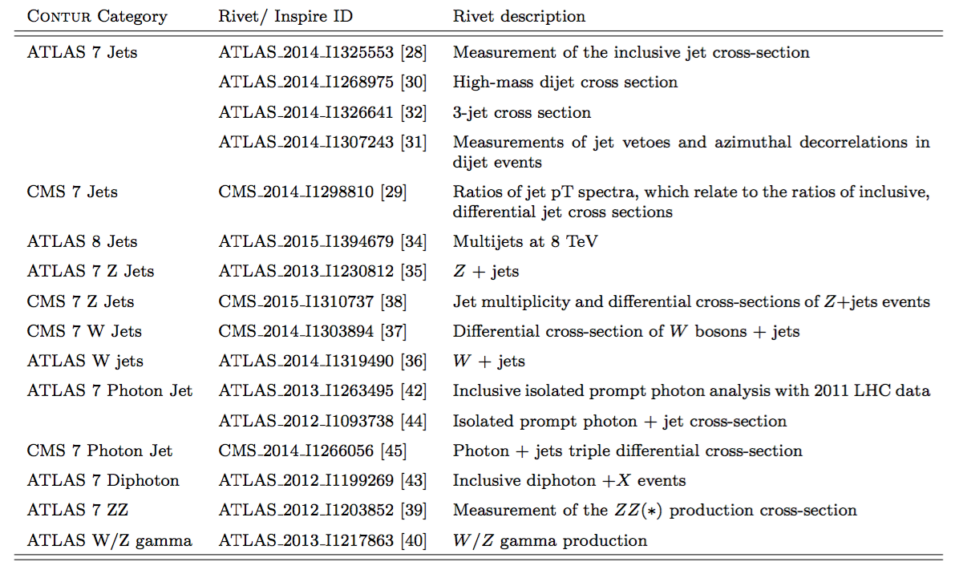

Slide 15
Key tools:
Constraints On New Theories Using Rivet
UFO interface
BSM Model in FeynRules
Final State Particles
New processes in Herwig7
Exclusion
Rivet, and data from HepData

Slide 16
Key tools:
Constraints On New Theories Using Rivet
UFO interface
BSM Model in FeynRules
Final State Particles
New processes in Herwig7
Exclusion
Rivet, and data from HepData
C O N T U R
https://contur.hepforge.org/
https://contur.hepforge.org/

Slide 17
Parameter Choices
Scan in M_{DM} and M_{Z’}
Four pairs of couplings:
Challenging: g_{q} = 0.25; g_{DM} = 1
Medium: g_{q} = 0.375; g_{DM} = 1
Optimistic: g_{q} = 0.5; g_{DM} = 1
DM-suppressed g_{q} = 0.375; g_{DM} = 0.25

Slide 18
Data Comparisons

Slide 19
Data Comparisons

Slide 20
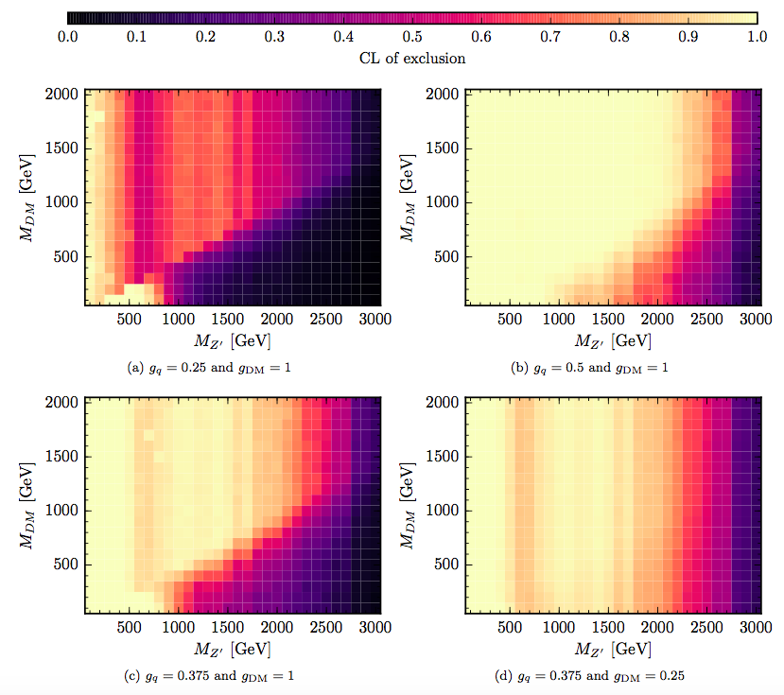
Heat Maps

Slide 21
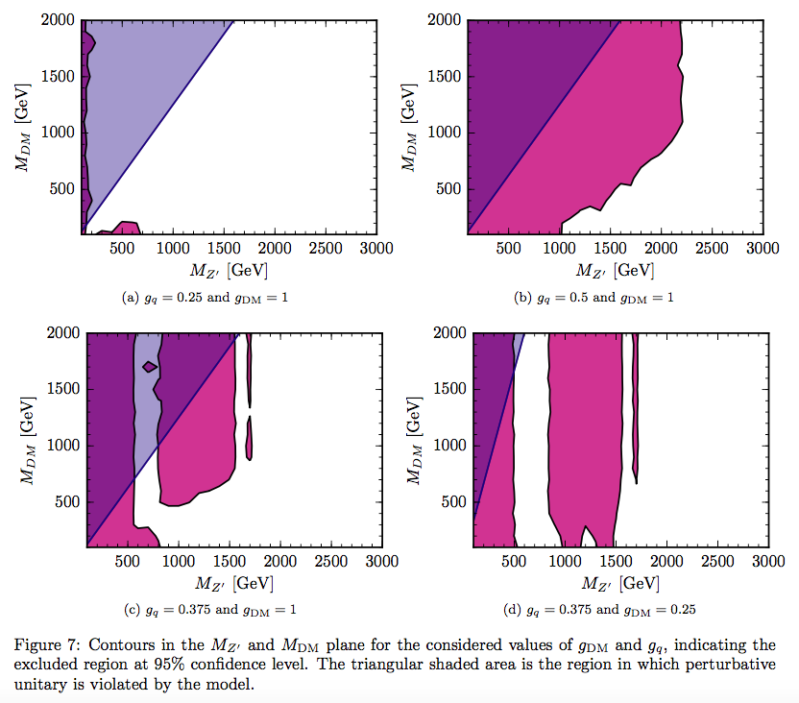
95% CL_{s} Contour

Slide 22
Conclusions
Particle-level measurements not only measure what is happening in our collisions, they constrain what is not happening.
Limit-setting procedure developed; even with conservative treatment of correlations, limits are competitive with those from dedicated searches using comparable data-sets
General framework developed:
consider all new processes in a given (simplified) model
consider all available final states. (e.g. V+jet shows previously unexamined sensitivity to the model considered)
Highly scaleable to other models & new measurements – plan continuous rolling development
See arXiv (and references therein), and hepforge.org/contur

