Slide 1
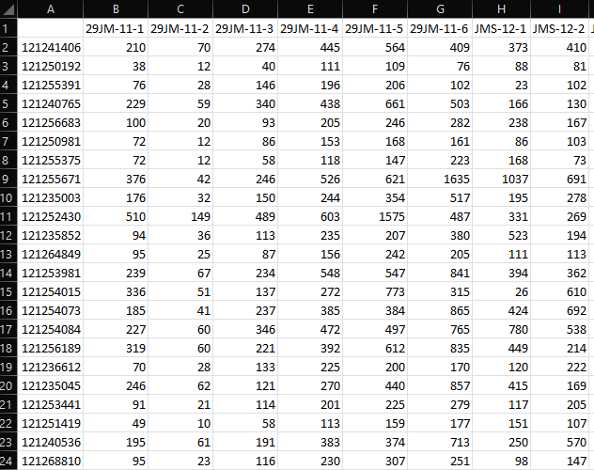
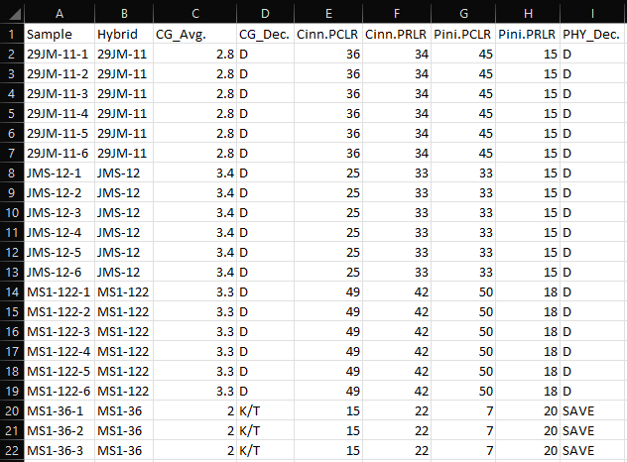
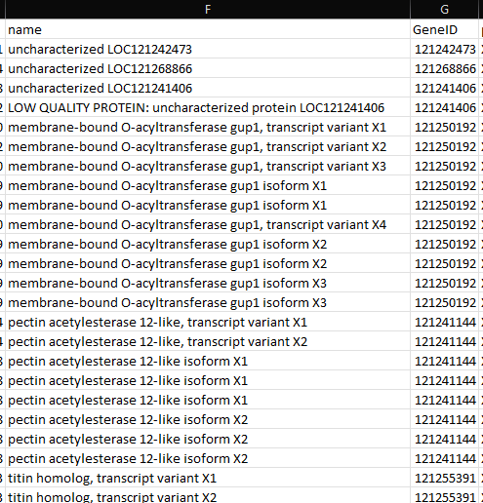
Plotting Data
Sample column
(must match with samples in plotting data)
Metadata
Annotation
ID column
(must match with IDs in plotting data)
Samples
Metadata
Annotation
ID column

