Slide 1
IMPERIA
SCHOOL OF COMPUTING & IT
BUSINESS COMMUNICATION
CIT405
ASSIGNMENT 2
LECTURER NAME : Ms Lau
START DATE: JANUARY END DATE : 22ND MARCH
PRESRNTED AND CREATED BY
ID No.1002217
DIPLOMA IN COMPUTING
-FULLTIME
SAZZAD HOSSAIN

Slide 2






DIVERSITY CHALENEGES
IN
BUSINESS COMMUNICATION
SOME COMMON PROBLEM FACED BY THE MANAGERS IN ORGNAIZATION

Slide 3



DIVERSITY CHALENGES
Diversity in the workplace is another strategic force influencing communication. Differences between the sender and the receiver in areas such as culture, age, gender, uses of nonverbal and education require sensitivity part of Diversity challenges.
Some of the Diversity challenges are
Educational Levels
Age factors
Nonverbal Differences

Slide 4


EDUCATIONAL LEVELS
Educational levels is defined as the standard of knowledge, the educational background and the experience about a particular job of a person.
Organization requires some specific educational background for their particular job position.
It depends on the organization and its environment.
Some organizations require a strong background for a higher position and some times they require very poor background for a higher position.

Slide 5
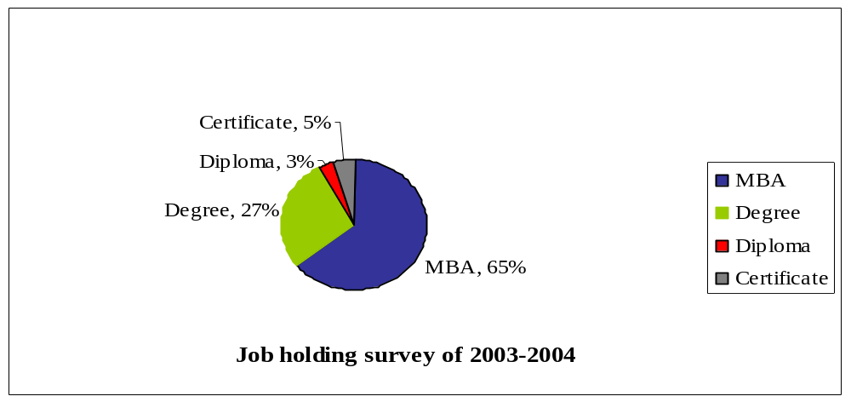
EDUCATIONAL LEVELS
Example:1
In year 2003-2004 there was a survey held which is done by Stamford University
65 percentages job goes to the Masters and MBA holders.
27 percentages of the job goes to the Degree and Bachelor degree holders.
5 percentages jobs goes to the Certificate.
A few percentages of the job goes to the Diploma holder

Slide 6
EDUCATIONAL LEVELS
Example:2
The kinds of communication can vary on the educational levels. Decision research corporation of U.K. has recently done a survey on the Business Scholl graduates and their supervisors.
In response to questions about long term success 85 percentages of the MBAs surveyed listed “oral communication” as “extremely important” more than other technical and non technical skills acquired in business school.
On the Bachelor and Diploma holder students are interested to do technical terms.
Example:3
In year 1970-1971 most of the North American, European Asian organizations have employed illiterate workers for doing their operational jobs. But now they are requiring more knowledgeable workers.

Slide 7


EDUCATIONAL LEVELS
Example:3
Some organization also provide induction training for the workers who has low standard education. For example company's rules and regulations, how to keep themselves secure, how operate machine and other technical terms.
Example:4
Imperia institute of technology has some vacant post for:
  Interior Design English
  Accounting
  Cost and Management Accounting
Their minimum requirement is graduation and they are encouraging fresh graduates to join.
On the other hand Universiti technology Tun Abdul Razzaq is requiring minimum diploma for the same post.

Slide 8

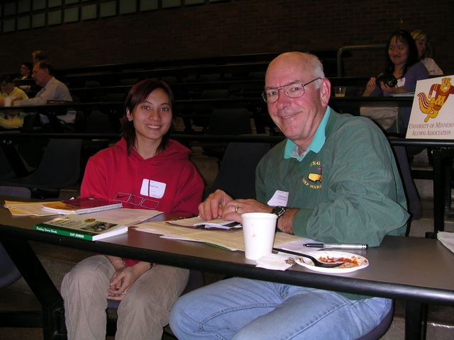
AGE FACTORS
In an organization different types of people is working there. Their age is also different. Different types of age peoples have different types of taste, want and strategy. Some times the difference between ages can effect business communication. This is called age factors.
Less percentages of similarity in thoughts and interest in between a young manager and old manager.
Young person more talkative, likes to rush here and there and also interested to some changes or wants to do new things.
Old manger seems to be serious, less talkative, wants to do his work alone sitting on a chair rather than rushing here and there.

Slide 9
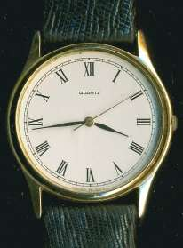

AGE FACTORS
Example:1
In year 1992-1993 there was a switch watch company in Switzerland. They just only made the analog watches. Even when the digital age came they were still making the analog watches. The C.E.O of that watch company was a old man. He believed that the ages of analog watches will never die.
But already digital watches caught all the markets. As a result the switch watch company was bankrupt.
Example:2
As the benefit from the old employees more knowledgeable and experience than young and new employee. Some European and American organizations provide a system called mentor and protégé to remove the barriers.

Slide 10

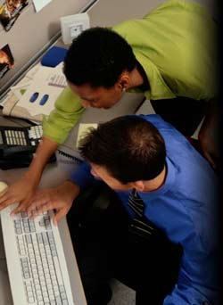
AGE FACTORS
Mentor:
An experienced, knowledgeable employee who serves as a role model for another employee.
Protégé:
A new employee who wants gain knowledge and experience from the mentor.
Mentor and protégé relationship usually depends on mutual understanding of the roles and characteristics of the people involved.
Some professional organization such as the National consortium for black professional development and the American society of profession and executive women provide mentor-relationship and network opportunities.

Slide 11
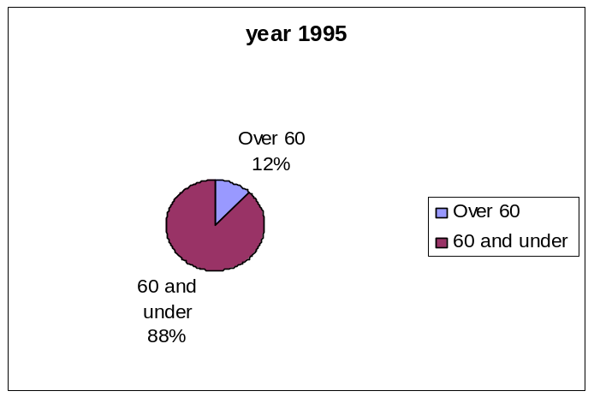
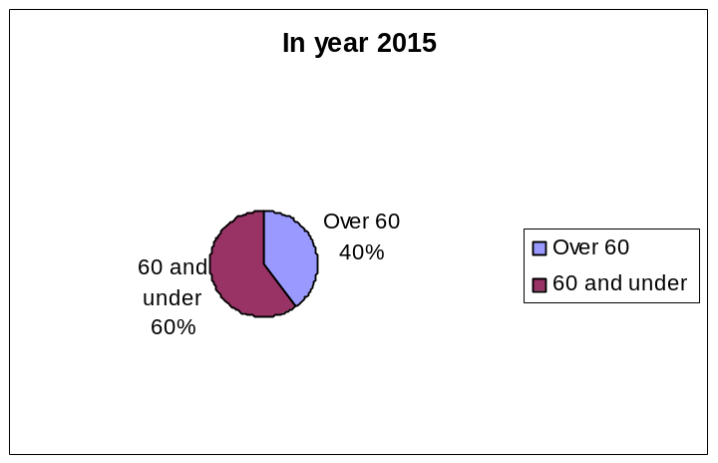
AGE FACTORS
Example:3
In America there is recent issue which is more important issue than ever. The so-called “greying America” has changed the age distribution in U.S.
There was a survey done by national council. It reflects
In year 1995 12% of the worker is over 60 and rest of them under 60.
In year 2015 it will be 40% of the worker over 60 and 60% of them would be under 60.

Slide 12
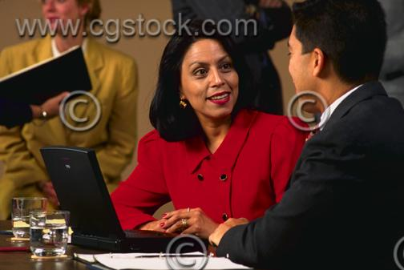
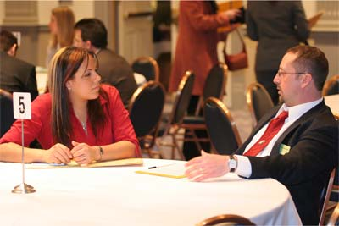
NONVERBAL DIFFERENCES
Nonverbal communication is anything other than words themselves that communicates or affects (positively or negatively) the message "contained" in the words.
There are five key elements that can make or break your attempt at successful nonverbal communication in business:
Facial Expression
Eye and Visual Behavior
Body Movement and Gesture

Slide 13

NONVERBAL DIFFERENCES
Facial Expression:
The face is one of most expressive channels of nonverbal communication.
Facial expressions are the most reliable in determining an individual’s emotional state. A manager who pays close attention to an employee’s facial expressions may have a glimpse of how the employee is feeling. Early identification of a problem can help manager encourage discussion, which ultimately helps resolve the problem.

Slide 14



NONVERBAL DIFFERENCES
Eye and Visual Behavior:
The eyes and visual behavior are a very important source of information for business leaders.
For example, suppose a trainer looks up and observes two employee talking in the back of the room. The trainer continuous talking but watches the employees. Before long, the employees, he is sending the message the disruptive employees stop talking and pay attention. However if the trainer breaks eye contact and look elsewhere, the message being sent is that is all right to talk during the training session.

Slide 15


NONVERBAL DIFFERENCES
Body Movement and Gesture:
When people think of nonverbal communication, the first thought is of gesture and body movement. Some are universal meaning of gesture and body movement.
For example, the head throw for “no” displayed by Greeks, Southern Italians, Bulgarians and Turks may be misinterpreted for “yes” in cultures where nodding signifies affirmation. Imagine discussing a business contract in turkey and nodding your head for “yes” while Turkish client believe you to say “no”. This may cause a great harm in business communication.

Slide 16
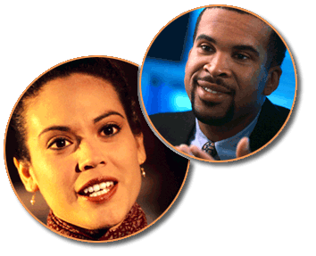


CONCLUSION
Challenges and risks are the part of the business. So as a businessman one have to be aware of that challenges and should take proper actions against them.

Slide 17
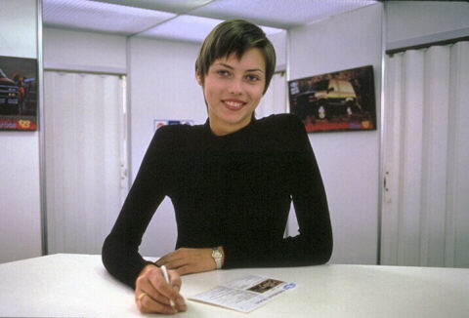
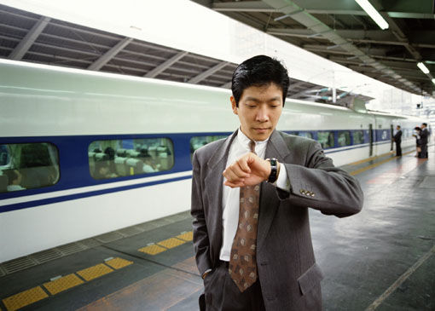
Thank you
Thank you for your cooperation and you can ask question

