Slide 1





IMPERIA
SCHOOL OF BUSSINESS / COMPUTING & IT
COMPUTER APPLICATION
CIT 104
ASSIGNMENT 4
LECTURER NAME : Ms BAVANI
START DATE: 16TH MAY END DATE : 7TH SEPTEMBER
PRESENTED AND CREATED BY
ID No.1002217
DIPLOMA IN COMPUTING
-FULLTIME
SAZZAD HOSSAIN

Slide 2


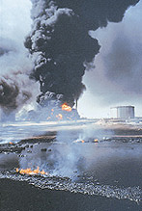

Greenhouse Effect
Present worlds top prior matter
Research and Project Created by
Sazzad Hossain

Slide 3


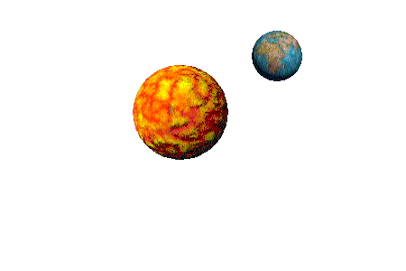


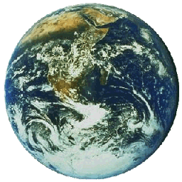
Today’s Outline
What is Greenhouse effect?
How does it occur ?
Advantages
Negative impacts
How to stop
The Diagram

Slide 4


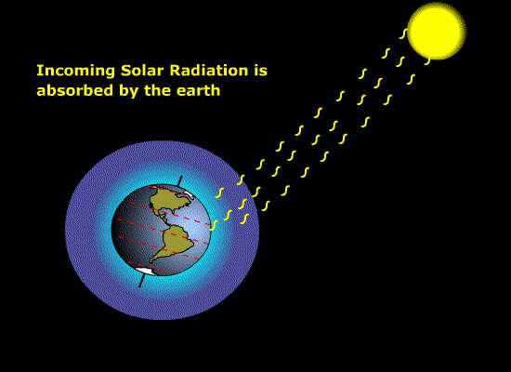




What is
Greenhouse effect?
The procedure makes the Global warm.
Main Greenhouse gases are
  Water Vapor (H₂O)
  Carbon-di-oxide(CO₂)
  Methane (CH₄)
It is a natural process.
Also made by human
  Burning fossils
  Gases of vehicles
  Gases from industry and others.

Slide 5




How does it occur ?
Solar radiations come to earth from sun
Some of it go back to universe.
Some of it has been trapped by Greenhouse or greenhouse gases.
This kept radiation help the earth to increase its heat.

Slide 6


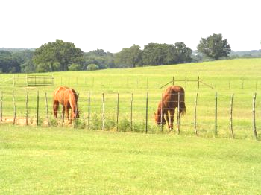
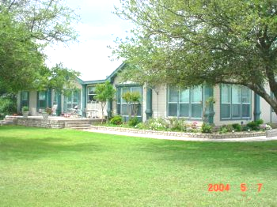
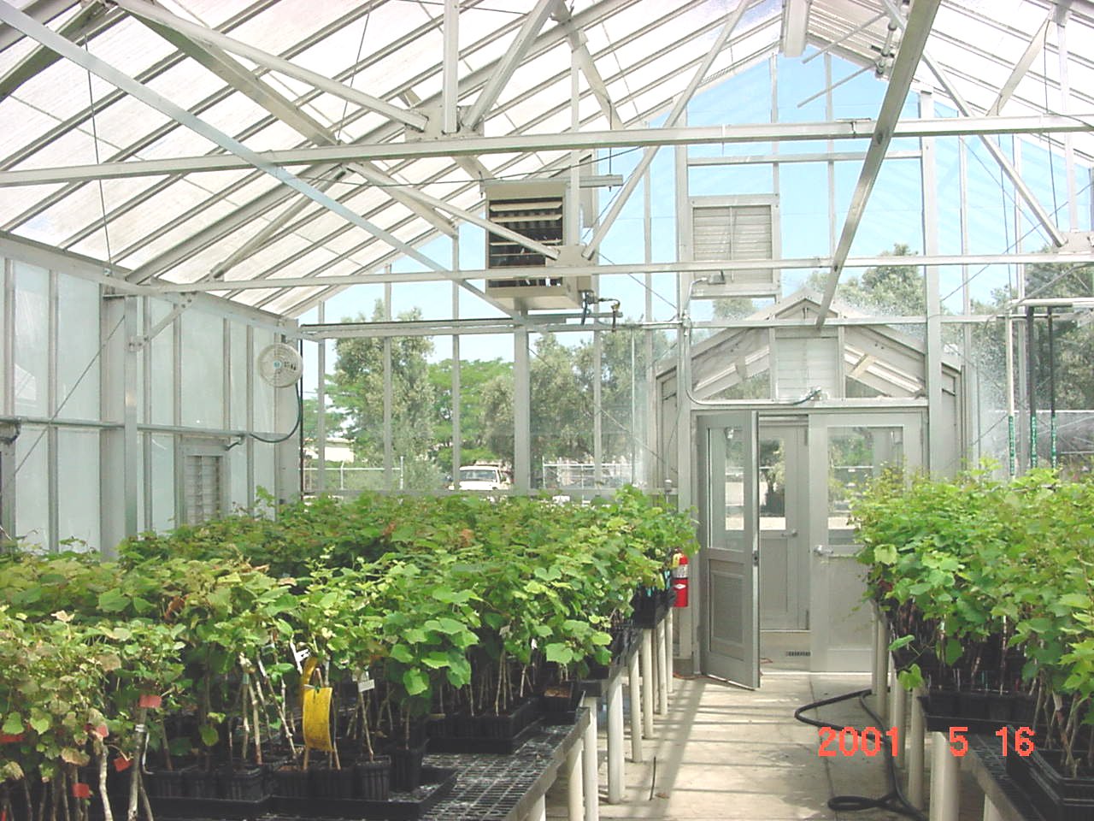

Advantages
It keeps the Earth's surface temperature.
It helps to keep balance of energy.
It has made the earth livable to the plants, human being and other creatures.
This process help some antic plants to survive.

Slide 7



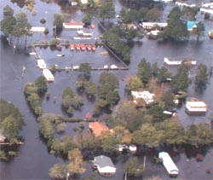
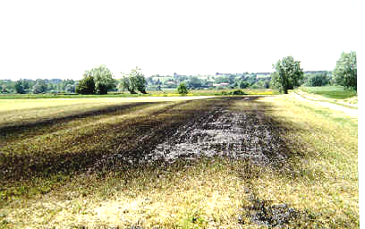



Negative impacts
Sea Level Rise.
Temperature will rise high level.
Flooding.
Life would be difficult for ice land creatures.
Low lands will go under the sea.
Potential Impact on human life
  Health and Diseases
  Economical Impact
  Agricultural Impact
  Effects on Aquatic systems
  Effects on Hydrological Cycle

Slide 8
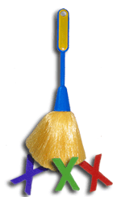

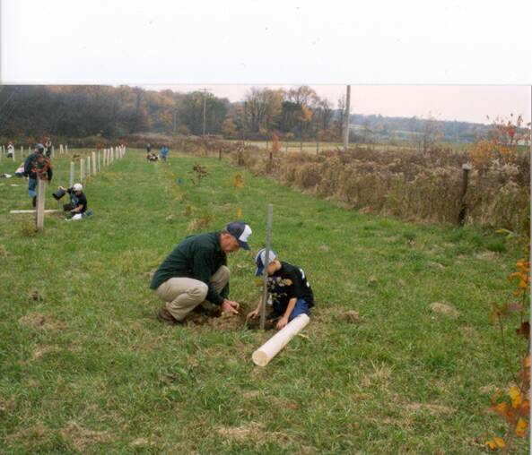
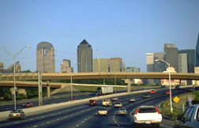
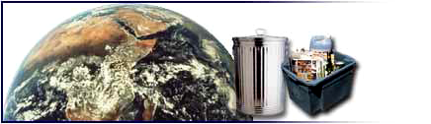

The Solutions
Conserve Fossil Fuels
Conserve Rainforests
Use Natural Energy
Ban CFCs
Reduce using harmful gases on industry and Vehicles
Plant more trees.
Not to burn garbage, recycle them.

Slide 9


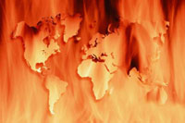
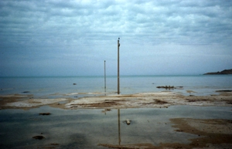

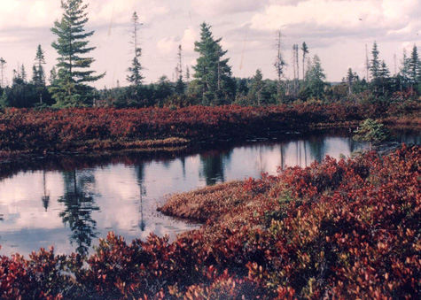
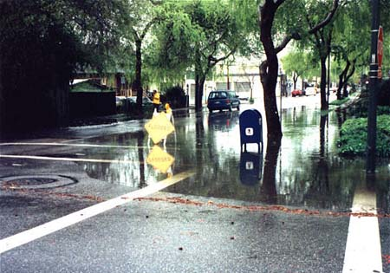


The Diagram
Rise of heat
Sea Level Rise
Flooding
Economy
Iceland melt
Greenhouse effect
Ecosystem
Low land divas
Health & diseases
Agriculture

Slide 10



Thanking You
If you want any further information you can contact this addresses:
URL: www.geocities.com/apon_rehman
E-mail: sazzadknife@gmail.com
Mobile: 0126439961

