Slide 1





IMPERIA
SCHOOL OF COMPUTING & IT
BUSINESS COMMUNICATION CIT 405
ASSIGNMENT 1
LECTURER NAME : Ms Lau START DATE: 4th Jan END DATE : 26th Jan
PRESENTED AND CREATED BY
ID No.1002217
DIPLOMA IN COMPUTING
-FULLTIME
SAZZAD HOSSAIN

Slide 2




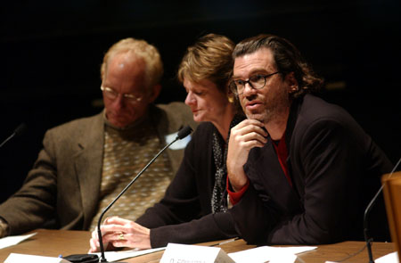


HOW TO MARKET A PRODUCT
An unique way to market your product

Slide 3
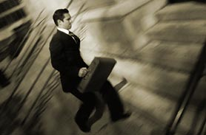
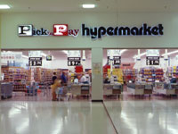
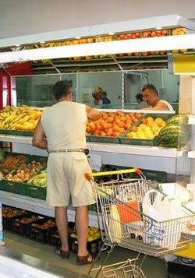


Thesis statement
An organization should maintain following three important aspects to market their product effectively.
Marketing research.
Advertising
Sales and distribution.

Slide 4

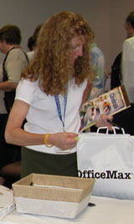

A. Marketing research
  A better Marketing research consists of
1. Field research
2. Surveys
3. Sampling.

Slide 5
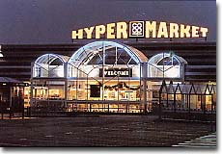
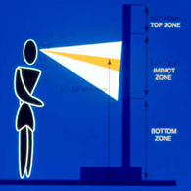
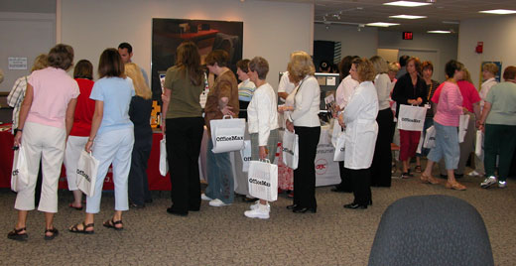
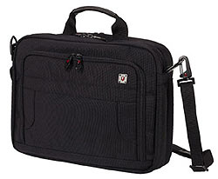
1. Field research
  By doing field research manager can get information about place of marketing
  Specify location and size.
  Special events and fairs.
  Display at eye level.

Slide 6




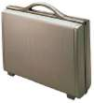
2. Surveys
  Surveys give a marketing manager exact information about people desire
  Personal interviews.
  Telephone survey
  Postal survey
  Internet survey

Slide 7


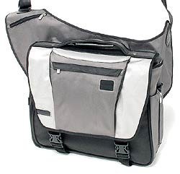
3. Sampling
  One can get future idea of a product by doing Sampling
  Testing with demo.
  Convenience samples
  Distribute free samples.

Slide 8



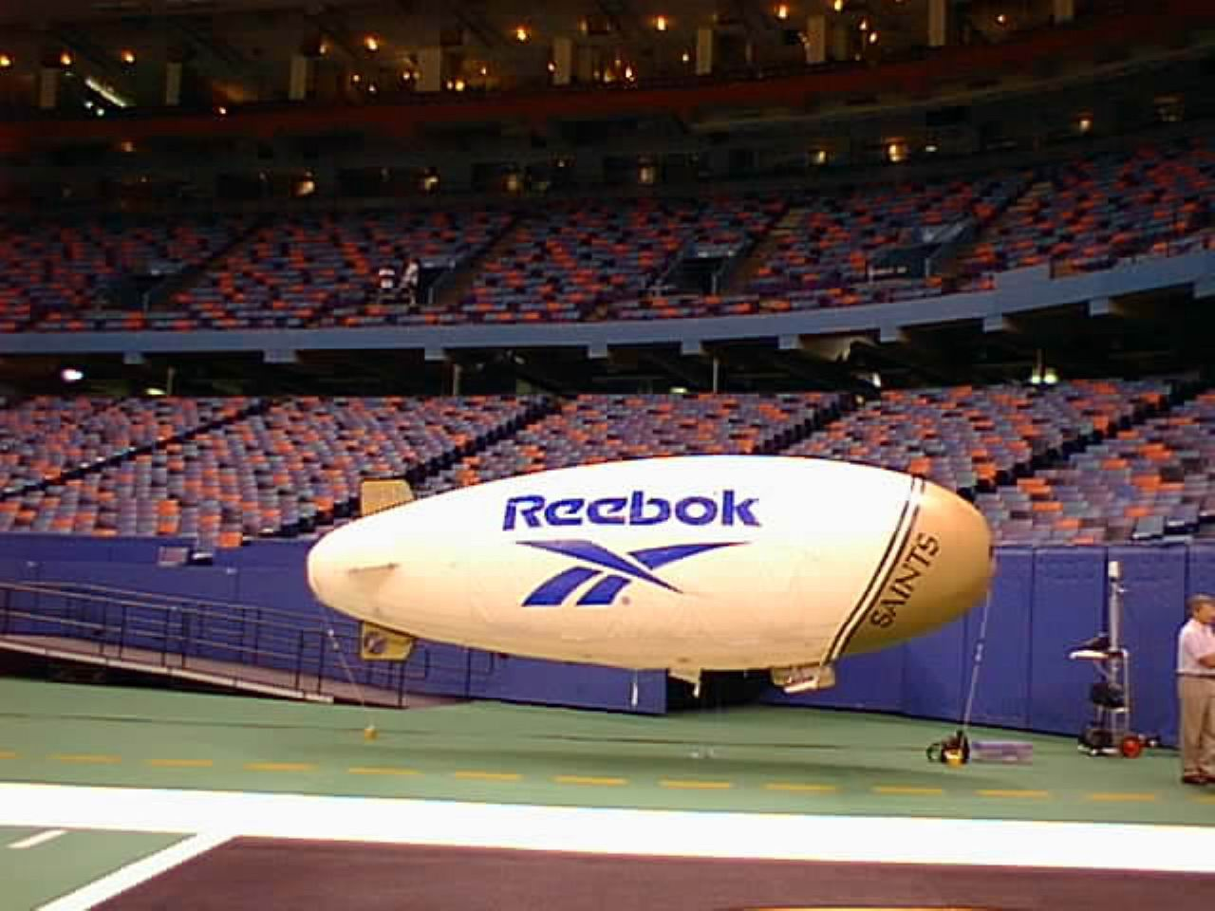
B. Advertising
There are main three ways of effective advertising.
  Out door adverting
  Commercial media.
  Advertising with appeal.

Slide 9

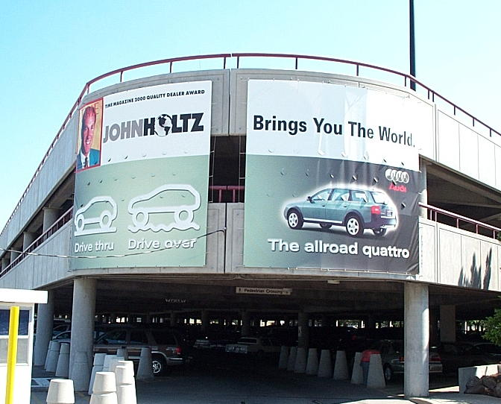

1. Outdoor advertising
Outdoor advertising is a easy and clear way to advertise a product
Leaflet and banners.
Newspapers and magazines.
Balloon display, motor posters and so on.

Slide 10


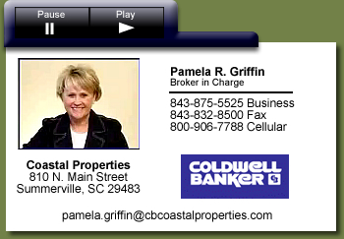
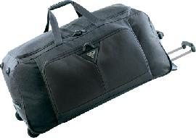
2. Commercial media
Commercial media makes all the categories of people to know about the product.
TV and Radio
Internet and mobile messages
Video tapes and cinemas.

Slide 11



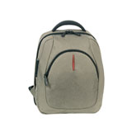
3. Advertising with appeal
    Advertising with appeal touches peoples heart and make them emotional.
    Poetic slogan.
    Attractive signs and brand name.
    Emotional approaches.

Slide 12

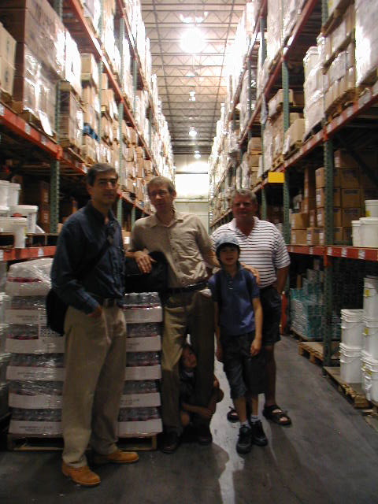


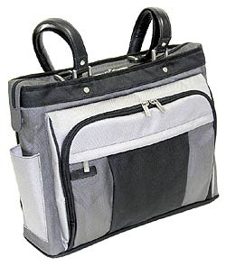
C. Sales and distribution
        A manager should look out following three things when he is doing sales and distributions.
        Sales promotion
        Distribution channels
        Special feature and assurance

Slide 13



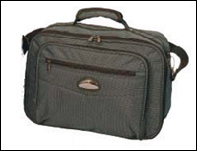
1. Sales promotion
Sales promotion encourages the customer to buy a product
Special features
Competitive price
Free gifts

Slide 14
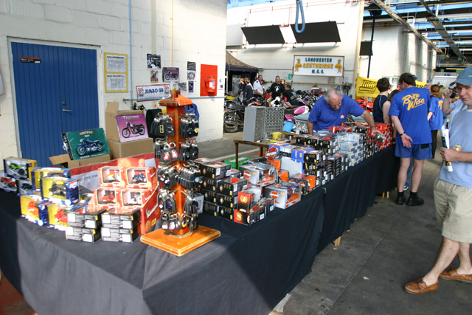
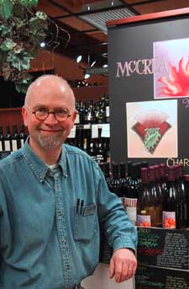

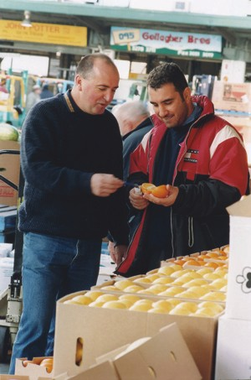
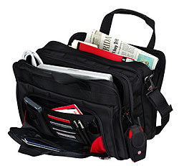
2. Distribution channels
Distribution channels assist marketing department to promote their product
Wholesaler
Retailers
Brokers
Online trading

Slide 15


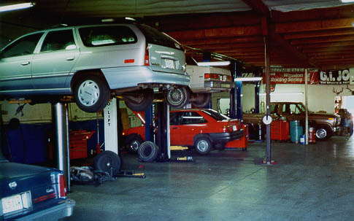

3. Special features and assurance
Customer feels secure and reliable when they get special features with product
Refund policies
Warranty and guaranty
Repair services

Slide 16



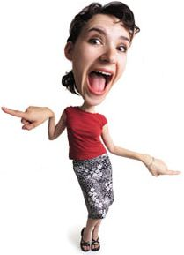
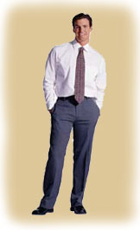
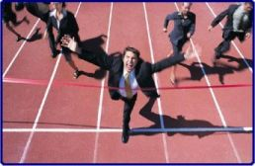
Above all methods are essential for a marketing to manager market a product effectively.
Conclusion

Slide 17




Thanking You
If you want any further information you can contact this addresses:
URL: www.geocities.com/apon_rehman
E-mail: sazzadknife@gmail.com
Mobile: 0126439961

