Slide 1

Innovation Hack
Theme:
Price Prediction Model
Team Name: AlphaOmega

Slide 2
PriceAI
AI model which can predict pricing for shipment considering quantitative data variables and indicators using real world datasets.
It is a framework for building models for logistics along with working model to predict shipping cost for domestic shipping and an interactive interface
Key aspects:
The product leverages machine learning for prediction and forecasting depending on various key features and markers in logistics and shipping.
A user interface platform is provided to analyze, along with APIs for quick integration to real world enterprise products
The solution is end to end prototype with capability of feeding various dataset and generating regression models based on parameters to predict cost
The solution is trained on real world dataset with multiple factors and can be easily scaled up for different markets and datasets.

Slide 3
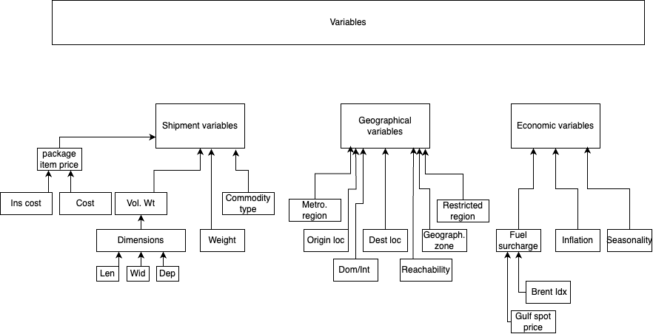
Variables
The shipping cost are influenced by a wide range of variables, each of which can affect the final price. These variables can be broadly categorized into factors related to the shipment itself, external economic factors, geographical and operational aspects.
Distance and weight are leading factors for cost followed by commodity type ,its urgency, cost and insurance cost, region reachability and risk. For international shipments, the regions are divided into zones, along with it fuel surcharge is another factor in shipment price which follows spot index.
Seasonality also independently affects the cost and availability.

Slide 4
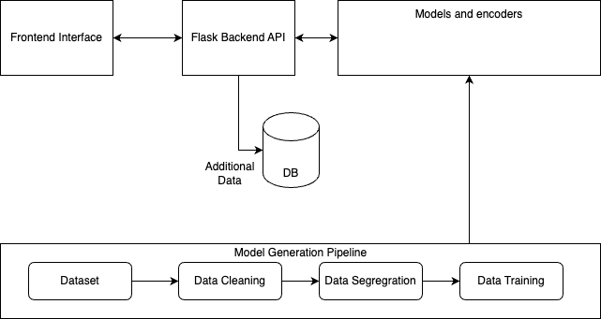
Architecture
The pipeline provided underlying model, and encoders are built in python independently and trained on different datasets. These are dumped as pickle files which are loaded into the python flask application interface.
The UI interface has dashboard for model which take parameters to show prediction and relevant information regarding it. The UI also has an insights tab which will show the key metrics about how the model has been tuned and evaluated.
The dashboard is to provide values to variables such as weight, locations etc based on the model and the model will return with price prediction.
Multiple models can be generated for different markets, parameters and dataset and effortlessly supported
The model’s notebook and EDA analysis is also available to train it on different data values.

Slide 5
Methodology
Using various available datasets and features, the analysis for an intelligent model depicts key variables and metrics.
The dataset have been built using conjunction of different real-world datasets of domestic shipping costs since a dataset is not yet provided and analysis has been done to define important variable, their correlation and impact on cost.
We first created a pincode directory for geographical information, this is done by getting pincode data which contains lat, long coordinates, region, state, reachability etc and cleaning it.
A Merged dataset for shipment is created by stacking all data after defining their column, it is then cleaned and formatted
Categorical data such as state is encoded and encoders are exported
Exploratory Data Analysis is done to find patterns and features.
Correlation between variables are determined to remove noise from the model
We build a function to train and evaluate dataset over various different regression models (XGBoost, Catboost, lgm,Grad boosting, Adaboost, Lasso LR) etc
Different models provide insights and key features, and can predict values
Models are evaluated against test data for r2 score to select appropriately such as XGBoost perform slightly better for higher cost min time of shipment but lgm and cat boost perform better for min cost higher time of shipment.

Slide 6
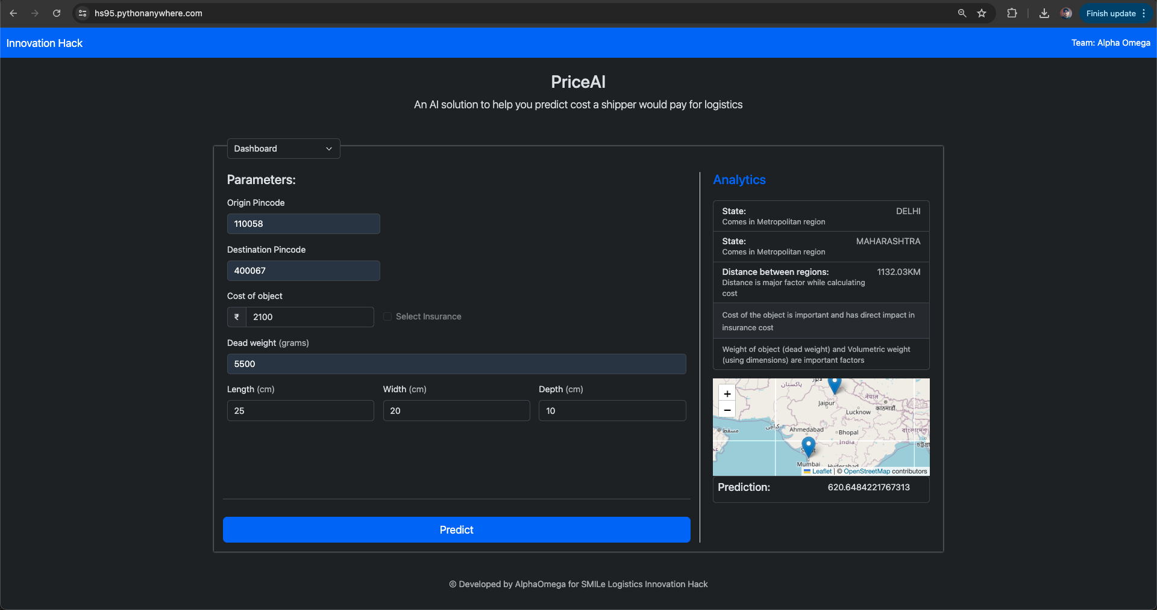
Prototype at a glance:
One of the model is plugged into the application and hosted on cloud for showcase at : AlphaOmega Demo

Slide 7
Tech Stack
Machine Learning:
Python
Pandas, Numpy, Scikit
Application:
Backend: Flask, python
DB: Mysql, SqlAlchemy
Cloud: pythonanywhere
Frontend: Javascript, HTML, CSS
Tools:
Bash, git, jupyter, leaflet

Slide 8
Business impact:
For an optimized supply chain, it is crucial that the prices used are accurate
Accurate prediction in advance can help as follows:
Customers can make more informed whereas companies can better allocate resources and manage budgets when they know shipping costs in advance
Knowing shipping costs in advance enables businesses to compare different shipping options and choose the most cost-effective one. This can lead to savings and better service delivery
Predictable shipping costs can lead to more reliable delivery times
Businesses can better plan their inventory and supply chain operations when they have accurate predictions of shipping costs

Slide 9
Business use case:
For supply chain planning in advance various algorithms and computation are done such as travelling salesman to find most efficient and cost-effective approach.
We demonstrate the business use case of having a prediction model as follows
3kg, (Vol -1 )
Delhi
3kg, (Vol -1 )
Case 1: We have 2 shipment, both from same origin(Delhi) but to two different destination (Mumbai and Pune). The cost of shipment for each is 500 and 650 resp (These cost are real data).
Mumbai
Pune
Case 2: We have 2 shipment, both from same origin(Delhi) but to two different destination (Mumbai and Pune).We route it In a way where both shipment are consolidated sent to Mumbai first and then a shipment from Mumbai to Pune is done separately. The cost of shipment for each is 600 and 200 resp (These cost are real data).
6kg, (Vol - 2 )
Delhi
Pune
Doing this shows the difference in amount with different routes, these values can become significant with large load, multiple iterations over a period of time
Mumbai
3kg, (Vol -1 )

Slide 10
Improvements
Currently we use haversine distance between two locations, but we can have additional column for road distance between locations
Since the dataset is not over a period, we’ve not done time series analysis which should be done for handling seasonality and few economic indicators such as fuel surcharges
Currently we’ve only tackled domestic data for IN, we should all build models for international shipping
The model dataset is for parcel delivery, we should tweak model with more data related to pallets, freight shipping for a wider range

Slide 11
About Team:
Harjot Singh Bhatia
Development Lead at VAKT Global Ltd
A polyglot programmer having knack of solving problems and creating innovative solutions.
Tech Stack: Python, Java, Springboot, Flask, Javascript, Postgres, Mysql
Email: harjot4995@gmail.com
LinkedIn: harjotsinghbhatia
Phone: +91 9891971299 / +91 8179448915

Slide 12
Thank you

