Slide 1
CRISIS: Continuous Responsive Imaging System In Space Mid-Term Presentation
Jared Krueger
Daniel Selva
Matt Smith
Mentor: Col. Keesee
16 October 2008

Slide 2
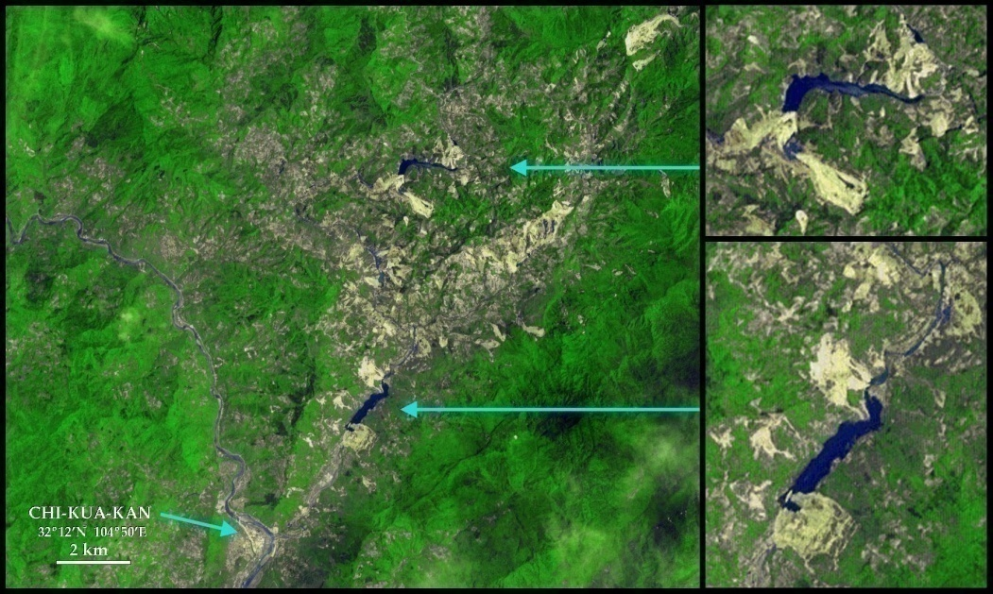
CRISIS Mission Statement
Recent natural disasters such as Hurricane Katrina have demonstrated the need for high resolution imagery with continuous coverage on short notice.
Military commanders have expressed similar needs to improve situational awareness on the battlefield.
Such a capability would provide government officials with crucial information on rapidly changing events, improving public safety and potentially saving many lives.
Lakes caused by a magnitude 7.9 earthquake in Sichuan province, China (May 2008)
NASA/GSFC/METI/ ERSDAC/JAROS, and U.S./Japan ASTER Science Team
Notes:
Mission statement:
Top level statement of mission goal and objectives
Requirements must flow from here
Customer-driven
What the system is intended to do broadly, and more generally why this capability is useful stakeholders (customer, society, tax payers, etc)
Photo:
Sichuan earthquake caused landslides
Created lakes → severe flood risk
Time-sensitive situation (aftershocks, logistical planning for humanitarian support)
Image shows the danger posed to a town downstream of the flood path

Slide 3
Mission Objectives to Requirements
Primary Objectives:
To support response planning and rescue operations for natural disasters.
To improve situational awareness for battlefield commanders.
To provide intelligence, surveillance, and reconnaissance (ISR).
Secondary Objectives:
To provide imagery to commercial customers (Google Earth).
To monitor longer duration climate or environmental changes, including effects of global warming.
Functional Requirements:
One meter resolution
100% coverage between ±70°latitude within 4 hours
Operational Requirements:
One year design lifetime
Image updated every 4 hours
Retargeting time < 24 hours
Constraints:
Low cost (≤ $1 million)
Small size (Pegasus D = 1.12 m)
Design within one semester
Notes:
Primary objectives:
Goals the system must achieve in order to be successful
Qualitative statements that flow from the mission definition
Single system can meet multiple demands ➔ Secondary objectives:
Other goals that can be accomplished given the functional capabilities that we build into the system as a result of the primary objectives
(note: for spiral 1 we focus exclusively on primary objectives; once the system design is in place, additional trades may be conducted in spiral 2 to determine the feasibility of pursuing secondary objectives)
Objectives drive requirements:
Functional requirements include performance (1 m resolution, compare with 0.41m for 2000kg GeoEye, the world’s highest resolution commercial satellite, or 32m for the Disaster Monitoring Constellation of 5 100kg satellite), coverage, and responsiveness.
Operational requirements include duration, availability, data distribution, survivability, and data content/form/format
Constraints include cost, schedule, size, technology readiness and other factors that limit design implementation. Note that the required lifetime is relatively low which will probably allow us to do interesting trades in the electric power subsystem.

Slide 4
Concept of Operations
Passive mode
System waits in a quiet state for targeting commands
Nadir pointing
No slewing maneuvers
S/C subsystems are quiescent
Comm listens for commands to begin tracking
Targeting mode
System changes from one ground target to another
Changing to a new ground target
Capability to slew through 2 x maximum off-nadir angle in 30 minutes
Tracking mode
System continuously tracks a ground target
System tracks one ground target
One image per spacecraft per target pass
One slewing maneuver (roll about velocity vector) per spacecraft per target pass
Image is taken when spacecraft is at a minimum range to the target
Image must be transmitted to the ground within 4 hours of capture
Acquisition
Initial mode after LV separation
Initial attitude determination
Ground station initial acquisition
Safe mode
Activated in the case of on-orbit faults
Power consumption is reduced
Passive attitude control
pass 2
pass 3
pass 1
View along the velocity vector
Target
Notes:
There are three primary modes of operation while the system is on-orbit, indicated by yellow boxes:
Passive mode
Targeting mode
Tracking mode
How does the system work? To illustrate this, let’s think of an example. Say that a meteorite has fallen on the Earth somewhere near the US and the government agencies require to the company operating our satellite to take some images of the zone. The ground station will send the command to the spacecraft. The spacecraft, which is normally in a passive mode, will go into targeting mode where it will slew to point to the target before going to tracking mode in which the spacecraft continuously tracks the target when it is visible and takes one picture when the range is minimum (no slewing along the velocity axis is needed). The s/c will continue to take one picture every pass whenever the target is visible. If the spacecraft receives the order to change to another target, it will go from tracking to targeting mode, slew and then go back to tracking mode.
In addition there are two secondary modes: acquisition mode and safe mode
The acquisition mode is used to recover from an unknown position typically after separation from the launch vehicle.
Safe mode is used in case of contingency or emergency if for example we lose a reaction wheel.

Slide 5
Systems Modeling Approach (1 of 2)
Application of GINA
Utilized GINA (Generalized Information Network Analysis) methodology
Spiral 1 (Mid-Term):
Start with simplest mission definition and driving requirements
Define model structure for critical subsystems and combine to create system interface
Spiral 2 (End of Term):
Add new subsystem models
Add new features to existing models
Iterate to find optimum design solution
3a
Develop System
Metrics
1
Define Customer
Requirements
2
Define Capability
Requirements
4
Derive Top-Level
Architecture(s)
3b
Functional
Analysis
Design
Iteration
Loop
7
Implement
Architecture
6
Select Final
Architecture
5
Evaluate
Architecture(s)
Notes:
So far we have followed the process through item 5
We defined requirements for the system based on what the customer needs (i.e. the mission statement)
We flowed those higher-level requirements into capabilities the system must have
3a) We have identified system metrics (resolution, coverage, revisit time, mass, cost) and have begun implementing some of them (coverage, and to some extent mass)
3b) We have modeled the functionality of four critical subsystems (described in later slides)
Using our model (described in later slides), have derived initial designs based on these metrics and functional requirements
We can quickly compare competing designs, although spiral 2 will add optimization to this process

Slide 6
Systems Modeling Approach (2 of 2)
Functional and operational requirements provide motivation for modeling certain subsystems first
Orbit dynamics
Optical payload
ADCS
Communications
N² diagram
Will be the driving subsystems for
Ground resolution
Coverage
Revisit time
Image delivery rate
Retargeting ability
Design vector | Orbits | Optical | ADCS | Comm
SAT_INITIALIZE | 4-12 | 4,12-19 | 4, 20-41 | 4, 42-60
61-74 | SAT_ORBIT | 61 | 62, 63, 68
75-82 |  | SAT_OPTICS |  | 75
83-95 |  |  | SAT_ADCS
96-102 |  |  |  | SAT_COMM
Notes:
In this first spiral, we decided to model Orbit dynamics, the optical payload, ADCS, and communications. Why did we choose these subsystems and not others? Because we thought that those would be driving subsystems to meet the most important operational and functional requirements such as resolution, coverage, revisit time, image delivery rate and retargeting.
As we show in this N2 square diagram, we also chose to apply the models in a given order: orbits → optical → ADCS → Comm. In this situation we have currently very little feedback from downstream subsystems to upstream subsystems which is good. Of course this is not very representative because we haven’t gone into much detail in each subsystem and also because we haven’t implemented very interacting subsystems such as power or structures.
The numbers in the cells represent actual variables of the models. For instance, 61 is range, which is an output from orbits and an input to the optical system. 62, 63, 68 are period, velocity and density, outputs from orbits and inputs to ADCS to calculate disturbances and momentum storage. 75 is the number of bits per image which is an output from optics and an input to comm to calculate data rate.
The N2 diagram will get more complex (i.e. show more interconnections) and less sequential as we reduce the ambiguity in the subsystem designs.

Slide 7
Model Implementation
Implemented an integrated model of the CRISIS system in MATLAB
Each subsystem is a different module that acts on a design vector (MATLAB struct)
Produces outputs/metrics of interest
Required aperture diameter
Swath width
Coverage percentage
Mass
Modular design is easily extensible (Spiral 2)
Can rapidly generate, evaluate, and compare candidate system designs (3 lines of MATLAB code)
Plot designs in terms of parameters of interest (e.g. cost vs. coverage)
Goal: identify pareto fronts in the trade space
Satellite system struct
sat(i) .Altitude = 567 km
.Inclination = 98 deg
.Resolution = 1 m
.Fnumber = 2
.Ixx = 60 kg^2 m
…
.Range = []
.Aperture = []
.CoverageWidth = []
.Mass = []
.Cost = []
…
inputs
outputs
Integrated CRISIS model
sat(i)
orbit.m
optics.m
adcs.m
comm.m
sat(i)
Initial system
(no outputs computed)
Final system
(outputs computed)
Subsystem modules
Notes:
Sat structure:
MATLAB structure whose fields contain the system design parameters
When first initialized, only the inputs to the model are inserted into the structure
As the sat structure passes through the models, the missing fields are computed and added
By the end of the model chain, all fields in the structure are populated
Process:
Initialize the design vector (or initialize many design vectors at once)
Run the design vector(s) through the integrated model (update sat design each time)
Plot parameters of interest against each other

Slide 8
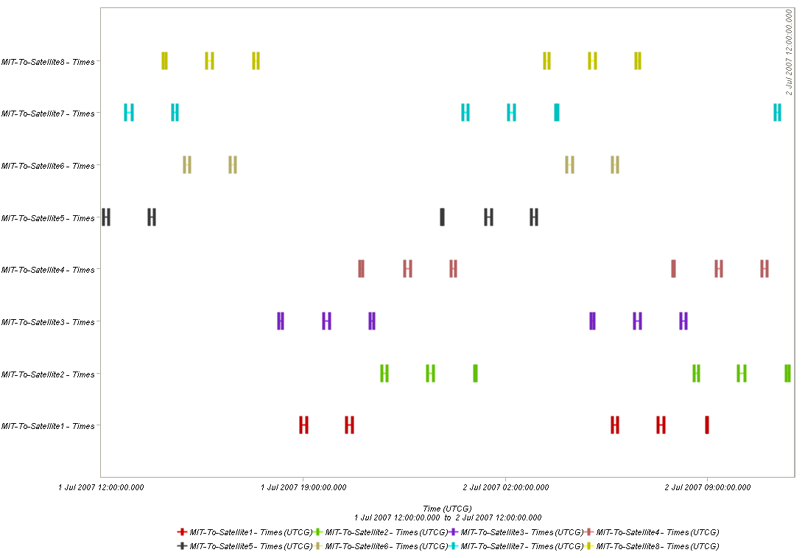
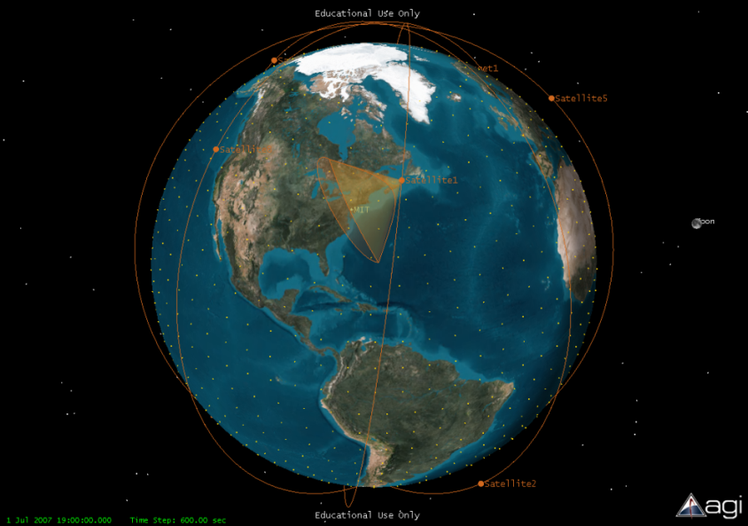
Orbit Analysis
Coverage Map for Facility at 40°N Latitude
Requirements:
100% global coverage within 4 hours
Image updated at least every 4 hours
One meter ground resolution or better
Orbital Parameter | Design Value
Altitude | 567 km
Inclination | 97.67°
Eccentricity | 0
Number of Planes | 4
RAAN | ±45°, 0°, 90°
Number of Sats | 8 (2 per plane)
Avg. Revisit Time | 24.8 min.
Max. Revisit Time | 42.7 min.
Physics:
STK Example
Notes:
Requirements:
1) Time required to complete 100% accumulated global coverage. This relates to the constellation’s ability to image any point on the globe at least once in the allotted time.
Revisit time for a given point; relates to constellation’s ability to provide rapidly updating imagery with no large coverage gaps.
Ground resolution is a fundamental driving requirement for the optical payload, but it is also related to the orbital altitude. Therefore, an altitude must be used that does not create an extreme demand on the optical subsystem. Such an altitude would allow the ground resolution requirement to be met even in worst case pass scenarios.
STK was primary analysis tool, generating access and coverage reports for various constellations at given ground facility (MIT). Coverage map shown indicates periods of coverage for each individual satellite in the constellation during one day. There are 44 separate passes that could each image the point of interest located at 40 degrees North latitude. Notice that each satellite has two or three passes in a row that have access to the facility. STK utilizes tracking sensors on each satellite that assume an imaging cone of 45 degrees. STK also assumes that coverage is available to the horizon which would not be the case for our system because of the poor resolution and imaging capability. Therefore our system includes a maximum pointing angle (eta) at which the required ground resolution is still obtained. This can be input into STK be a part of our future simulations. The current results give us the appropriate trend and are suitable for the first spiral iteration.

Slide 9
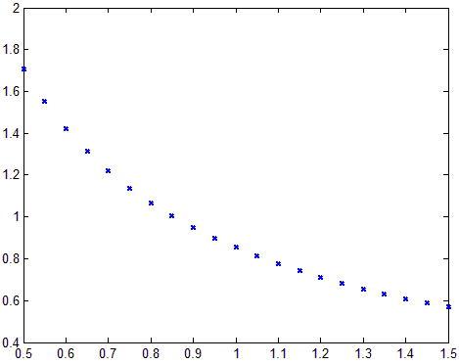
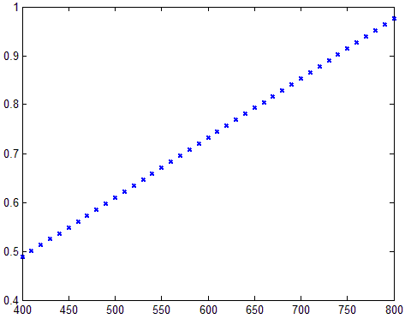
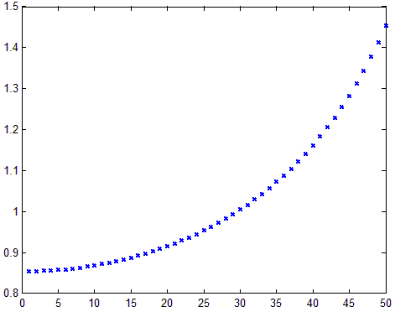
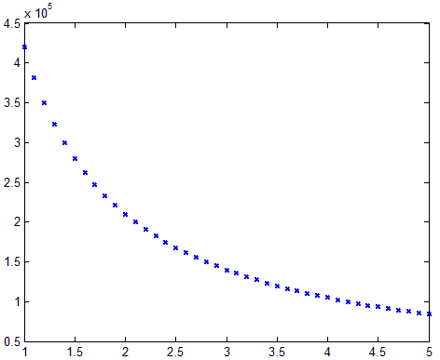
Optical Payload
Requirements:
Ground resolution ≤ 1 m
Compact primary mirror (D_{max} ≤ 1.12 m)
Validation:
Model outputs match values given in SMAD Table 9-15 “Calculating Design Parameters for a Passive Optical Sensor” (p. 287)
Model implementation:
Earth-facing telescope
Assume S/C can slew through an off-nadir angle η
Simple first: consider just optical geometry
Further validation/sample data:
Verify expected trends
Nadir ground resolution (m)
Nadir ground resolution (m)
detector
aperture
Ground res. at nadir
Aperture diameter (m)
Altitude (km)
Ground res. at max slant angle
Off-nadir ground resolution (m)
Swath width (m)
Swath width
ground
SW
Maximum η (deg)
F/#
Notes:
Matt will fill in

Slide 10

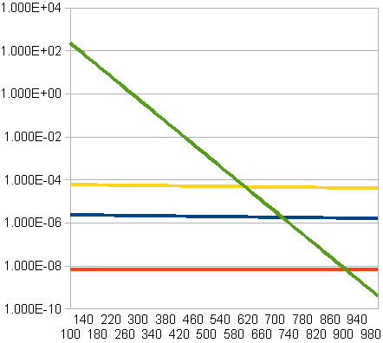

Attitude Determination and Control Subsystem
gravity
orbits, geometry
Requirements in each mode
acquisition
(relaxed requirements)
gravity
Disturbances
passive
Slew: none
Pointing: 1°
gravity
Slew : 2η in P/4 once every week
Pointing: FOV/2 = 0.3°
aero
targeting
Slew: η/2 in P/4 once every orbit
Pointing: FOV/2 = 0.3°
magnetic
tracking
safe
(relaxed requirements)
solar
slewing torque
secular torque
cyclic torque
The models were tested with the FireSat input values and the resulting outputs were coherent with SMAD
actuators
Reaction wheels
Magnetic Torquers
Thrusters
 | Design values | COTS
RW | T=0.18 mNm H=0.2 mNms | T=20 mNm H=1 mNms 18kg, 4-25W
MGT | D=4.5 Am^2 | D=5 Am^2 750g, 0.5-6W
THR | F = 1.8mN Mp = 4.5kg | F = 50mN
torque
momentum
dipole
thrust
prop. mass
Notes:
Requirements are different depending on the operational mode of the spacecraft so the first step was to identify modes and put requirements for each of them.
We saw that there was almost exact correspondence between our modes from the CONOPS section and typical ADCS modes (normal, slewing, safe-mode).
Focus on the three principal modes: passive, targeting, tracking (the other have relaxed requirements).
Focus on two kinds of requirements: pointing accuracy and slewing maneuvers.
When we see the accuracy requirements it is pretty obvious that passive techniques like gravity gradient alone are not enough. Spinning configurations with momentum bias were not considered either because of the frequent slewing maneuvers needed to change targets. So we selected 3-axis stabilized configuration at least for targeting and tracking modes.
Next step is to model the disturbance environment.
SMAD models were implemented in MATLAB for gravity gradient, atmospheric aerodynamic drag, Earth’s magnetic field, and solar pressure, and they were validated with an Excel spreadsheet and manual calculations with the Firesat values. The results show that for our altitude=567km, the aerodynamic torque is the greatest one, but if we go higher, the magnetic field becomes predominant. The values are nevertheless pretty small (0.2mNm).
Next, slewing requirements + disturbance torques are the main inputs for the actuators model that estimate the main design parameters for reaction wheels, magnetic torquers and thrusters. CMGs were not considered because of high cost.
So two different architectures:
Reaction wheels + magnetic torquers (for momentum dumping and coarse control).
Thrusters (alone or with reaction wheels)
The results show that both architectures meet the requirements (are feasible with COTS) which means that we probably don’t need the thrusters which are not very appropriate for compensating for cyclic disturbances. The torque of 0.2mNm integrates in P/4 to yield a 0.2mNms need for momentum storage in RW. However, we need first a dynamic analysis of the control loop that allows estimation of control accuracy and second some kind of estimation of mass/cost/power before making a final decision (spiral 2).
Sensors: In this spiral 1, we will just say that table 11-14 in SMAD allows us to say that any combination of sun sensors, horizon sensors and magnetometers can meet the requirements in all modes. IMU are not considered because of high cost/weight/power demands. Star sensors are very accurate but also very expensive..

Slide 11
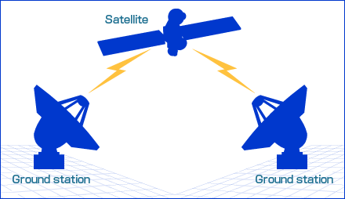


Communications Subsystem
Requirements:
Data Rate: 100bps UL for Command, N images/day in T minutes (probably less than 1MB/s)
BER : 1E-07 uplink, 1E-05 downlink
Eb/N0 (BPSK) = 11.3 dB (UL) and 9.6dB (DL)
Frequency : S-BAND (2-2.2 GHz)
Satellite Antenna Diameter < 1m
EIRP = 30dBW
Eb/N0=12 dB
Margin = 20dB
Εmin = 10deg
Design:
Notes:
In communications architecture we define an uplink and a downlink. Requirements are very different for both:
For the uplink (command), smaller data rates are needed (so smaller bandwidths) but we need a better reliability (i.e. BER) and thus a higher Eb/N0.
For the downlink (telemetry, data), higher data rates are needed but we can relax the requirements in terms of BER and Eb/N0. Note that downlink data rates are directly determined by operational requirements such as the number of images per day.
The frequency choice is informed by regulations and technical constraints (lower bound = ionosphere, higher bound = atmosphere loss)
Satellite Antennas have to fit in the LV fairing…
The approach we used is slightly different from the one proposed in SMAD. SMAD proposes an approach where, in addition to the ground station parameters which are always assumed to be known, the satellite transmitted power is fixed to calculate the diameter and a margin with respect to the required Eb/N0. In our approach, both the diameter and the transmitted power are outputs and the margin is fixed.
The results show that the requirements can be met with pretty small antennas (D<0.6m).

Slide 12
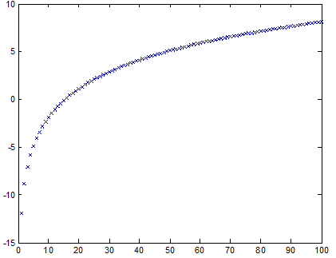
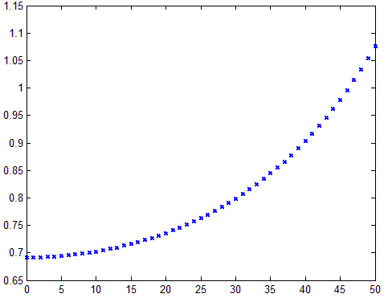
Single Axis Trades
Validate model interfaces
Downlink transmitting power (dBW)
Required aperture diameter (m)
Images per day
Maximum off-nadir pointing angle (deg)
Optics ↔ comm interface
Trend as expected (increase in number of images per day → increase in the transmitter power)
Logarithmic trend because power in dB
Reasonable values for power in the order of 1W for 20 images per day
Orbit ↔ optics interface
Trend as expected (increasing the off-axis angle increases the slant range, increasing the required aperture diameter)
1/cos(η) trend because of relationship between slant range and off-axis angle
Notes:
Single axis trades allow us to verify the interfaces between the different model components
Look for expected trends and reasonable values

Slide 13
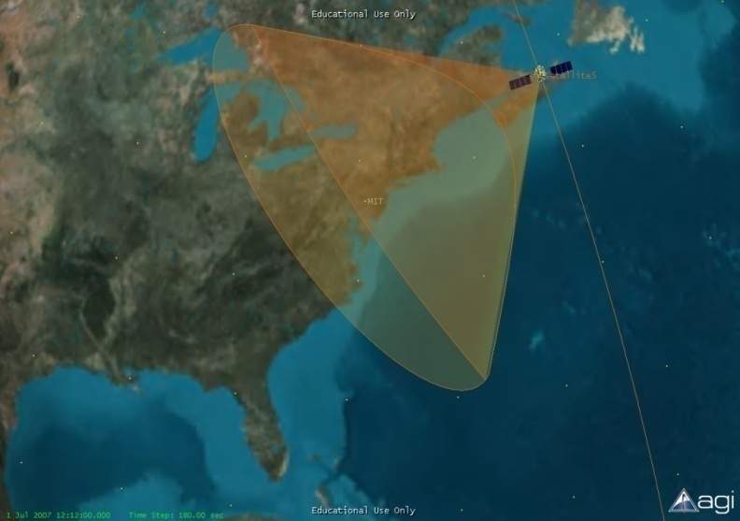
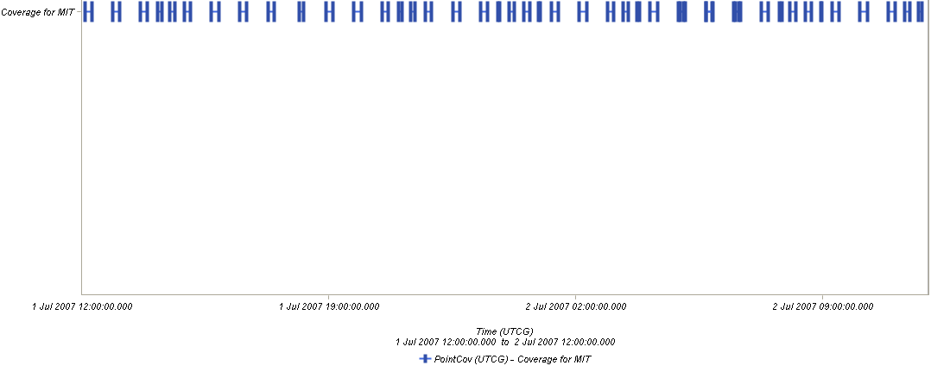

Orbit Analysis Results
# Planes | # Satellites | 100% Cvg Time (Minutes) | Mean Instant % Cvg | Median Cvg Gap (Minutes) | Max Revisit Time (Minutes) | Mean Revisit Time (Minutes) | Mean Duration (Seconds) | # of Passes per Day
2 | 8 | 189 | 28.15 | 12.66 | 168.39 | 22.64 | 574.274 | 44
4 | 8 | 63 | 27.52 | 31.26 | 42.72 | 24.81 | 574.209 | 44
2 | 4 | 229 | 14.08 | 36.55 | 211.32 | 53.48 | 572.851 | 22
4 | 4 | 139 | 13.78 | 63.49 | 135 | 62.75 | 585.44 | 20
1 | 2 | 570 | 7.11 | 37.11 | 450 | 111.28 | 570.037 | 11
2 | 2 | 471 | 7.05 | 84.87 | 303.63 | 122.2 | 574.762 | 10
4P8S
2P8S
Notes:
Several constellation simulations run in STK. All simulations occurred for the duration of one day. Coverage statistics calculated using “Coverage” tool in STK, while access statistics were calculated to single ground facility located at 40 degrees North latitude (MIT). All orbits are sun-synchronous at an altitude of 567 kilometers. Satellites are assumed to be evenly distributed throughout orbital planes with equivalent spacing.
Key parameters of interest include 100% Cvg Time (accumulated, how long it takes the constellation to cover the entire globe); Median Cvg Gap (describes the statistical spread of coverage gaps); Max Revisit Time (between passes to the facility).
Based on these parameters an initial design would include 8 satellites distributed in 4 orbital planes. Though this results in a greater median coverage gap, the max revisit time is much smaller (on the order of ¼). Also it only takes the constellation about an hour to map the entire globe. The access chart highlights the difference between four planes and two planes. The access for four planes is much more evenly distributed throughout the day and avoids large gaps in coverage between planes. For these reasons, we decided on the appropriate initial constellation. This design must be iterated however to include future cost models, which are affected by the number of satellites/planes in the constellation.

Slide 14
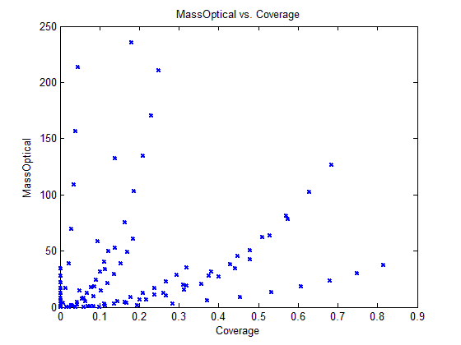
Multi-Axis Trade
Notes:
Matt will finish

Slide 15
Conclusions
Identified five operational modes (three nominal, two additional) that define the concept of operations
Identified, analyzed, and modeled four critical system elements (orbit, optics, ADCS, comm)
Developed a parameterized MATLAB model for the system
Enumerates and evaluates complete system designs
Modular design allows for expansion in spiral 2
Limited performance metrics have been included (coverage, mass)
Initial orbit analysis gives a baseline constellation design
8 satellites in 4 planes (sun-synchronous orbit at 567 km)
Additional modeling (e.g. cost) will constrain constellation design
Initial ADCS analysis demonstrates the feasibility of both reaction wheels and thrusters for our needs

Slide 16
Plan for Spiral Two
Improve current subsystem models
Orbits: fully integrate STK with MATLAB model and use STK to compute coverage and revisit statistics for various constellations and simulations
Optics: add noise process model for CCD, enable imagery simulation
ADCS: add a dynamic simulation via Simulink
Comm: improved analysis of link geometry and timing from STK
Model and analyze remaining subsystems
Thermal, Power, GNC, Launch, Propulsion
Generate functions for figures of merit
Cost, mass, reliability
Continue trade analysis involving figures of merit and key design parameters
Determine optimum overall system design

Slide 17
References
Hecht, E. Optics
Born and Wolf, Principles of Optics
Goodman

Slide 18
Backup slide: ADCS design process
Mission requirements, mission profile, type of insertion
Define control modes and system level
requirements by control mode
list of different control modes during mission. Requirements and constraints in each mode
Payload, thermal and power needs. Orbit, pointing direction. Disturbance environment
Select type of s/c control by
attitude control mode
Method for stabilizing and control: 3-axis, spinning or gravity gradient
Values for forces from GG, magnetic aerodynamics, solar pressure, internal disturbances and powered effects on control (cg offsets, slosh)‏
s/c geometry, orbit, solar/magnetic models, mission profile
Quantify disturbance environment
Sensor suite: Earth, sun, inertial or other sensing devices. Control actuators: reaction wheels, thrusters or magnetic torquers. Data processing electronics, or processing requirements.
s/c geometry, pointing accuracy, orbit conditions, mission requirements, lifetime, orbit, pointing direction, slew rates
Select and size ADCS hardware
All of above
Define determination and
control algorithms
algorithms, parameters, and logic for each determination and control mode
ITERATION
Notes:
Idem

Slide 19
Backup slide: ADCS : Defining control modes
Injection
Not necessary if the launch vehicle can put the satellite directly into orbit
Acquisition
Yes. Low pointing accuracy requirement (5deg). Initial coarse attitude determination.
Normal
Yes. High pointing requirement (0.3 deg)‏
Safe-mode
Yes. Power consumption reduction. Low pointing requirement (1deg)‏
Slew
Yes. Off-nadir pointing for new target acquisition.
Notes:
Idem

Slide 20
Backup slide: ADCS : Selecting type of s/c control
S/C control
PASSIVE TECHNIQUES
Gravity gradient
Magnetic torquers
SPINNING
STABILIZATION
3-AXIS STABILIZATION
Momentum bias
Zero-momentum
Pointing direction (the Earth, a star): Nadir (the Earth)‏
Passive techniques OK (only if low accuracy, > 1deg)‏
Pointing accuracy: 0.3deg (medium-high accuracy)‏
Passive alone is not enough
Reorientations, slew: Frequent
Spin stabilization not adequate
3-axis stabilization
Notes:
Idem

Slide 21
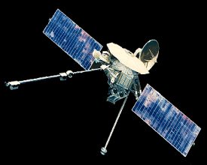
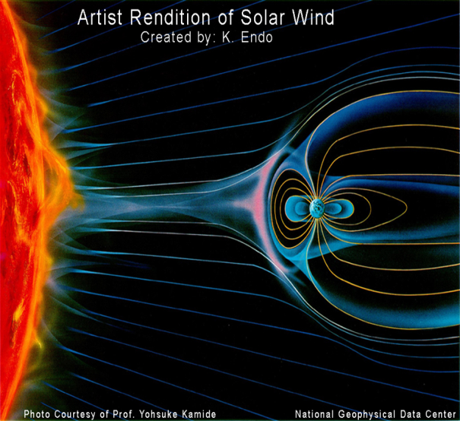

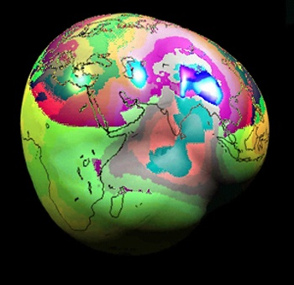
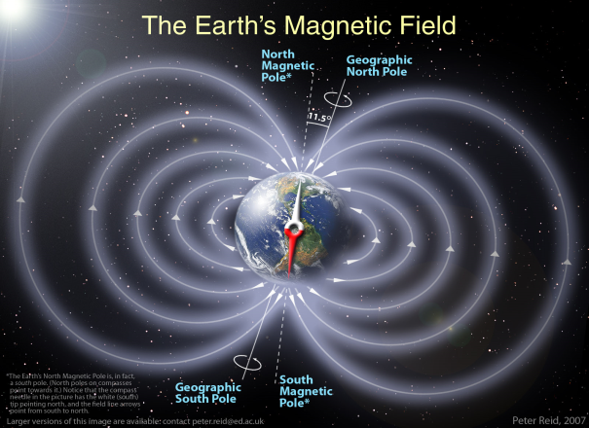
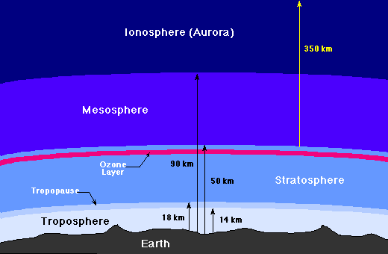



Backup slide: ADCS : Quantifying disturbance environment
Notes:
Idem

Slide 22
Backup slide : N² diagram
Design vectorc | Orbits | Optical | ADCS | Comm
SAT_INITIALIZE | 4-12 | 4,12-19 | 4, 20-41 | 4, 42-60
61-74 | SAT_ORBIT | 61 | 62, 63, 68
75-82 |  | SAT_OPTICS |  | 75
83-95 |  |  | SAT_ADCS
96-102 |  |  |  | SAT_COMM
4 | Altitude | km
5 | Inclination | deg
6 | Eccenctricity | #
7 | RAAN | deg
8 | ArgPerigee | deg
9 | Nplanes | #
10 | AnglePlanes | deg
11 | Nsats | #
12 | MaxPointing | deg
13 | Aperture | m
14 | Wavelength | m
15 | ArraySize | #
16 | PixelSize | m
17 | Nbits | #
18 | SamplingFactor | #
19 | Fnumber | #
20 | MaxDeviation | deg
21 | SurfaceArea | m^2
22 | Reflectance | #
23 | MaxSolarAngle | deg
24 | OffsetCPsolar | m
25 | OffsetCPaero | m
26 | ResidualDipole | Am^2
27 | DragCoefficient | #
28 | MaxSlewAngle | deg
29 | MaxSlewTime | s
30 | RWMarginFactor | #
31 | ThrusterMomentArm | m
32 | DumpingPulseDuration | s
33 | DumpingPulseFrequence | 1/day
34 | NumberofRW | #
35 | SlewingPulseDuration | s
36 | SlewingPulseFrequence | 1/day
37 | ADCSSpecificImpulse | s
38 | Ixx | kg/m^2
39 | Iyy | kg/m^2
40 | Izz | kg/m^2
41 | Lifetime | years
42 | ULRequiredEbN0 | dB
43 | ULEbN0Margin | dB
44 | ImplementationLoss | dB
45 | ULTXPower | W
46 | ULTXAntennaGain | dB
47 | ULTXLineLoss | dB
48 | GroundAntennaMinElevation | deg
49 | ULFrequency | Hz
50 | ULTXAntennaDiameter | m
51 | ULDataRate | Hz
52 | ULTXAntennaPointingOffset | W
53 | ULRXAntennaEfficiency | dB
54 | DLRequiredEbN0 | deg
55 | DLEbN0Margin | deg
56 | DLFrequency | deg
57 | DLRXAntennaPointingOffset | deg
58 | DLRXAntennaDiameter | dB
59 | DLTXLineLoss | m
60 | ImagesPerDay | #
61 | Range | km
62 | Velocity | km/s
63 | Density | kg/m^3
64 | Semimajor | km
65 | MeanAngMotion | rad/s
66 | VelocityPer | km/s
67 | VelocityApo | km/s
68 | Period | s
69 | RevisitTime | s
70 | rho | deg
71 | epsilon | deg
72 | lamda | deg
73 | range | km
74 | CoverageWidth | km
75 | Flength | m
76 | GResNadir | m
77 | GResOff | m
78 | FOV | deg
79 | SwathWidthNad | km
80 | SwathWidthOff | km
81 | DataVolume | bit
82 | MassOptical | kg
83 | TorqueGravity | Nm
84 | TorqueMagnetic | Nm
85 | TorqueSolar | Nm
86 | TorqueAero | Nm
87 | MaxTorque | Nm
88 | RWTorque | Nm
89 | RWMomentum | Kgm2/s
90 | RWMaxOmega | rad/s
91 | MagneticTorque | Nm
92 | MGTorquersDipole | Am2
93 | ThrusterForce | N
94 | ADCSDeltaV | m/s
95 | ADCSPropellantMass | kg
96 | ULRXAntennaDiameter | m
97 | ULRXAntennaGain | dB
98 | ULRXAntennaBeamwidth | deg
99 | DLTXPower | dBW
100 | DLTXAntennaBeamwidth | deg
101 | DLTXAntennaGain | dB
102 | DLTXAntennaDiameter | m

