Slide 1
WORKING DEMO BUILD
NER Smart Logistics &
Accessibility Intelligence
Multimodal route planning, live landslide and flood risk, and settlement-level accessibility scoring for the eight North Eastern states.
PROBLEM STATEMENT
MINISTRY
THEME
TEAM
SIH26002
MDoNER
Smart Automation
CodeCrew
Smart India Hackathon 2026 · Software · Built and running end to end
Notes:
Opening frame. Say up front that this is a working demo build, not a production system - the whole deck is written to that standard. Everything shown runs: a real API, a real network graph, live weather, and a model that trains at boot.

Slide 2




THE PROBLEM
Eight states, one of the hardest logistics geographies in India
The LEADS 2025 report puts North Eastern states across the full performance range - Mizoram an Exemplar, while Nagaland, Arunachal Pradesh, Manipur and Assam still trail. The causes are structural, not administrative: hill terrain, monsoon blockages, single-lifeline corridors, and transport networks that do not connect to each other.
Single points of failure
Monsoon-driven blockage
NH-10 is Sikkim's only road lifeline. NH-2 is Manipur's. One landslide isolates a state capital.
Corridors close on antecedent rainfall, not on the day's downpour - so closures are predictable, and are not predicted.
Modes that do not co-plan
Access is never scored
Road, rail, Brahmaputra waterway and UDAN air cargo are planned in separate silos with no shared view.
Nothing tells you a bridge cannot take the truck, or that the last 18 km has no motorable road at all.
NER Smart Logistics & Accessibility Intelligence · SIH26002 · Team CodeCrew
2
Notes:
Frame the problem as structural and predictable. The point of the platform is that these failures are forecastable, and that nobody currently scores accessibility at all.

Slide 3




THE PLATFORM
Five surfaces over one shared engine
Route Planner
Network Risk
Accessibility Atlas
Field Mode
Model & Data
Ranked multimodal routings with a grounded explanation of why the top one won.
Live corridor risk, condition-derived alerts, and who gets stranded if corridors close.
0-100 index for every settlement over six auditable sub-scores.
The same plan as sub-160-character SMS / USSD pages for 2G districts.
What the model is, how well it does, and which data is real.
One engine underneath
SETTLEMENTS
CORRIDORS
NETWORK MODELLED
LIVE WEATHER NODES
CARGO PROFILES
STRESS SCENARIOS
59
114
17,712 km
59
6
6
8 NE states + Siliguri and Kolkata gateways
Road, rail, waterway and air cargo
Real NH / NFR / NW-2 / UDAN topology
Open-Meteo, refreshed every 15 minutes
Each genuinely changes the chosen route
Re-run through the same models
NER Smart Logistics & Accessibility Intelligence · SIH26002 · Team CodeCrew
3
Notes:
Five screens, one engine. Emphasise that the numbers on the bottom row are the actual size of the working system, not a target.

Slide 4



SCOPE
What this demo is - and what it is not
A demo that blurs this line is worth less than one that does not. Everything below is stated the same way in the repository README and on the product's own Model & Data screen.
Real and running
Demo data layer
Not built
Settlement coordinates, elevations and states for 59 places
Corridor topology: actual NH numbers, the NF Railway network, NW-2 Brahmaputra, NW-16 Barak, scheduled and UDAN-RCS air sectors
Live rainfall for all 59 nodes from Open-Meteo, every 15 minutes
Routing, risk, accessibility and explanation engines - all computed, none scripted
A classifier genuinely trained at every server start
Per-corridor landslide and flood susceptibility priors
Pavement condition, bridge load class, gradient, night-travel safety
Settlement accessibility attributes: ramp, step-free, assisted boarding, last-mile gap, nearest health facility, coverage
The historical disruption record the classifier learns from - synthesised from monsoon climatology, because open per-corridor incident data is not downloadable
Reinforcement learning. The planner is a deterministic multi-objective shortest path - calling that RL would be a lie
Live sensor, satellite or vehicle-telematics ingestion
A language model. Explanations come from a grounded template engine, so the system cannot state what the data does not support
Authentication, multi-tenancy, and any production hardening
NER Smart Logistics & Accessibility Intelligence · SIH26002 · Team CodeCrew
4
Notes:
The honesty slide, deliberately placed before the product tour so everything after it is read correctly. Swapping the demo layer for real NHAI / NDMA / state-PWD records means replacing one file.

Slide 5
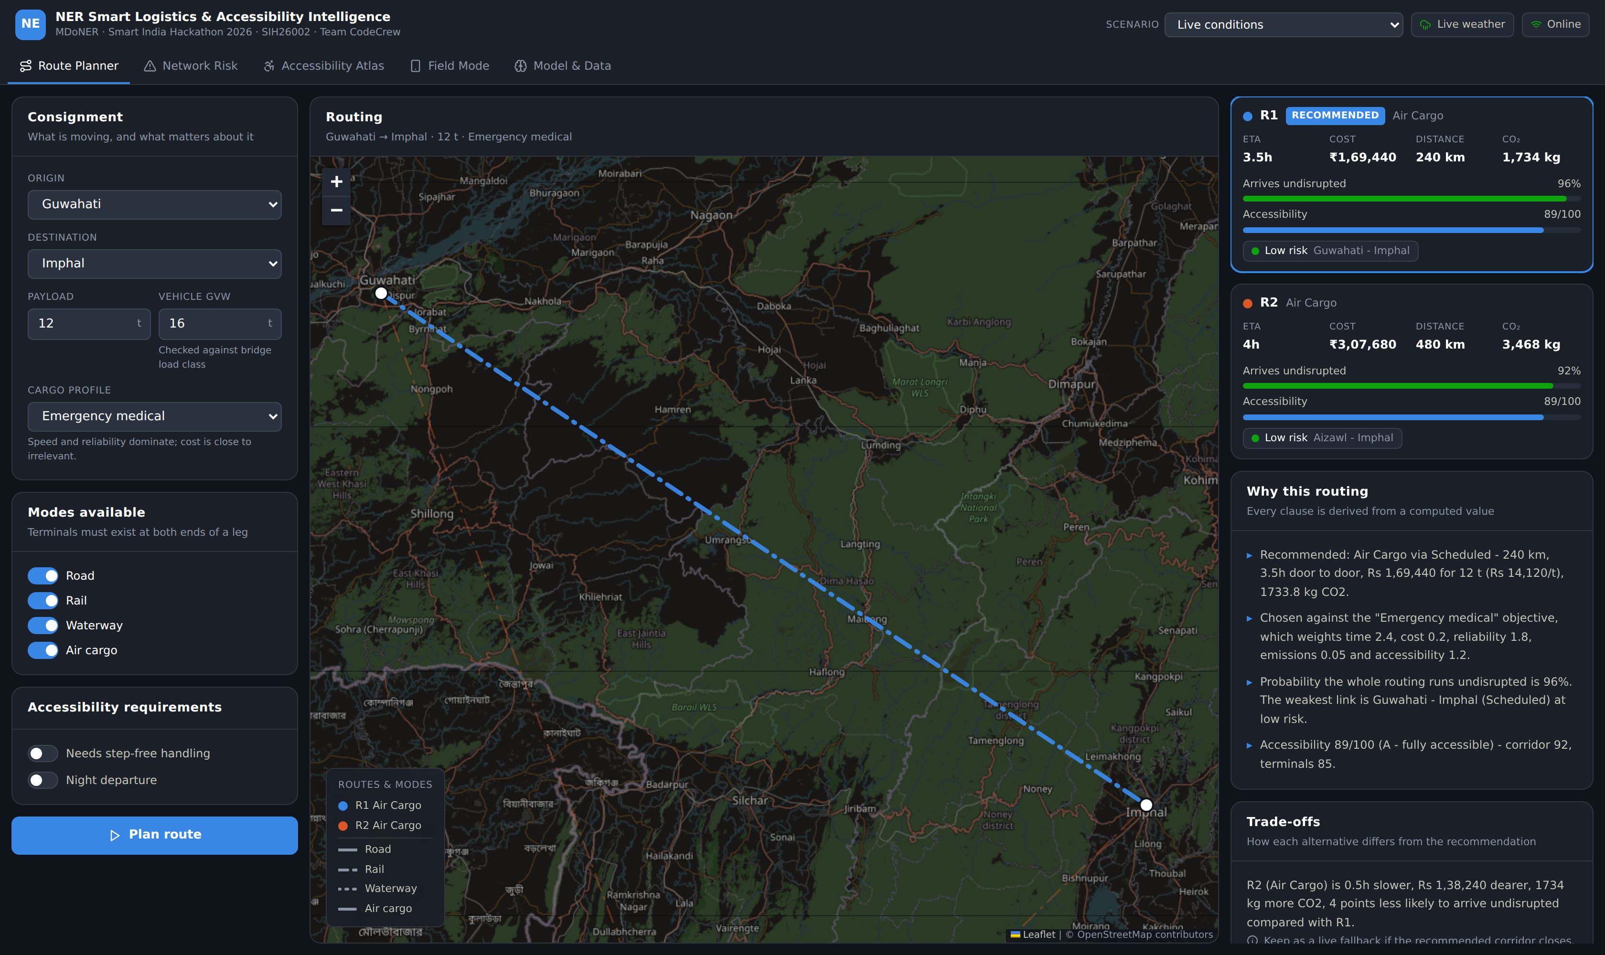
PRODUCT TOUR · 01
Route Planner
Plans a consignment across the multimodal network and shows the reasoning, not just the answer.
1
Ranked routings
Three genuinely distinct options from Yen's k-shortest-paths, not one route relabelled.
2
Grounded explanation
Every clause cites a value the planner computed - distance, weakest link, rainfall, both risk models.
3
Live constraints
Bridge load class is checked against vehicle gross weight; step-free handling and night travel are consignment inputs.
4
Arrival probability
The product of every link's survival probability, shown per route.
NER Smart Logistics & Accessibility Intelligence · SIH26002 · Team CodeCrew
5
Notes:
Route Planner. Plans a consignment across the multimodal network and shows the reasoning, not just the answer.

Slide 6
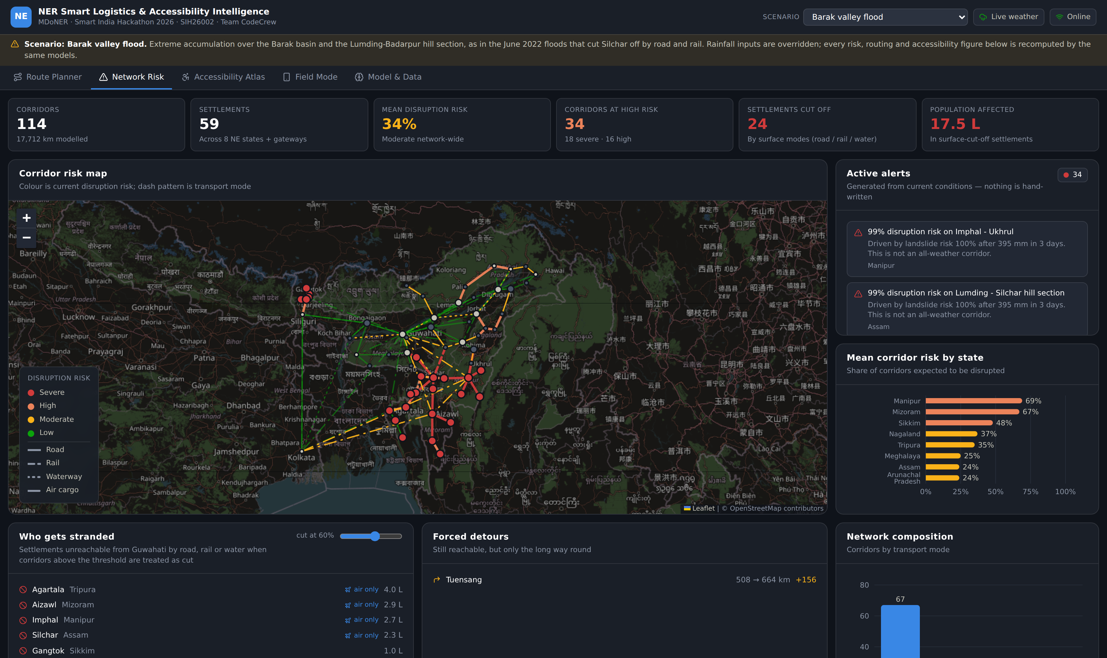
PRODUCT TOUR · 02
Network Risk
The operating picture: what is at risk right now, and who loses their connection if it closes.
1
Colour is risk, dash is mode
Corridor colour carries current disruption risk; transport mode is carried by line pattern.
2
Alerts are derived
Nothing is hand-written. If the rain stops, the alerts clear themselves.
3
Who gets stranded
Treat corridors above a threshold as cut, then ask which settlements are unreachable over surface modes.
4
Air excluded on purpose
Relief and resupply move on the ground; an air bridge on paper hides the isolation this view exists to show.
NER Smart Logistics & Accessibility Intelligence · SIH26002 · Team CodeCrew
6
Notes:
Network Risk. The operating picture: what is at risk right now, and who loses their connection if it closes.

Slide 7
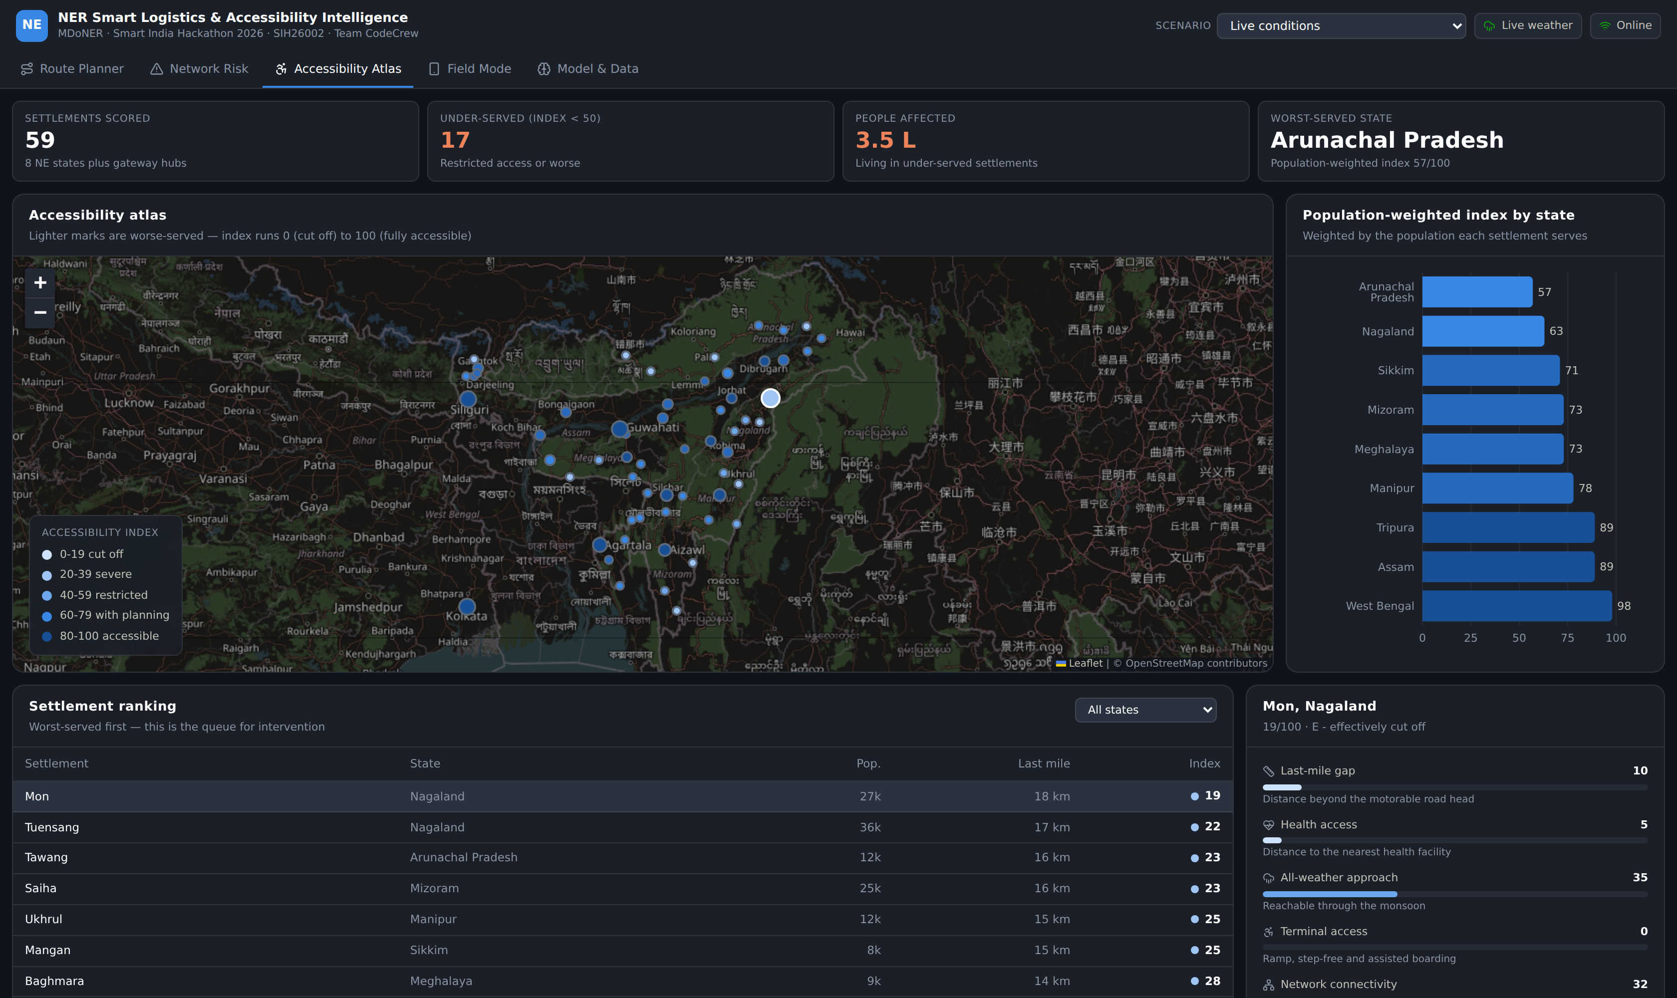
PRODUCT TOUR · 03
Accessibility Atlas
The differentiator: scoring places, not just routes - because a route that arrives at an unusable road head has not arrived.
1
0-100 per settlement
Six sub-scores: last-mile gap, health-facility distance, all-weather approach, terminal access, connectivity, coverage.
2
Auditable, not a black box
Every index opens into the sub-scores and raw facilities that produced it.
3
Population-weighted roll-up
State ranking weighted by the population each settlement serves - the queue for intervention.
4
17 settlements under 50
Restricted access or worse, covering roughly 3.5 lakh people in this dataset.
NER Smart Logistics & Accessibility Intelligence · SIH26002 · Team CodeCrew
7
Notes:
Accessibility Atlas. The differentiator: scoring places, not just routes - because a route that arrives at an unusable road head has not arrived.

Slide 8
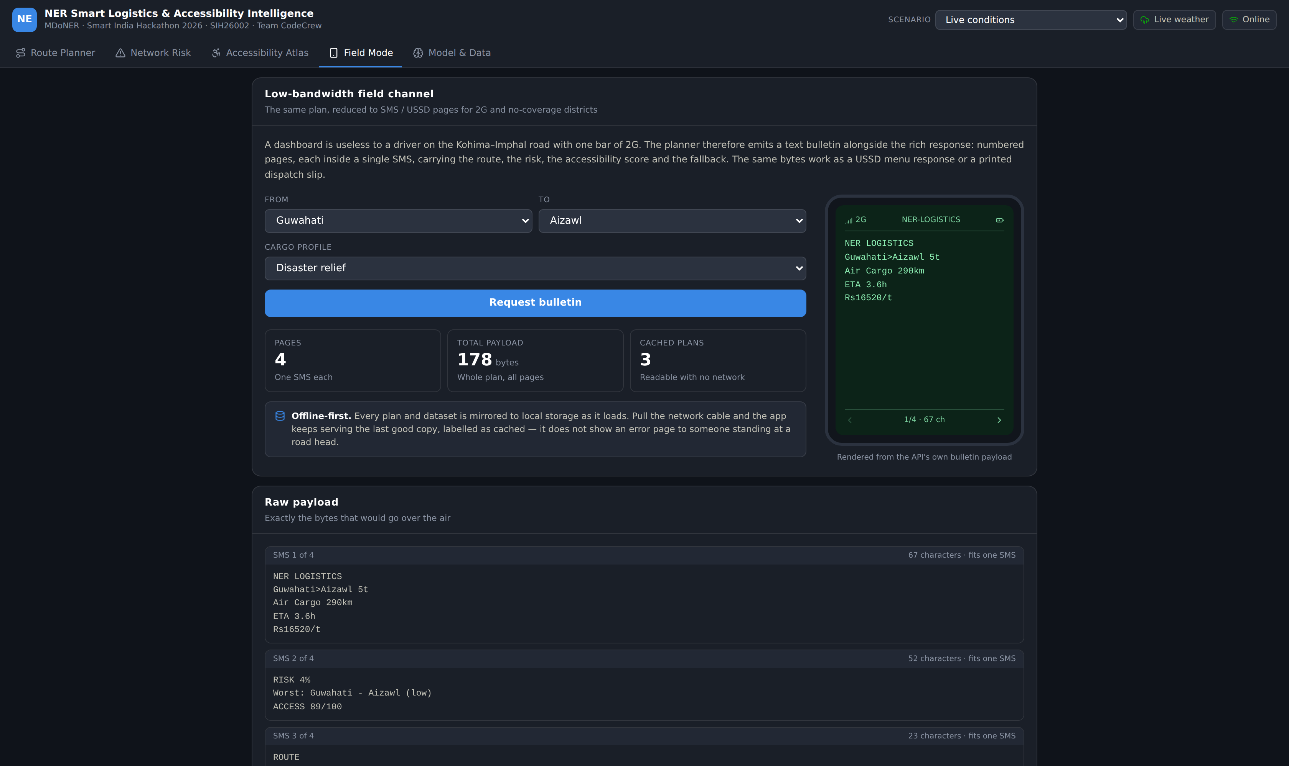
PRODUCT TOUR · 04
Field Mode
A dashboard is useless to a driver on the Kohima-Imphal road with one bar of 2G.
1
Sub-160-character pages
The same plan as numbered SMS pages - route, risk, accessibility and the fallback, each inside one message.
2
One payload, three channels
The same bytes work as an SMS, a USSD menu response, or a printed dispatch slip.
3
Offline-first by default
Every response is mirrored to local storage; losing the network shows a labelled cached plan, never an error page.
4
Rendered from the real API
The feature-phone screen shows the actual bulletin payload, with its byte count.
NER Smart Logistics & Accessibility Intelligence · SIH26002 · Team CodeCrew
8
Notes:
Field Mode. A dashboard is useless to a driver on the Kohima-Imphal road with one bar of 2G.

Slide 9
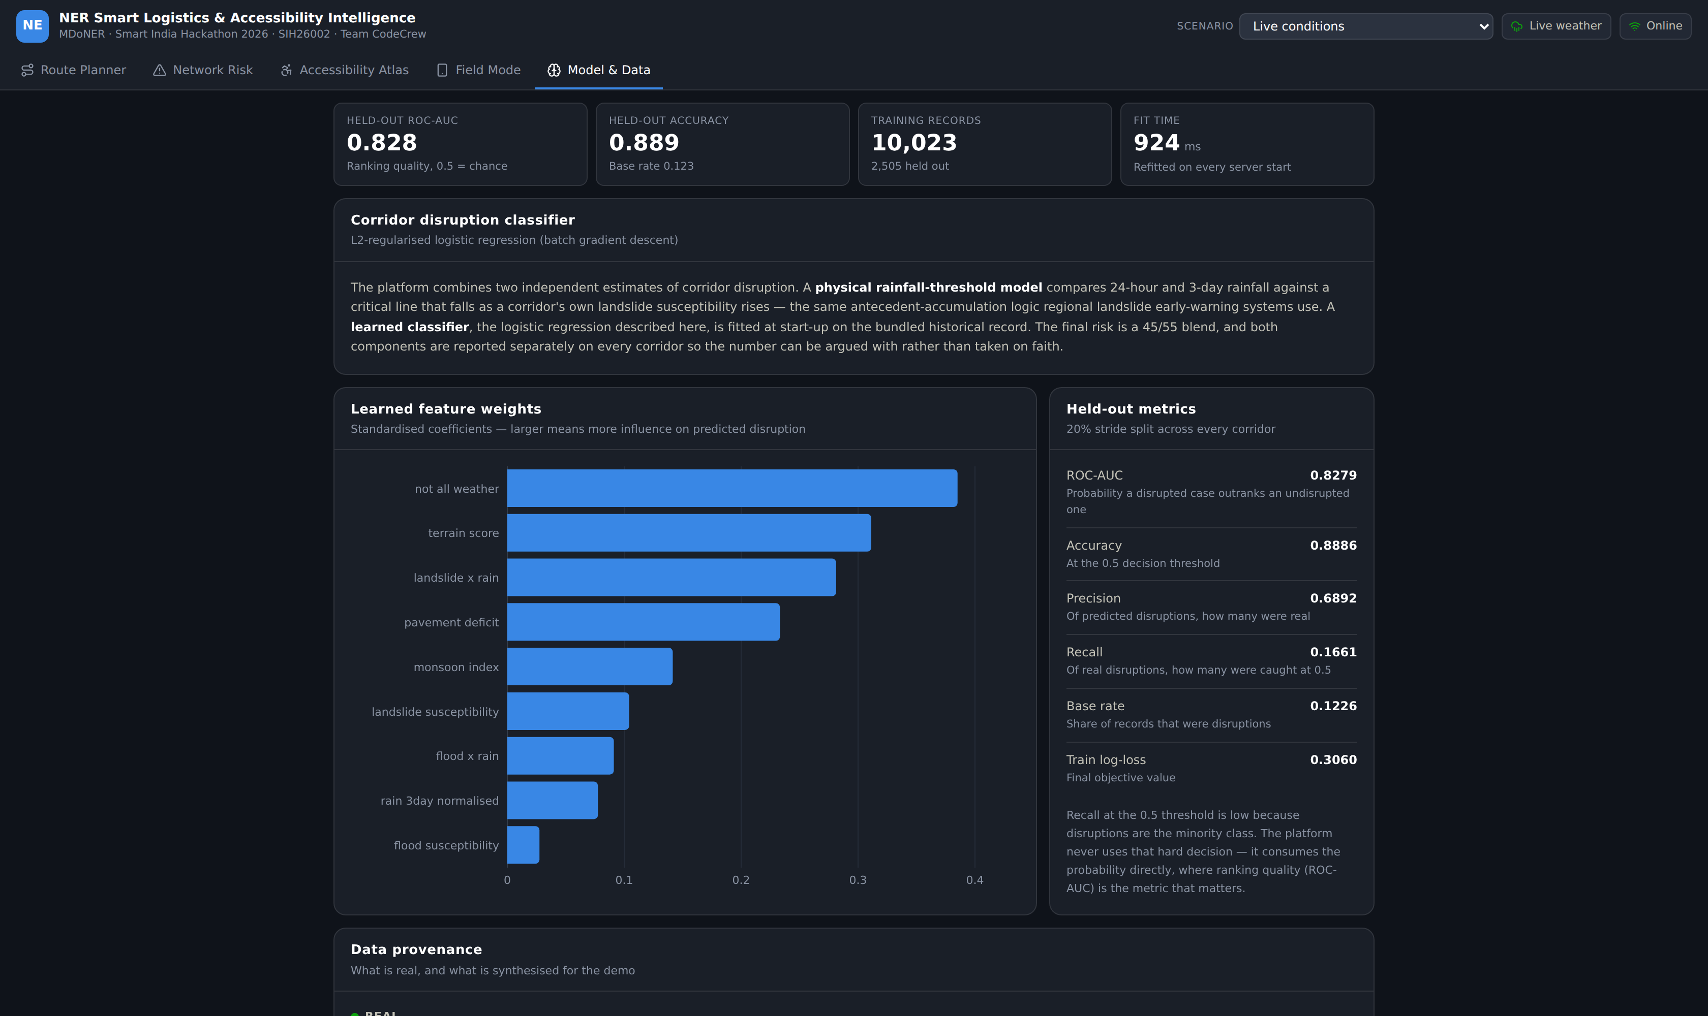
PRODUCT TOUR · 05
Model & Data
The honesty screen, shipped inside the product rather than kept for the pitch.
1
Learned weights, on screen
The classifier's standardised coefficients, so its reasoning can be inspected.
2
Held-out metrics
ROC-AUC, accuracy, precision, recall and base rate on a 20% split held out across every corridor.
3
Stated provenance
Which data is real and which is the demo layer - in the product, not just the README.
4
Honest about recall
Low recall at the 0.5 threshold is explained: the platform consumes the probability, never the hard decision.
NER Smart Logistics & Accessibility Intelligence · SIH26002 · Team CodeCrew
9
Notes:
Model & Data. The honesty screen, shipped inside the product rather than kept for the pitch.

Slide 10




ARCHITECTURE
How a request becomes a routing
Inputs
Risk engine
Graph search
Scoring
Output
Open-Meteo live rainfall
Network topology
Corridor priors
Consignment request
Rainfall-threshold model
Trained classifier
45 / 55 blend
Per-corridor assessment
(settlement, mode) expansion
Transfer arcs at terminals
Dijkstra + Yen k-shortest
Node-revisit rejection
Time, cost, reliability
Emissions, accessibility
Profile re-weighting
Barrier detection
Ranked routings
Grounded explanation
SMS / USSD bulletin
Offline-cached response
Stack
API
ENGINES
WEB
MAP & CHARTS
Node + Express, ES modules, no build step
Dependency-free: graph, routing, risk, accessibility
React 18 + TypeScript + Vite + Tailwind v4
Leaflet / OpenStreetMap, Recharts
No API keys, no database, no external service beyond the free Open-Meteo forecast API - and the platform degrades to monsoon climatology when that is unreachable, so it runs fully offline.
NER Smart Logistics & Accessibility Intelligence · SIH26002 · Team CodeCrew
10
Notes:
Left to right is the actual call path. Stress that the engines have no dependencies - they are written to be read and audited.

Slide 11
ENGINE · 01
Routing: a graph that knows what a terminal is
The (settlement, mode) expansion
One objective, five terms
A plain node-to-node graph cannot express transshipment. Switching road to rail at Dimapur costs four hours and a handling fee, and is only possible because Dimapur actually has a rail terminal. So the search space is expanded to (settlement, mode) pairs, and moving between two modes at one place is an explicit transfer arc that exists only where both terminals do.
cost = wtime·time + wmoney·cost + wrisk·(-ln(1-p))
+ w
co2·emissions + waccess·deficit
Reliability enters as -ln(1-p) because that is the only additive form whose path total corresponds to the real quantity: the probability the whole routing survives is the product of its links' survival probabilities. Terms are normalised to a typical NER movement so no term silently dominates.
Three design decisions that made the answers correct
Yen's k-shortest-paths
Node-revisit rejection
Impassable gating at 97%
Produces genuinely different alternatives - a rail routing, a drier road routing - instead of three cosmetic variants of one corridor.
Yen is loopless over the expanded graph, so it can legally return "drive Guwahati to Shillong, then fly back through Guwahati". Those paths are rejected.
Above that probability a corridor is treated as closed, not merely expensive - otherwise a cheap washed-out road outscores a sound one on price.
NER Smart Logistics & Accessibility Intelligence · SIH26002 · Team CodeCrew
11
Notes:
These three decisions came out of testing - each fixed a wrong answer the first implementation gave. Worth saying so: they are evidence the system was actually exercised.

Slide 12
ENGINE · 02
The profile changes the answer, not just the label
Same origin, same destination, same 12 tonnes. Only the objective weights differ - and the platform picks a different mode, corridor and cost each time.
Cargo profile | Weighting emphasis | Chosen mode | ETA | Cost | CO₂
Emergency medical | Time 2.4 · Reliability 1.8 | Air cargo | 3.5 h | ₹ 1,69,440 | 1,734 kg
Perishable / agri | Time 1.8 · Cost 0.7 | Road | 18.3 h | ₹ 19,834 | 356 kg
General freight | Balanced across all five | Road | 18.3 h | ₹ 19,834 | 356 kg
Bulk freight | Cost 2.6 · Time 0.25 | Rail + Road | 22.1 h | ₹ 17,750 | 230 kg
Low-emission | Emissions 3.0 | Rail + Road | 22.1 h | ₹ 17,750 | 230 kg
Disaster relief | Reliability 2.0 · Access 1.6 | Air cargo | 3.5 h | ₹ 1,69,440 | 1,734 kg
Emergency medical flies
Bulk freight takes the train
Relief buys reliability
Cost weight drops to 0.2, so a 5x price for 15 hours saved is the right trade.
Cost weight 2.6 against time 0.25 moves the answer onto rail - cheaper and 35% less CO₂.
Reliability 2.0 and accessibility 1.6 pick the option most likely to actually arrive.
NER Smart Logistics & Accessibility Intelligence · SIH26002 · Team CodeCrew
12
Notes:
Guwahati to Imphal, 12 tonnes, live conditions. This table is the clearest evidence the objective function is doing real work.

Slide 13

ENGINE · 03
Risk: a physical model and a learned one, reported separately
HELD-OUT ROC-AUC
HELD-OUT ROC-AUC
Physical
Learned
0.828
Ranking quality; 0.5 is chance
0.828
HELD-OUT ACCURACY
Regional landslide early-warning systems trigger on antecedent accumulation, not the day's intensity. 24-hour and 3-day rainfall are compared against a critical line that falls as the corridor's own susceptibility rises; the exceedance ratio maps through a logistic curve. Flooding uses basin accumulation with a relief factor - water pools on the valley floor and drains above ~600 m.
An L2-regularised logistic regression, trained by batch gradient descent at every server start on the bundled historical record. It is genuinely fitted, not handed its coefficients - and it recovers the right structure: all-weather status, terrain class and the landslide x rainfall interaction come out as the dominant signals.
HELD-OUT ACCURACY
0.889
Base rate 0.123
0.889
TRAINING RECORDS
TRAINING RECORDS
10,023
2,505 held out on a stride split
10,023
FIT TIME
FIT TIME
924 ms
924 ms
Refitted on every server start
Learned feature weights · standardised coefficients
Blended 45 / 55
Both components are reported on every corridor, side by side, so the number can be argued with rather than taken on faith. A corridor with no historical signal still gets a sane physical estimate; a corridor the data knows well gets the benefit of it.
NER Smart Logistics & Accessibility Intelligence · SIH26002 · Team CodeCrew
13
Notes:
The two-model design is the defensible part: neither is asked to do a job it cannot. Point out that the classifier recovering all-weather status and the landslide-rain interaction as top signals is a sanity check that it learned real structure.

Slide 14
ENGINE · 04
Accessibility: scoring places, not just paths
Two related questions. Is this route physically usable for this consignment and these people? And how well-served is this settlement in the first place?
Route accessibility · checked against the consignment
Settlement index · six sub-scores, 0-100
Bridge load class against the vehicle's gross weight - a blocking barrier, with the mitigation stated
Last-mile gap
22%
Health-facility distance
20%
Gradient and lanes sustained climbs above 10% restrict heavy and low-power vehicles
All-weather approach
16%
Terminal accessibility
16%
All-weather status corridors liable to close under sustained rain are flagged before dispatch
Step-free handling checked at every terminal the load passes through, when required
Network connectivity
16%
Mobile coverage
10%
Population-weighted accessibility index by state
Settlements scored
59
Under-served (index < 50)
17
People affected
3.5 L
Worst served
Mon, 19
NER Smart Logistics & Accessibility Intelligence · SIH26002 · Team CodeCrew
14
Notes:
This is the part of the problem statement nobody else builds. The index is deliberately auditable - it opens into its own sub-scores.

Slide 15

STRESS TEST
Barak valley flood: the same models, different rainfall
Scenarios substitute rainfall inputs and re-run every model - a genuine what-if, not a scripted demo. This one reproduces the June 2022 floods that cut Silchar off by road and rail.
Live conditions
Barak valley flood
Reachable by air only
Mean network risk
21%
34%
Four state capitals and regional hubs lose every surface connection to the Guwahati hub:
Corridors at severe risk
2
18
Silchar · air bridge only
Agartala · air bridge only
Active alerts
5
34
Aizawl · air bridge only
Imphal · air bridge only
Settlements surface-cut off
0
24
This is what actually happened in June 2022. The platform reaches the same conclusion from rainfall alone, and re-routes accordingly: the recommendation for Guwahati to Silchar switches from rail to air cargo, 3.5 hours at 61% arrival probability.
Population affected
0
17.5 L
And when nothing works, it says so
Disable air cargo during the flood and the planner does not dress up a bad answer. It reports that every routing crosses a corridor it expects to be closed, shows the least-bad options with their honest 1% and 0% arrival probabilities, and tells the operator to treat dispatch as conditional on ground confirmation.
NER Smart Logistics & Accessibility Intelligence · SIH26002 · Team CodeCrew
15
Notes:
The money slide. The platform independently reproduces a real historical event from rainfall inputs, and - just as important - refuses to fake an answer when there is not one.

Slide 16

DATA
Where every number comes from
Real
Demo layer
Verifiable against public sources
Plausible and internally consistent, not surveyed
Settlements
59 places - coordinates, elevation, state, terminal facilities
Corridor priors
Landslide and flood susceptibility per corridor
Road corridors
NH-27, NH-2, NH-6, NH-10, NH-13, NH-306, NH-54 and others, by number and routing
Road condition
Pavement index, bridge load class, gradient, lane class
Rail
NF Railway network, including the Lumding-Badarpur hill section
Night safety
Whether night travel is advised on a corridor
Waterways
NW-2 Brahmaputra and NW-16 Barak
Settlement access
Ramp, step-free, assisted boarding
Air
Scheduled sectors plus UDAN-RCS routes
Service distance
Last-mile gap and nearest health facility
Weather
Open-Meteo current + forecast precipitation, 15-minute refresh
Coverage
Mobile data availability per settlement
Mode economics
Indicative freight rates, speeds, CO₂ per tonne-km
Training history
Synthesised disruption records - see the note below
One file stands between the demo and real data
Open per-corridor incident records for the NER are not publicly downloadable, so the classifier is fitted on a synthesised history generated from NE-India monsoon climatology and the corridor priors. Swapping in real NHAI / NDMA / state-PWD incident data means replacing server/src/data/history.js - nothing else changes.
NER Smart Logistics & Accessibility Intelligence · SIH26002 · Team CodeCrew
16
Notes:
If asked "how much of this is real" - this slide is the answer, and it is the same answer the product itself gives on its Model & Data screen.

Slide 17

ENGINEERING
Built to be checked, not just demonstrated
END-TO-END CHECKS
ENGINE DEPENDENCIES
NETWORK VALIDATION
MODEL RETRAIN
25
0
boot
boot
Run with npm run smoke - no mocks, real engines
Graph, routing, risk and accessibility are plain code
A malformed corridor fails loudly at start-up
Refitted every start; metrics published at /api/model
Three defects the tests and review caught - and what each one was
Routes that teleported
A 1% route recommended
Totals that did not add up
Yen's algorithm is loopless over the expanded (settlement, mode) graph, where Guwahati-road and Guwahati-air are different vertices. It legally returned "drive Guwahati to Shillong, then fly Shillong-Guwahati-Imphal" - a path that revisits Guwahati and is nonsense on the ground.
Under the flood scenario the planner recommended a rail line with a 1% chance of arriving, because the -ln(1-p) risk term saturates at the probability cap and a cheap corridor won on price.
Origin loading and destination hand-over were counted in the quoted total but never shown as legs, so an operator reading the itinerary could not reconcile the cost.
FIX Over-fetch candidates and reject any path that revisits a physical settlement.
FIX Corridors above 97% disruption are treated as closed. If that leaves no route, the planner re-runs ungated and flags the answer as least-bad.
FIX Handling is emitted as itinerary legs; a test now asserts the legs sum to the total.
NER Smart Logistics & Accessibility Intelligence · SIH26002 · Team CodeCrew
17
Notes:
Say plainly that these were our own bugs, found by exercising the system. A demo that has never been stressed has never been wrong.

Slide 18
ROADMAP
What production would need
Phase 1
0-3 months
Phase 2
3-9 months
Phase 3
9-24 months
Real data substitution
Pilot in one state
Scale and learn
NHAI / NDMA / state-PWD incident records replace the synthesised training history
PM Gati Shakti and NESIDS layers for corridor and asset attributes
State transport department feeds for bridge load class and pavement condition
Retrain and re-validate the classifier on real outcomes
Modular, state-by-state rollout - start with one accessible state, not all eight
Community operators collecting local-language accessibility data
SMS / USSD gateway integration for the field channel
Operator feedback loop on route outcomes, which is the data RL would need
Satellite and IoT road-sensor ingestion for near-real-time corridor state
Reinforcement learning over accumulated outcome data - once there is data to learn from
Multilingual interfaces; security handling for border districts
Integration with UDAN cargo scheduling and inland-waterway berth planning
The architecture already assumes this path: the demo data layer is isolated in three files, and the engines that consume it do not change when it is replaced.
NER Smart Logistics & Accessibility Intelligence · SIH26002 · Team CodeCrew
18
Notes:
Phase 3 is where RL becomes honest - it needs outcome data that only a pilot can generate. Say that explicitly rather than claiming RL today.

Slide 19
Run it yourself
The whole platform starts with two commands and needs no API key, no database and no external service beyond a free weather API it can also do without.
5
product surfaces
$
npm install
$
npm run dev
web on :5173, API on :5174
114
corridors modelled
$
npm run smoke
25 end-to-end checks, no server needed
59
settlements scored
25
end-to-end checks
Team CodeCrew
WORKING DEMO BUILD
Smart India Hackathon 2026 · SIH26002 · MDoNER · Smart Automation
Notes:
Close on the fact that it runs. Offer to demo any scenario live - the scenario control re-drives every screen.

