Slide 1
seSNN
inference state
projection
R
PL
dream state
projection
projection
neurons
STMM
memory group
Network Modules (R, PL, STMM)

Slide 2
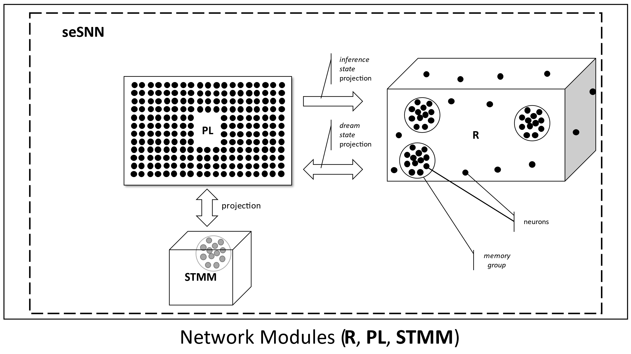

Slide 3
R
STMM
flow direction
flow direction
VN
Vascular Network (VN)

Slide 4
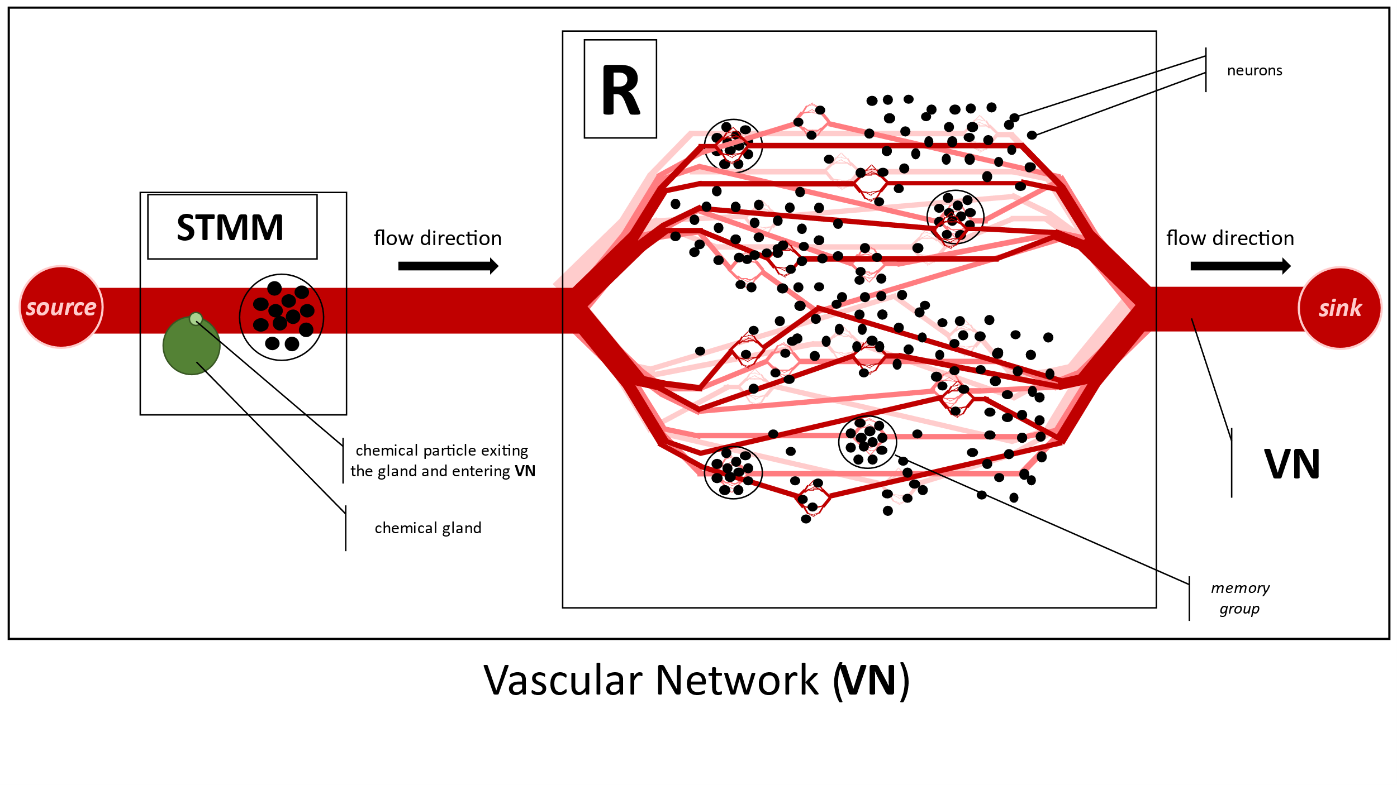

Slide 5
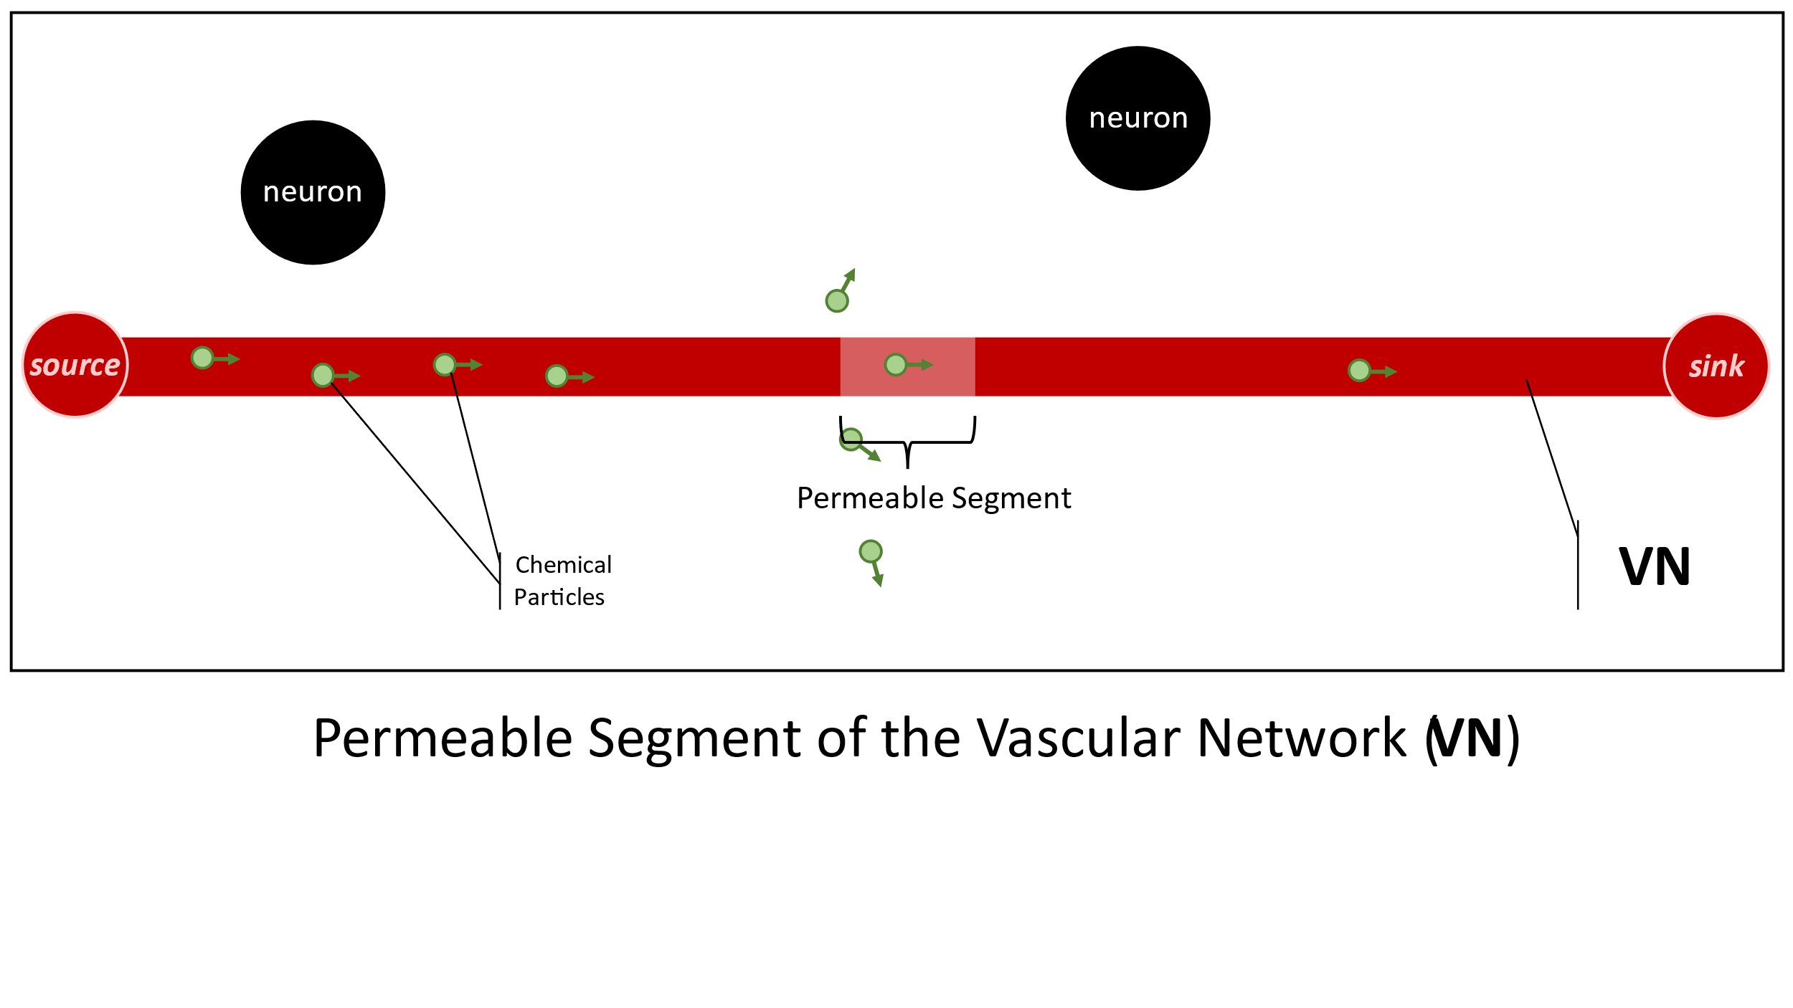

Slide 6
R
R
Electrode
neuron
Activated Memory Group
A
B
A
B
1
memory group
2
Memory group activation via current injection
R
R
firing neuron
A
B
A
B
3
4
Self-sustained (but time-limited) activation of a pair of memory groups through a ‘’short circuit current” after modifying the weights of relevant synapses with V-STDP
Induced “short circuit current” while V-STDP is effective.

Slide 7
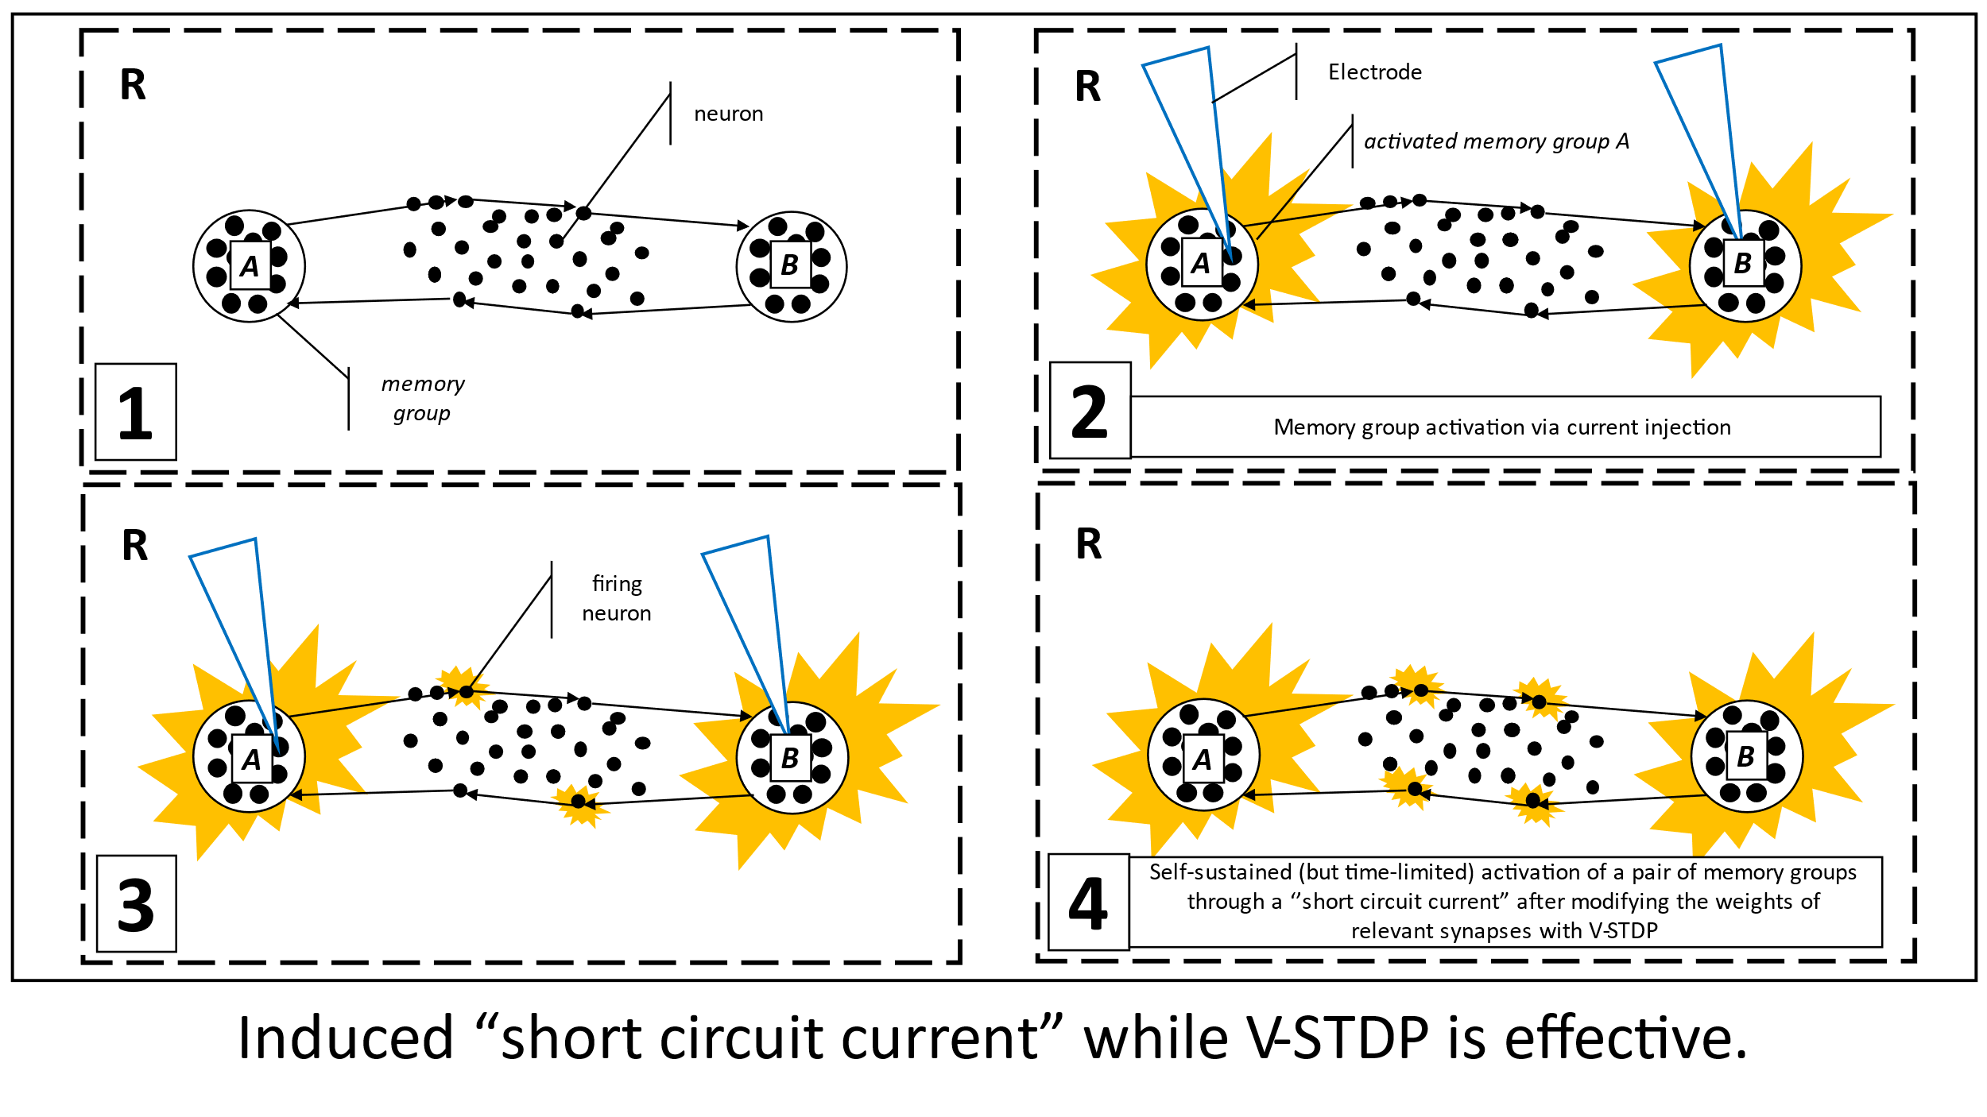

Slide 8
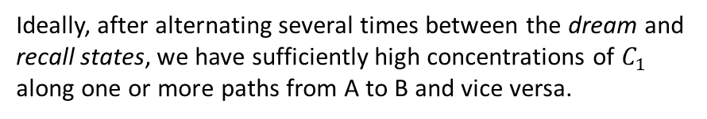
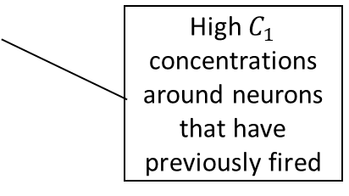
seSNN
seSNN
STMM
PL
R
STMM
PL
R
B
B
A
A
1
2
Random activation of A during the dream state
STMM activation during the recall state
seSNN
R
STMM
PL
R
B
B
High $C_{1}$ concentrations around neurons that have previously fired
A
A
3
Ideally, after alternating several times between the dream and recall states, we have sufficiently high concentrations of $C_{1}$ along one or more paths from A to B and vice versa.
End of the recall state
dream and recall states

Slide 9
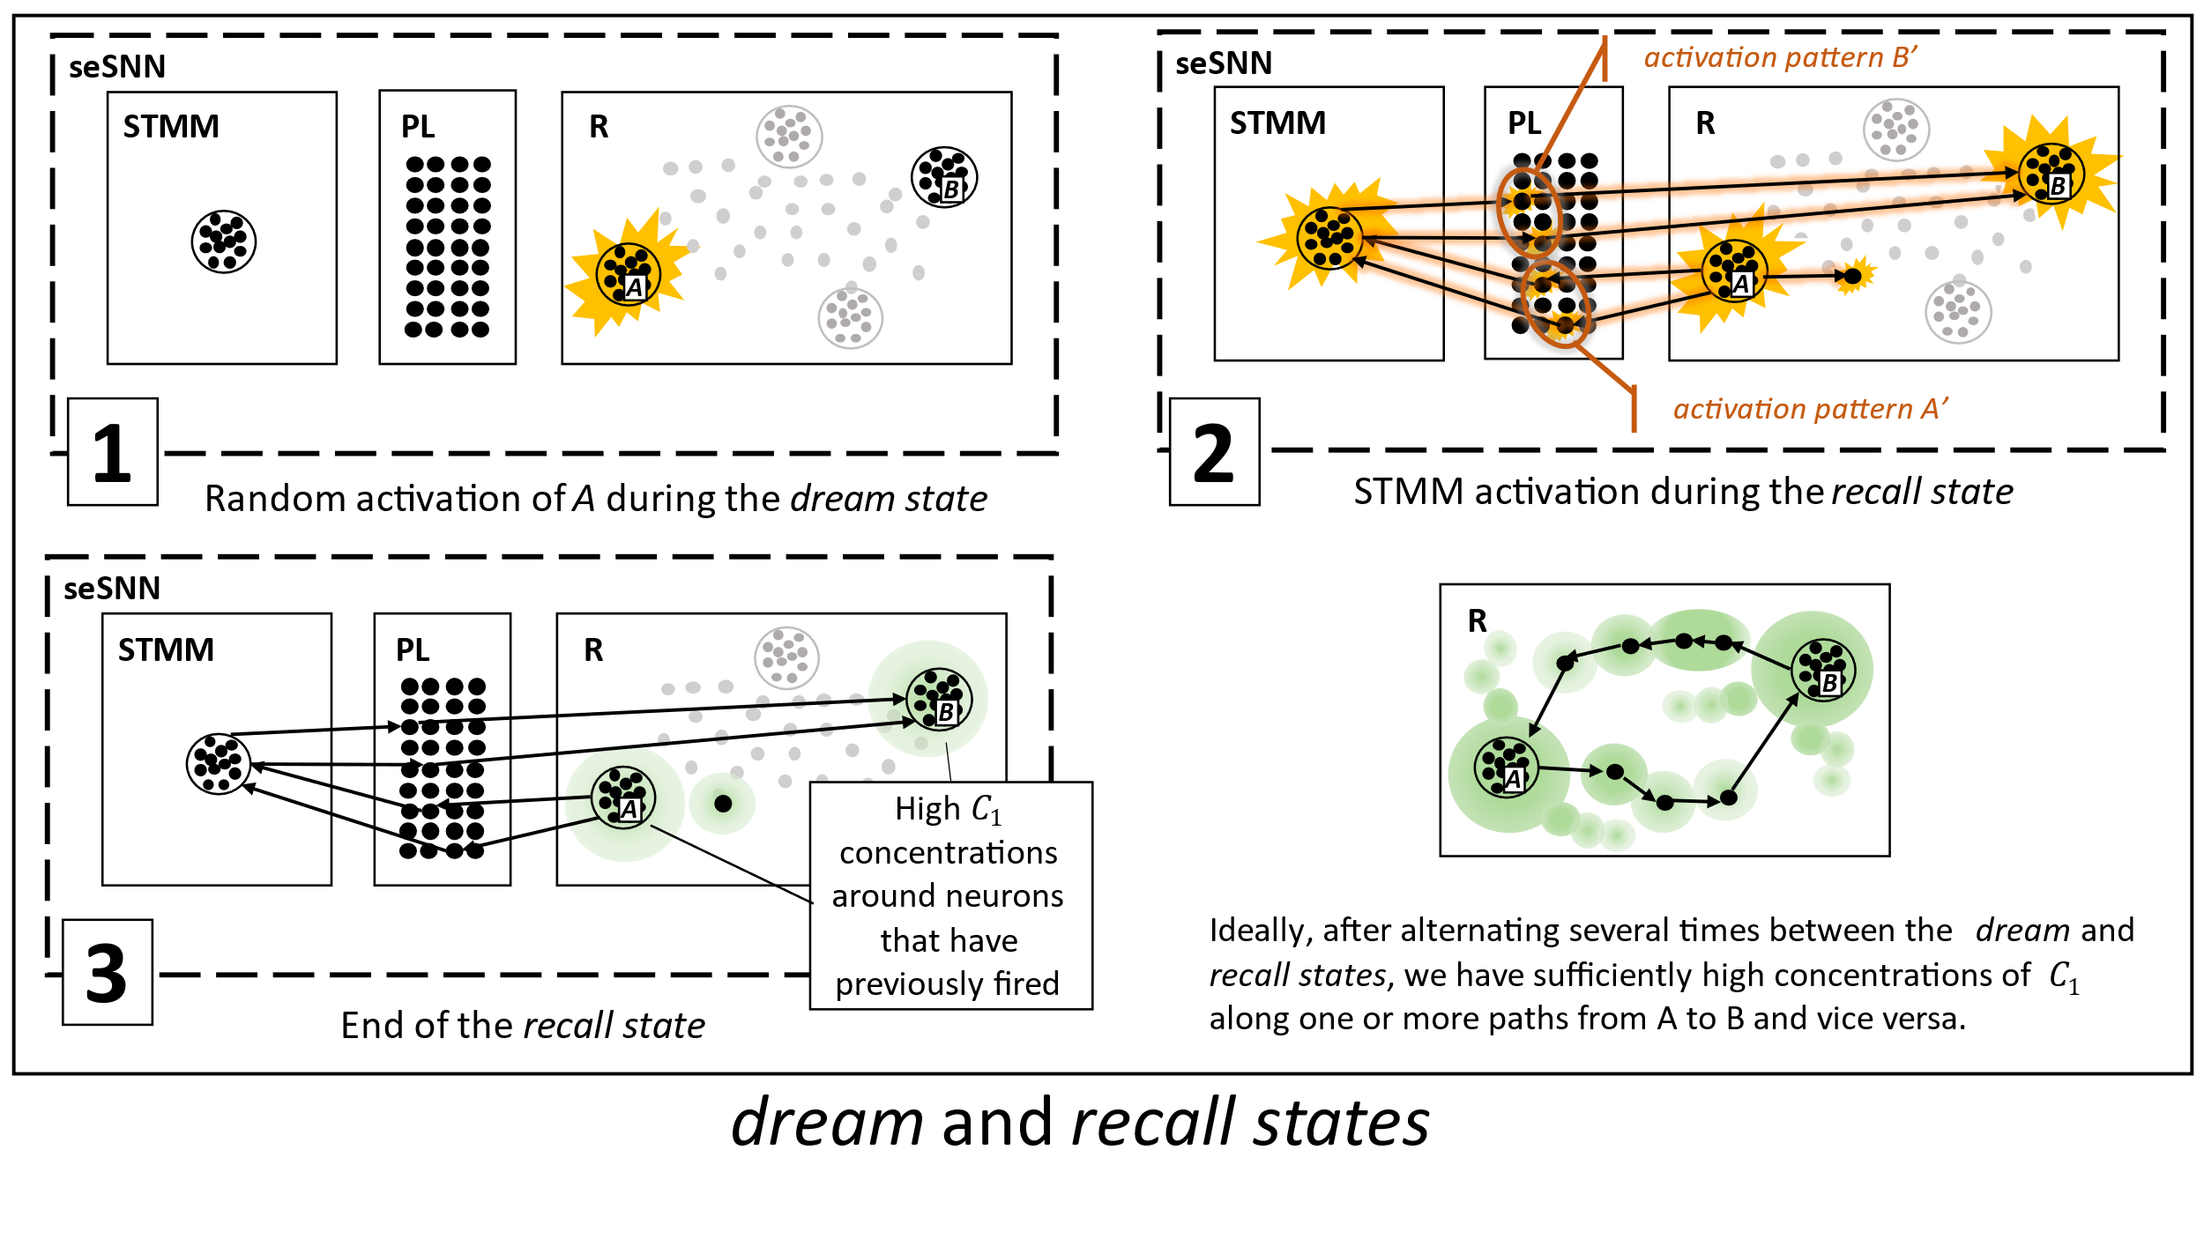

Slide 10
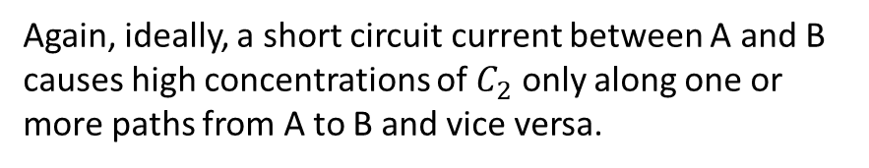
R
B
Again, ideally, a short circuit current between A and B causes high concentrations of $C_{2}$ only along one or more paths from A to B and vice versa.
A
R
1
B
A
2
Start and end of the short circuit state

Slide 11
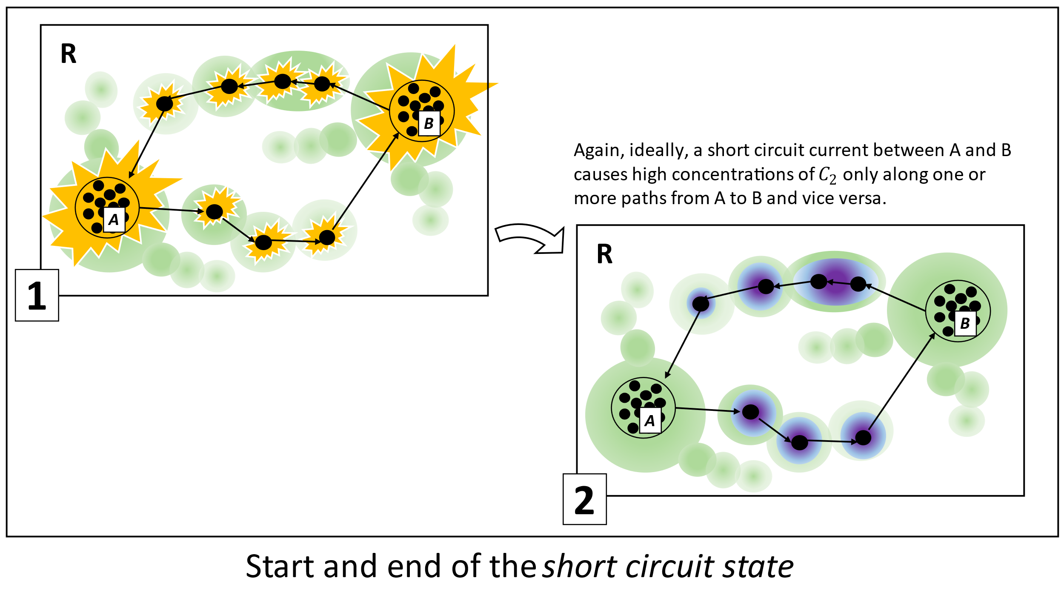

Slide 12


random
activation
of A xor B
“short circuit
current”
between
A and B
Existence of a new
long-term association
between A and B
non-permanent
V-STDP
non-permanent
V-STDP
non-permanent
V-STDP
permanent
V-STDP
dream state
recall state
short circuit state
t
$C_{1}$-release
$C_{2}$-release
Idealized sleep cycle state timeline

Slide 13
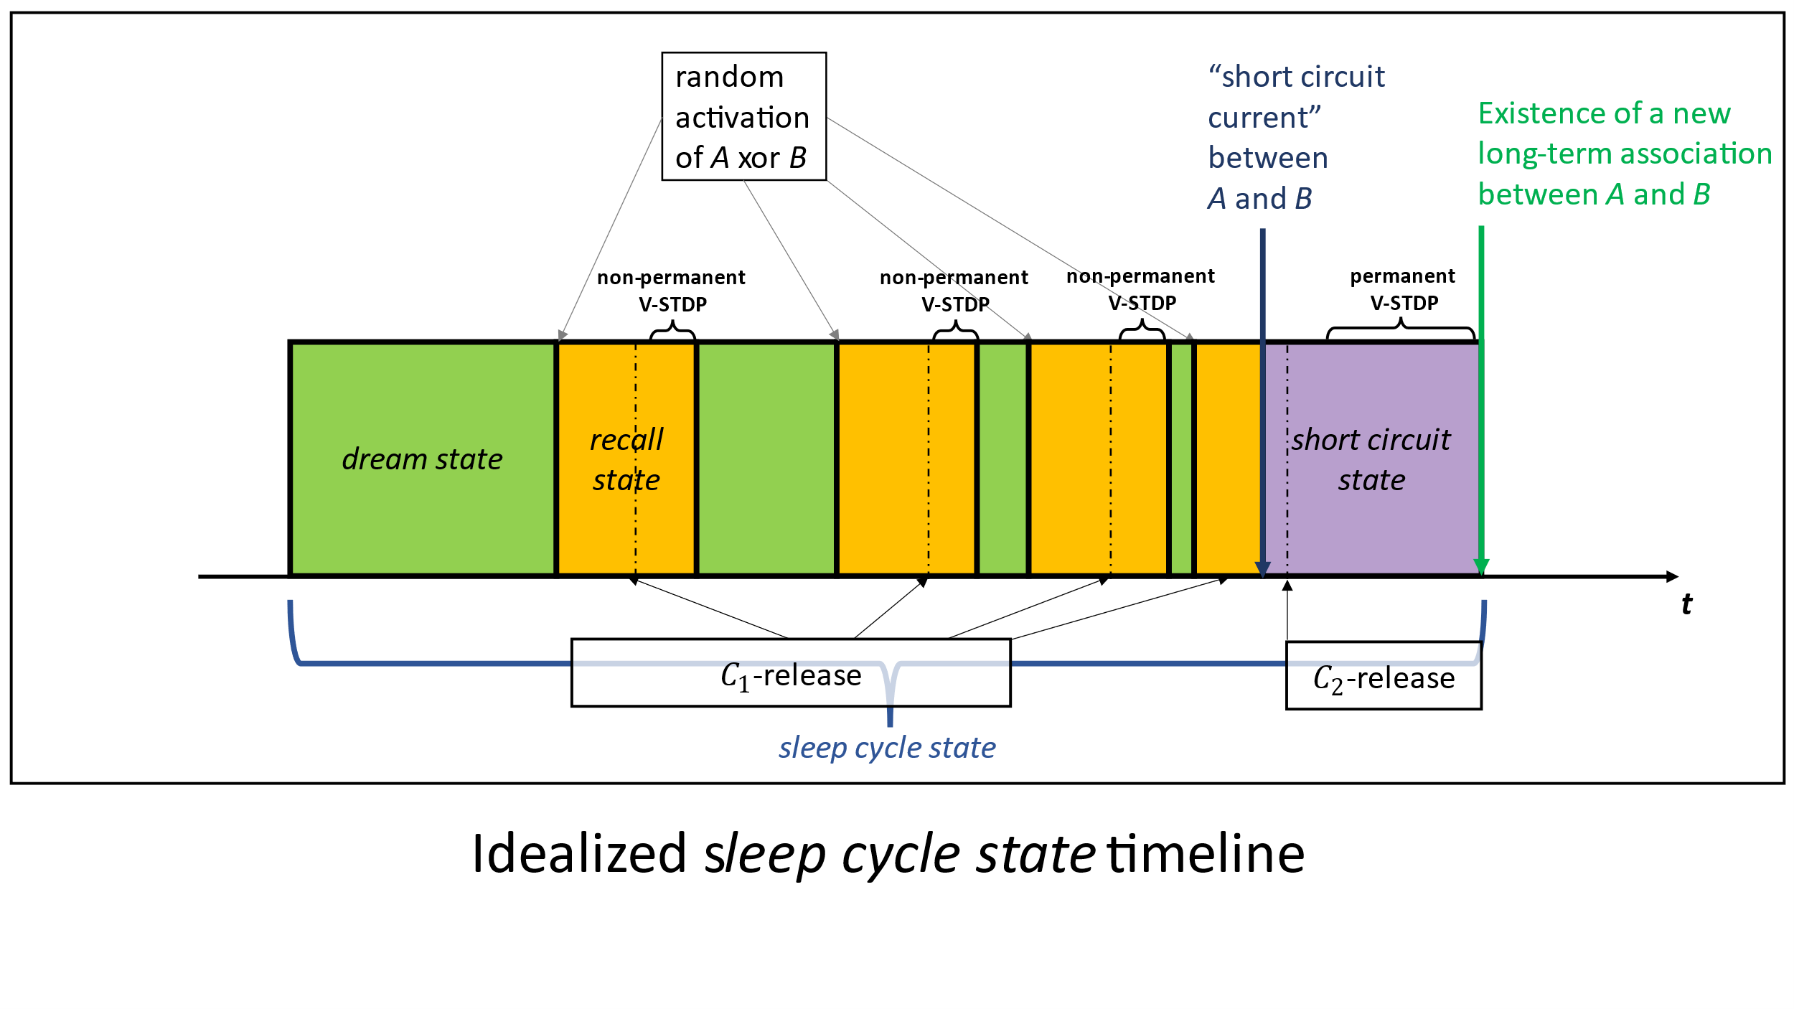

Slide 14
recall state
A and B deactivated
short circuit current between A and B
dream state
short circuit state
A xor B activated
sleep cycle state

