Slide 1
seSNN
inference state
projection
R
PL
dream state
projection
projection
neurons
STMM
concept
assembly
Network Modules (R, PL, STMM)

Slide 2
R
STMM
flow direction
flow direction
VN
Vascular Network (VN)

Slide 3
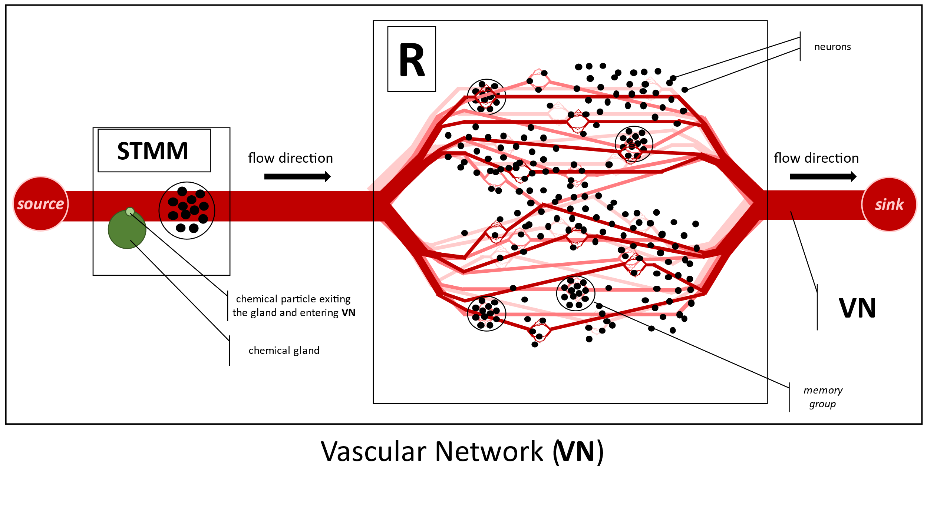
concept
assembly

Slide 4
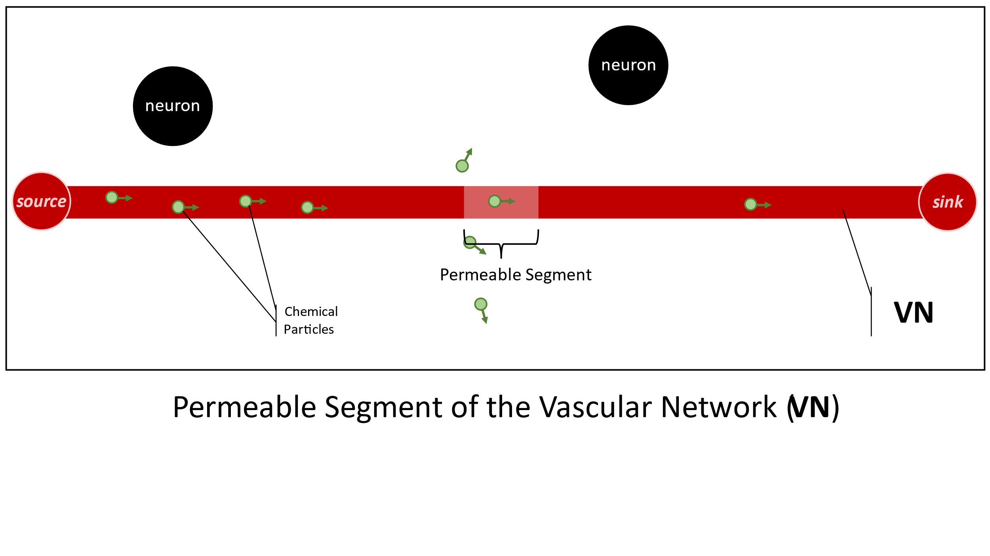

Slide 5
R
R
Electrode
neuron
Activated Memory Group
A
B
A
B
1
memory group
2
Memory group activation via current injection
R
R
firing neuron
A
B
A
B
3
4
Self-sustained (but time-limited) activation of a pair of memory groups through a ‘’short circuit current” after modifying the weights of relevant synapses with V-STDP
Induced “short circuit current” while V-STDP is effective.

Slide 6
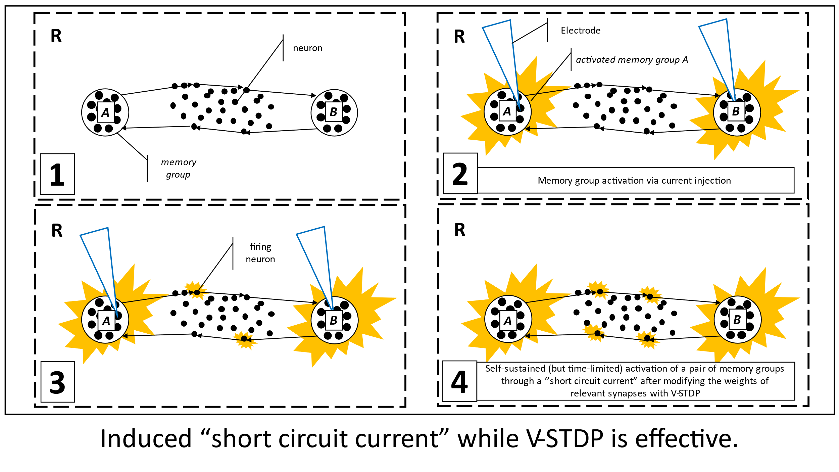
activated concept assembly
concept
assembly

Slide 7
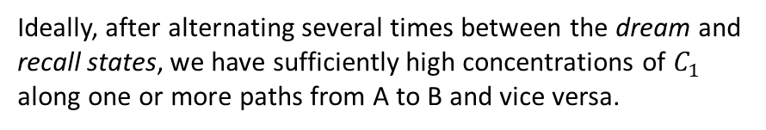
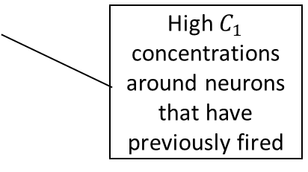
seSNN
seSNN
STMM
PL
R
STMM
PL
R
B
B
A
A
1
2
Random activation of A during the dream state
STMM activation during the recall state
seSNN
R
STMM
PL
R
B
B
High $C_{1}$ concentrations around neurons that have previously fired
A
A
3
Ideally, after alternating several times between the dream and recall states, we have sufficiently high concentrations of $C_{1}$ along one or more paths from A to B and vice versa.
End of the recall state
dream and recall states

Slide 8
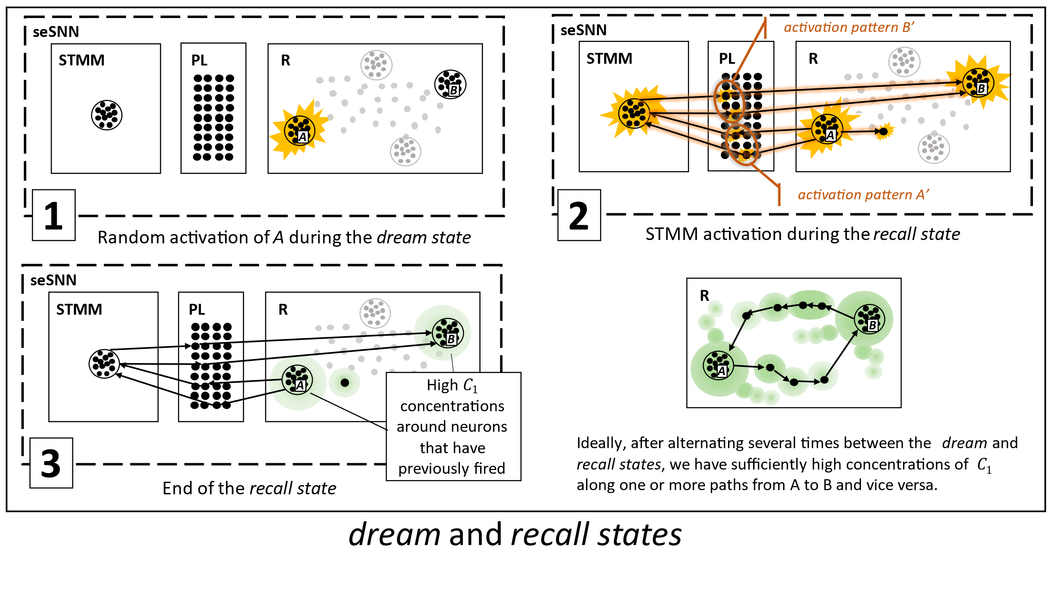

Slide 9
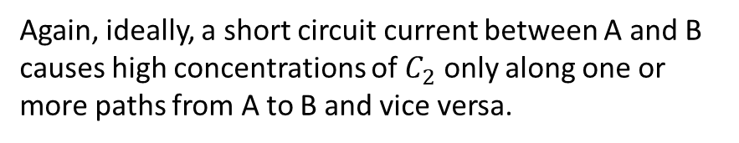
R
B
Again, ideally, a short circuit current between A and B causes high concentrations of $C_{2}$ only along one or more paths from A to B and vice versa.
A
R
1
B
A
2
Start and end of the short circuit state

Slide 10
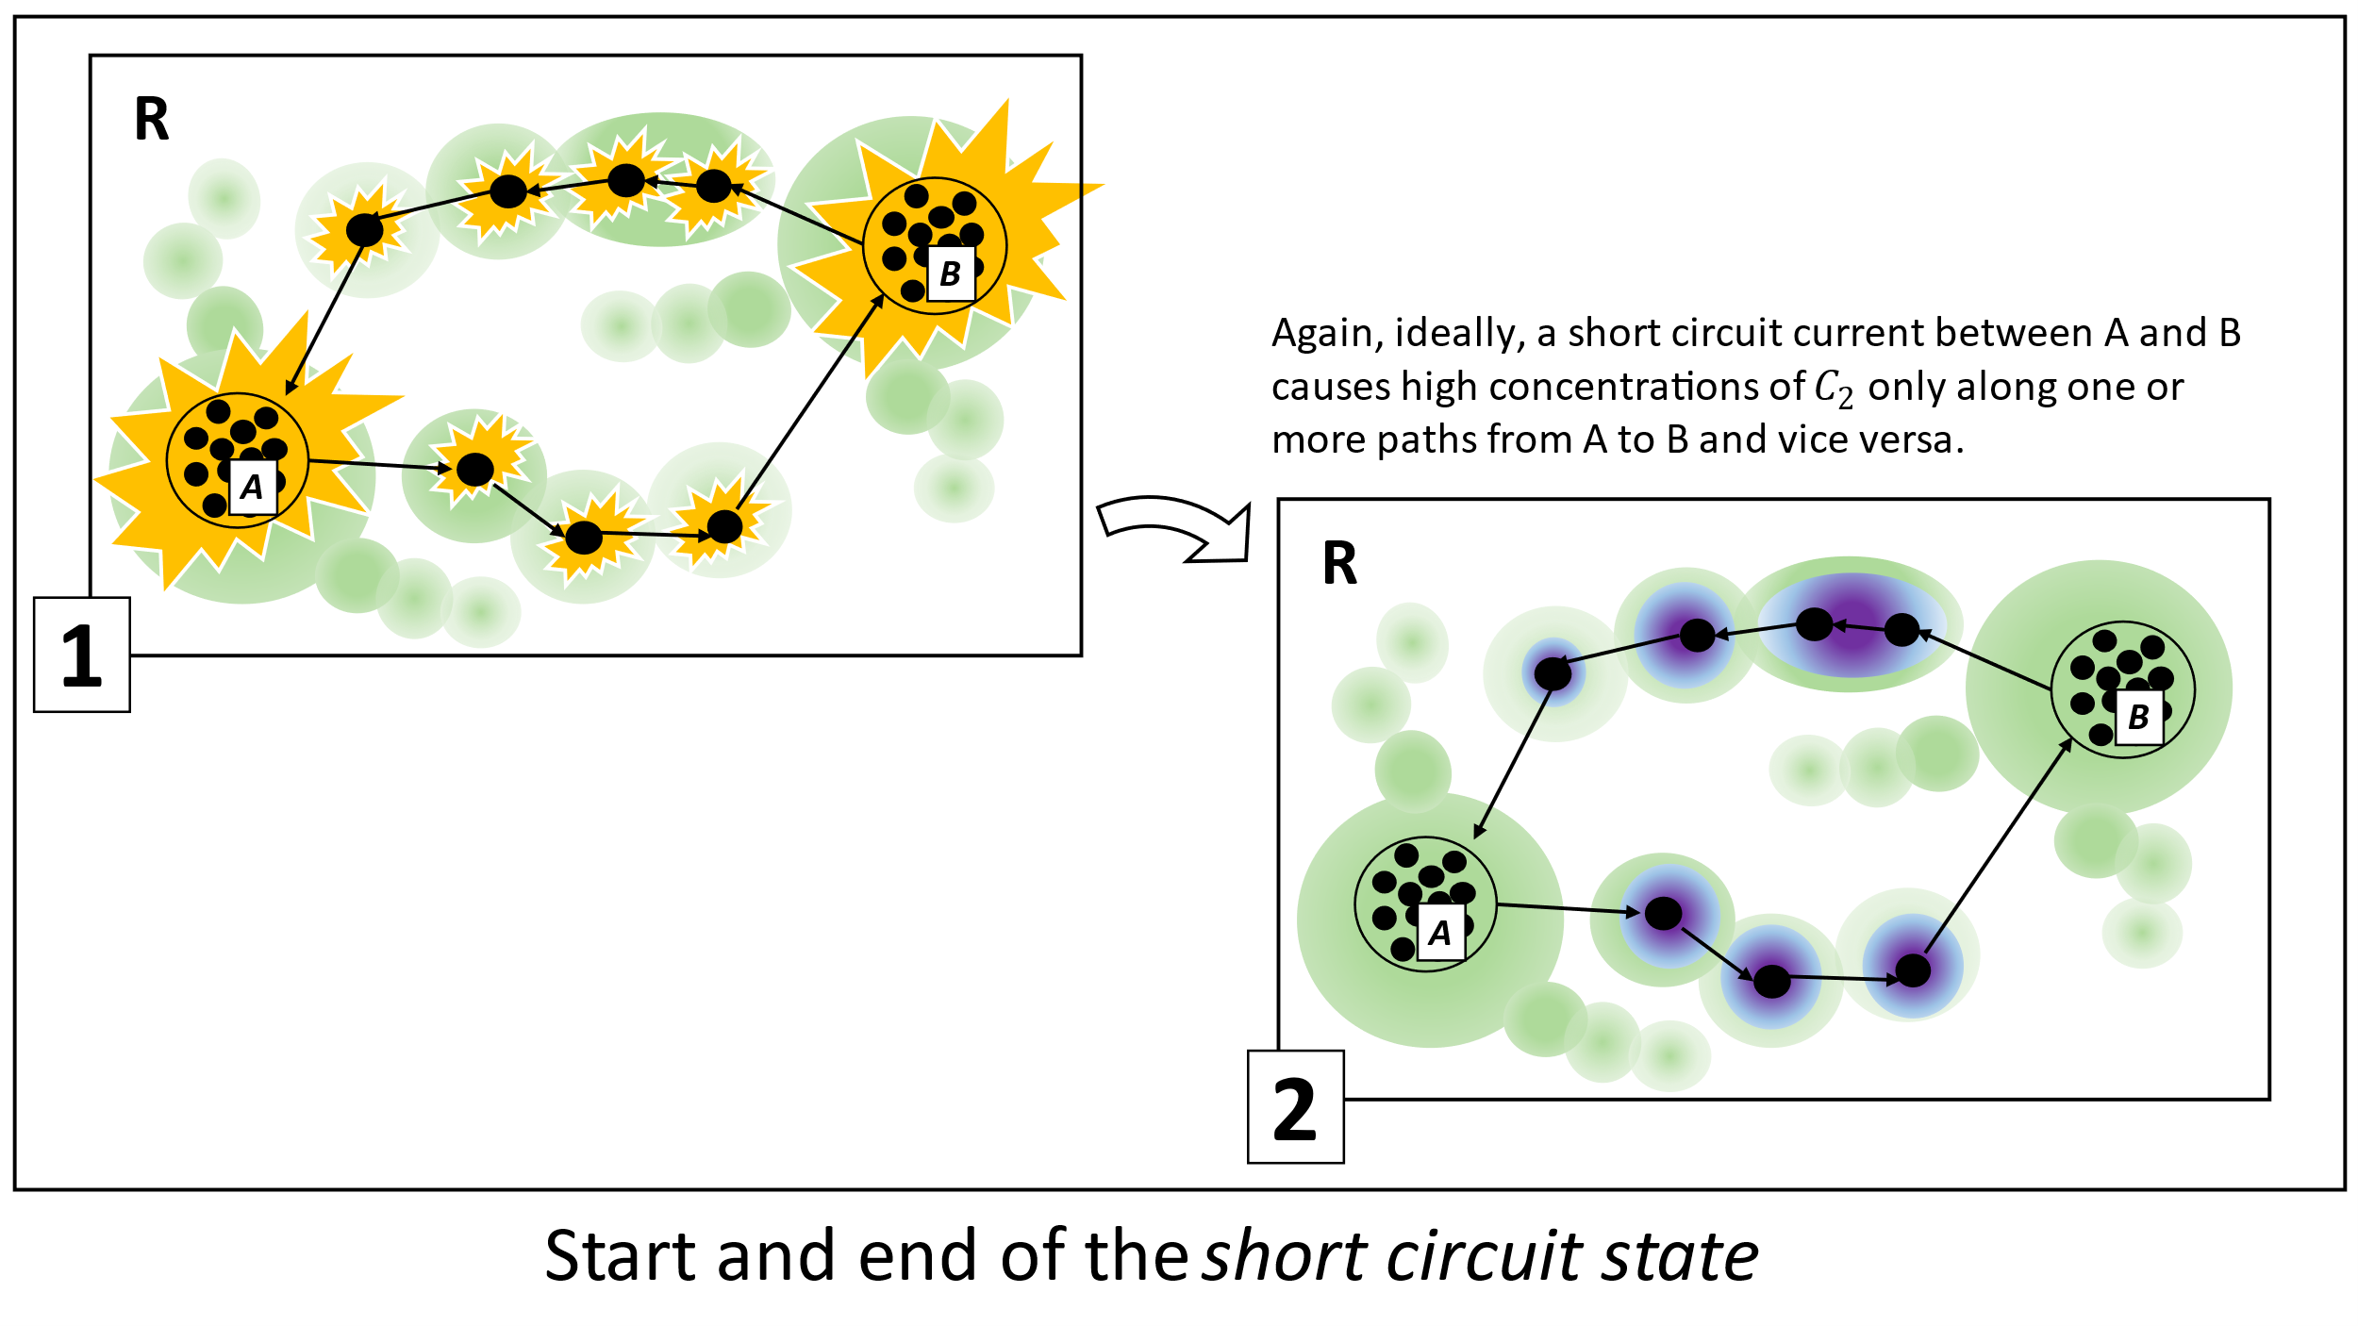

Slide 11


random
activation
of A or B
“short circuit
current”
between
A and B
Existence of a new
long-term association
between A and B
non-permanent
V-STDP
non-permanent
V-STDP
non-permanent
V-STDP
permanent
V-STDP
dream state
recall state
short circuit state
t
$C_{1}$-release
$C_{2}$-release
Idealized sleep cycle state timeline

Slide 12
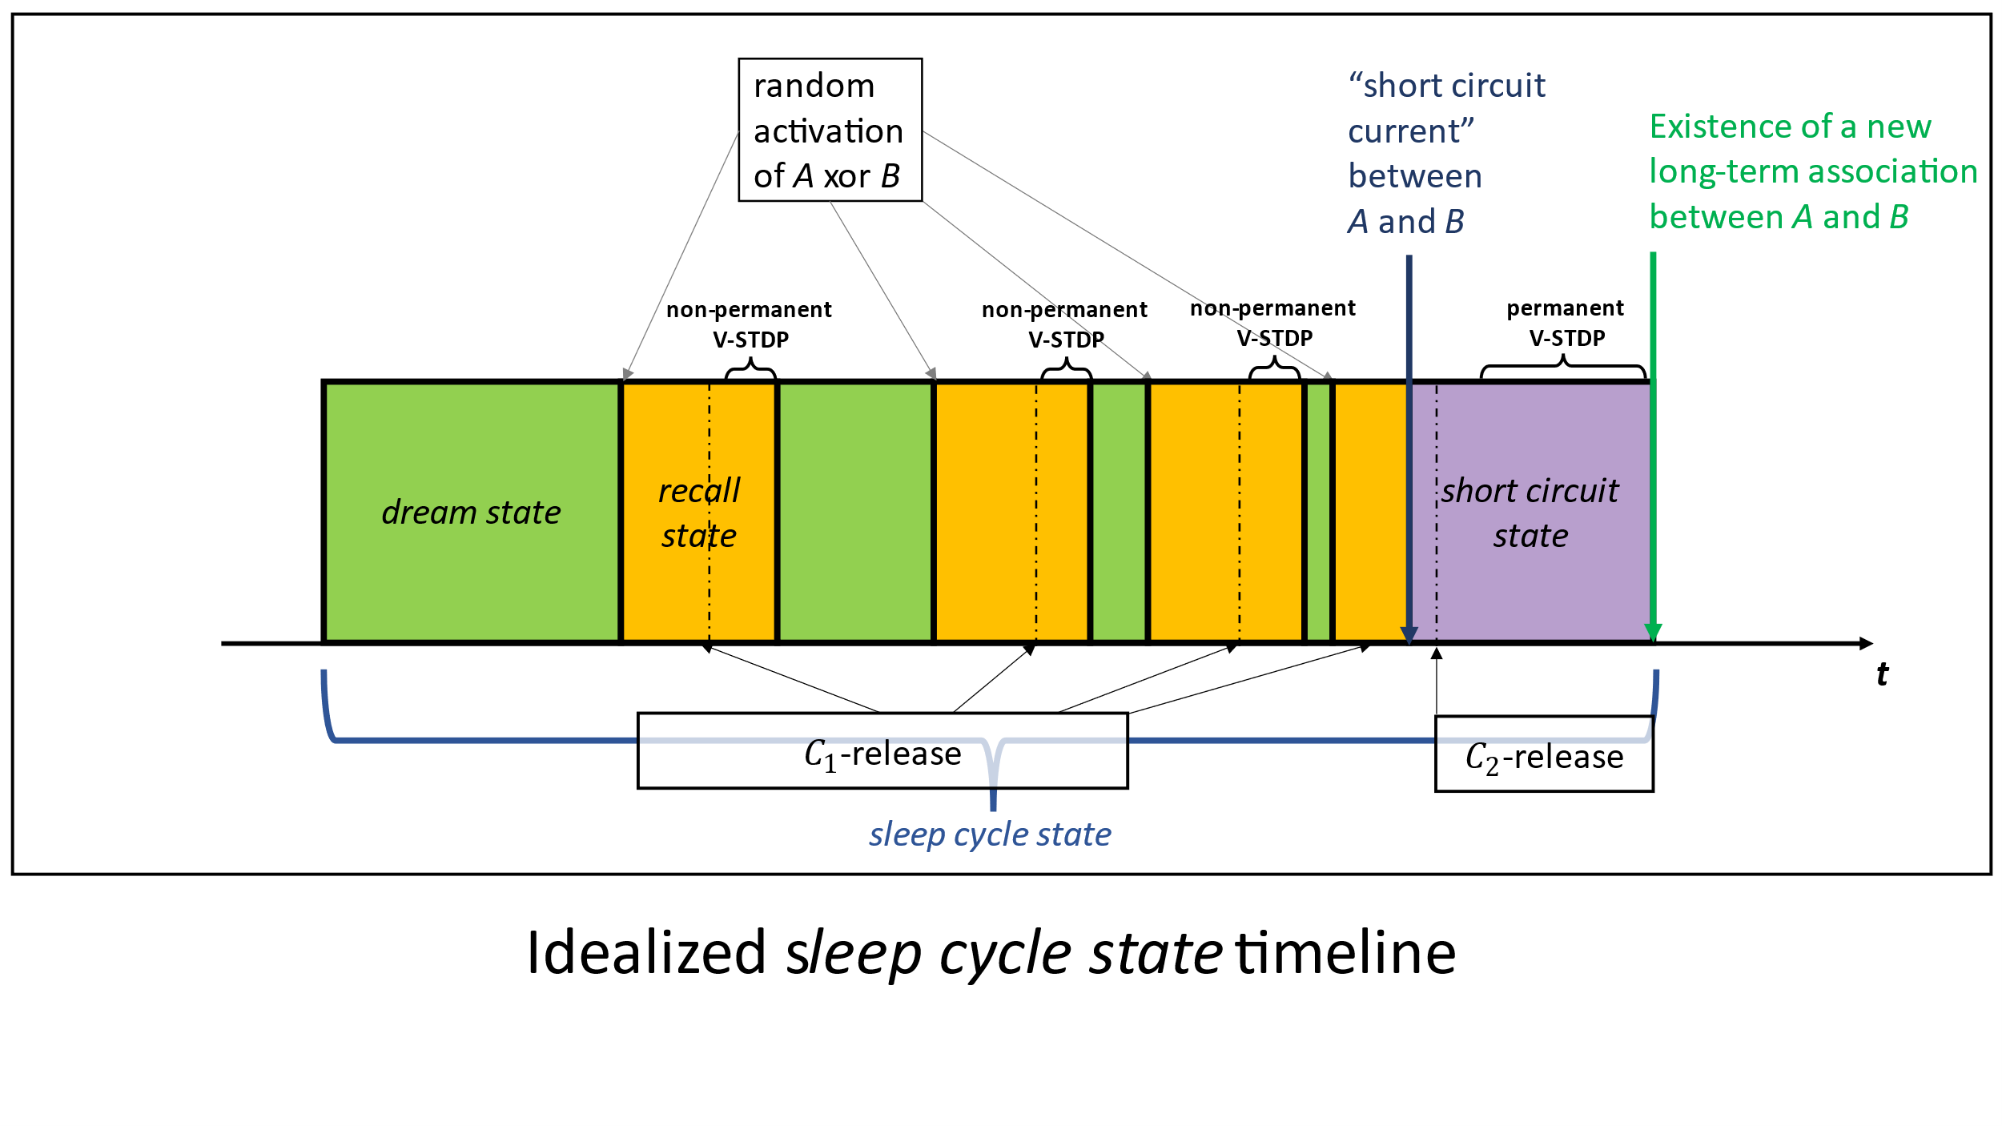
random
activation
of A or B

Slide 13
recall state
A and B deactivated
short circuit current between A and B
dream state
short circuit state
A or B activated
sleep cycle state

Slide 14


$$B$$
$$A$$

Slide 15
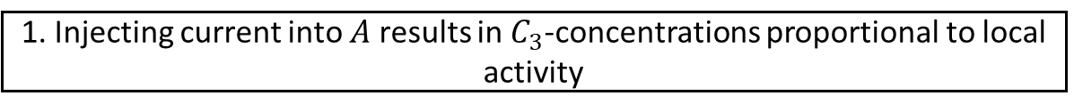
excitatory
neuron
1. Injecting current into $A$ results in $C_{3}$-concentrations proportional to local activity
inhibitory
neuron
start
target

Slide 16
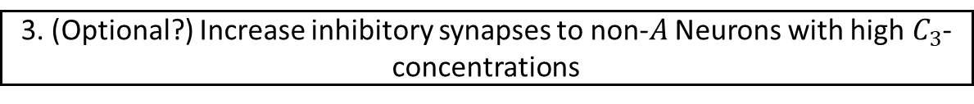

excitatory
neuron
2. Higher Probability of temporarily strengthening weak synapses to not too distant neurons
inhibitory
neuron
3. (Optional?) Increase inhibitory synapses to non-$A$ Neurons with high$C_{3}$-concentrations
start
target
Probability of non-permanent
weight increase
$C_{1}$-concentration around sink neuron
Strength of the Synapse

Slide 17
excitatory
neuron
Path Finding
inhibitory
neuron
start
target
Reservoir (R)
Pattern Layer (PL)
PL
projection

Slide 18
excitatory
neuron
1. Injecting current into $A$ results in $C_{3}$-concentrations proportional to local activity
inhibitory
neuron
start
$$B$$
target
$$A$$

Slide 19
excitatory
neuron
2. Higher Probability of temporarily strengthening weak synapses to not too distant neurons
inhibitory
neuron
3. (Optional?) Increase inhibitory synapses to non-$A$ Neurons with high$C_{3}$-concentrations
start
$$B$$
target
Probability of non-permanent
weight increase
$C_{1}$-concentration around sink neuron
Strength of the Synapse
$$A$$

Slide 20
excitatory
neuron
2. Higher Probability of temporarily strengthening weak synapses to not too distant neurons
inhibitory
neuron
3. (Optional?) Increase inhibitory synapses to non-$A$ Neurons with high$C_{3}$-concentrations
start
$$B$$
target
$$A$$

Slide 21




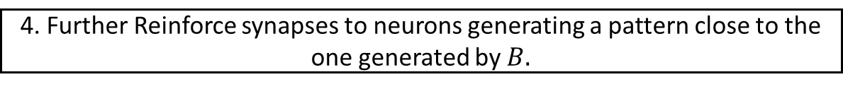
excitatory
neuron
4. Further Reinforce synapses to neurons generating a pattern close to the one generated by $B.$
inhibitory
neuron
PL
PL
PL
PL
start
$$B$$
target
$$A_{0,0}$$
$$A_{0,1}$$
$$A_{0,2}$$
$$B$$
$$A$$

Slide 22
excitatory
neuron
5. Repeat
inhibitory
neuron
start
$$B$$
target
$$A$$

Slide 23




excitatory
neuron
4. Repeat
inhibitory
neuron
start
PL
PL
PL
PL
target
PL
$$A_{0,0}$$
$$A_{0,1}$$
$$A_{0,2}$$
$$B$$

