Slide 1
Marine Heatwaves Working Group
August 6, 2018

Slide 2
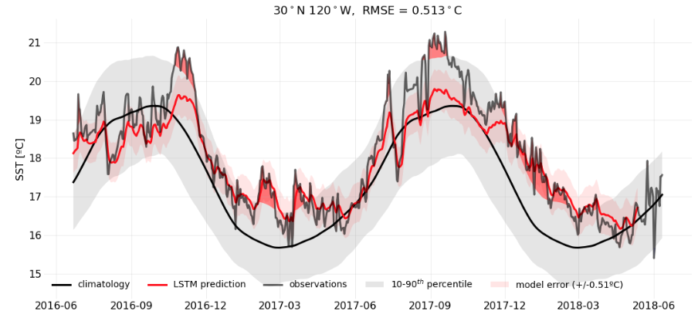
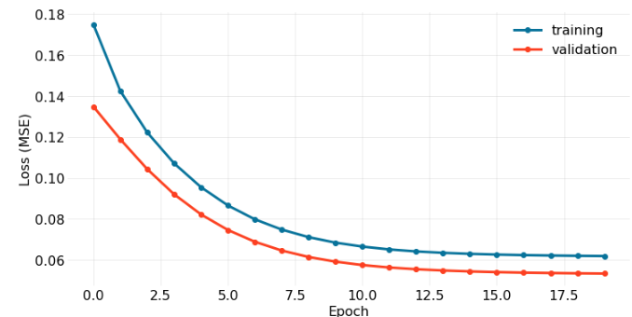
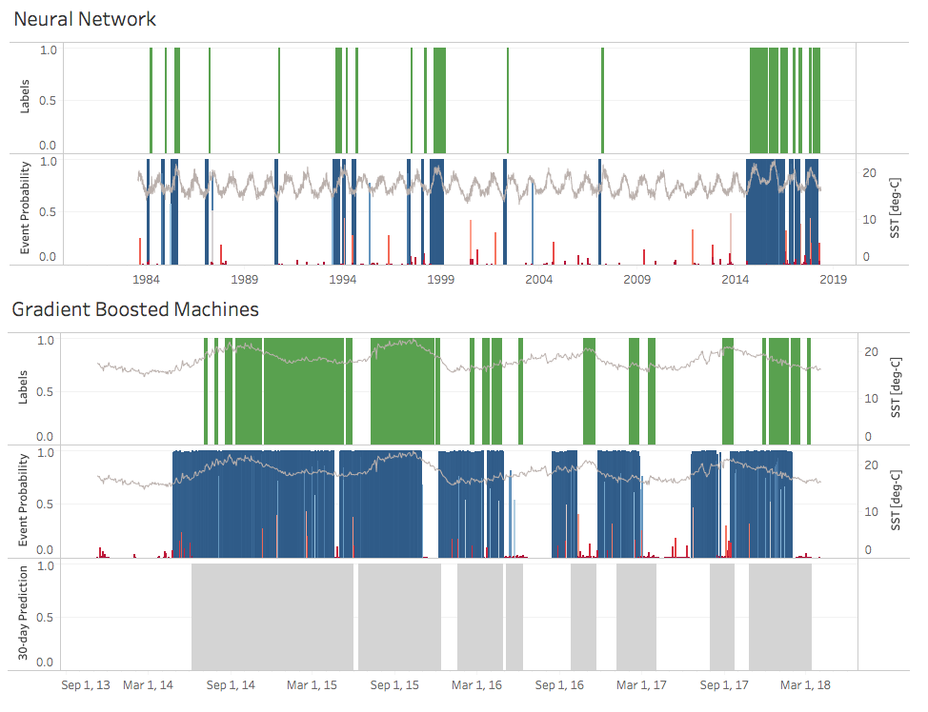
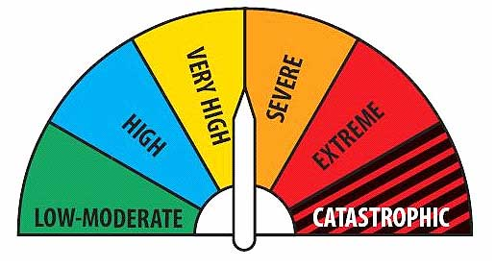
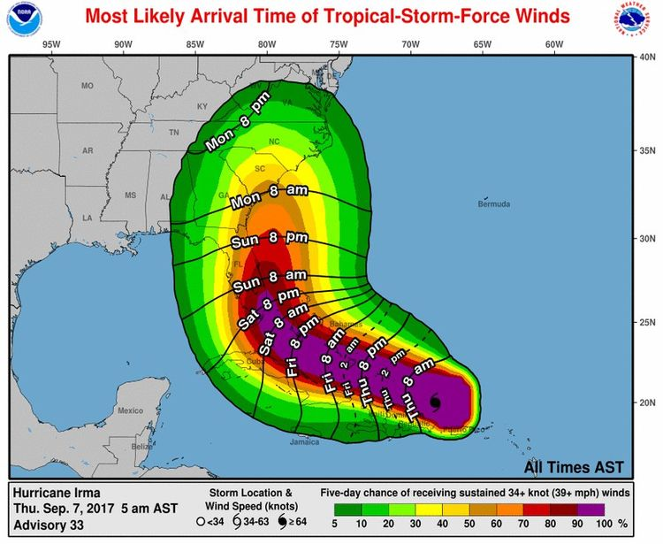
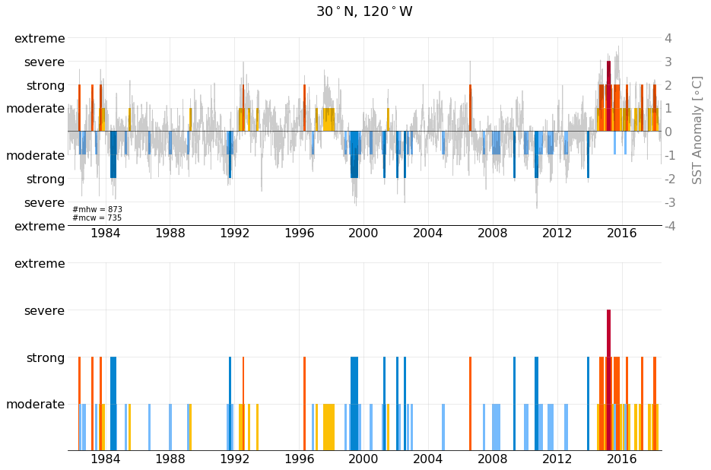
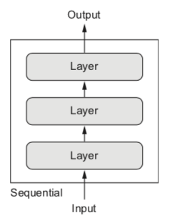
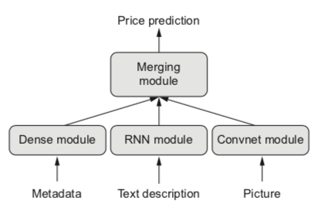
Long Short-Term Memory
Gradient Boosted Machines
Neural Network
Visualizations
Multi-Input Models
Prediction vs. Predictability

Slide 3
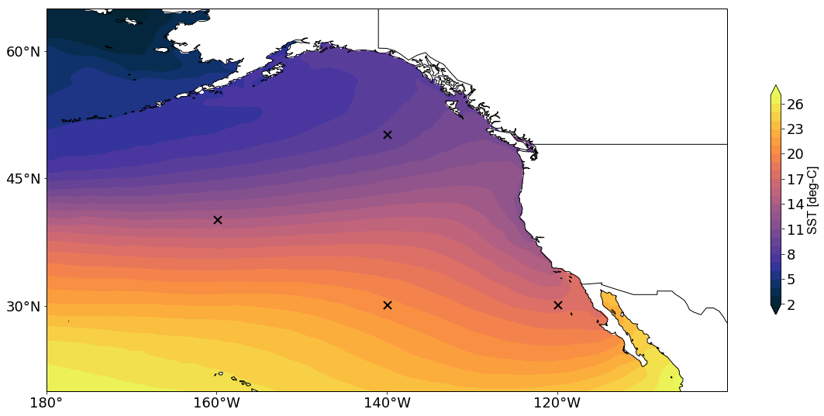
Long Short-Term Memory
Output
Design several sequential LSTM models with different feature combinations
Optimize by tuning parameters to minimize loss function
Several design choices (input sequence length, optimizer, activation, loss function, learning rate, epochs, batch size, validation split, dropout, units, etc.)
Experiment on 4 time series from the North Pacific
30n120w, 30n140w, 40n160w, 50n140w
Features are selected based on their relationship to sea surface temperature and suspect in driving marine heatwaves.
Dense (1)
LSTM (6)
Sequential
Input
Notes:
RNN’s usually end with one or two Dense layers
For regressions, end stack of layers with a Dense layer. The number of units should equal the number of values you’re trying to predict (often 1) and no activation

Slide 4
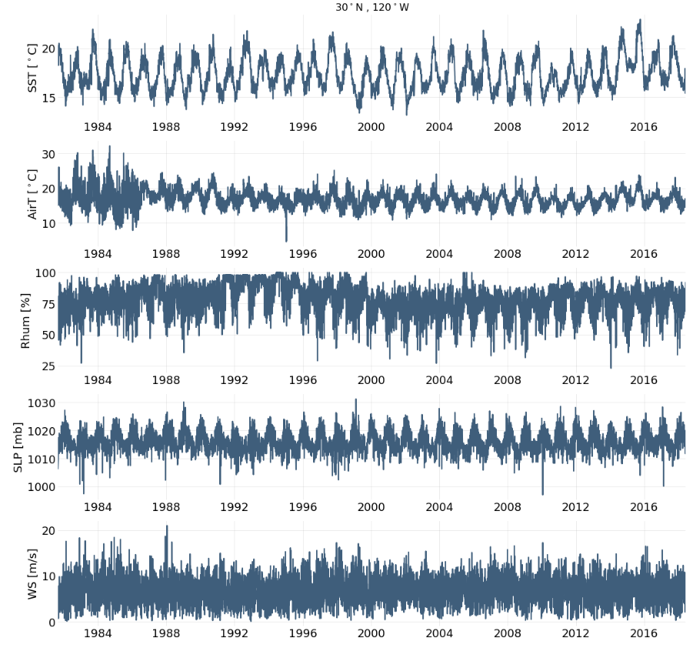
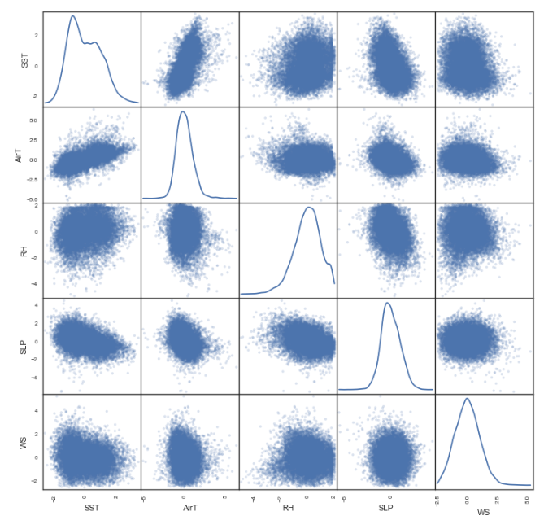
Features

Slide 5
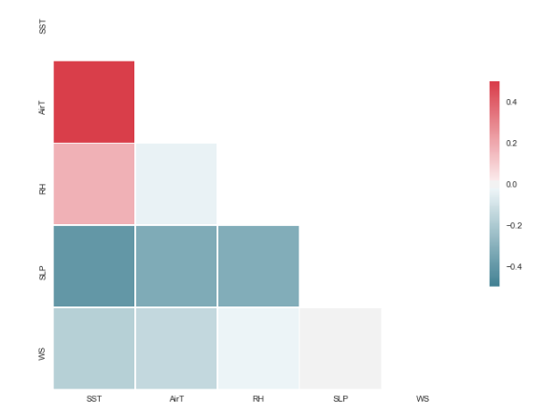
Features

Slide 6
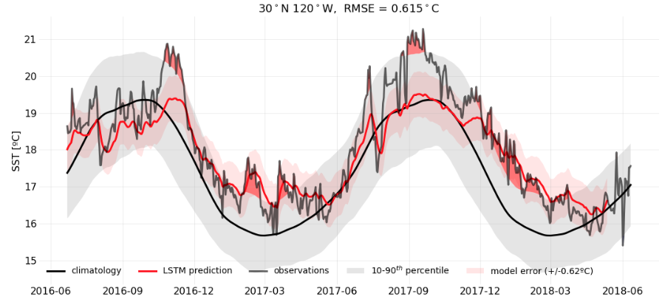
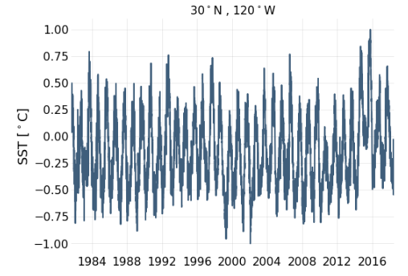
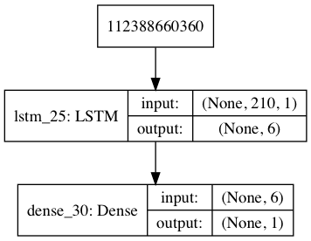
Experiment 1:
Features: SST
30 day forecast
210 day input sequence
validation set = last 720 observations
Sequential Model
LSTM: 6 units, dropout=0, tanh activation, return sequences=True
Dense: 1 unit, tanh activation
Compile – MSE loss, Adagrad optimizer (l.r.=0.01)
Fit – 10 epochs, 200 batch size, 0.20 validation split, shuffle=False

Slide 7
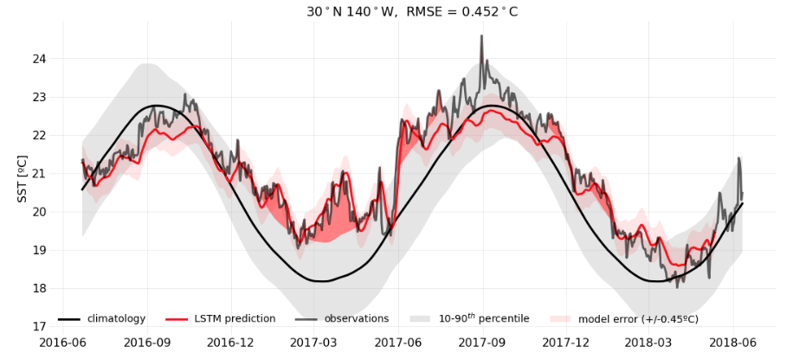
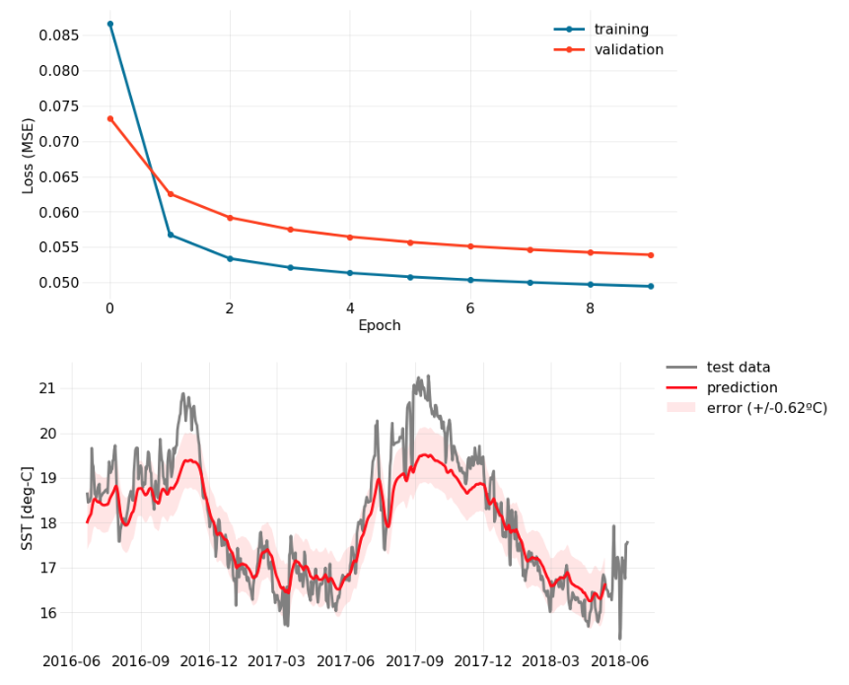
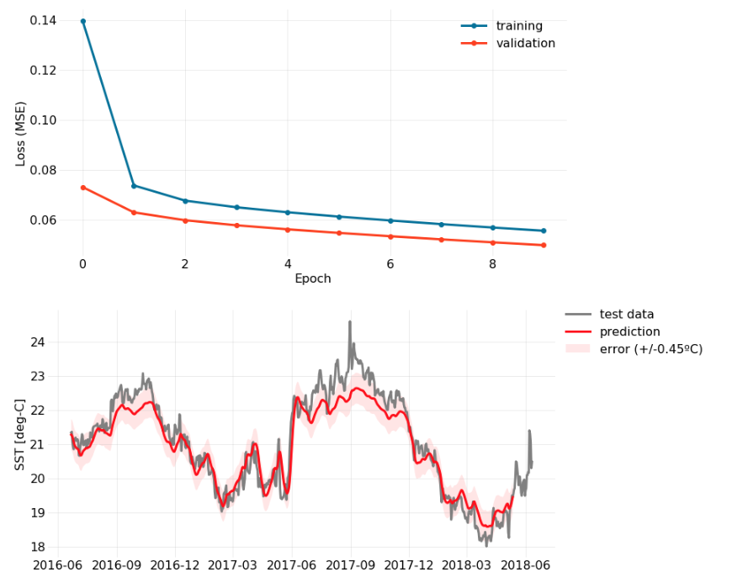

Slide 8
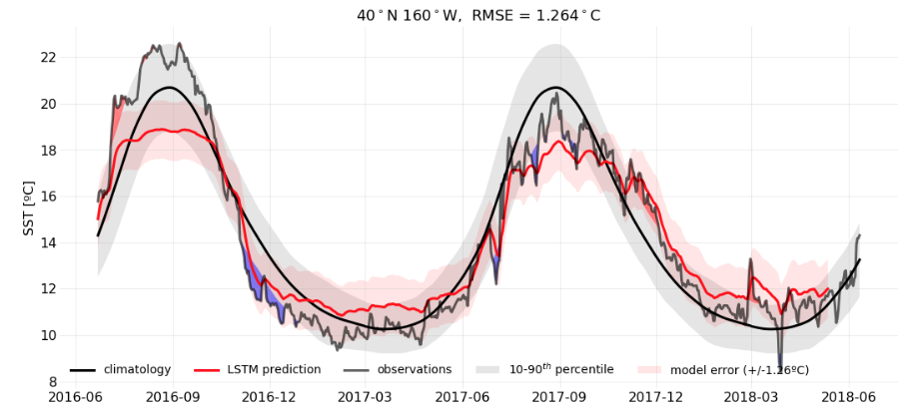
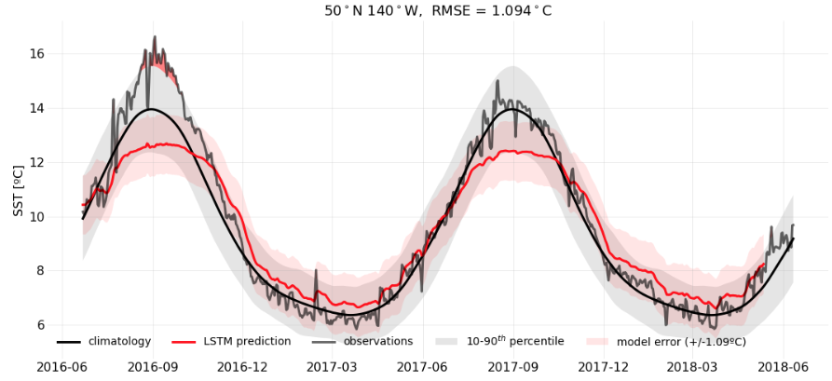
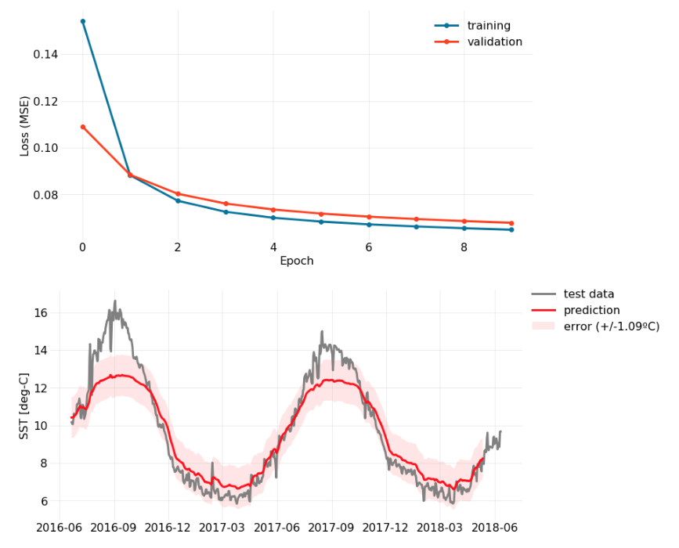
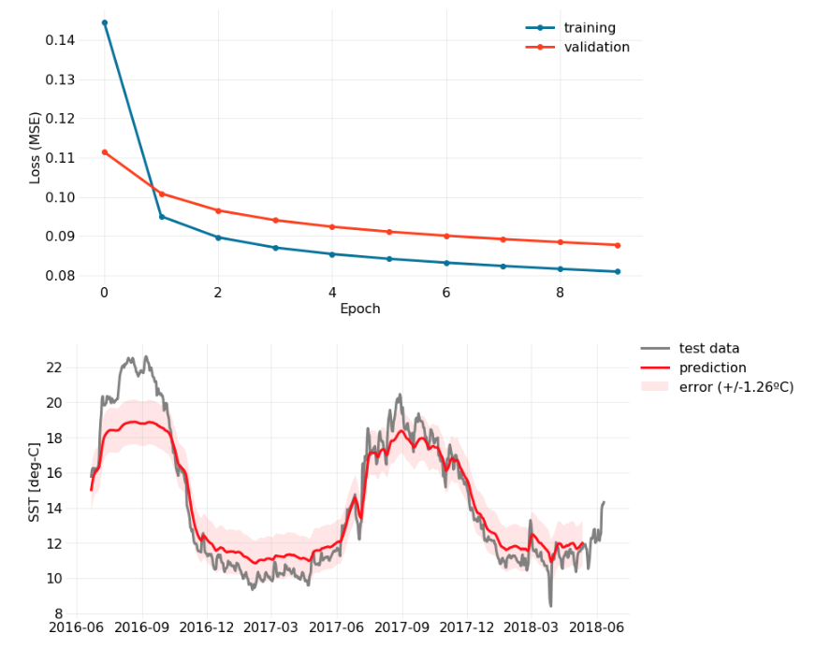

Slide 9
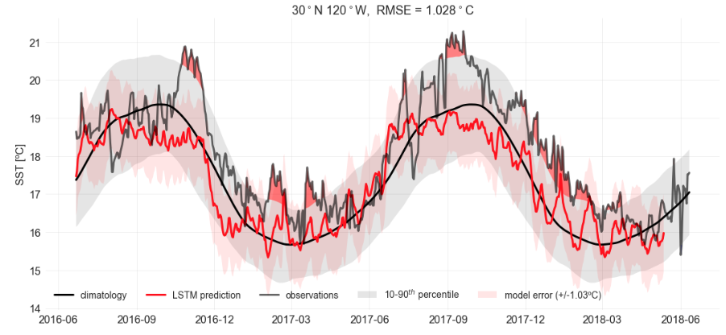
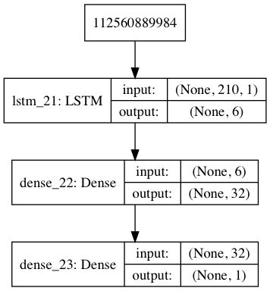
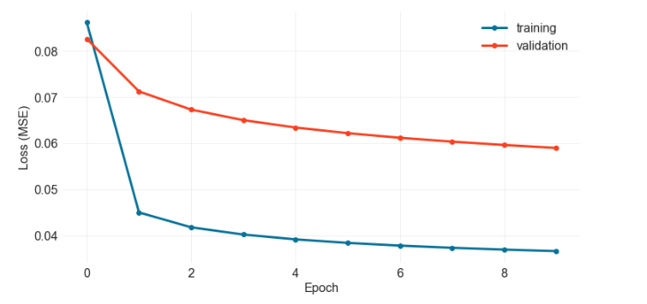
Experiment 2:
Features: SST, AirT, RH, WS, SLP
30 day forecast
210 day input sequence
validation set = last 720 observations
Sequential Model
LSTM: 6 units, dropout=0, tanh activation, return sequences=True
Dense: 32 units, tanh activation
Dense: 1 unit
Compile – MSE loss, Adagrad optimizer (lr=0.01)
Fit – 10 epochs, 200 batch size, 0.20 validation split, shuffle=False

Slide 10
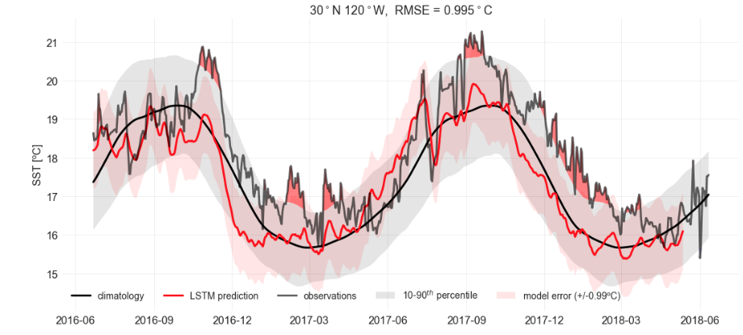
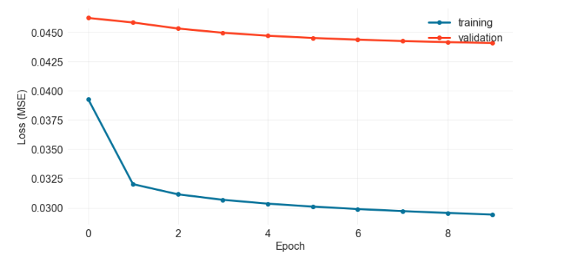
Experiment 3:
Features: SST, AirT, SLP
30 day forecast
210 day input sequence
validation set = last 720 observations
Sequential Model
LSTM: 6 units, dropout=0, tanh activation, return sequences=True
Dense: 32 units, tanh activation
Dense: 1 unit
Compile – MSE loss, Adagrad optimizer (lr=0.01)
Fit – 10 epochs, 200 batch size, 0.20 validation split, shuffle=False

Slide 11
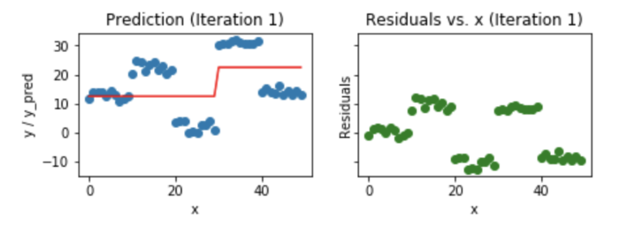
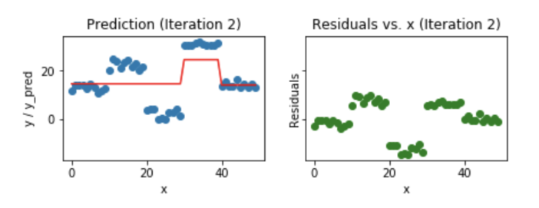
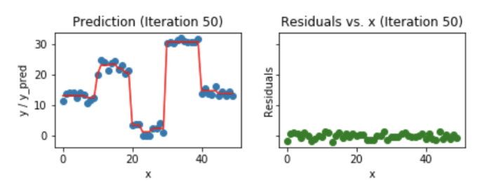
What is Gradient Boosting?
Boosting is a method of converting a sequence of “weak” learners into a more complex predictor.
Supervised learning that minimizes the loss function (MSE) using gradient descent and updates the predictions based on a learning rate. Used for regression and classification problems
Weighted prediction ensemble of several weaker prediction models (decision trees)
Leverages patterns seen in the residuals of many weaker models to make the prediction better. Boosting stops when residuals are close to zero to prevent overfitting.
https://medium.com/mlreview/gradient-boosting-from-scratch-1e317ae4587d
Notes:
1- learn a regression predictor
2- compute the error residual
3- Learn to predict the residual

Slide 13
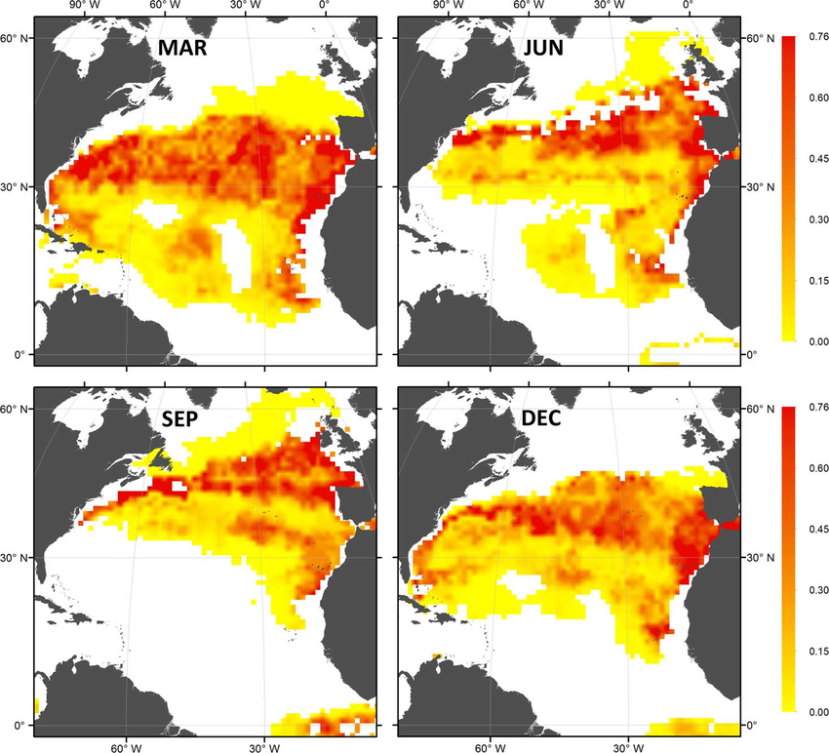
Mapping Marine Heatwave Predictions with Gridded Weather Data
Notion of Time
Monthly Habitat Preference
Vandeperre et al. 2016
Notes:
Spatial predictions of monthly habitat preference for small juvenile (SJ) for the months of March, June, September, and December. Predicted values of monthly habitat preference are represented by a yellow-red color gradient; White cells indicate no predictions were made

Slide 14
Keras Functional API
Graph-like models
Multimodial imputs merge data coming from different input sources
Notes:
Up until now we have been using the Sequential model class
Makes the assumption that the network has exactly one input and one output, and consists o a linear stack of layers
Very inflexible model

