Slide 1

Features of RStudio
Haley Carter

Slide 2
What’s the difference between R and RStudio?
R is a programming language, written primarily for statistical analyses. You can code in R without RStudio.
RStudio is an integrated development environment, or IDE, that was created to make coding in R easier.

Slide 3
Programming languages: A system for giving instructions to a computer (writing code)
IDE: Integrated Development Environment (e.g. RStudio): A GUI that helps make writing computer programs easier and interfaces with an interpreter or compiler
Usually includes: File explorer, Area for writing code/scripts, Console for running interpreted languages, General terminal window for your system
GUI: Graphical User Interface: Programs on your computer with buttons and other visual elements; you can interact with a mouse or touchscreen
for example: Powerpoint, Word, SPSS, Zoom, internet browser, etc.

Slide 4
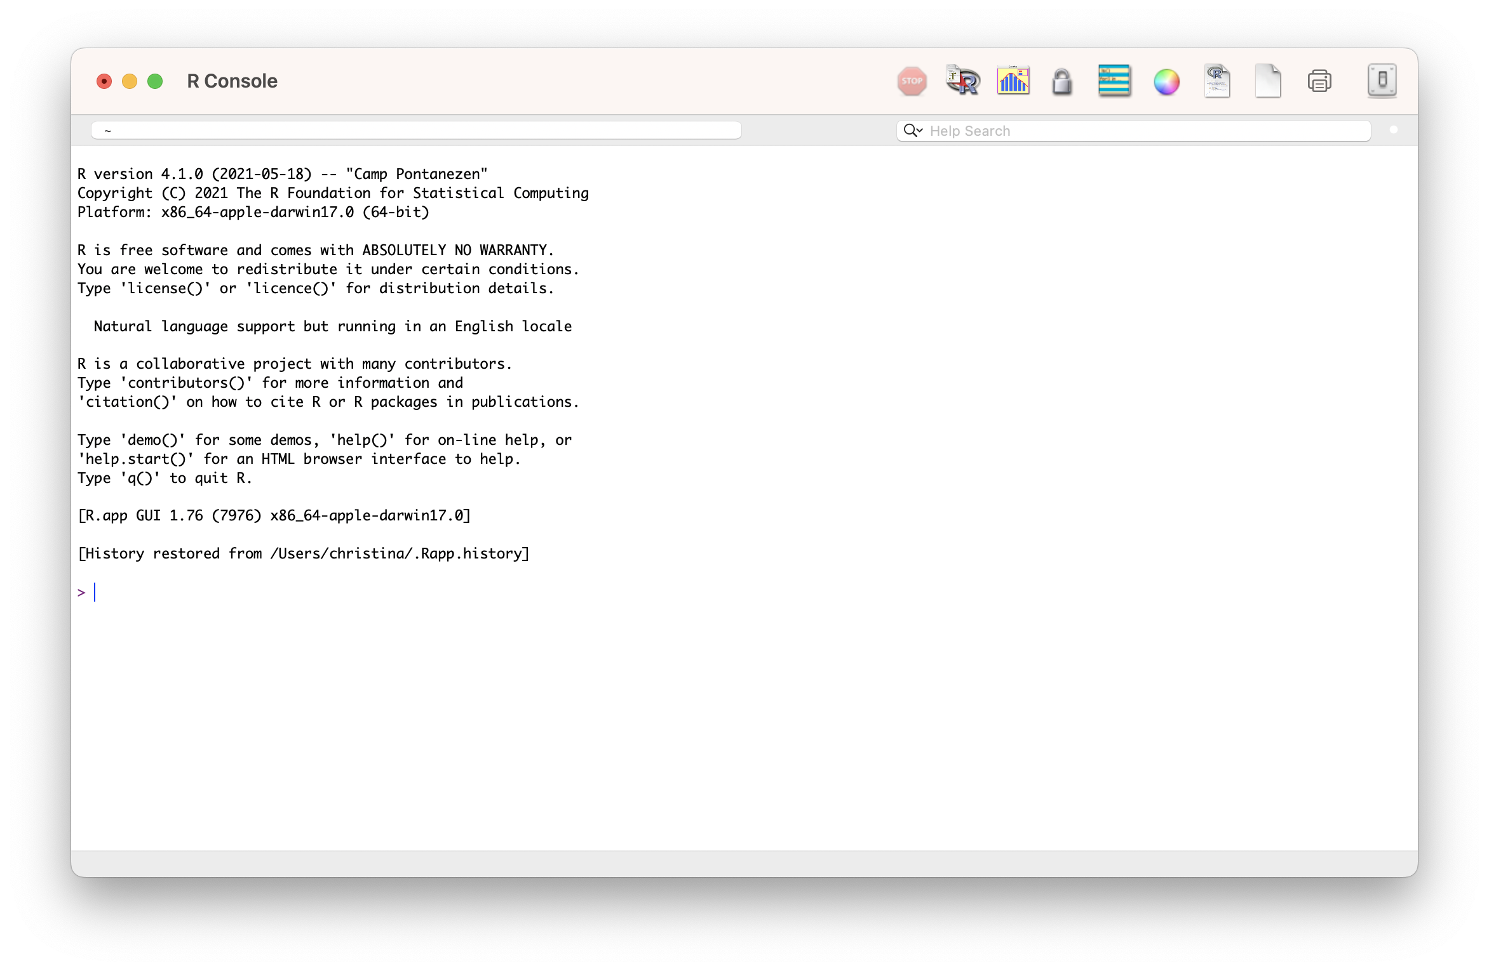


Slide 5
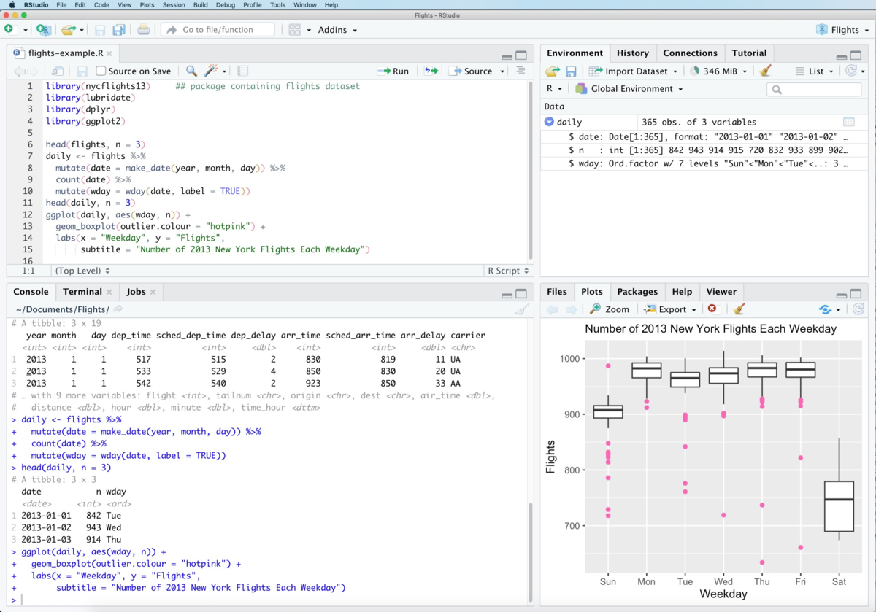
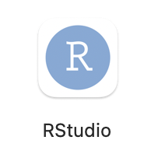

Slide 6
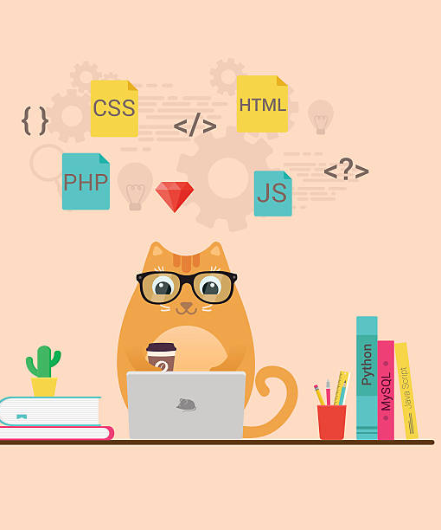
Everything that is an R command still has to run through the R interpreter (in the R console in RStudio)
Some buttons and menus write R code for us…

Slide 7
Which of these are true?
A: RStudio is a programming language
B: R and RStudio are the same program
C: RStudio is an IDE
D: RStudio is a GUI
E: R automatically makes our code reproducible
F: All R commands have to run through the R console

Slide 8
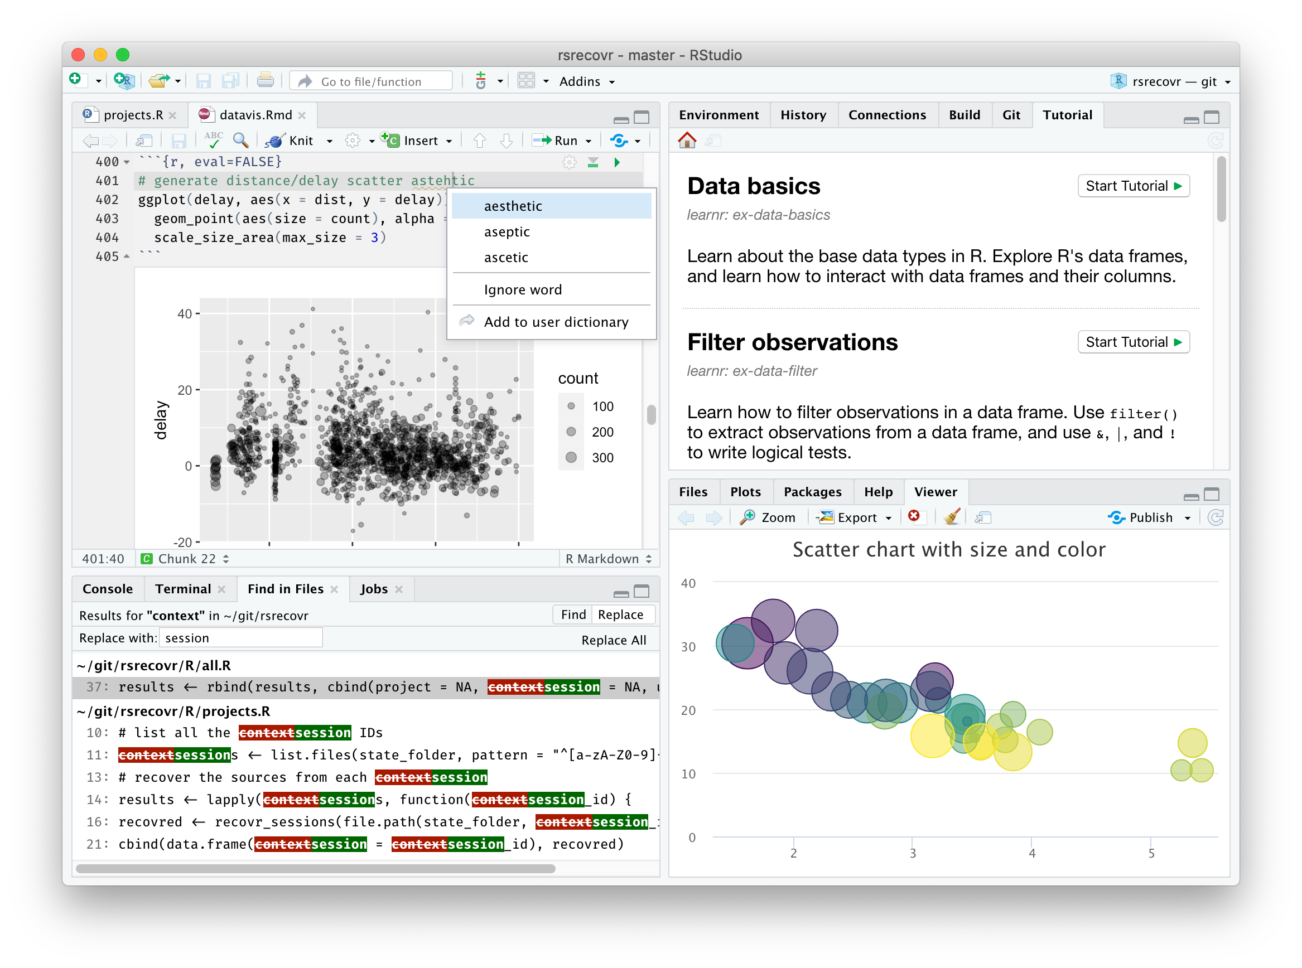
Let’s open RSTUDIO

